Slide 1
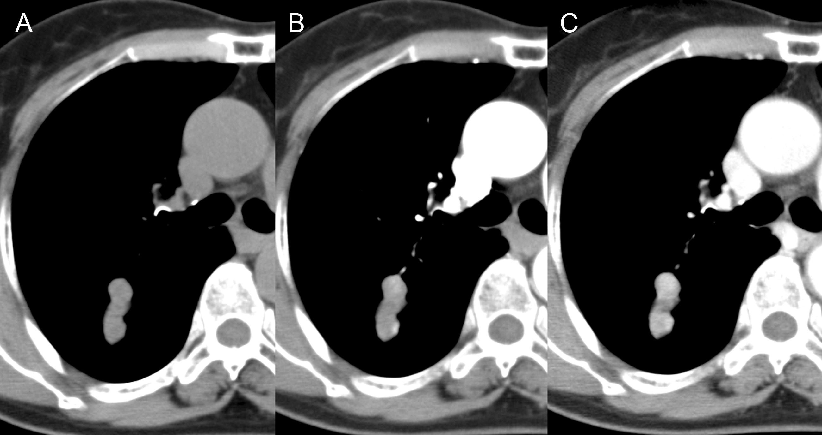
Figure 1: (A) A solitary mass in the posterior segment of the right upper lobe of the lung. The CT attenuation value ...
Notes:
Figure 1: (A) A solitary mass in the posterior segment of the right upper lobe of the lung. The CT attenuation value before contrast injection was 43 Hounsfield units (HU). (B) The attenuation value at the early phase was 62 HU. (C) The attenuation value at the delayed phase was 94 HU.
Unless provided in the caption above, the following copyright applies to the content of this slide: © The Author 2013. Published by Oxford University Press on behalf of the European Association for Cardio-Thoracic Surgery. All rights reserved.

Slide 2
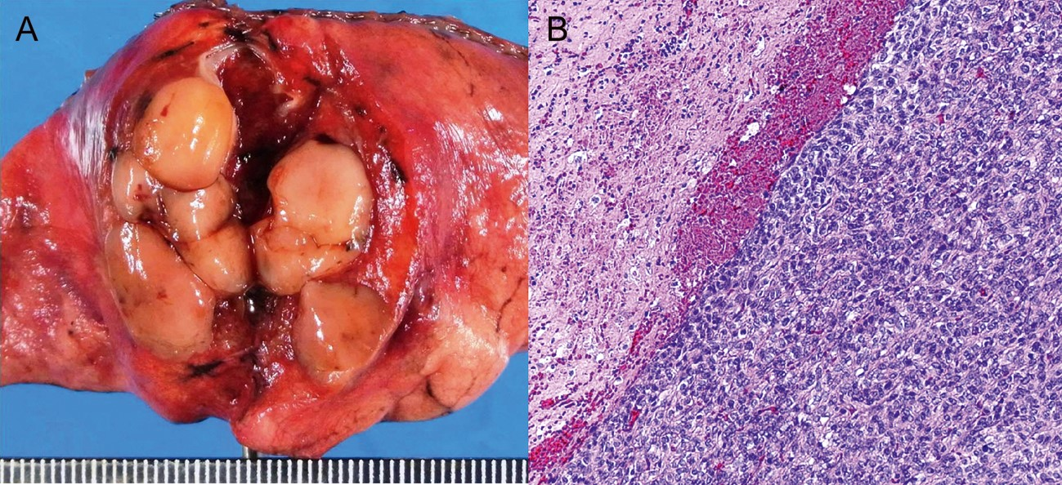
Figure 2: (A) The resected specimen of the lung tumour showed a yellow-white, well-circumscribed, multinodular nodule. ...
Notes:
Figure 2: (A) The resected specimen of the lung tumour showed a yellow-white, well-circumscribed, multinodular nodule. (B) The histological examination showed a hypercellular area with more than 20 mitoses per 10 HPFs on the right, and a sclerotic area on the left (haematoxylin and eosin; ×100).
Unless provided in the caption above, the following copyright applies to the content of this slide: © The Author 2013. Published by Oxford University Press on behalf of the European Association for Cardio-Thoracic Surgery. All rights reserved.

