Slide 1
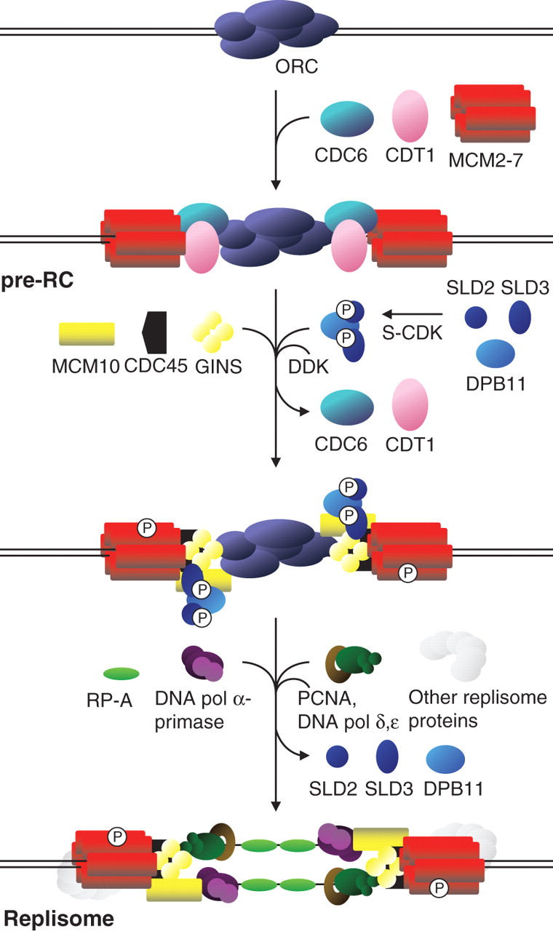
Fig. 1 Initiation of eukaryotic DNA replication. See text for details. Formation of the pre-replication complex ...
Notes:
Fig. 1 Initiation of eukaryotic DNA replication. See text for details. Formation of the pre-replication complex (pre-RC) occurs prior to the S-phase; activation of the pre-RC and initiation of replication require the activities of CDK (cyclin-dependent kinase) and DDK (DBF4-dependent kinase; CDC7 kinase). ORC = origin recognition complex; RP-A = single-stranded DNA binding protein; DNA pol α-primase = initiating DNA polymerase; DNA pol δ, ɛ = processive DNA polymerases; PCNA = sliding clamp. Details of the replication fork are simplified and many replisome proteins are not shown. Figure adapted from Aves (2009).
Unless provided in the caption above, the following copyright applies to the content of this slide: © The Author 2011. Published by Oxford University Press on behalf of the Annals of Botany Company. All rights reserved. For Permissions, please email: journals.permissions@oup.com

