Slide 1
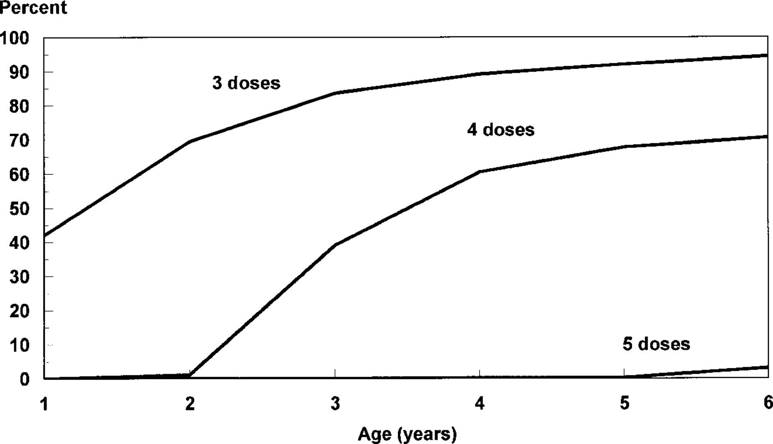
Figure 1 Levels of diphtheria vaccine coverage among control subjects (n = 2169) by dose and age, Russian Federation, ...
Notes:
Figure 1 Levels of diphtheria vaccine coverage among control subjects (n = 2169) by dose and age, Russian Federation, 1991–1992
Unless provided in the caption above, the following copyright applies to the content of this slide: © 2000 by the Infectious Diseases Society of America

