Slide 1
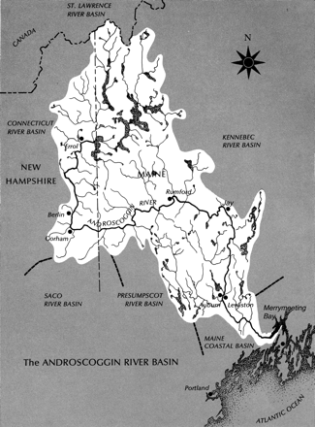
Figure 1 Map of the Androscoggin Watershed, 1975. Credit: Page Helm Jones, Evolution of a Valley: The Androscoggin ...
Notes:
Figure 1 Map of the Androscoggin Watershed, 1975. Credit: Page Helm Jones, Evolution of a Valley: The Androscoggin Story (Phoenix Publishing,1975).
Unless provided in the caption above, the following copyright applies to the content of this slide: © 2012 The Author. Published by Oxford University Press on behalf of the American Society for Environmental History and the Forest History Society. All rights reserved. For Permissions, please email: journals.permissions@oup.com

Slide 2
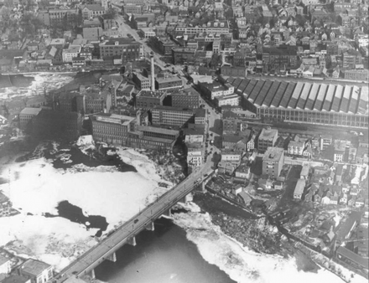
Figure 2 Large volumes of foam and scum in the Androscoggin River (seen here in this ca. 1930s photograph at the twin ...
Notes:
Figure 2 Large volumes of foam and scum in the Androscoggin River (seen here in this ca. 1930s photograph at the twin cities of Lewiston and Auburn, Maine) made it impossible to ignore the increasing level of river pollution. Credit: Androscoggin Historical Society, Auburn, Maine.
Unless provided in the caption above, the following copyright applies to the content of this slide: © 2012 The Author. Published by Oxford University Press on behalf of the American Society for Environmental History and the Forest History Society. All rights reserved. For Permissions, please email: journals.permissions@oup.com

Slide 3
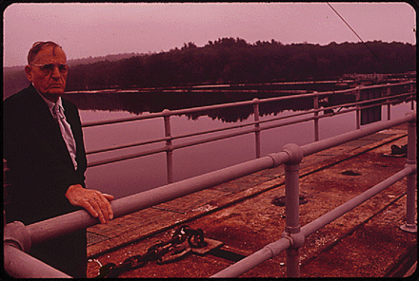
Figure 3 Walter Lawrance at Gulf Island Dam, one of the most polluted sections of the Androscoggin River, where ...
Notes:
Figure 3 Walter Lawrance at Gulf Island Dam, one of the most polluted sections of the Androscoggin River, where Lawrance focused his efforts to control the environment through technology. Credit: Charles Steinhacker, Walter Lawrance, Rivermaster, at Gulf Island Dam at Lewiston, on the Androscoggin River, 1973. National Archives and Records Administration.
Unless provided in the caption above, the following copyright applies to the content of this slide: © 2012 The Author. Published by Oxford University Press on behalf of the American Society for Environmental History and the Forest History Society. All rights reserved. For Permissions, please email: journals.permissions@oup.com

Slide 4
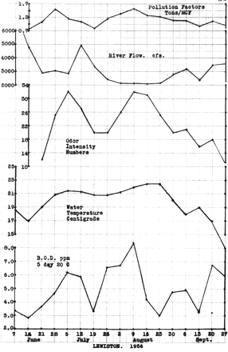
Figure 4 Lawrance correlated his measurements of odor intensity with a wide range of other readings he took along the ...
Notes:
Figure 4 Lawrance correlated his measurements of odor intensity with a wide range of other readings he took along the Androscoggin River, including pollution load, river flow, water temperature, and the biochemical oxygen demand. Credit: Androscoggin River Studies Annual Report 1956, 25. Walter A. Lawrance papers. Edmund S. Muskie Archives and Special Collections Library, Bates College.
Unless provided in the caption above, the following copyright applies to the content of this slide: © 2012 The Author. Published by Oxford University Press on behalf of the American Society for Environmental History and the Forest History Society. All rights reserved. For Permissions, please email: journals.permissions@oup.com

Slide 5
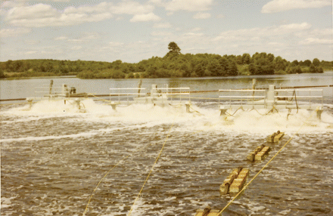
Figure 5 Using mechanical aerators on the Androscoggin's Gulf Island Pond, Lawrance attempted to recreate the natural ...
Notes:
Figure 5 Using mechanical aerators on the Androscoggin's Gulf Island Pond, Lawrance attempted to recreate the natural oxygenation that the river's many impounded falls had once provided. Credit: Androscoggin River Studies Annual Report 1969, 102. Walter A. Lawrance papers. Edmund S. Muskie Archives and Special Collections Library, Bates College.
Unless provided in the caption above, the following copyright applies to the content of this slide: © 2012 The Author. Published by Oxford University Press on behalf of the American Society for Environmental History and the Forest History Society. All rights reserved. For Permissions, please email: journals.permissions@oup.com

Slide 6
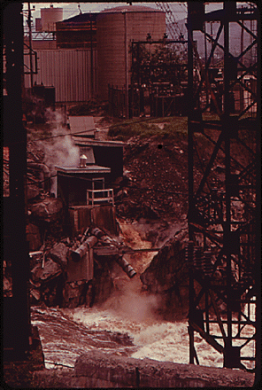
Figure 6 The passage of the 1972 Clean Water Act did not immediately stop pollution from the pulp and paper industry. ...
Notes:
Figure 6 The passage of the 1972 Clean Water Act did not immediately stop pollution from the pulp and paper industry. Credit: Charles Steinhacker, Brown Paper Company, Showing outfall into the Androscoggin River, 1973. National Archives and Records Administration.
Unless provided in the caption above, the following copyright applies to the content of this slide: © 2012 The Author. Published by Oxford University Press on behalf of the American Society for Environmental History and the Forest History Society. All rights reserved. For Permissions, please email: journals.permissions@oup.com

