Slide 1
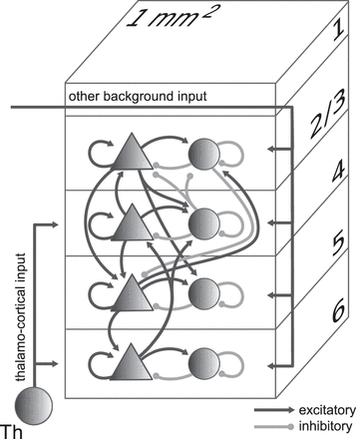
Figure 1. Model definition. Layers 2/3, 4, 5, and 6 are each represented by an excitatory (triangles) and an inhibitory ...
Notes:
Figure 1. Model definition. Layers 2/3, 4, 5, and 6 are each represented by an excitatory (triangles) and an inhibitory (circles) population of model neurons. The number of neurons in the population is chosen according to Binzegger et al. (2004) based on the countings of Beaulieu and Colonnier (1983) and Gabbott and Somogyi (1986). Input to the populations is represented by thalamo-cortical input targeting layers 4 and 6 and other external background input to all populations. Excitatory (black) and inhibitory (gray) connections with connection probabilities >0.04 are shown. The model size corresponds to the cortical network under a surface of 1 mm2.
Unless provided in the caption above, the following copyright applies to the content of this slide: © The Author 2012. Published by Oxford University Press.This is an Open Access article distributed under the terms of the Creative Commons Attribution License (http://creativecommons.org/licenses/by-nc/3.0/), which permits non-commercial reuse, distribution, and reproduction in any medium, provided the original work is properly cited. For commercial re-use, please contact journals.permissions@oup.com.

Slide 2
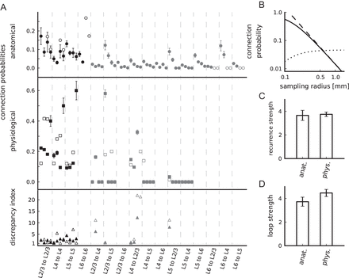
Figure 2. Properties of connectivity maps. (A) Connection probabilities according to the anatomical (top panel, ...
Notes:
Figure 2. Properties of connectivity maps. (A) Connection probabilities according to the anatomical (top panel, circles) and physiological connectivity maps (center panel, squares) and corresponding discrepancy indices (bottom panel, triangles). Both raw (closed markers) and modified (open markers) maps are shown (also provided in Supplementary Table 1). The data are horizontally arranged according to their classification as within-layer (black) and interlayer (gray) connections. For a given pair of pre- and postsynaptic layer, the data are arranged from left to right according to connection types: Excitatory to excitatory, excitatory to inhibitory, inhibitory to excitatory, and inhibitory to inhibitory. L5i to L5e/i outside of the displayed range, see Supplementary Table 1. Error bars are minimal statistical errors (Supplementary Material). (B) Dependence on sampling radius of the anatomical connection probability (solid: eq. (1), dashed: eq. (2)) and the product of connection probability and area (dotted) in double-logarithmic representation. (C) Anatomical and physiological recurrence strength. (D) Anatomical and physiological loop strength. Error bars in C and D are based on the minimal statistical error estimates of connection probabilities using error propagation.
Unless provided in the caption above, the following copyright applies to the content of this slide: © The Author 2012. Published by Oxford University Press.This is an Open Access article distributed under the terms of the Creative Commons Attribution License (http://creativecommons.org/licenses/by-nc/3.0/), which permits non-commercial reuse, distribution, and reproduction in any medium, provided the original work is properly cited. For commercial re-use, please contact journals.permissions@oup.com.

Slide 3
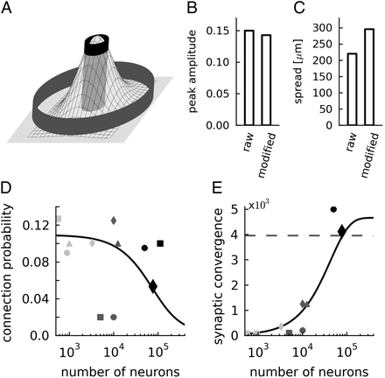
Figure 3. Lateral connectivity model. (A) Two-dimensional Gaussian with 2 cylinders indicating the lateral sampling of ...
Notes:
Figure 3. Lateral connectivity model. (A) Two-dimensional Gaussian with 2 cylinders indicating the lateral sampling of the anatomical (gray outer cylinder) and the physiological (black inner cylinder) experiments. (B) Estimated peak amplitude C0 and (C) lateral spread σ of the connectivity model based on mean connectivity of the anatomical and physiological raw and modified maps. (D) Average connection probability (black line, based on eq. (9)) and (E) average synaptic convergence (black line, average number of synaptic inputs per neuron derived from the connection probability and the number of neurons using eq. (1)) of the layered network model as a function of the network size expressed in number of neurons. The dashed horizontal line marks 85% of the maximal synaptic convergence in the local network. Black diamonds show the data used in our simulations, further markers indicate other published cortical network models: Haeusler and Maass (2007) (light gray square), Izhikevich (2006) (light gray triangle), Izhikevich et al. (2004) (light gray circle, embedded local network is defined by the area receiving connections from a single long-range axon), Lundqvist et al. (2006); Djurfeldt et al. (2008) (light gray diamond, local network represented by one hypercolumn), Vogels and Abbott (2005); Vogels et al. (2005) (dark gray circle), Sussillo et al. (2007) (dark gray square), Brunel (2000) (dark gray triangle), Kriener et al. (2008) (dark gray diamond), Kumar et al. (2008) (black circles), and Morrison et al. (2007) (black square).
Unless provided in the caption above, the following copyright applies to the content of this slide: © The Author 2012. Published by Oxford University Press.This is an Open Access article distributed under the terms of the Creative Commons Attribution License (http://creativecommons.org/licenses/by-nc/3.0/), which permits non-commercial reuse, distribution, and reproduction in any medium, provided the original work is properly cited. For commercial re-use, please contact journals.permissions@oup.com.

Slide 4
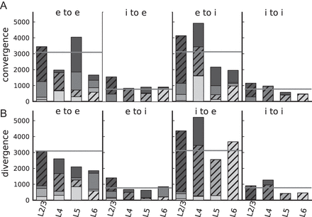
Figure 5. Cell-type specific convergence (A) and divergence (B) of the integrated connectivity map. The histograms ...
Notes:
Figure 5. Cell-type specific convergence (A) and divergence (B) of the integrated connectivity map. The histograms display blocks of data for the 4 different connection types between excitatory (e) and inhibitory (i) neurons (as indicated). For a neuron in the layer specified on the horizontal axis, the individual bar segments show the absolute number of synapses the neuron receives from a source layer (convergence) or establishes in a target layer (divergence). Bar segments are arranged according to the physical location of the layers in the cortex (from top to bottom: L2/3, L4, L5, L6). Hatched bars represent within-layer connections. Lightness of gray increases from superficial to deeper layers. Gray horizontal lines indicate the convergence and divergence of a balanced random network with the same total number of neurons and synapses as the layered model.
Unless provided in the caption above, the following copyright applies to the content of this slide: © The Author 2012. Published by Oxford University Press.This is an Open Access article distributed under the terms of the Creative Commons Attribution License (http://creativecommons.org/licenses/by-nc/3.0/), which permits non-commercial reuse, distribution, and reproduction in any medium, provided the original work is properly cited. For commercial re-use, please contact journals.permissions@oup.com.

Slide 5
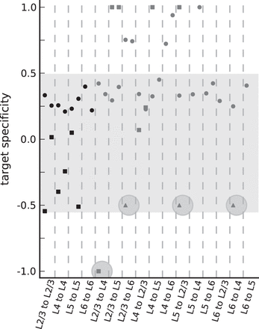
Figure 4. Anatomical (circles) and physiological (squares) estimates of target specificity based on the modified ...
Notes:
Figure 4. Anatomical (circles) and physiological (squares) estimates of target specificity based on the modified connectivity maps. +1(−1) indicates exclusive selection of excitatory (inhibitory) targets, and 0 random selection. Triangles show additional candidates of inhibition-specific projections discovered in photostimulation or EM studies. The shaded area highlights the estimates of all within-layer projections and the interlayer projections with target specificity values between 0 and 0.5 (“nonspecific” interlayer connections). Within these bounds, the anatomical and physiological estimates are 0.32 ± 0.07 and −0.17 ± 0.28, respectively. The largest statistically well constrained values from a single laboratory are exhibited by the projections L2/3e to L2/3, L4e to L4, and L5e to L5 (compare Supplementary Table 1) of the raw physiological map. The target specificity of these data is −0.01 ± 0.03. The 4 highlighted data points are candidates of specific target type selection. For every pair of pre- and postsynaptic layer, the figure shows data for both presynaptic neuron types (left: Excitatory, right: Inhibitory).
Unless provided in the caption above, the following copyright applies to the content of this slide: © The Author 2012. Published by Oxford University Press.This is an Open Access article distributed under the terms of the Creative Commons Attribution License (http://creativecommons.org/licenses/by-nc/3.0/), which permits non-commercial reuse, distribution, and reproduction in any medium, provided the original work is properly cited. For commercial re-use, please contact journals.permissions@oup.com.

Slide 6
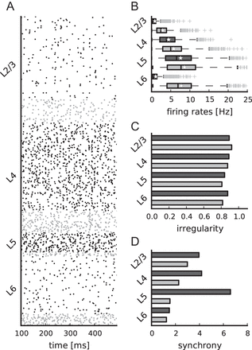
Figure 6. Simulated spontaneous cell-type specific activity. (A) Raster plot of spiking activity recorded for 400 ms of ...
Notes:
Figure 6. Simulated spontaneous cell-type specific activity. (A) Raster plot of spiking activity recorded for 400 ms of biological time of layers 2/3, 4, 5, and 6 (from top to bottom; black: Excitatory, gray: Inhibitory). Relative number of displayed spike trains corresponds to the relative number of neurons in the network (total of 1862 shown). (B–D) Statistics of the spiking activity of all 8 populations in the network based on 1000 spike trains recorded for 60 s (B and C) and 5 s (D) for every population. (B) Boxplot (Tukey 1977) of single-unit firing rates. Crosses show outliers, stars indicate the mean firing rate of the population. (C) Irregularity of single-unit spike trains quantified by the coefficient of variation of the interspike intervals. (D) Synchrony of multiunit spiking activity quantified by the variance of the spike count histogram (bin width 3 ms) divided by its mean.
Unless provided in the caption above, the following copyright applies to the content of this slide: © The Author 2012. Published by Oxford University Press.This is an Open Access article distributed under the terms of the Creative Commons Attribution License (http://creativecommons.org/licenses/by-nc/3.0/), which permits non-commercial reuse, distribution, and reproduction in any medium, provided the original work is properly cited. For commercial re-use, please contact journals.permissions@oup.com.

Slide 7
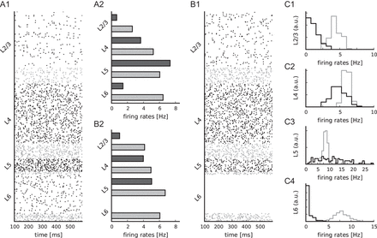
Figure 7. Dependence of spontaneous activity on input. (A1–A2) Spontaneous activity after replacing the Poissonian ...
Notes:
Figure 7. Dependence of spontaneous activity on input. (A1–A2) Spontaneous activity after replacing the Poissonian background spikes with DC currents. Cell-type specific external input currents equivalent to the reference parameterization for the number of inputs. (A1) Raster plot shows spiking activity recorded for 500 ms of biological time of layers 2/3, 4, 5, and 6 (from top to bottom; black: Excitatory, gray: Inhibitory). Relative number of displayed spike trains corresponds to the relative number of neurons in the network (total of 1862 shown). (A2) Average firing rates of the spiking activity shown in A1. (B1–B2) Spontaneous activity with layer-independent Poissonian background inputs (Table 5). Raster plot (B1) and firing rate histogram (B2) equivalent to A1 and A2. (C) Histograms of the excitatory and inhibitory population firing rates for L2/3 (C1), L4 (C2), L5 (C3), and L6 (C4) for randomly drawn external inputs (100 trials, see Materials and Methods for details).
Unless provided in the caption above, the following copyright applies to the content of this slide: © The Author 2012. Published by Oxford University Press.This is an Open Access article distributed under the terms of the Creative Commons Attribution License (http://creativecommons.org/licenses/by-nc/3.0/), which permits non-commercial reuse, distribution, and reproduction in any medium, provided the original work is properly cited. For commercial re-use, please contact journals.permissions@oup.com.

Slide 8
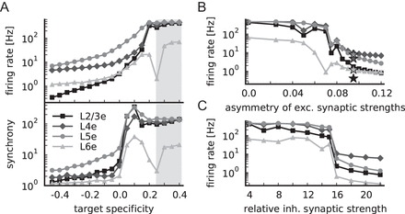
Figure 9. Relevance of target specificity for network stability. (A) Population firing rates (top panel) and synchrony ...
Notes:
Figure 9. Relevance of target specificity for network stability. (A) Population firing rates (top panel) and synchrony (bottom panel), both in logarithmic representation, as a function of the target specificity of candidate projections L2/3e to L4, L2/3e to L6, L5e to L2/3, and L6e to L4, see Supplementary Table 3 for corresponding connection probabilities. A target specificity of zero reflects random connectivity; the gray-shaded area marks the range of target specificity of other interlayer connections (0.33 ± 0.08). (B) Population firing rates of the model with target specificity of candidate projections of +0.4 as a function of the asymmetry of excitatory to inhibitory and excitatory to excitatory synaptic strengths (defined as (wie − wee)/(wie + wee), with fixed mean excitatory synaptic strength). Stars indicate firing rates of the reference model with target specificity of candidate projections of −0.4. (C) As B, but as a function of the relative inhibitory synaptic strength. All markers as in Figure 8A.
Unless provided in the caption above, the following copyright applies to the content of this slide: © The Author 2012. Published by Oxford University Press.This is an Open Access article distributed under the terms of the Creative Commons Attribution License (http://creativecommons.org/licenses/by-nc/3.0/), which permits non-commercial reuse, distribution, and reproduction in any medium, provided the original work is properly cited. For commercial re-use, please contact journals.permissions@oup.com.

Slide 9
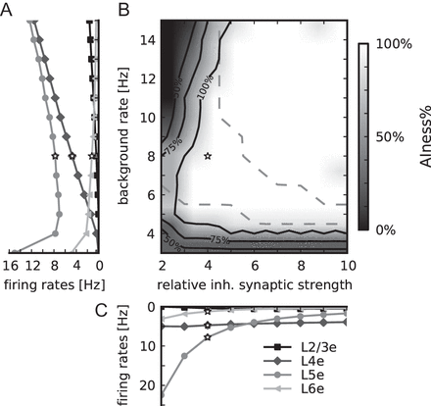
Figure 8. Dependence of network activity on the external background firing rate and the relative inhibitory synaptic ...
Notes:
Figure 8. Dependence of network activity on the external background firing rate and the relative inhibitory synaptic strength. White stars mark the reference parameter set. (A) Population firing rates of excitatory populations in layers 2/3 (squares), 4 (diamonds), 5 (circles), and 6 (triangles), lightness increases with cortical depth, as a function of the background rate at fixed relative inhibitory synaptic strength (g = 4). (B) AIness%, the percentage of populations with the firing rate <30 Hz, irregularity between 0.7 and 1.2, and synchrony <8 (data collected for 5 s per simulation), as a function of the background rate and the relative inhibitory synaptic strength. Labeled black contour lines indicate areas where 50%, 75%, and 100% of all populations fire asynchronously and irregularly at low rate. Dashed contour lines confine the area where the firing rates are ordered in accordance to Table 6. (C) Population firing rates of excitatory populations as a function of the relative inhibitory synaptic strength at fixed background rate (8 Hz) (markers as in A).
Unless provided in the caption above, the following copyright applies to the content of this slide: © The Author 2012. Published by Oxford University Press.This is an Open Access article distributed under the terms of the Creative Commons Attribution License (http://creativecommons.org/licenses/by-nc/3.0/), which permits non-commercial reuse, distribution, and reproduction in any medium, provided the original work is properly cited. For commercial re-use, please contact journals.permissions@oup.com.

Slide 10
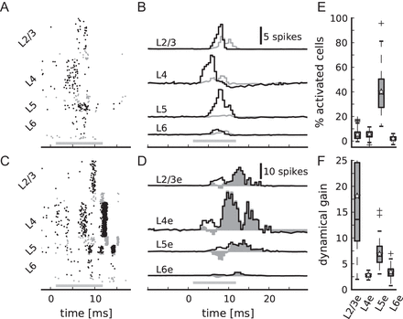
Figure 10. Response to transient thalamic input. Thalamic firing rates increase step-like by 15 Hz for a duration of 10 ...
Notes:
Figure 10. Response to transient thalamic input. Thalamic firing rates increase step-like by 15 Hz for a duration of 10 ms; 0 ms corresponds to the onset of transient input, gray bars show the arrival of thalamic spikes at cortical neurons taking the mean delay (for simplicity the same as within the network, 1.5 ms) into account. (A) Cell-type specific spiking activity of the network with i-specific projections. Markers as in Figure 6A. (B) Corresponding cell-type specific population spike counts averaged over 100 instantiations of network and input (excitatory populations in black, inhibitory in gray). Spike counts are calculated with a bin width of 0.5 ms with the number of recorded neurons L3e: 500, L3i: 141, L4e: 529, L4i: 132, L5e: 117, L5i: 25, L6e: 347, L6i: 71 (numbers correspond to relative population sizes). (C) Spiking activity of a control network without i-specific projections (target specificity of candidate projections of +0.4) stabilized by an asymmetry of excitatory synaptic strengths of 0.095. (D) Corresponding cell-type specific population spike counts of excitatory populations averaged over 100 instantiations. Filled area shows the difference of the data in D and B. (E) Average percentage of cells in the excitatory populations that are activated by thalamic stimulation in relation to the ongoing activity (according to the data in B). (F) Dynamical gain, defined as the firing rate during the stimulus presentation divided by the spontaneous firing rate, of excitatory populations (according to the data in B).
Unless provided in the caption above, the following copyright applies to the content of this slide: © The Author 2012. Published by Oxford University Press.This is an Open Access article distributed under the terms of the Creative Commons Attribution License (http://creativecommons.org/licenses/by-nc/3.0/), which permits non-commercial reuse, distribution, and reproduction in any medium, provided the original work is properly cited. For commercial re-use, please contact journals.permissions@oup.com.

Slide 11
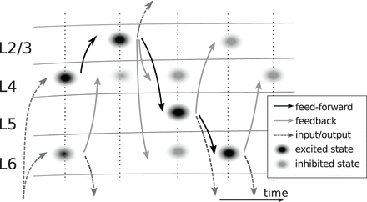
Figure 11. Flow of activity following transient thalamic input. Black and gray ellipses represent excited and inhibited ...
Notes:
Figure 11. Flow of activity following transient thalamic input. Black and gray ellipses represent excited and inhibited activity states, respectively. Dark gray dashed arrows indicate input and output of the local network. The black arrows represent the feed-forward loop projections L4 to L2/3 to L5 to L6. The gray arrows correspond to the activation of the candidate i-specific connections (L2/3e to L4 and to L6, L5e to L2/3, and L6e to L4).
Unless provided in the caption above, the following copyright applies to the content of this slide: © The Author 2012. Published by Oxford University Press.This is an Open Access article distributed under the terms of the Creative Commons Attribution License (http://creativecommons.org/licenses/by-nc/3.0/), which permits non-commercial reuse, distribution, and reproduction in any medium, provided the original work is properly cited. For commercial re-use, please contact journals.permissions@oup.com.

Slide 12
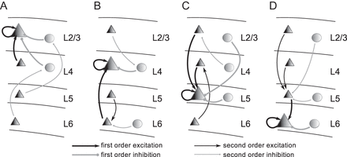
Figure 12. Input structure for the excitatory cell types L2/3e (A), L4e (B), L5e (C), and L6e (D) (large triangles). The ...
Notes:
Figure 12. Input structure for the excitatory cell types L2/3e (A), L4e (B), L5e (C), and L6e (D) (large triangles). The illustrations show the strongest pathways, that is, only connection probabilities >0.04 are considered, of direct (first order, thick arrows) and indirect (second order, thin arrows) excitation (black) and inhibition (gray) of a given population (see Supplementary Material for further details). Triangles represent excitatory and circles inhibitory populations.
Unless provided in the caption above, the following copyright applies to the content of this slide: © The Author 2012. Published by Oxford University Press.This is an Open Access article distributed under the terms of the Creative Commons Attribution License (http://creativecommons.org/licenses/by-nc/3.0/), which permits non-commercial reuse, distribution, and reproduction in any medium, provided the original work is properly cited. For commercial re-use, please contact journals.permissions@oup.com.

