Slide 1
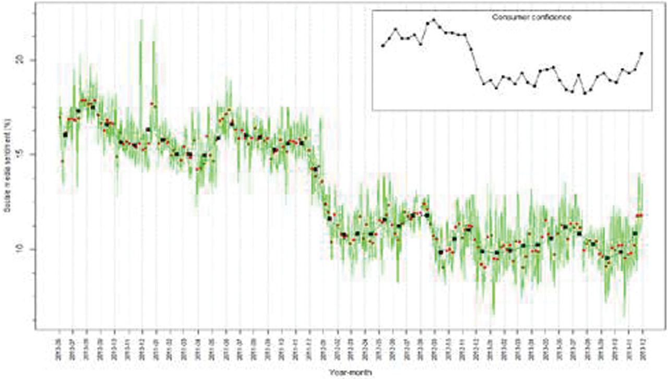
Figure 1. Social Media Sentiment (daily, weekly and monthly) in the Netherlands, June 2010–November 2013. The ...
Notes:
Figure 1. Social Media Sentiment (daily, weekly and monthly) in the Netherlands, June 2010–November 2013. The development of consumer confidence for the same period is shown in the insert ( Daas and Puts 2014 ).
Unless provided in the caption above, the following copyright applies to the content of this slide: © The Author 2015. Published by Oxford University Press on behalf of the American Association for Public Opinion Research. All rights reserved. For permissions, please e-mail: journals.permissions@oup.com

Slide 2
Figure 2. Science Paradigms from Hey, Tansley, and Tolle (2009) .
Notes:
Figure 2. Science Paradigms from Hey, Tansley, and Tolle (2009) .
Unless provided in the caption above, the following copyright applies to the content of this slide: © The Author 2015. Published by Oxford University Press on behalf of the American Association for Public Opinion Research. All rights reserved. For permissions, please e-mail: journals.permissions@oup.com

Slide 3
Figure 3. A Typical Rectangular Format for Traditional Data Analysis.
Notes:
Figure 3. A Typical Rectangular Format for Traditional Data Analysis.
Unless provided in the caption above, the following copyright applies to the content of this slide: © The Author 2015. Published by Oxford University Press on behalf of the American Association for Public Opinion Research. All rights reserved. For permissions, please e-mail: journals.permissions@oup.com

Slide 4
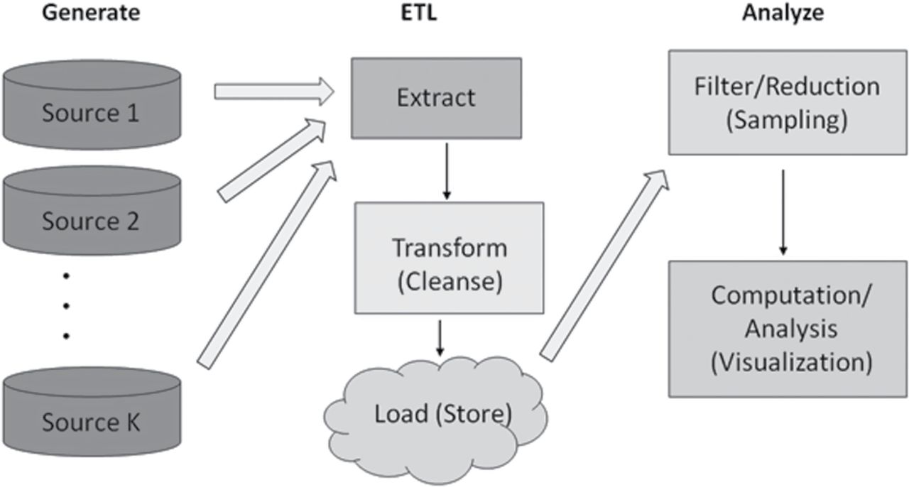
Figure 4. Big Data Process Map (graph created by Paul Biemer).
Notes:
Figure 4. Big Data Process Map (graph created by Paul Biemer).
Unless provided in the caption above, the following copyright applies to the content of this slide: © The Author 2015. Published by Oxford University Press on behalf of the American Association for Public Opinion Research. All rights reserved. For permissions, please e-mail: journals.permissions@oup.com

Slide 5
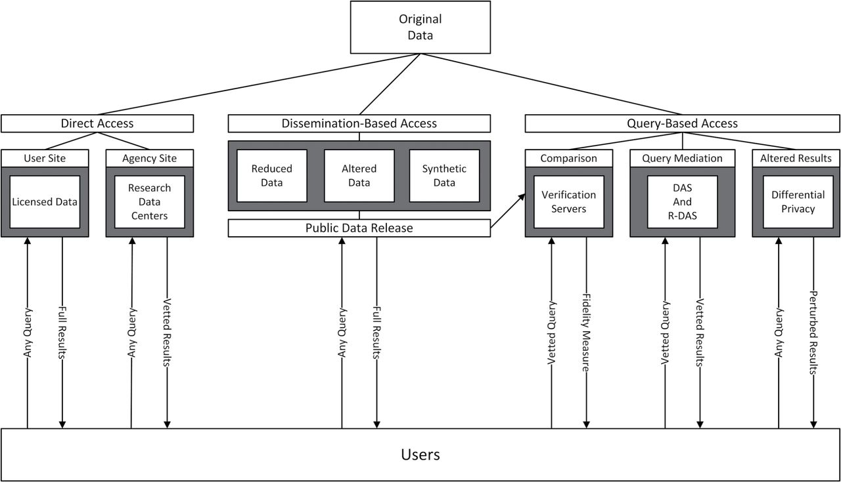
Figure 5. Models for User-Data Interaction, from Kinney, Karr, and Gonzalez (2009) .
Notes:
Figure 5. Models for User-Data Interaction, from Kinney, Karr, and Gonzalez (2009) .
Unless provided in the caption above, the following copyright applies to the content of this slide: © The Author 2015. Published by Oxford University Press on behalf of the American Association for Public Opinion Research. All rights reserved. For permissions, please e-mail: journals.permissions@oup.com

Slide 6
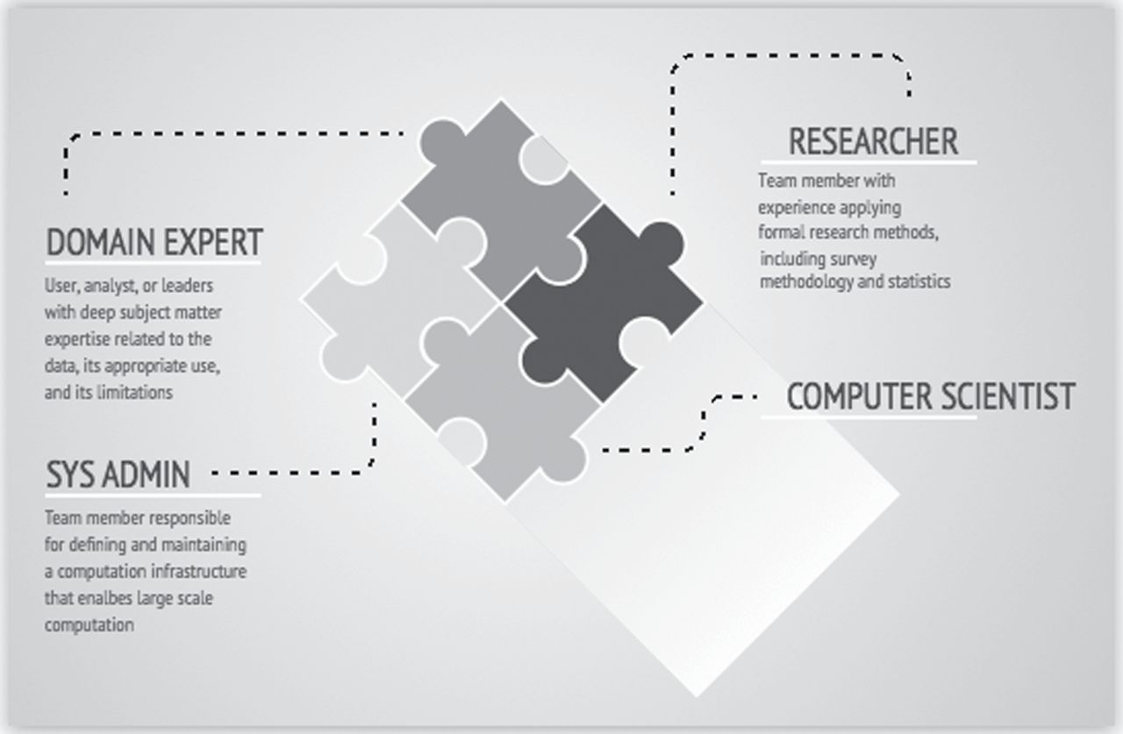
Figure 6. The Different Roles Needed in a Big Data Team (graph created by Abe Usher).
Notes:
Figure 6. The Different Roles Needed in a Big Data Team (graph created by Abe Usher).
Unless provided in the caption above, the following copyright applies to the content of this slide: © The Author 2015. Published by Oxford University Press on behalf of the American Association for Public Opinion Research. All rights reserved. For permissions, please e-mail: journals.permissions@oup.com

Slide 7
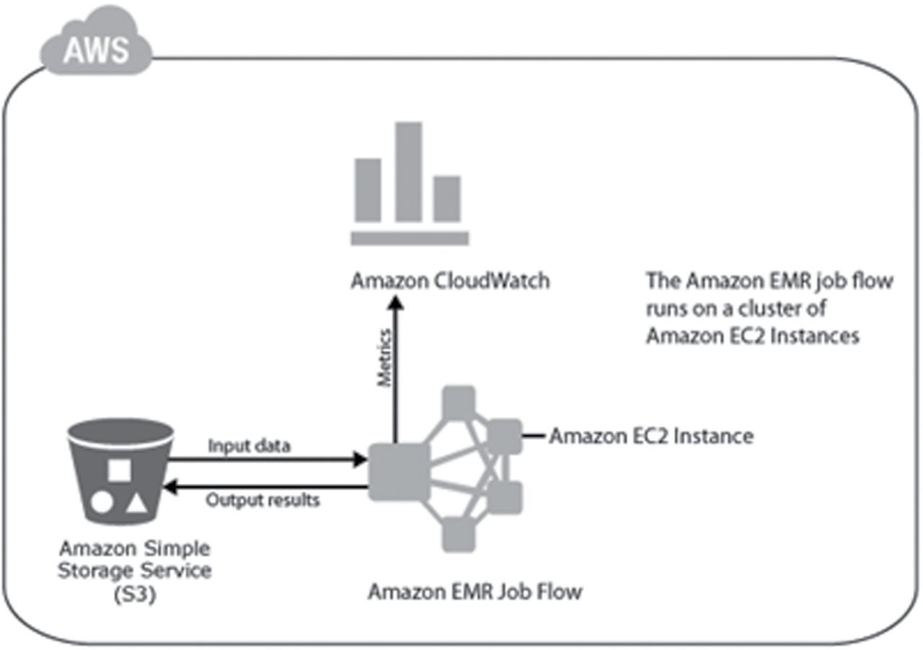
Figure 7. The Amazon Elastic MapReduce (EMR) Service Remains One of the Most Popular Utility Compute Cloud Versions of ...
Notes:
Figure 7. The Amazon Elastic MapReduce (EMR) Service Remains One of the Most Popular Utility Compute Cloud Versions of Hadoop (graph created by Abe Usher).
Unless provided in the caption above, the following copyright applies to the content of this slide: © The Author 2015. Published by Oxford University Press on behalf of the American Association for Public Opinion Research. All rights reserved. For permissions, please e-mail: journals.permissions@oup.com

Slide 8
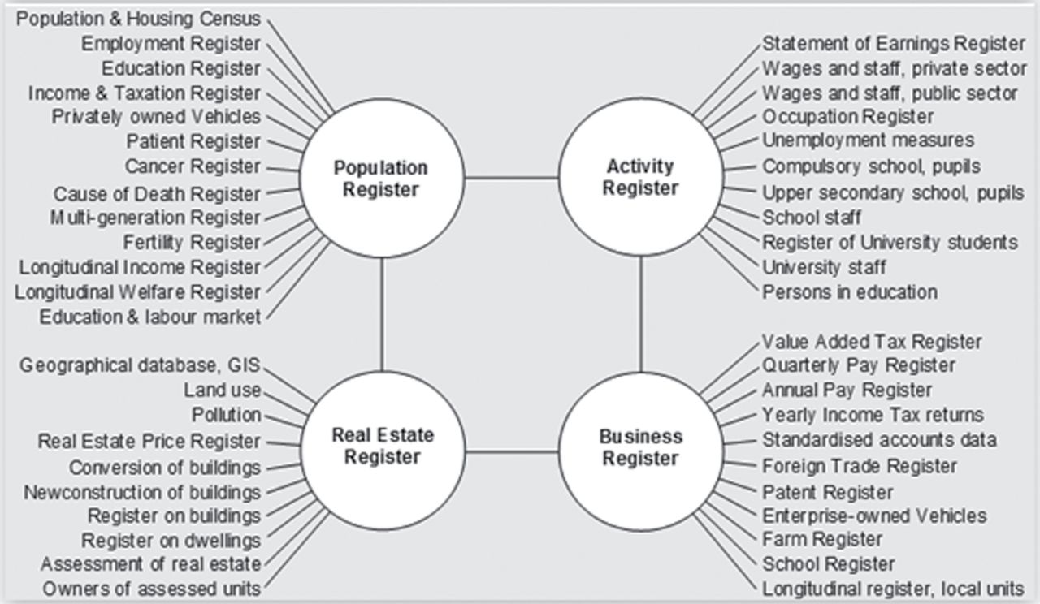
Figure 8. A System of Statistical Registers—by Object Type and Subject Field, from Wallgren and Wallgren (2014) .
Notes:
Figure 8. A System of Statistical Registers—by Object Type and Subject Field, from Wallgren and Wallgren (2014) .
Unless provided in the caption above, the following copyright applies to the content of this slide: © The Author 2015. Published by Oxford University Press on behalf of the American Association for Public Opinion Research. All rights reserved. For permissions, please e-mail: journals.permissions@oup.com

