Slide 1
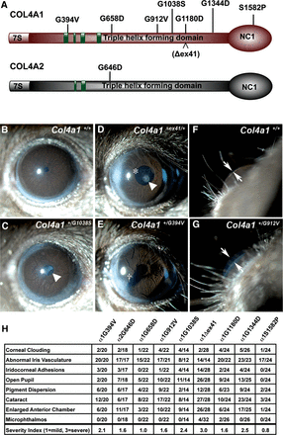
Figure 1. Col4a1 and Col4a2 mutations cause highly penetrant ocular anterior segment dysgenesis. (A) Schematic ...
Notes:
Figure 1. Col4a1 and Col4a2 mutations cause highly penetrant ocular anterior segment dysgenesis. (A) Schematic representation of COL4A1 and COL4A2 domain structure and the positions of the mutations analyzed in this study; green boxes: putative integrin-binding sites. (B–G) Representative images from slit lamp examination of control (Col4a1+/+) and mutant (Col4a1+/mut) eyes showing ocular anterior segment dysgenesis in mutant mice, including open pupil (asterisk), enlarged and torturous iris vasculature, cataracts (arrowhead), iridocorneal adhesion (cross) and enlarged anterior chamber (arrows point to the anterior chamber). (H) The frequency of distinct ocular anterior segment dysgenesis phenotypes caused by different Col4a1 and Col4a2 mutations is shown in the table. The overall severity for each eye was ranked as mild (score = 1), moderate (score = 2) and severe (score = 3), and the average score of each strain is indicated. Note that in Col4a1+/Δex41 mice a severe open pupil phenotype prevented assessment of iris vasculature abnormalities in a subset of eyes. Between 14 and 32 eyes were analyzed per allele.
Unless provided in the caption above, the following copyright applies to the content of this slide: © The Author 2013. Published by Oxford University Press.This is an Open Access article distributed under the terms of the Creative Commons Attribution Non-Commercial License (http://creativecommons.org/licenses/by-nc/3.0/), which permits non-commercial re-use, distribution, and reproduction in any medium, provided the original work is properly cited. For commercial re-use, please contact journals.permissions@oup.com

Slide 2
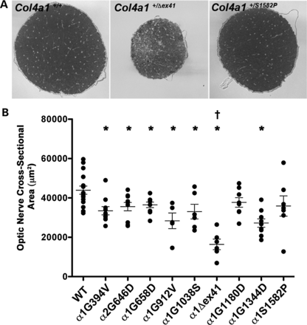
Figure 2. Col4a1 and Col4a2 mutations cause variable optic nerve hypoplasia. (A) Representative images of optic nerve ...
Notes:
Figure 2. Col4a1 and Col4a2 mutations cause variable optic nerve hypoplasia. (A) Representative images of optic nerve cross sections from Col4a1+/+ and Col4a1+/mut mice and (B) quantitative analysis of optic nerve cross-sectional area show variability in the size of mutant optic nerves, ranging from severely hypoplastic (Col4a1+/Δex41) to indistinguishable from control (Col4a1+/G1180D and Col4a1+/S1582P). Values are presented as mean ± SEM. Comparisons between Col4a1+/+ (WT) and each mutant strain were performed using Student's t-test (*P < 0.05). Comparison amongst different strains was performed using one-way ANOVA followed by Tukey's post hoc test. With the exception of Col4a1+/G1344D, Col4a1+/Δex41 was significantly different from all other Col4a1 mutations (†P < 0.05). Between 5 and 16 optic nerves were examined per allele.
Unless provided in the caption above, the following copyright applies to the content of this slide: © The Author 2013. Published by Oxford University Press.This is an Open Access article distributed under the terms of the Creative Commons Attribution Non-Commercial License (http://creativecommons.org/licenses/by-nc/3.0/), which permits non-commercial re-use, distribution, and reproduction in any medium, provided the original work is properly cited. For commercial re-use, please contact journals.permissions@oup.com

Slide 3
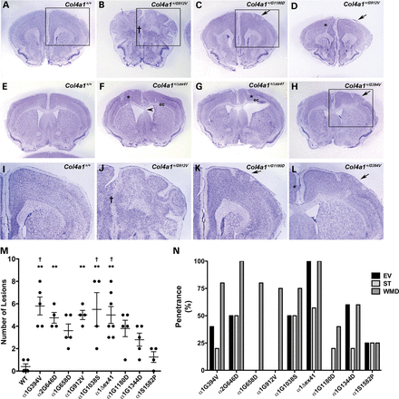
Figure 3. Col4a1 and Col4a2 mutations cause variable brain malformations. (A–L) Representative images of coronal brain ...
Notes:
Figure 3. Col4a1 and Col4a2 mutations cause variable brain malformations. (A–L) Representative images of coronal brain sections from Col4a1+/+ and Col4a1+/mut mice stained with cresyl violet show diverse cortical defects in mutant mice. We observed molecular layer heterotopia (MLH) (arrows in C, D, H, K and L), midline fusion defects († in B and J), and focal (asterisks in D, F, G and L) or widespread heterotopias resembling extensive foliation (boxed area in B and higher magnification of the boxed area in J). (I–L) show higher magnification images of boxed area in A, B, C, and H, respectively. Other malformations include enlarged ventricles (F and G), septal thinning (arrowhead in F) and white matter defects (asterisk in D, F, and G) usually associated with disorganized lamination or with enlarged ventricles that manifest as thinning of white matter tracts in the external capsule (labeled as ‘ec’ in F and G). (M) Quantifying cortical neuronal lamination defects show that the number of lesions is influenced by allelic heterogeneity, with the greatest number of lesions observed in Col4a1+/G394V, Col4a1+/Δex41 and Col4a1+/G1038S brains, while Col4a1+/S1582P brains were not significantly different from Col4a1+/+ (WT). Comparisons between Col4a1+/+ (WT) and each mutant strain were performed using Student's t-test and, with the exception of the Col4a1+/S1582P brains, all Col4a1+/mut brains had a significantly higher number of lesions compared to Col4a1+/+ brain (P < 0.01, data not shown). Comparison amongst different strains was performed using one-way ANOVA followed by Tukey's post hoc test, Col4a1+/G394V, Col4a2+/G646D, Col4a1+/G912V, and Col4a1+/G1038S, Col4a1+/Δex41 brains had significantly more lesions than Col4a1+/+ brains (**P < 0.01), and Col4a1+/G394V, Col4a1+/G1038S and Col4a1+/Δex41 brains had significantly more lesions than Col4a1+/S1582P brains (†P < 0.05). (N) Penetrance of brain malformations other than lamination defects (EV: enlarged ventricles, ST: septal thinning, and WMD: white matter defect). Col4a1+/Δex41 and Col4a1+/S1582P brains showed the highest and lowest frequency of these malformations, respectively. Between 4 and 7 brains were analyzed per allele.
Unless provided in the caption above, the following copyright applies to the content of this slide: © The Author 2013. Published by Oxford University Press.This is an Open Access article distributed under the terms of the Creative Commons Attribution Non-Commercial License (http://creativecommons.org/licenses/by-nc/3.0/), which permits non-commercial re-use, distribution, and reproduction in any medium, provided the original work is properly cited. For commercial re-use, please contact journals.permissions@oup.com

Slide 4
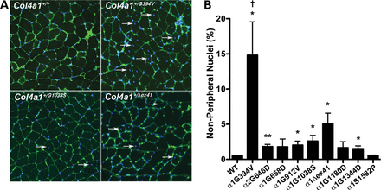
Figure 4. Col4a1 and Col4a2 allelic heterogeneity influences myopathy. (A) Representative Col4a1^{+/+} and ...
Notes:
Figure 4. Col4a1 and Col4a2 allelic heterogeneity influences myopathy. (A) Representative Col4a1+/+ and Col4a1+/mut quadriceps muscle sections immunolabeled for COLIV and counterstained with DAPI showing variability in the number of non-peripheral nuclei (arrows) in mutant muscles. (B) Quantitative analysis of non-peripheral nuclei from all strains is shown in the bar graph. We counted a minimum of 4250 fibers in five muscles from five mice per allele and the values are presented as mean ± SEM. While Col4a1+/S1582P muscles are indistinguishable from Col4a1+/+ muscles, a considerable increase in the number of non-peripheral nuclei was observed in Col4a1+/G394V and Col4a1+/Δex41 muscles. All other mutations showed a modest increase in non-peripheral nuclei, not always reaching statistical significance compared to control muscles. The number of non-peripheral nuclei was significantly higher in Col4a1+/G394V muscles compared with all other Col4a1 mutant muscles. Comparisons between Col4a1+/+ (WT) and each mutant strain were performed using Student's t-test (*P < 0.05; **P < 0.01). Comparison amongst different strains was performed using one-way ANOVA followed by Tukey's post hoc test (†P < 0.01).
Unless provided in the caption above, the following copyright applies to the content of this slide: © The Author 2013. Published by Oxford University Press.This is an Open Access article distributed under the terms of the Creative Commons Attribution Non-Commercial License (http://creativecommons.org/licenses/by-nc/3.0/), which permits non-commercial re-use, distribution, and reproduction in any medium, provided the original work is properly cited. For commercial re-use, please contact journals.permissions@oup.com

Slide 5
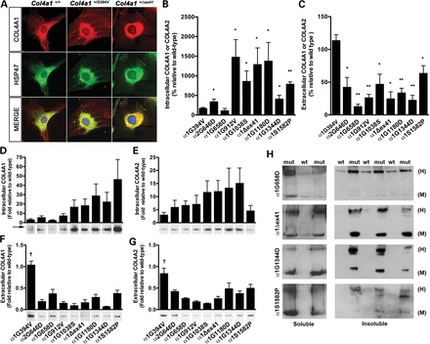
Figure 5. Biosynthetic effects of Col4a1 and Col4a2 mutations. (A) Representative photomicrographs of ...
Notes:
Figure 5. Biosynthetic effects of Col4a1 and Col4a2 mutations. (A) Representative photomicrographs of Col4a1+/+ and Col4a1+/mut mouse embryonic fibrobalsts (MEFs) co-immunolabeled for COL4A1 and HSP47, a collagen-specific chaperone residing in the ER. Col4a1 mutations lead to variable increase in co-localization of COL4A1 and HSP47, suggesting that some mutations lead to more severe intracellular accumulation than others. (B–G) Western blot and densitometric analyses of intracellular and extracellular COL4A1 and COL4A2 levels in MEFs. (B) Soluble intracellular COL4A1 levels (or COL4A2 for Col4a2+/G646D) were normalized to an actin loading control and compared with samples from Col4a1+/+ littermates loaded on the same gel under reducing conditions. (C) Extracellular COL4A1 levels were determined by analyses of conditioned media from the same cell cultures used in (B). Loading volumes were normalized to the total protein concentration of the cellular fraction and the conditioned media from Col4a1+/mut cells were compared with that of cells from Col4a1+/+ littermates that were loaded on the same gel. In a separate experiment, laminin labeling was used to demonstrate that normalization to total protein concentration returned consistent results (Supplementary Material, Fig. S3). For (B) and (C), we used three to five independent MEF lines isolated from individual embryos for each mutant line. Values were compared using Student's t-test (*P < 0.05; **P < 0.01) and are presented as mean ± SEM. (D–G) To compare strains directly, reduced total intracellular or conditioned media from all strains were loaded on a single gel and probed for COL4A1 or COL4A2. We used five independent MEF lines derived from different embryos for each mutation and the values amongst strains run on the same gel were compared using a one-way ANOVA followed by a Tukey's post hoc test (†P < 0.01), arrow indicates a COL4A1 band of higher molecular weight. (H) Representative photomicrographs of western blot analyses of detergent-soluble and-insoluble intracellular COL4A1 in Col4a1+/+ (wt) and mutant (mut) MEFs showing variability in the proportions of intracellular COL4A1 monomers (M) and COL4A1-containing heterotrimers (H) in MEFs with different Col4a1 mutations. We used three to five independent MEF lines derived from different embryos per mutation.
Unless provided in the caption above, the following copyright applies to the content of this slide: © The Author 2013. Published by Oxford University Press.This is an Open Access article distributed under the terms of the Creative Commons Attribution Non-Commercial License (http://creativecommons.org/licenses/by-nc/3.0/), which permits non-commercial re-use, distribution, and reproduction in any medium, provided the original work is properly cited. For commercial re-use, please contact journals.permissions@oup.com

Slide 6
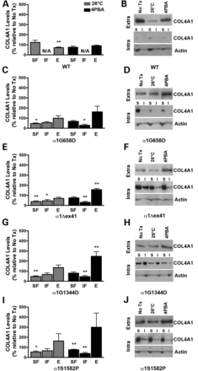
Figure 6. Effects of reduced temperature and 4PBA on COL4A1 biosynthesis in Col4a1 mutant MEFs. Mutant MEFs were ...
Notes:
Figure 6. Effects of reduced temperature and 4PBA on COL4A1 biosynthesis in Col4a1 mutant MEFs. Mutant MEFs were cultured under normal growth conditions at 37°C, at reduced temperature (26°C) or in the presence of 4PBA (10 mm) for 12 h, then serum deprived in the presence of 50 µg/ml ascorbic acid under the same conditions to promote assembly and secretion of COL4A1-containing heterotrimers. Protein lysate (soluble [SF] and insoluble [IF] intracellular fractions) and conditioned medium (E: extracellular) were subjected to western blot analysis. (A) Col4a1+/+ (WT) showed no difference in intracellular levels of COL4A1 with decreased temperature or 4PBA treatment, but demonstrated a decreased in extracellular levels of COL4A1 under decreased temperature conditions not seen with 4PBA treatment. While growing MEFs at reduced temperature decreased levels of intracellular COL4A1 in all selected Col4a1 mutant strains ((C) Col4a1 +/G658D, (E) Col4a1 +/Δex41, (G) Col4a1 +/G1344D and (I) Col4a1 +/S1582P), it only led to a small, non-significant increase in the levels of extracellular COL4A1 in Col4a1 +/G1344D and Col4a1 +/S1582P MEFs. In contrast, 4PBA decreased the levels of intracellular COL4A1 with a more pronounced reduction in the insoluble fraction and promoted secretion of COL4A1-containing heterotrimers. Values are presented as mean ± SEM. For statistical analysis, Student's t-tests were performed. *P < 0.05; **P < 0.01. N = 3–9 MEF lines per mutation. (B, D, F, H, J) Representative western blot images for the selected mutations and wild type. Extra: extracellular, Intra: intracellular, I: insoluble fraction, S: soluble fraction.
Unless provided in the caption above, the following copyright applies to the content of this slide: © The Author 2013. Published by Oxford University Press.This is an Open Access article distributed under the terms of the Creative Commons Attribution Non-Commercial License (http://creativecommons.org/licenses/by-nc/3.0/), which permits non-commercial re-use, distribution, and reproduction in any medium, provided the original work is properly cited. For commercial re-use, please contact journals.permissions@oup.com

