Slide 1
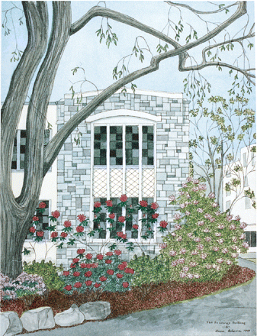
Fig. 1 Early work. AA painted ‘Hennings Building’ in 1991, 9 years before her PPA symptoms began. Watercolour.
Notes:
Fig. 1 Early work. AA painted ‘Hennings Building’ in 1991, 9 years before her PPA symptoms began. Watercolour.
Unless provided in the caption above, the following copyright applies to the content of this slide: © The Author (2007). Published by Oxford University Press on behalf of the Guarantors of Brain. All rights reserved. For Permissions, please email: journals.permissions@oxfordjournals.org

Slide 2
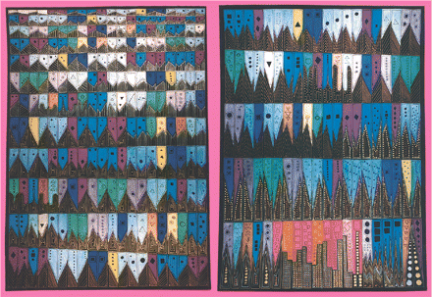
Fig. 2 Emergent transmodal creativity. AA painted ‘Unravelling Boléro’ in 1994, 6 years before PPA symptoms began. ...
Notes:
Fig. 2 Emergent transmodal creativity. AA painted ‘Unravelling Boléro’ in 1994, 6 years before PPA symptoms began. Gouache.
Unless provided in the caption above, the following copyright applies to the content of this slide: © The Author (2007). Published by Oxford University Press on behalf of the Guarantors of Brain. All rights reserved. For Permissions, please email: journals.permissions@oxfordjournals.org

Slide 3
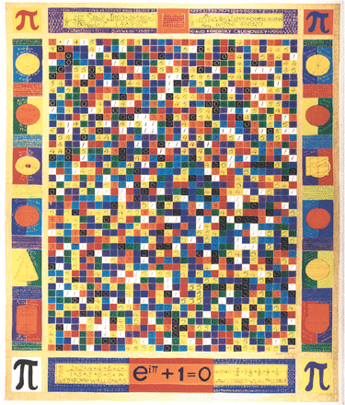
Fig. 3 In 1998, 2 years before PPA symptoms, AA painted ‘pi’, in which she transformed the decimal expansion of pi ...
Notes:
Fig. 3 In 1998, 2 years before PPA symptoms, AA painted ‘pi’, in which she transformed the decimal expansion of pi into a visual matrix to capture the random nature of that expansion. Rather than translating one sensory modality into another as in ‘Unravelling Boléro’, in ‘pi’ AA translates an abstract, conceptual image (numerical randomness) directly into visual form. Gouache.
Unless provided in the caption above, the following copyright applies to the content of this slide: © The Author (2007). Published by Oxford University Press on behalf of the Guarantors of Brain. All rights reserved. For Permissions, please email: journals.permissions@oxfordjournals.org

Slide 4
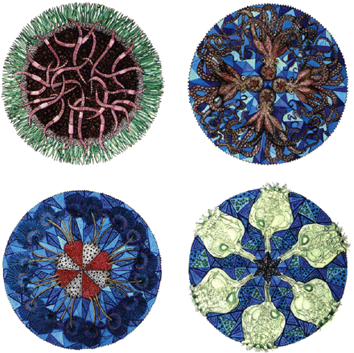
Fig. 4 In 2000, as her PPA symptoms arose, AA painted an ‘ABC Book of Invertebrates’. Each letter of the alphabet ...
Notes:
Fig. 4 In 2000, as her PPA symptoms arose, AA painted an ‘ABC Book of Invertebrates’. Each letter of the alphabet was assigned an organism, which was painted in mandala format. Examples shown include (from upper left, clockwise): ‘E’ for earthworm, ‘O’ for octopus, ‘R’ for rotifer and ‘P’ for peacock worm. This period revealed AA's increasing tendency to render symmetric images. Gouache.
Unless provided in the caption above, the following copyright applies to the content of this slide: © The Author (2007). Published by Oxford University Press on behalf of the Guarantors of Brain. All rights reserved. For Permissions, please email: journals.permissions@oxfordjournals.org

Slide 5
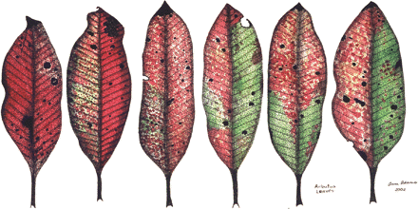
Fig. 5 Increasing photographic realism. In 2002, 2 years after her illness became clinically apparent, AA painted ...
Notes:
Fig. 5 Increasing photographic realism. In 2002, 2 years after her illness became clinically apparent, AA painted ‘Arbutus leaves’, which reflects a trend toward increasingly photographic reproductions of stimuli she encountered. Gouache.
Unless provided in the caption above, the following copyright applies to the content of this slide: © The Author (2007). Published by Oxford University Press on behalf of the Guarantors of Brain. All rights reserved. For Permissions, please email: journals.permissions@oxfordjournals.org

Slide 6
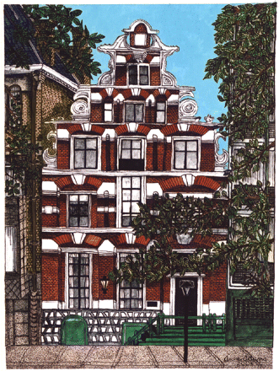
Fig. 6 In 2004, AA painted ‘Amsterdam’ shortly before her UCSF evaluation. At UCSF, she could scarcely communicate ...
Notes:
Fig. 6 In 2004, AA painted ‘Amsterdam’ shortly before her UCSF evaluation. At UCSF, she could scarcely communicate through spoken language but her motor examination was unremarkable. ‘Amsterdam’ was one of many paintings from this period that focused on buildings, with a particular emphasis on facades and surrounding surfaces. Gouache.
Unless provided in the caption above, the following copyright applies to the content of this slide: © The Author (2007). Published by Oxford University Press on behalf of the Guarantors of Brain. All rights reserved. For Permissions, please email: journals.permissions@oxfordjournals.org

Slide 7
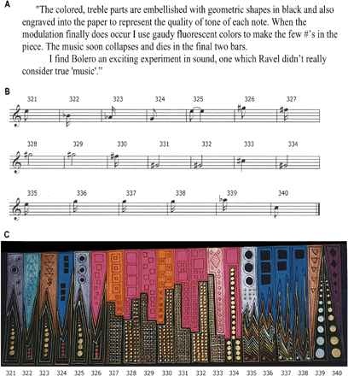
Fig. 7 Representation of the key change in Ravel's ‘Boléro’. (A) AA recorded her plans to paint the key change in ...
Notes:
Fig. 7 Representation of the key change in Ravel's ‘Boléro’. (A) AA recorded her plans to paint the key change in ‘Boléro’ (type transcribed from handwritten notes). (B) Musical notation representing AA's favourite or ‘most interesting’ treble clef notes for bars 321–340. (C) The excerpt from ‘Unraveling Boléro’ painted to represent bars 321–340. AA used both visual (musical score) and auditory (a ‘Boléro’ performance) inputs when composing ‘Unraveling Boléro’. Never did she experience direct sensory linkage phenomena akin to synaesthesia.
Unless provided in the caption above, the following copyright applies to the content of this slide: © The Author (2007). Published by Oxford University Press on behalf of the Guarantors of Brain. All rights reserved. For Permissions, please email: journals.permissions@oxfordjournals.org

Slide 8
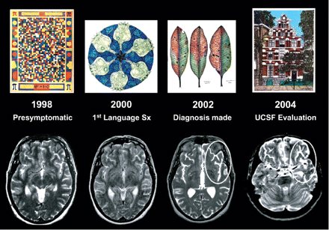
Fig. 8 Serial MRI scans performed to follow AA's acoustic neuroma, showing emergent atrophy within the left frontal ...
Notes:
Fig. 8 Serial MRI scans performed to follow AA's acoustic neuroma, showing emergent atrophy within the left frontal operculum. Scans performed before AA's PPA diagnosis reveal no definite cortical atrophy, which becomes evident by 2002 around the left fronto-insular region, with widening of sulci and the Sylvian fissure compared to the right hemisphere (ovals). Each MRI is paired with a representative painting from the same year.
Unless provided in the caption above, the following copyright applies to the content of this slide: © The Author (2007). Published by Oxford University Press on behalf of the Guarantors of Brain. All rights reserved. For Permissions, please email: journals.permissions@oxfordjournals.org

Slide 9
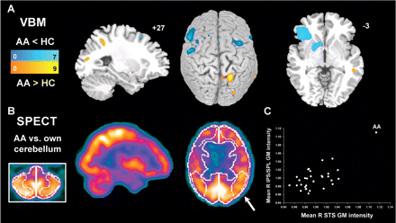
Fig. 9 Neuroimaging results. (A) Grey matter reductions in AA vs. controls (blue colourscale) were accompanied by ...
Notes:
Fig. 9 Neuroimaging results. (A) Grey matter reductions in AA vs. controls (blue colourscale) were accompanied by focal areas of increased grey matter intensity in right posterior neocortex (orange colourscale). Bars indicate t-scores. Displayed voxels are significant at P < 0.001 (whole brain, uncorrected). (B) AA showed increased cerebral perfusion in only one ROI examined, the right parietal cortex (arrow, 112% of cerebellar baseline). (C) Mean grey matter intensities from right IPS/SPL and right STS ROIs (arbitrary units), plotted against each other for each subject, show the degree to which AA's values exceeded those of controls. For axial images, the left side of the image corresponds to the left side of the brain. Sagittal images are from right hemisphere. VBM data are superimposed on slice and surface-rendered images of the Montreal Neurological Institute template brain. HC = healthy controls.
Unless provided in the caption above, the following copyright applies to the content of this slide: © The Author (2007). Published by Oxford University Press on behalf of the Guarantors of Brain. All rights reserved. For Permissions, please email: journals.permissions@oxfordjournals.org

Slide 10
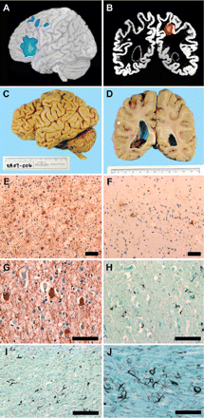
Fig. 10 Neuropathological findings. (A, C) Severe atrophy of left IFC, including Broca's area, was demonstrated with ...
Notes:
Fig. 10 Neuropathological findings. (A, C) Severe atrophy of left IFC, including Broca's area, was demonstrated with VBM (A) and at autopsy (C). The interval between MRI acquisition and death was 3 years. (B, D) VBM also revealed increased grey matter in AA vs. controls in the right IPS (B), and this region was structurally normal (or better) at autopsy (D). VBM data in (B) are superimposed on AA's segmented grey matter image to facilitate comparison with post-mortem examination. In (B) and (D), the right side of the image corresponds to the right side of the brain. (E) Tau immunohistochemistry showed severe tau pathology in left IFC, whereas right parietal cortex (F) was relatively unremarkable. (G) Ballooned neurons in deep layers of left frontal cortex (phosphorylated neurofilament stain). (H) Thorny astrocytes in frontal cortex (Gallyas silver stain). (I, J) Abundant argyrophilic pathology in subcortical white matter, including coiled bodies and numerous threads. The findings confirm a diagnosis of CBD. Scale bars represent 80 microns (C–I) and 40 microns (J).
Unless provided in the caption above, the following copyright applies to the content of this slide: © The Author (2007). Published by Oxford University Press on behalf of the Guarantors of Brain. All rights reserved. For Permissions, please email: journals.permissions@oxfordjournals.org

Slide 11
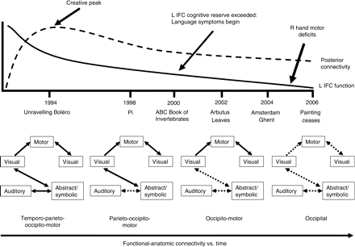
Fig. 11 Functional-anatomic model for AA's artistic timeline. AA's art peaked 6 years before overt PPA symptoms, at a ...
Notes:
Fig. 11 Functional-anatomic model for AA's artistic timeline. AA's art peaked 6 years before overt PPA symptoms, at a time when incipient left IFC histopathology may have begun to accumulate. Heightened connectivity across multiple posterior cortices would have been required for ‘Unravelling Boléro’ and, to a lesser extent, for ‘Pi’, whereas AA's later works emphasized visual imagery without representing other sensory or conceptual modalities. Progressive disconnection among posterior regions (dashed lines), owing to low-grade cortical or, more likely, extensive white matter tau pathology, may have contributed to the trends in AA's art. Visual→Motor→Visual linkages refer to use of the motor system to translate an internal visual image into an external visual art form. L IFC = left inferior frontal cortex.
Unless provided in the caption above, the following copyright applies to the content of this slide: © The Author (2007). Published by Oxford University Press on behalf of the Guarantors of Brain. All rights reserved. For Permissions, please email: journals.permissions@oxfordjournals.org

