Slide 1
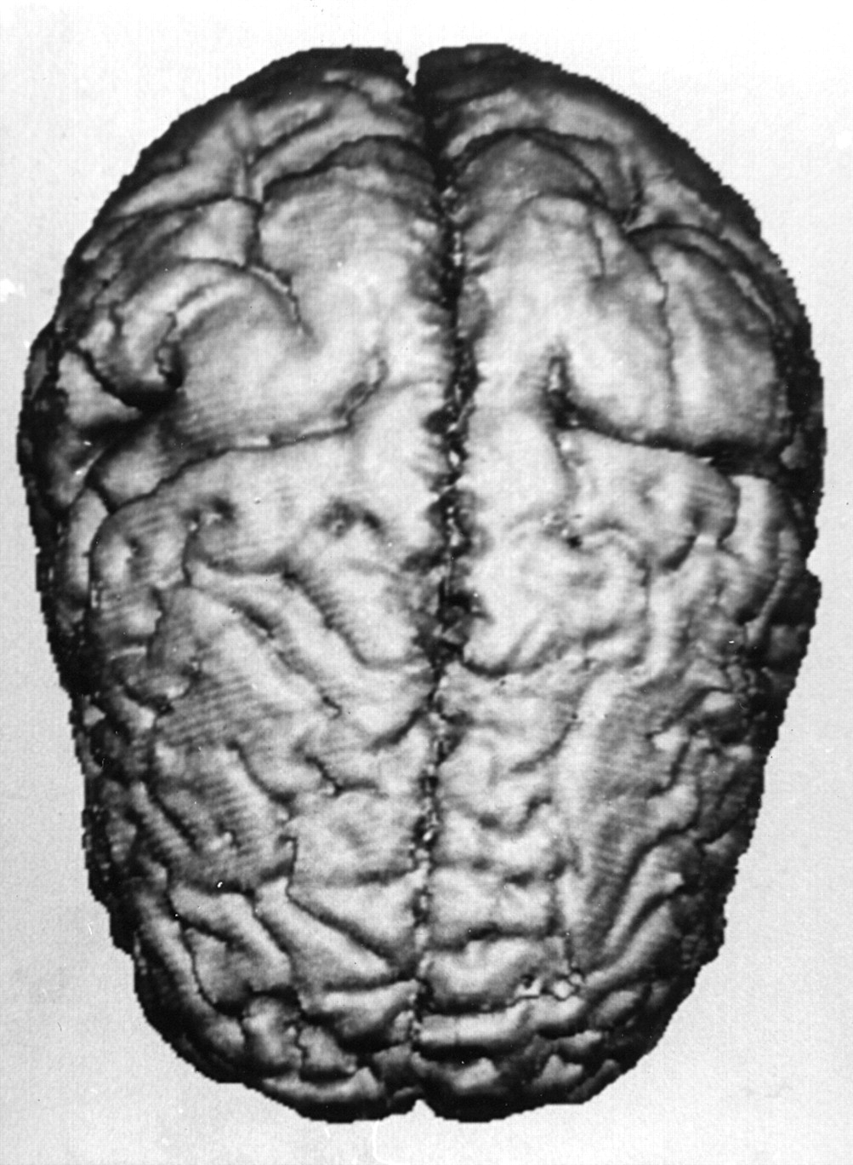
Fig. 1 Vertical view (occipital pole at top of picture) of surface rendering of high-resolution MRI scan of patient ...
Notes:
Fig. 1 Vertical view (occipital pole at top of picture) of surface rendering of high-resolution MRI scan of patient with gross bilateral posterior macrogyria. The underlying diagnosis is probably pachygyria based on detailed analysis of the unreconstructed images.
Unless provided in the caption above, the following copyright applies to the content of this slide: © Oxford University Press 2000

