Slide 1
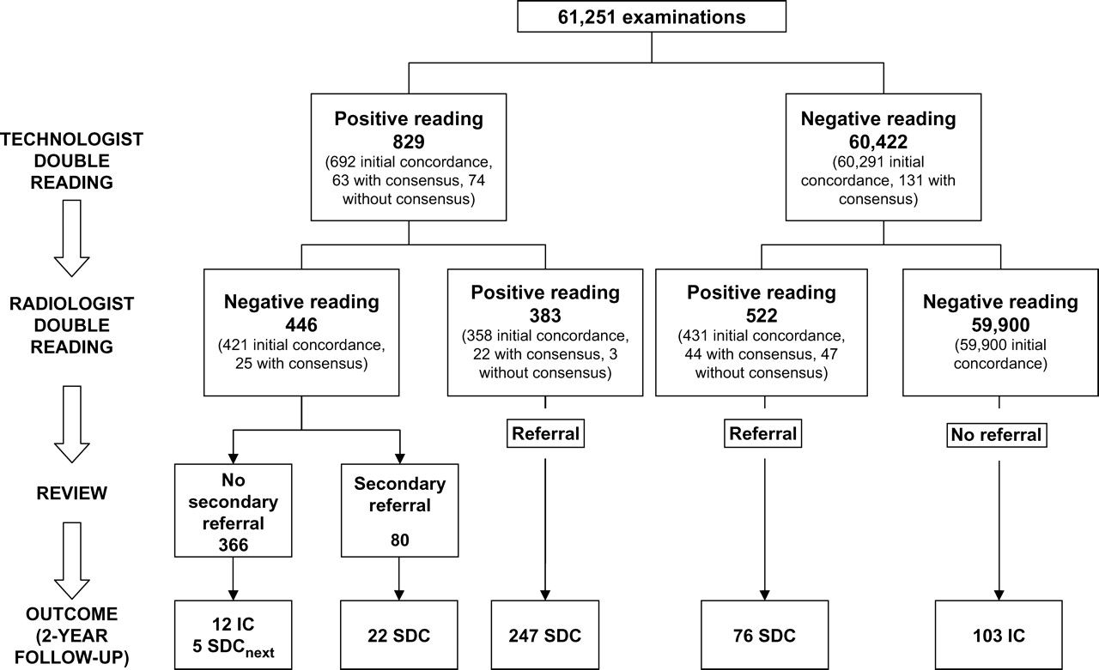
Fig. 1 Mammography screening outcome at the 2-year follow-up. Mammograms were independently read (although the ...
Notes:
Fig. 1 Mammography screening outcome at the 2-year follow-up. Mammograms were independently read (although the second reader was not blinded to the reading outcome of the first reader) by two technologists and, in turn, by two radiologists. Radiologists were blinded to the referral opinion of the technologists. SDC = screen-detected cancer; IC = interval cancer; SDCnext = cancer detected at subsequent screening; positive reading = screening examination requiring additional imaging; initial concordance = reading agreement between two readers following independent double reading; with consensus = reading agreement between two readers following independent double reading and consensus meeting; without consensus = no reading agreement between two readers following independent double reading and consensus meeting; Secondary referral = referral based on radiologist review of a technologist positive reading.
Unless provided in the caption above, the following copyright applies to the content of this slide: © The Author 2007. Published by Oxford University Press.

Slide 2
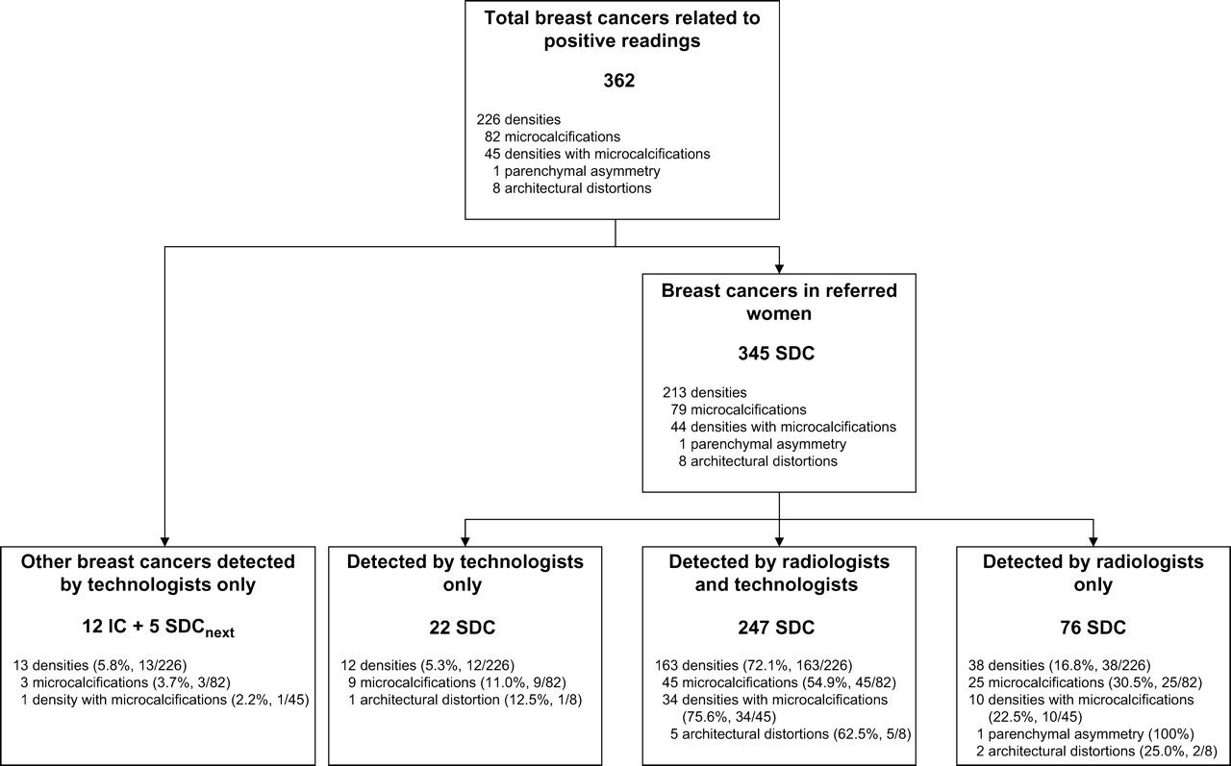
Fig. 2 Mammographic abnormalities in breast cancers detected by technologists and radiologists. SDC = ...
Notes:
Fig. 2 Mammographic abnormalities in breast cancers detected by technologists and radiologists. SDC = screen-detected cancer; IC = interval cancer; SDCnext = cancer detected at subsequent screening.
Unless provided in the caption above, the following copyright applies to the content of this slide: © The Author 2007. Published by Oxford University Press.

