Slide 1
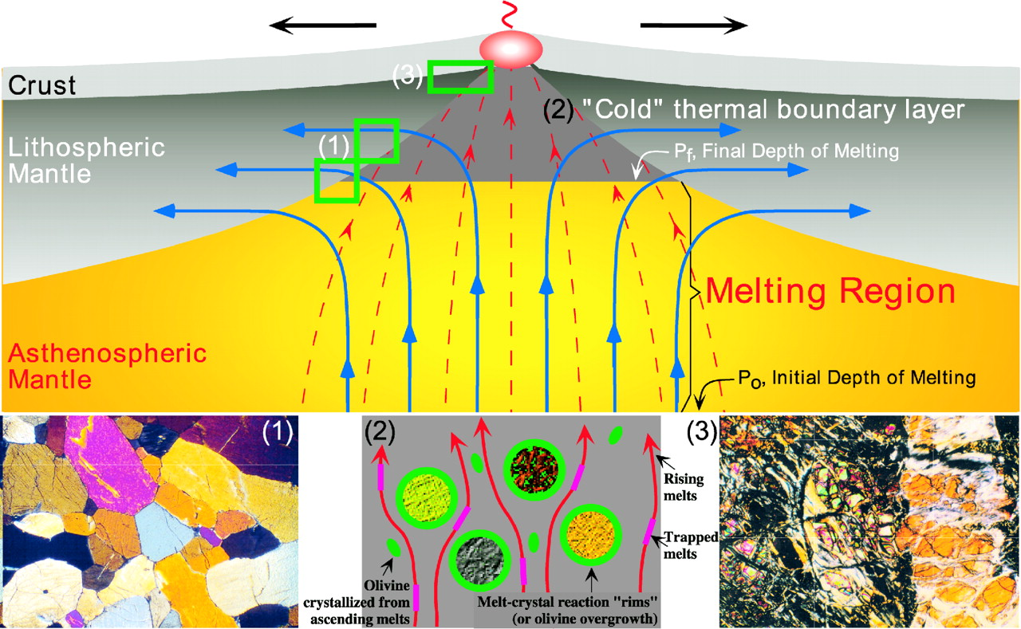
Fig. 1. A working framework for interpreting the geochemical characteristics of abyssal peridotites in the context of ...
Notes:
Fig. 1. A working framework for interpreting the geochemical characteristics of abyssal peridotites in the context of mantle melting, melt extraction and post-melting processes beneath mid-ocean ridges (modified from Niu, 1997). The mantle beneath an ocean ridge is conveniently considered as having two regions: the melting region between the solidus (Po) and the depth of melting cessation (Pf) as a result of conductive cooling to the seafloor, and the cold thermal boundary layer (TBL, labeled ‘2’) between the base of the crust and Pf. No melting occurs in the TBL, but the advanced residues continue to rise and flow laterally away from the ridge (thick arrowed lines). The newly formed melts at depth ascend, migrate through and interact with advanced residues in the TBL, including cooling-induced olivine crystallization, entrapment of melt, and complex ‘chromatographic’ processes. The advanced residues so processed, particularly in the central column of the TBL, continue to rise to shallow levels and are variably serpentinized (labeled ‘3’) before they are tectonically exposed and sampled on the seafloor as abyssal peridotites. On the other hand, melting residues at deep levels (labeled ‘1’) that turn laterally will not experience the TBL processes, never be serpentinized, and never be sampled as abyssal peridotites, but may be sampled as fresh ophiolitic or massif peridotites in the geological record (e.g. Frey et al., 1985; Godard et al., 2000; Griselin & Davies, 2003).
Unless provided in the caption above, the following copyright applies to the content of this slide: Journal of Petrology 45(12) © Oxford University Press 2004; all rights reserved

Slide 2
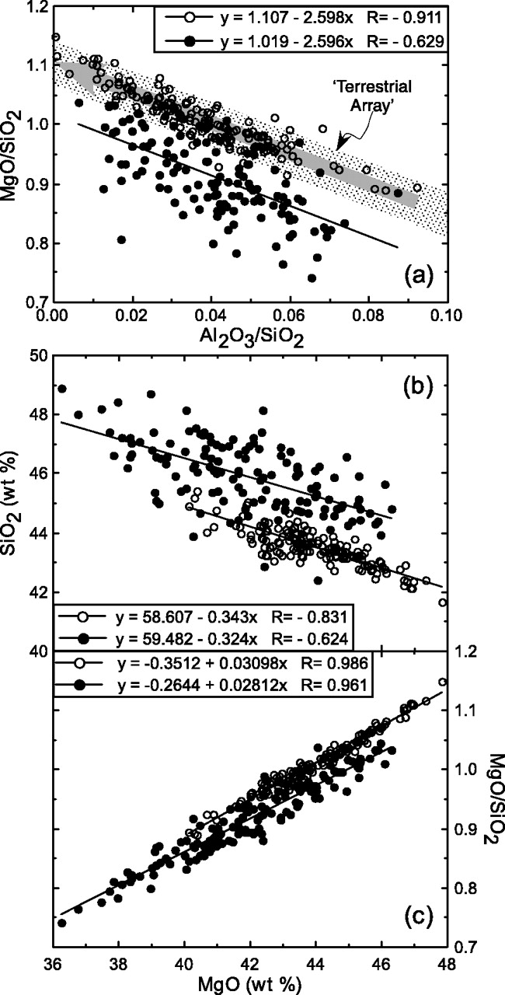
Fig. 2. Comparisons between actual bulk-rock analyses (filled circles; normalized to 100% anhydrous totals) and ...
Notes:
Fig. 2. Comparisons between actual bulk-rock analyses (filled circles; normalized to 100% anhydrous totals) and reconstructed bulk-rock compositions (Niu et al., 1997) of abyssal peridotites (open circles). (a) In MgO/SiO2–Al2O3/SiO2 space, the reconstructed bulk compositions define a tight trend (R = −0·911, indicated by the thick gray line with arrow) that is identical to the ‘terrestrial array’ (Jagoutz et al., 1979; Hart & Zindler, 1986). The scattered, yet statistically significant trend (R = −0·629) defined by the analyzed bulk compositions gives a slope (−2·596) identical to the slope of the terrestrial array (−2·598), but about 10% lower (i.e. 1·019 vs 1·107 in their respective intercepts) in MgO/SiO2 at a given Al2O3/SiO2. (b) in SiO2–MgO space, both datasets define negative trends with essentially identical slopes (−0·343 and −0·324, respectively). (c) in MgO/SiO2–MgO space, both datasets show similar slopes and very tight trends, indicating that the magmatic signatures in these serpentinized and weathered abyssal peridotites remain preserved.
Unless provided in the caption above, the following copyright applies to the content of this slide: Journal of Petrology 45(12) © Oxford University Press 2004; all rights reserved

Slide 3
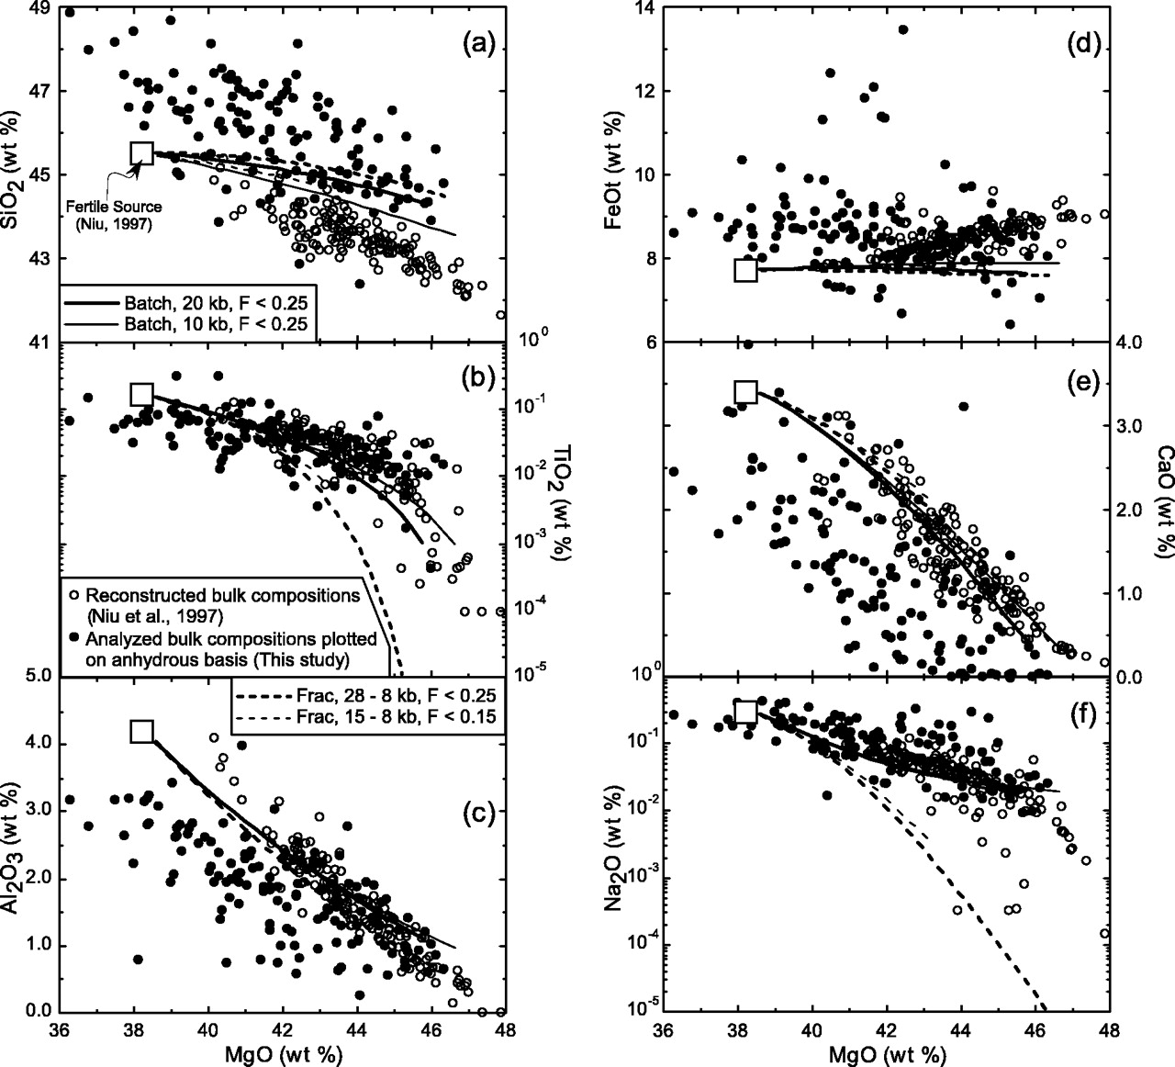
Fig. 3. Comparisons between actually analyzed and reconstructed bulk compositions of abyssal peridotites (same ...
Notes:
Fig. 3. Comparisons between actually analyzed and reconstructed bulk compositions of abyssal peridotites (same symbols as in Fig. 2) on MgO variation diagrams vs SiO2 (a), TiO2 (b), Al2O3 (c), FeOt (d), CaO (e) and Na2O (f). For comparison, also plotted are calculated melting residues of both isobaric batch melting (at P = 10 and 20 kbar, respectively) and near-fractional (1% melt porosity) decompression melting (28–8 kbar and 15–8 kbar, respectively) models of Niu (1997). Considering the probably ∼10% relative MgO (∼10% of MgO in the protoliths) loss in analyzed abyssal peridotites (see text), the Al2O3–MgO and CaO–MgO trends can be explained by both melting models. The TiO2–MgO and Na2O–MgO trends are better explained by batch (vs near-fractional melting) melting. To a first order, the Niu (1997) and Niu et al. (1997) interpretation for SiO2–MgO and FeOt–MgO trends remains valid despite the current debate (see text). The scatter and large variation in FeOt–MgO space largely results from inhomogeneous distribution of ‘FeOt’ in serpentinized peridotites and the small size of the samples studied.
Unless provided in the caption above, the following copyright applies to the content of this slide: Journal of Petrology 45(12) © Oxford University Press 2004; all rights reserved

Slide 4
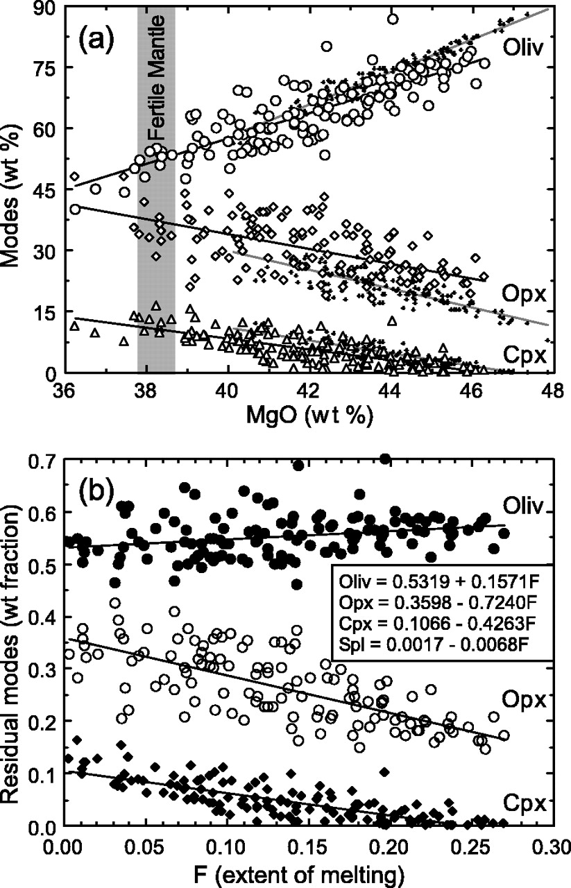
Fig. 4. (a) Comparisons between observed modes of olivine, opx and cpx (wt %; small symbols) in abyssal peridotites ...
Notes:
Fig. 4. (a) Comparisons between observed modes of olivine, opx and cpx (wt %; small symbols) in abyssal peridotites (Dick, 1989; Niu et al., 1997) with those calculated (Niu, 1997) from actually analyzed bulk compositions of abyssal peridotites (large symbols) on MgO variation diagrams. (b) Plot of the results in (a) in terms of modal mass fractions (normalized to a total of 1 − F) against the extent of melting (F) to show that the incongruent melting relationship derived from the actually analyzed serpentinized samples [−0·4263 Cpx −0·7240 Opx −0·0068 Spinel +0·1571 Olivine +1·0000 Melt = 0] resembles remarkably that derived from the actual modes [−0·466 Cpx −0·652 Opx −0·049 Spinel +0·167 Olivine +1·000 Melt = 0] (Niu, 1997, 1999). Particularly noteworthy are the consistent opx/cpx >1 ratios interpreted to characterize decompression melting (Niu, 1997). For comparison purpose, the extent of melting (F) is calculated using a single fertile mantle source (MgO = 38·3 ± 0·53 wt%): F = −1·234 +3·249 × 10−2 MgO (Niu, 1997). The calculated F values should not be taken as having true significance, but the consistent melting relationship in both (a) and (b) indicates that serpentinization and weathering did not obliterate magmatic signatures in these rocks.
Unless provided in the caption above, the following copyright applies to the content of this slide: Journal of Petrology 45(12) © Oxford University Press 2004; all rights reserved

Slide 5
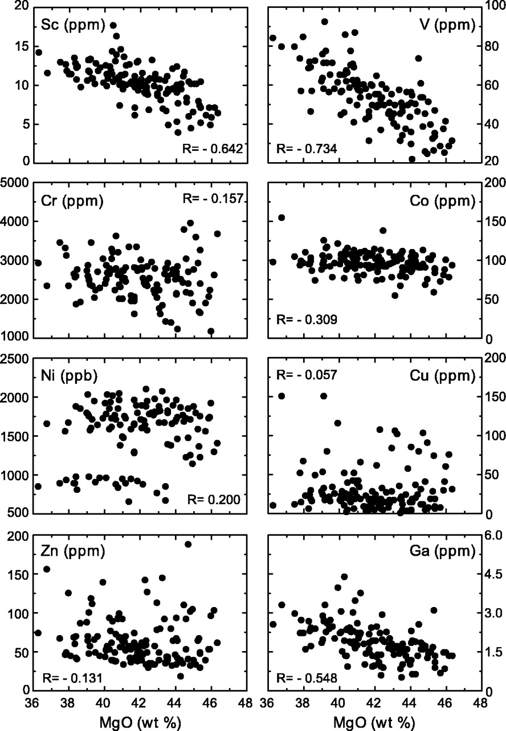
Fig. 5. MgO variation diagrams of representative transition metals plus Ga (see text for details).
Notes:
Fig. 5. MgO variation diagrams of representative transition metals plus Ga (see text for details).
Unless provided in the caption above, the following copyright applies to the content of this slide: Journal of Petrology 45(12) © Oxford University Press 2004; all rights reserved

Slide 6
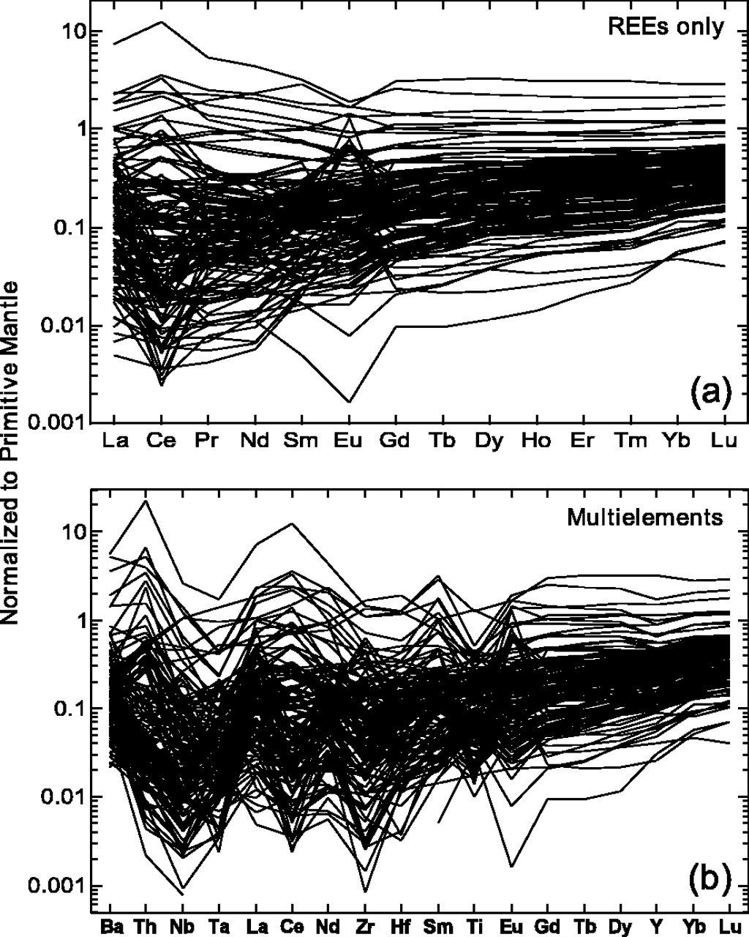
Fig. 6. Primitive mantle (Sun & McDonough, 1989) normalized REE patterns (a) and selected multi-element diagram (b) ...
Notes:
Fig. 6. Primitive mantle (Sun & McDonough, 1989) normalized REE patterns (a) and selected multi-element diagram (b) of bulk-rock abyssal peridotites to show the non-smooth patterns and over 2–3 orders of magnitude abundance variations, suggesting that abyssal peridotites are not simple residues (Niu & Hékinian, 1997b; Niu et al., 1997) but have experienced significant post-melting modifications.
Unless provided in the caption above, the following copyright applies to the content of this slide: Journal of Petrology 45(12) © Oxford University Press 2004; all rights reserved

Slide 7
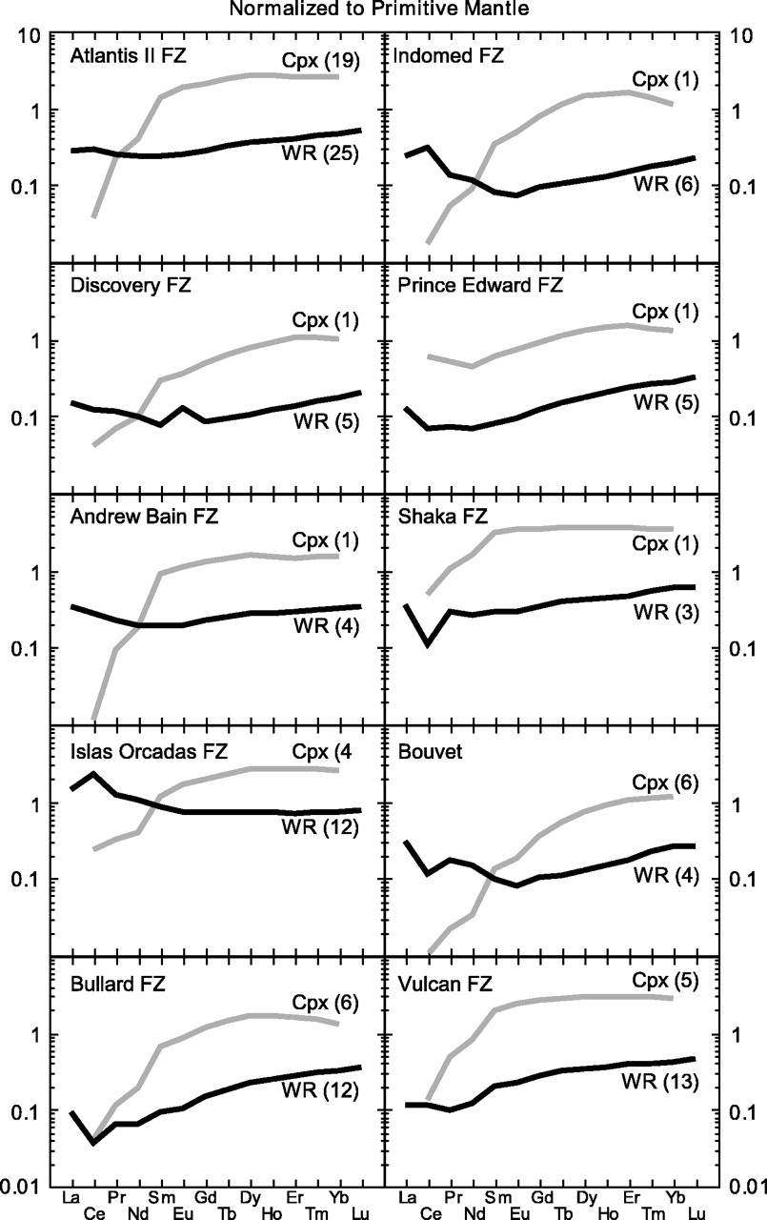
Fig. 7. Comparison of primitive mantle normalized REE contents of average residual cpx (Johnson et al., 1990; Johnson ...
Notes:
Fig. 7. Comparison of primitive mantle normalized REE contents of average residual cpx (Johnson et al., 1990; Johnson & Dick, 1992) with average bulk-rock (WR) compositions of the same sample suites from ridge–transforms of the Southwest Indian and American–Antarctic ridges. Except for samples from the Prince Edward Transform, residual cpx show highly depleted LREE abundances. In contrast, bulk-rock compositions show flat or LREE-enriched patterns. The Ce anomalies may be due to seafloor weathering, but could also have been inherited from seawater, the ultimate source of hydrothermal fluids for serpentinization. The numerals in parentheses are the number of analyses available for averaging.
Unless provided in the caption above, the following copyright applies to the content of this slide: Journal of Petrology 45(12) © Oxford University Press 2004; all rights reserved

Slide 8
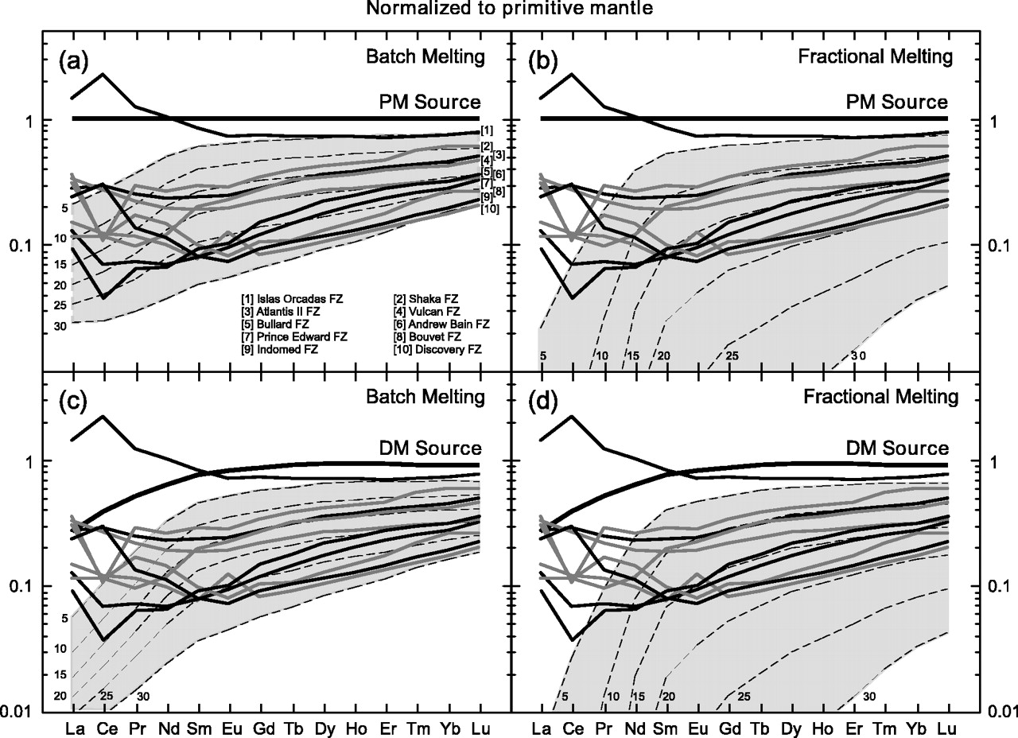
Fig. 9. Comparison of primitive mantle normalized REE patterns of abyssal peridotite site averages (Fig. 7) with ...
Notes:
Fig. 9. Comparison of primitive mantle normalized REE patterns of abyssal peridotite site averages (Fig. 7) with endmember batch (a and c) and fractional (b and d) melting models using both primitive mantle (PM; a and b) (Sun & McDonough, 1989) and a depleted mantle source (DM; c and d) (Niu & Hékinian, 1997b). All the model parameters and distribution coefficients are taken from the literature and have been summarized by Niu & Hékinian (1997b). Except for the sample suite from the Islas Orcadas transform, the slopes of MREE and HREE (after Sm) of all sample suites can be reasonably well explained by varying extents of melting from either model using either source. However, the elevated abundances of LREE (La, Ce, Pr, Nd) cannot be explained by either melting model using either source. The shaded regions represent residues of 5–30% (as labeled) melting from the respective sources and melting models.
Unless provided in the caption above, the following copyright applies to the content of this slide: Journal of Petrology 45(12) © Oxford University Press 2004; all rights reserved

Slide 9
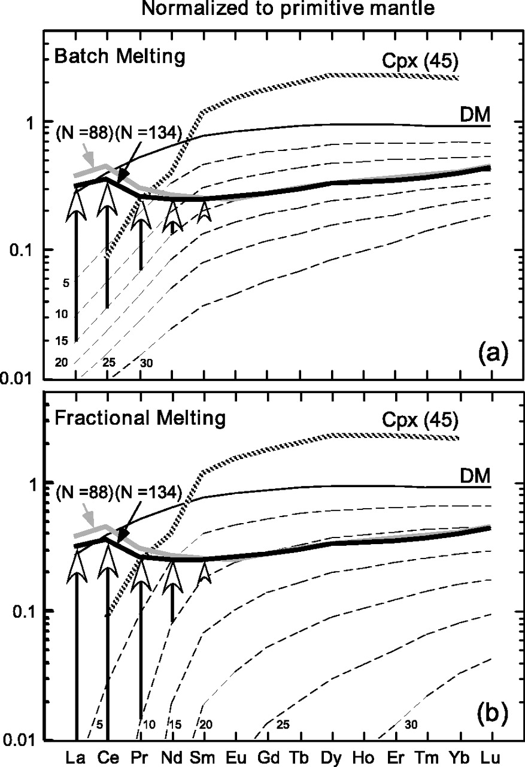
Fig. 10. Same as panels (c) and (d) of Fig. 9, but showing the grand average of sample suites with residual cpx ...
Notes:
Fig. 10. Same as panels (c) and (d) of Fig. 9, but showing the grand average of sample suites with residual cpx previously studied (N = 88; Figs 7 and 9) and the global average of the entire dataset (N = 134; Electronic Appendix 1). The MREE and HREE of the averages can be modeled by ∼15% batch melting (a) or ∼10% fractional melting (b) from a depleted source (Niu & Hékinian, 1997b). The elevated LREE can be modeled successfully by adding a less depleted melt component as indicated by the vertical arrows [see Niu & Hékinian (1997b) for model details]. However, such refertilization models, despite being effective, are arbitrary in choosing the right amount of the melt with the right compositions for the actual observations (Fig. 9).
Unless provided in the caption above, the following copyright applies to the content of this slide: Journal of Petrology 45(12) © Oxford University Press 2004; all rights reserved

Slide 10
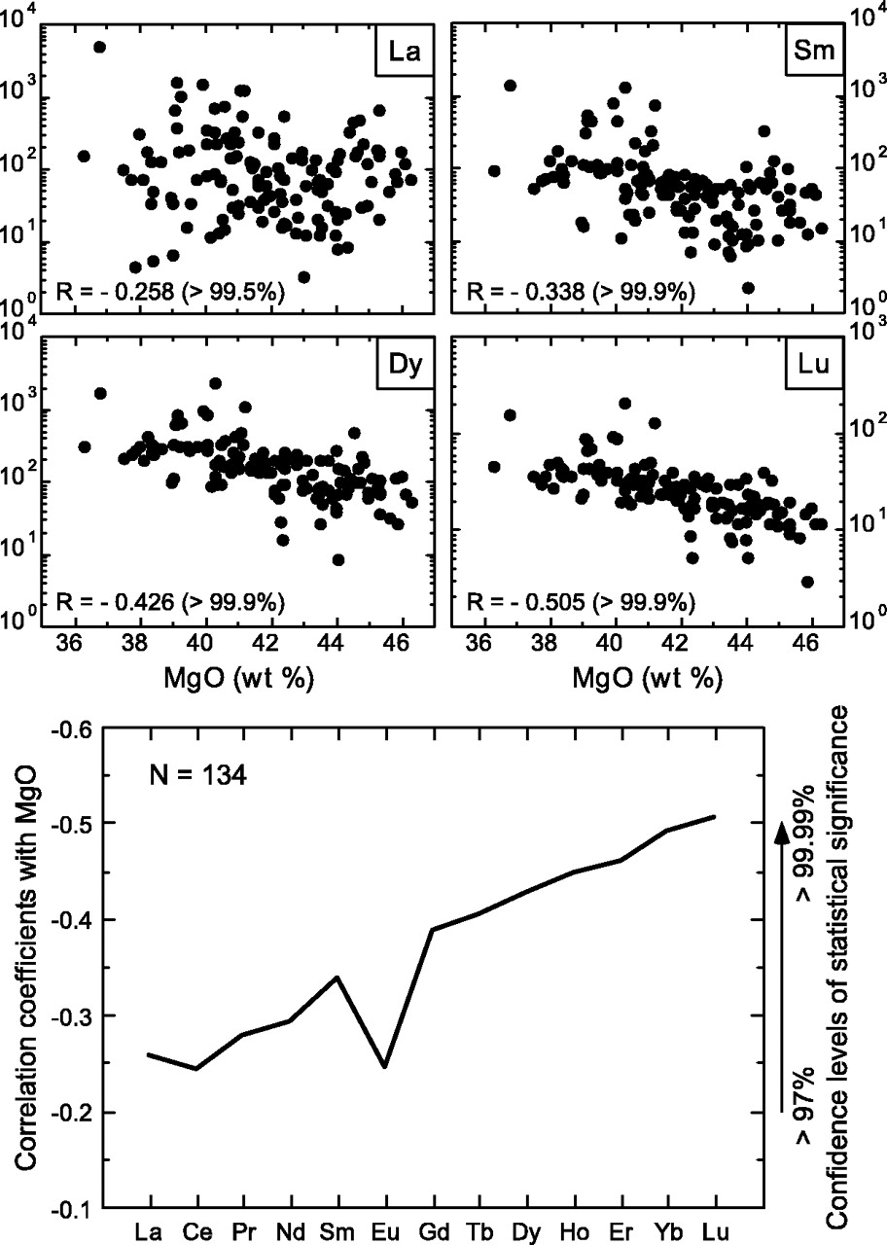
Fig. 11. The scattered yet statistically significant inverse correlations of REE with MgO are consistent with REE ...
Notes:
Fig. 11. The scattered yet statistically significant inverse correlations of REE with MgO are consistent with REE being incompatible during mantle melting and with the reasoning that MgO, despite its loss, still retains signatures of mantle melting. The better correlation of MgO with progressively heavier REE (except for Eu), suggests that the HREE tell us more faithfully about mantle melting (see Figs 6, 9 and 10) whereas LREE have experienced post-melting enrichments (Figs 7–9). The poor Eu–MgO correlation may be due to the mobility of Eu2+ during serpentinization or seafloor weathering.
Unless provided in the caption above, the following copyright applies to the content of this slide: Journal of Petrology 45(12) © Oxford University Press 2004; all rights reserved

Slide 11
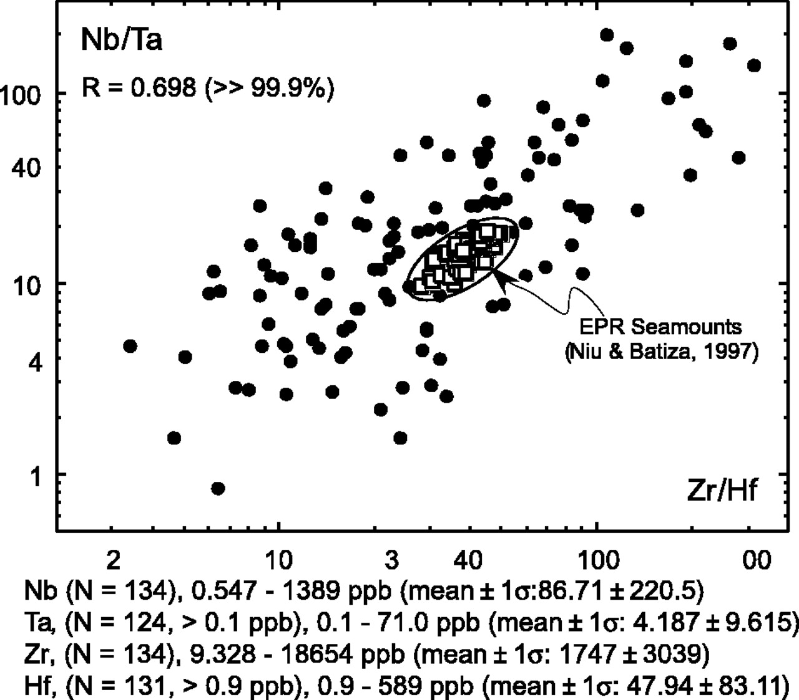
Fig. 12. Scattered, yet statistically significant (R = 0·698 for N = 131), correlation between Zr/Hf and Nb/Ta ratios ...
Notes:
Fig. 12. Scattered, yet statistically significant (R = 0·698 for N = 131), correlation between Zr/Hf and Nb/Ta ratios of abyssal peridotites and near East Pacific Rise (EPR) seamounts (open squares). The chondritic ratios of Nb/Ta = 17·57 and Zr/Hf = 36·30 (Sun & McDonough, 1989) lie within the ellipse defined by the EPR seamount data.
Unless provided in the caption above, the following copyright applies to the content of this slide: Journal of Petrology 45(12) © Oxford University Press 2004; all rights reserved

Slide 12
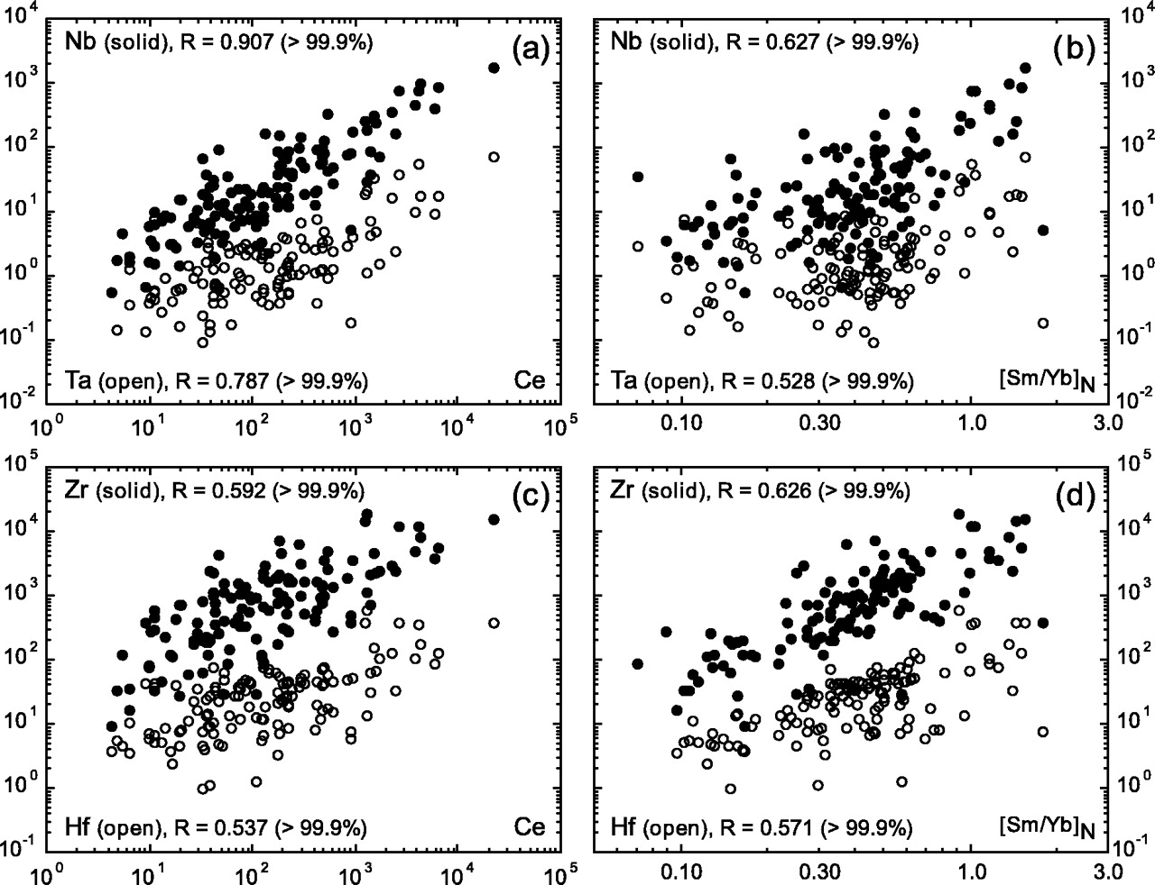
Fig. 13. The scattered yet statistically significant correlations of Nb, Ta, Zr and Hf with Ce and [Sm/Yb]_{N} ...
Notes:
Fig. 13. The scattered yet statistically significant correlations of Nb, Ta, Zr and Hf with Ce and [Sm/Yb]N indicate that these analytically ‘difficult’ HFSE and analytically ‘easy’ REE both are of good quality (also see Electronic Appendix 1 for details). Such correlations are best explained by magmatic processes.
Unless provided in the caption above, the following copyright applies to the content of this slide: Journal of Petrology 45(12) © Oxford University Press 2004; all rights reserved

Slide 13
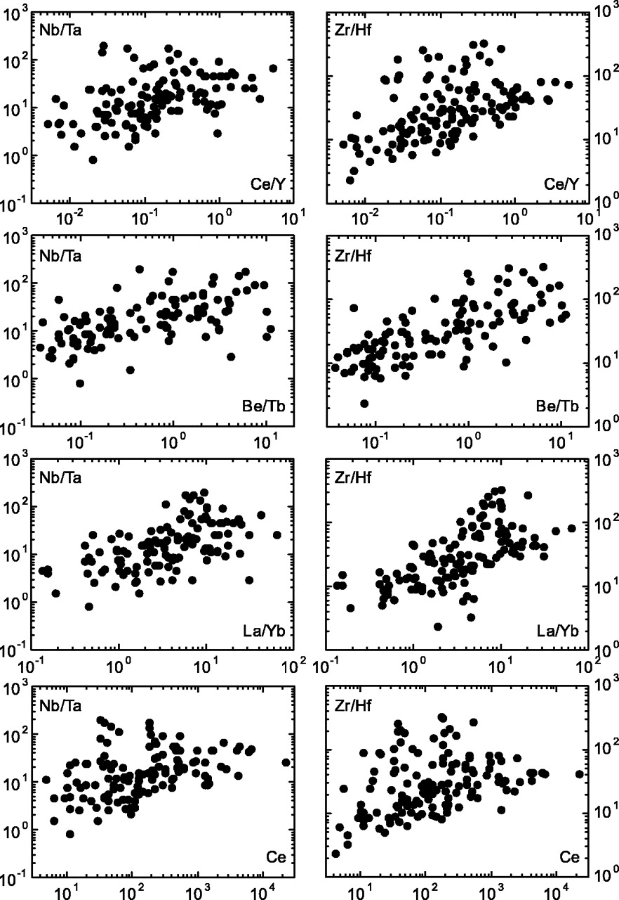
Fig. 14. The scattered yet correlated trends of Nb/Ta and Zr/Hf with Ce and ratios of more incompatible elements over ...
Notes:
Fig. 14. The scattered yet correlated trends of Nb/Ta and Zr/Hf with Ce and ratios of more incompatible elements over less incompatible elements (Ce vs Y, Be vs Tb, La vs Yb) are not only consistent with the notion that Zr is more incompatible than Hf and Nb is more incompatible than Ta, but also suggest that Nb–Ta and Zr–Hf fractionations are caused by magmatic processes.
Unless provided in the caption above, the following copyright applies to the content of this slide: Journal of Petrology 45(12) © Oxford University Press 2004; all rights reserved

Slide 14
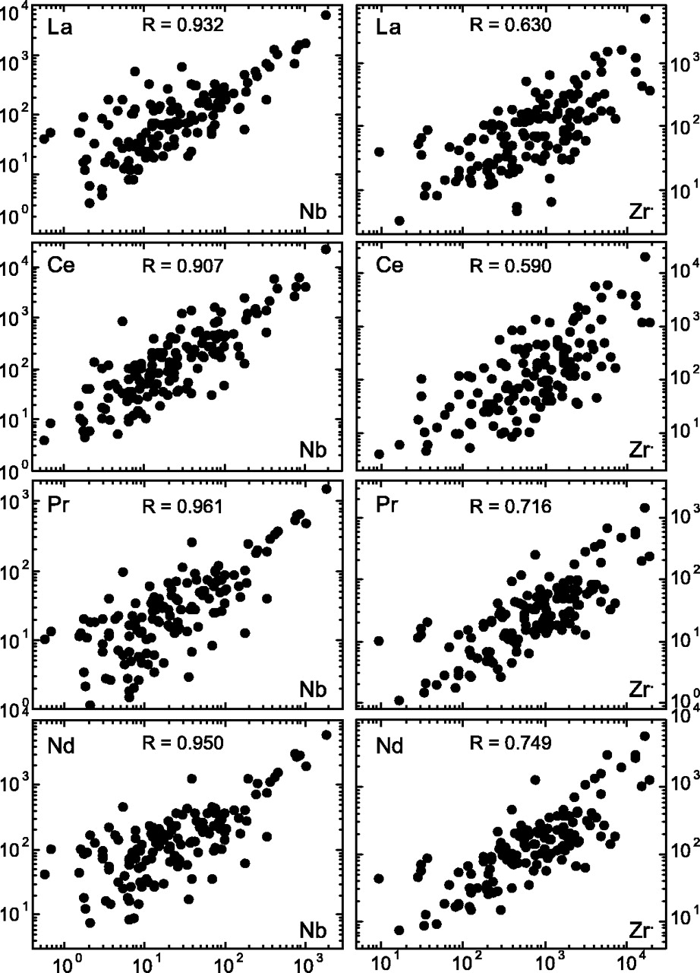
Fig. 8. The statistically significant correlations of LREE (e.g. La, Ce, Pr and Nd) with HFSE (e.g. Nb and Zr) ...
Notes:
Fig. 8. The statistically significant correlations of LREE (e.g. La, Ce, Pr and Nd) with HFSE (e.g. Nb and Zr) indicate that the process or processes that led to REE enrichments also caused the HFSE enrichments.
Unless provided in the caption above, the following copyright applies to the content of this slide: Journal of Petrology 45(12) © Oxford University Press 2004; all rights reserved

Slide 15
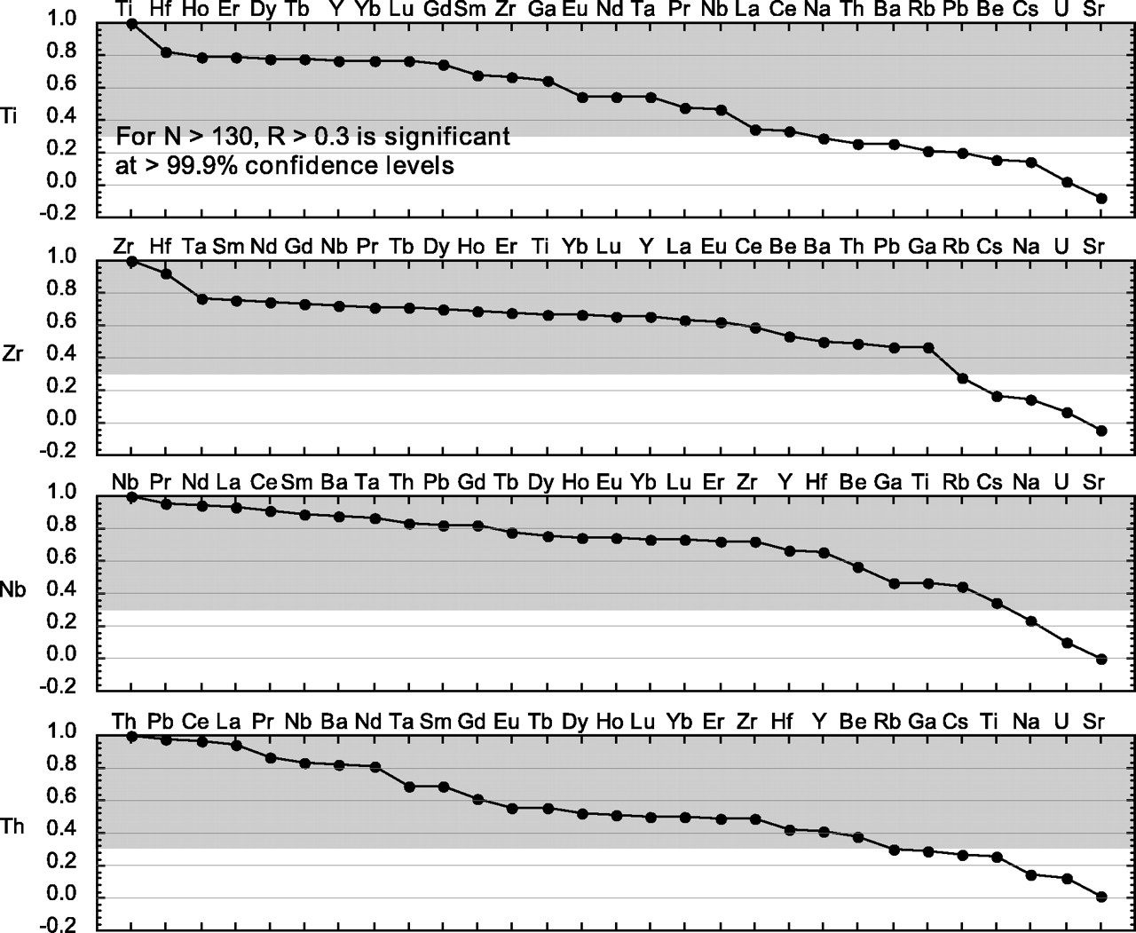
Fig. 15. Plots of correlation coefficients of the relatively immobile incompatible elements Ti, Zr, Nb and Th with all ...
Notes:
Fig. 15. Plots of correlation coefficients of the relatively immobile incompatible elements Ti, Zr, Nb and Th with all other incompatible elements. The significant correlations (R > 0·3) would suggest that the elements of interest are immobile during serpentinization or seafloor weathering. The degrees of correlation also depend on similarity of incompatibility, i.e. similarity in magmatic behavior. For example, RZr–Hf is significantly better than RZr–Ti and RZr–Nb.
Unless provided in the caption above, the following copyright applies to the content of this slide: Journal of Petrology 45(12) © Oxford University Press 2004; all rights reserved

Slide 16
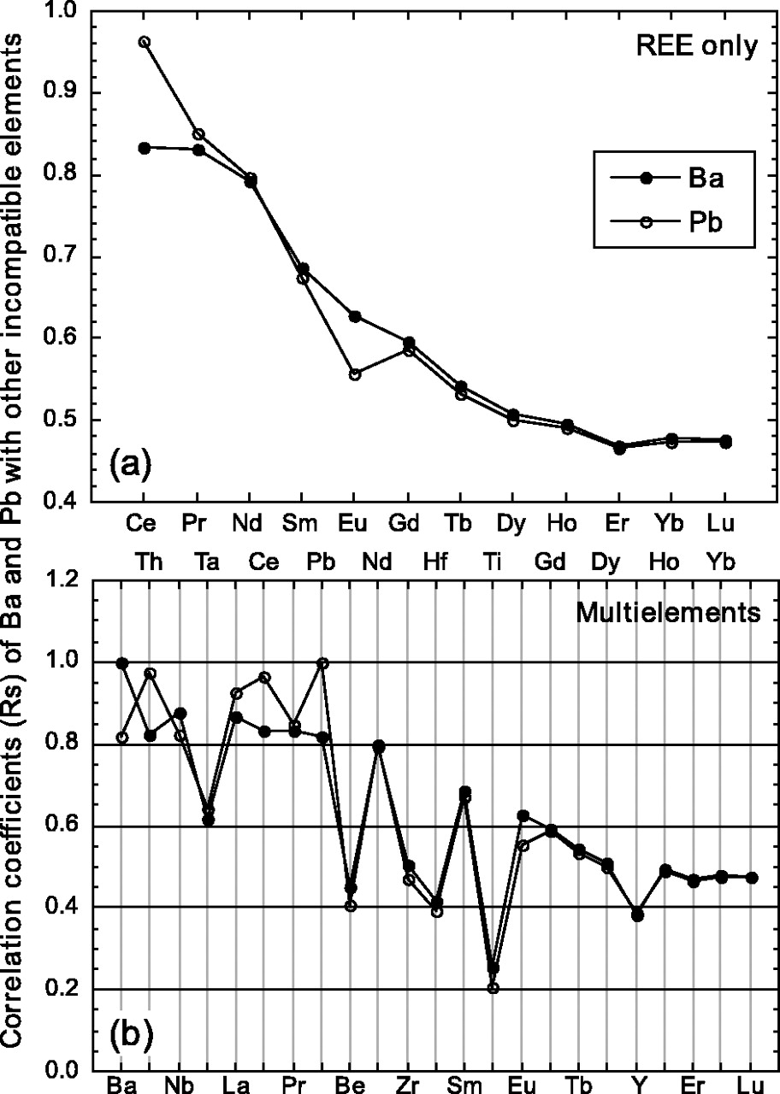
Fig. 16. Correlation coefficients of Ba and Pb with REE (a) and other incompatible elements (b). The significant ...
Notes:
Fig. 16. Correlation coefficients of Ba and Pb with REE (a) and other incompatible elements (b). The significant correlations of Ba and Pb with LREE, Th, Nb, etc. suggest that Ba and Pb are not mobile during serpentinization or seafloor weathering.
Unless provided in the caption above, the following copyright applies to the content of this slide: Journal of Petrology 45(12) © Oxford University Press 2004; all rights reserved

Slide 17
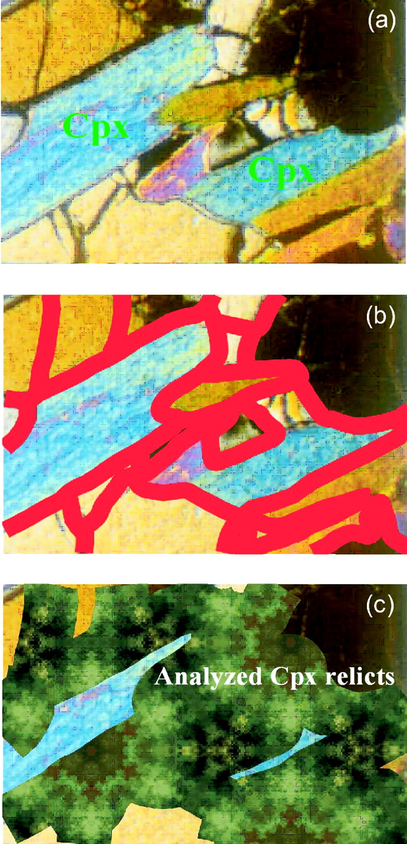
Fig. 17. A conceptual illustration that post-melting magmatic refertilization affects only rims, not ‘cores’, of ...
Notes:
Fig. 17. A conceptual illustration that post-melting magmatic refertilization affects only rims, not ‘cores’, of residual cpx. The rims are subsequently serpentinized. The analyzed ‘cores’, which survived serpentinization, thus show no effect of post-melting refertilization. (a) Fresh peridotite in the thermal boundary layer (Fig. 1). (b) Melt percolating along grain boundaries and cracks. (c) Serpentinization extends from grain boundaries and cracks; only cpx relicts are analyzed, thus showing no evidence for melt refertilization.
Unless provided in the caption above, the following copyright applies to the content of this slide: Journal of Petrology 45(12) © Oxford University Press 2004; all rights reserved

Slide 18
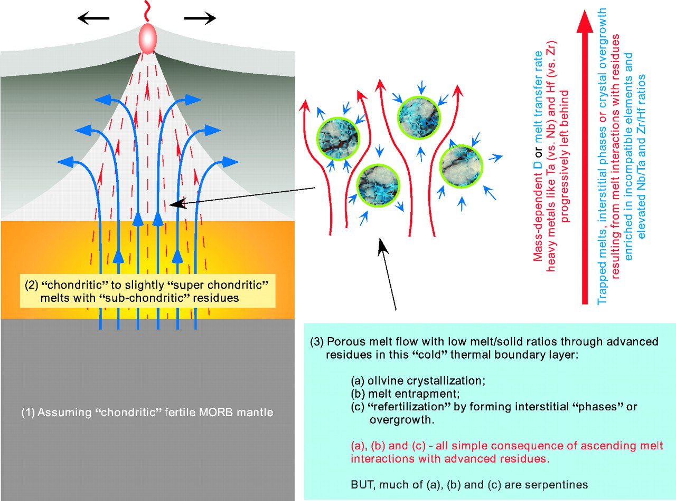
Fig. 18. Illustration of the hypothesis that the large Zr–Hf and Nb–Ta fractionations in abyssal peridotites may have ...
Notes:
Fig. 18. Illustration of the hypothesis that the large Zr–Hf and Nb–Ta fractionations in abyssal peridotites may have resulted from ascending–percolating melt interaction with the advanced residues in the thermal boundary layer beneath mid-ocean ridges (also see Fig. 1). The process may be very similar to the chromatographic process (Navon & Stolper, 1987), but mass-dependent elemental fractionation may be significant.
Unless provided in the caption above, the following copyright applies to the content of this slide: Journal of Petrology 45(12) © Oxford University Press 2004; all rights reserved

Slide 19
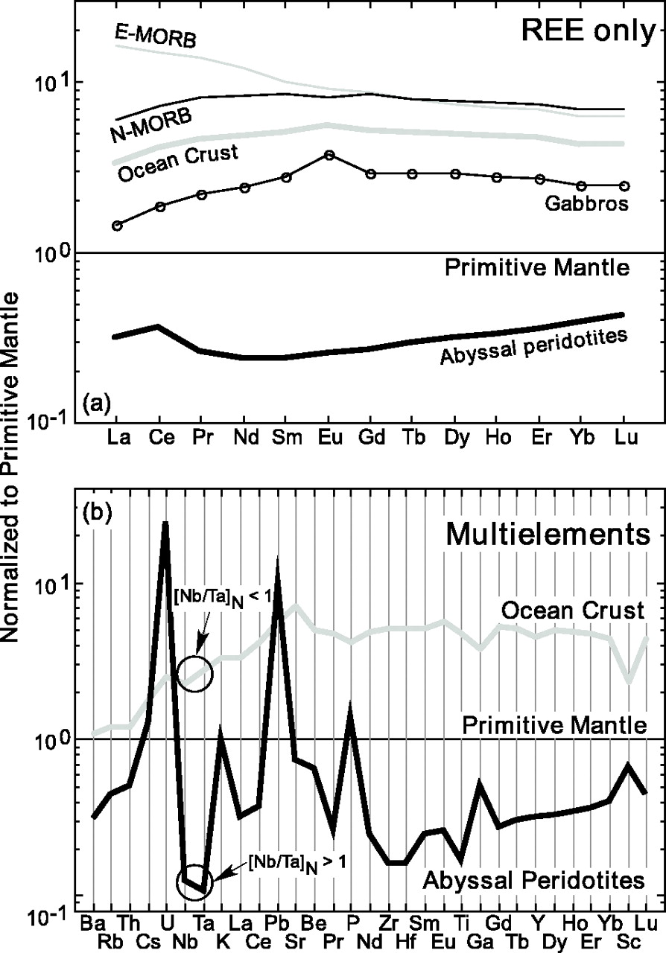
Fig. 19. Comparison of global average of abyssal peridotites with average depleted normal MORB (N-MORB), enriched MORB ...
Notes:
Fig. 19. Comparison of global average of abyssal peridotites with average depleted normal MORB (N-MORB), enriched MORB (E-MORB), oceanic gabbros and model ocean crust (Niu & O'Hara, 2003) in terms of REE (a) and other incompatible elements (b) on primitive mantle (Sun & McDonough, 1989; McDonough & Sun, 1995) normalized plots. The higher than expected abundances of more incompatible elements to the left should be noted; these support the suggestion that abyssal peridotites are not simple melting residues. Mobile elements such as Rb, Cs, U, K and Sr (see Fig. 15) may be added during serpentinization or seafloor weathering, but Ba, Th, Nb, Ta, Pb and LREE are enriched by post-melting magmatic processes. The subchondritic Nb/Ta ratio of model ocean crust and super-chondritic Nb/Ta ratio in average abyssal peridotites should also be noted.
Unless provided in the caption above, the following copyright applies to the content of this slide: Journal of Petrology 45(12) © Oxford University Press 2004; all rights reserved

Slide 20
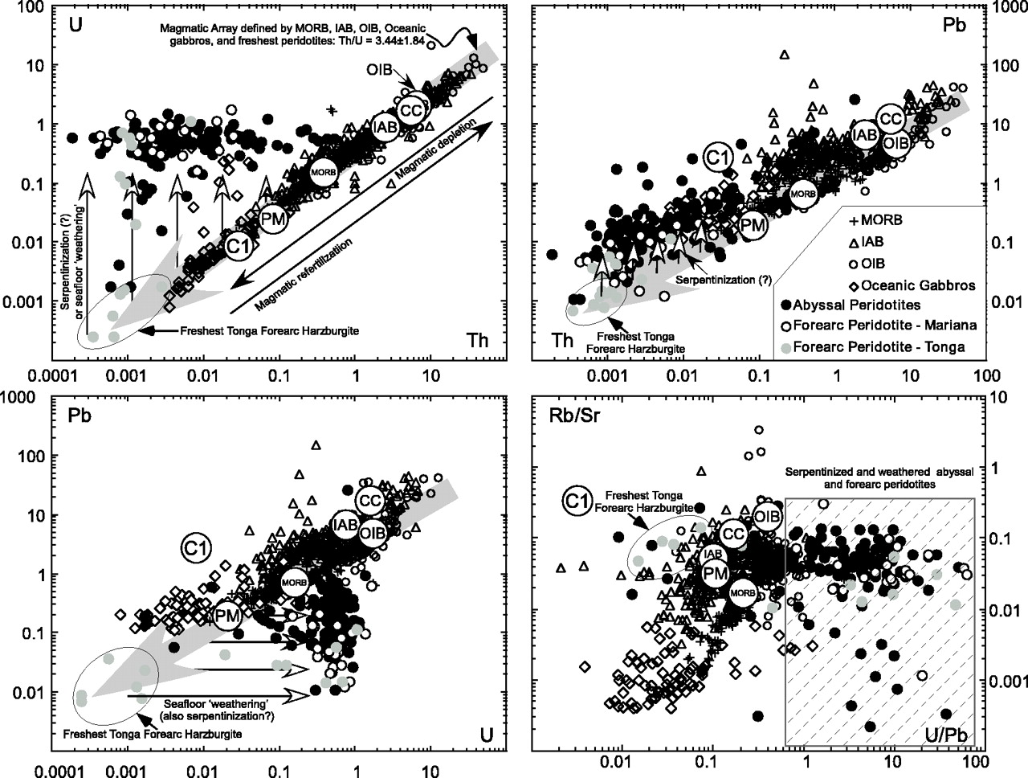
Fig. 20. Comparisons of abyssal peridotites with MORB, IAB (island arc basalts), OIB (ocean island basalts), oceanic ...
Notes:
Fig. 20. Comparisons of abyssal peridotites with MORB, IAB (island arc basalts), OIB (ocean island basalts), oceanic gabbros, serpentinized Mariana forearc peridotites and both extremely fresh and serpentinized Tonga forearc peridotites in U–Th, Pb–Th, Pb–U and Rb/Sr–U/Pb spaces. Data sources: MORB, Niu et al. (1999, 2001, 2002a) and Regelous et al. (1999); IAB, Ewart et al. (1998) and Y. Niu (unpublished data, 2004) from Mariana and Tonga; OIB, M. Regelous (compiled data, 2002); oceanic gabbros, Bach et al. (2001), Niu et al. (2002b), Niu & O'Hara (2003) and Y. Niu (unpublished data, 2004); Mariana and Tonga forearc peridotites, Y. Niu (unpublished data, 2004). Open circles with letters are respective averages. Average OIB, PM and C1 values are from Sun & McDonough (1989), and CC (bulk continental crust) from Rudnick & Fountain (1995). Among all these elements, U, Rb and Sr are shown to be mobile (Fig. 15), and all have been added to the expected melting residues. In particular, the fresh unserpentinized Tonga forearc peridotites plot at the most depleted end of the magmatic U–Th array, yet serpentinized and weathered abyssal and forearc peridotites are highly enriched in U, leading to elevated U/Pb ratios. Of all the lithologies considered, serpentinized and weathered abyssal peridotites (also forearc peridotites) have the highest U/Pb.
Unless provided in the caption above, the following copyright applies to the content of this slide: Journal of Petrology 45(12) © Oxford University Press 2004; all rights reserved

