Slide 1
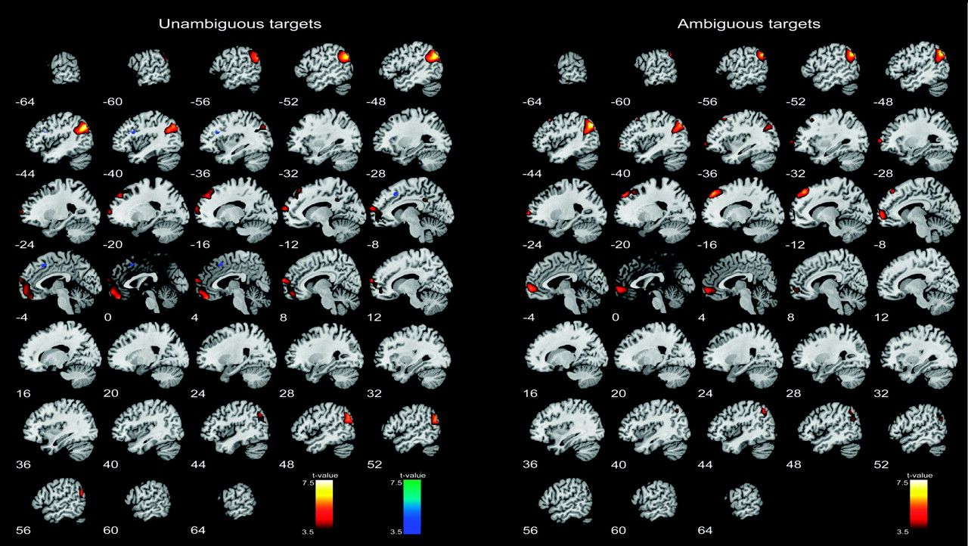
Figure 1. Results of the regression analysis for unambiguous and ambiguous trials. Brain activation increases (red) and ...
Notes:
Figure 1. Results of the regression analysis for unambiguous and ambiguous trials. Brain activation increases (red) and decreases (blue) with the number of related primes preceding the target. Activation is corrected for multiple comparisons at P < 0.05 with a cluster extent of 12 voxels.
Unless provided in the caption above, the following copyright applies to the content of this slide: © The Author 2009. Published by Oxford University Press. All rights reserved. For permissions, please e-mail: journals.permissions@oxfordjournals.org

Slide 2
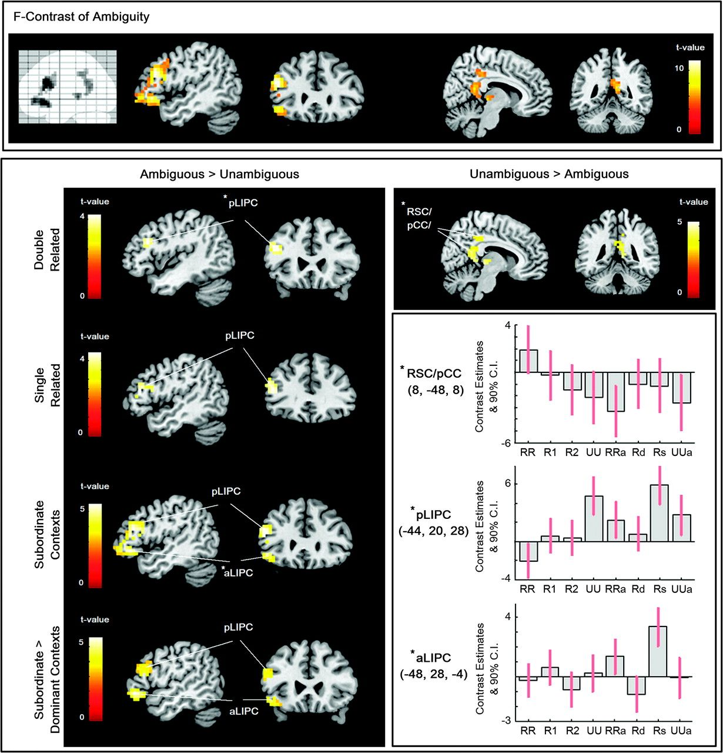
Figure 2. Top panel: Brain activation reflecting the main effect of ambiguity. Peak activation of the inferior frontal ...
Notes:
Figure 2. Top panel: Brain activation reflecting the main effect of ambiguity. Peak activation of the inferior frontal and medial parietal cluster is displayed on coronal and sagittal slices of the Anatomy toolbox template. Bottom panel: Comparisons between ambiguous and unambiguous trials across relatedness condition. Left: Stronger LIPC activation was observed for ambiguous compared with unambiguous trials in the double related (RRa > RR) and single related condition ([Rd + Rs] > [R1 + R2]), in single related trials addressing the subordinate meaning compared with unambiguous single related trials (Rs > R2) and compared with trials addressing the dominant meaning ([Rs > R2] > [Rd > R1]). Right: Stronger activation was observed for unambiguous compared with ambiguous trials in the double related condition only (RR > RRa). Contrasts with no differential activation are not shown. Coronal and sagittal slices display peak activation. Contrast estimates are provided for regions marked by an asterisk. R, related; U, unrelated; a, ambiguous; Rd/Rs, trials addressing the dominant/subordinate meaning of the homonym. All differential contrasts are masked by the main effect of ambiguity at P < 0.001 (uncorrected). Activation is corrected for multiple comparisons at P < 0.05 with a cluster extent of 12 voxels.
Unless provided in the caption above, the following copyright applies to the content of this slide: © The Author 2009. Published by Oxford University Press. All rights reserved. For permissions, please e-mail: journals.permissions@oxfordjournals.org

Slide 3
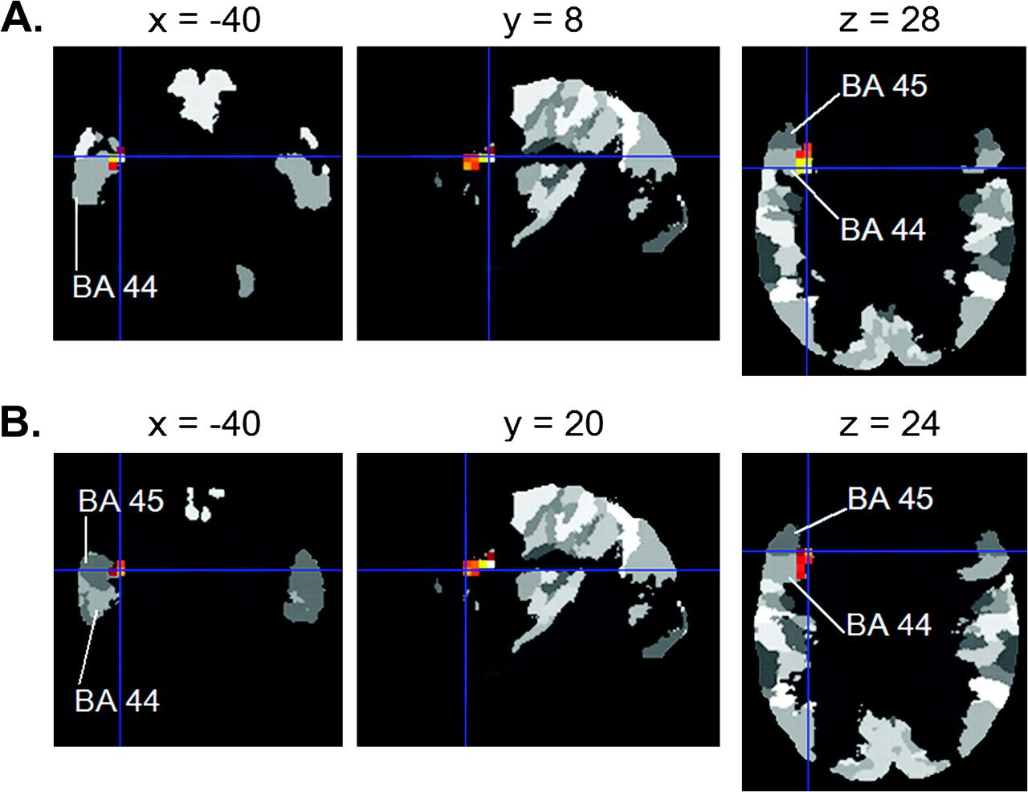
Figure 3. Brain activation common to the regression analysis with the number of related primes as a negative regressor ...
Notes:
Figure 3. Brain activation common to the regression analysis with the number of related primes as a negative regressor and the differential contrast comparing subordinate ambiguous trials (Rs) to the respective single related unambiguous trials (R2). (A) Peak activation and (B) activation at the local maxima are superimposed onto the cytoarchitectonic probability maps from the Anatomy toolbox. Activation is corrected for multiple comparisons at P < 0.05 with a cluster extent of 12 voxels.
Unless provided in the caption above, the following copyright applies to the content of this slide: © The Author 2009. Published by Oxford University Press. All rights reserved. For permissions, please e-mail: journals.permissions@oxfordjournals.org

