Slide 1
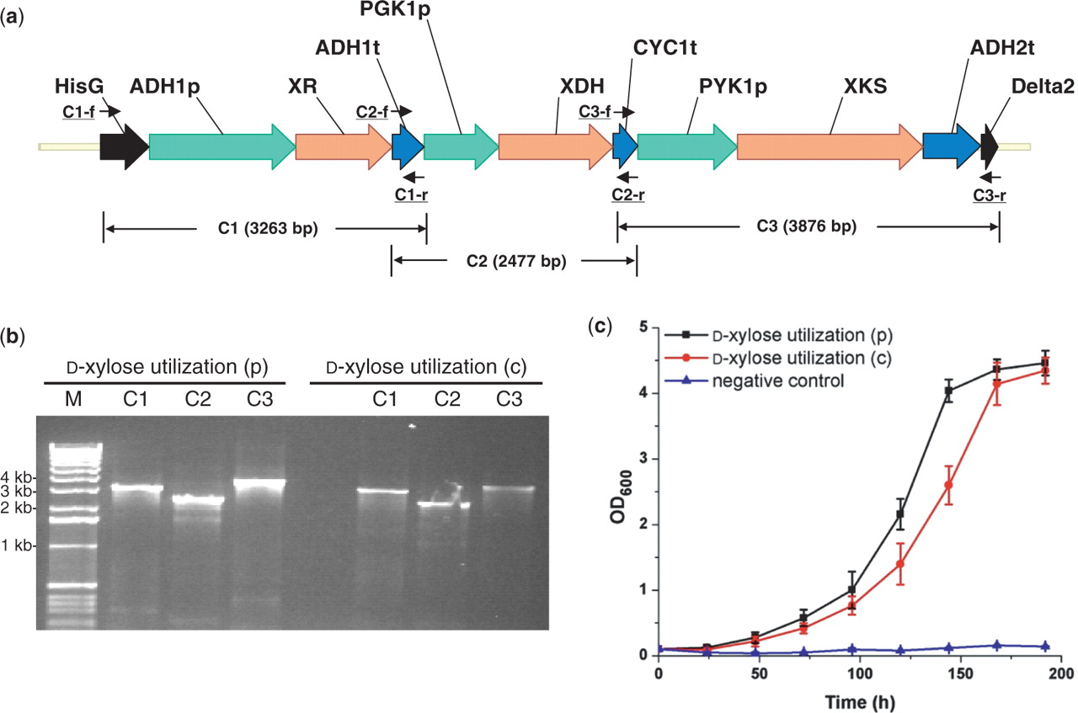
Figure 1. Construction of the d -xylose utilization pathway in Saccharomyces cerevisiae . ( a ) The assembled d ...
Notes:
Figure 1. Construction of the d -xylose utilization pathway in Saccharomyces cerevisiae . ( a ) The assembled d -xylose utilization pathway with its corresponding verification primers; ( b ) PCR analysis of the assembled d -xylose utilization pathway on a plasmid [ d -xylose utilization (p), using pRS426m as a backbone] and on a chromosome [ d -xylose utilization (c), integrated to the δ site(s)]. M represents 1 kb DNA ladder from Invitrogen; ( c ) Growth of S. cerevisiae strains carrying d- xylose utilization pathway using d -xylose as the sole carbon source. Cells carrying the empty vector pRS426 were used as the negative control.
Unless provided in the caption above, the following copyright applies to the content of this slide: © 2008 The Author(s)This is an Open Access article distributed under the terms of the Creative Commons Attribution Non-Commercial License (http://creativecommons.org/licenses/by-nc/2.0/uk/) which permits unrestricted non-commercial use, distribution, and reproduction in any medium, provided the original work is properly cited.

Slide 2
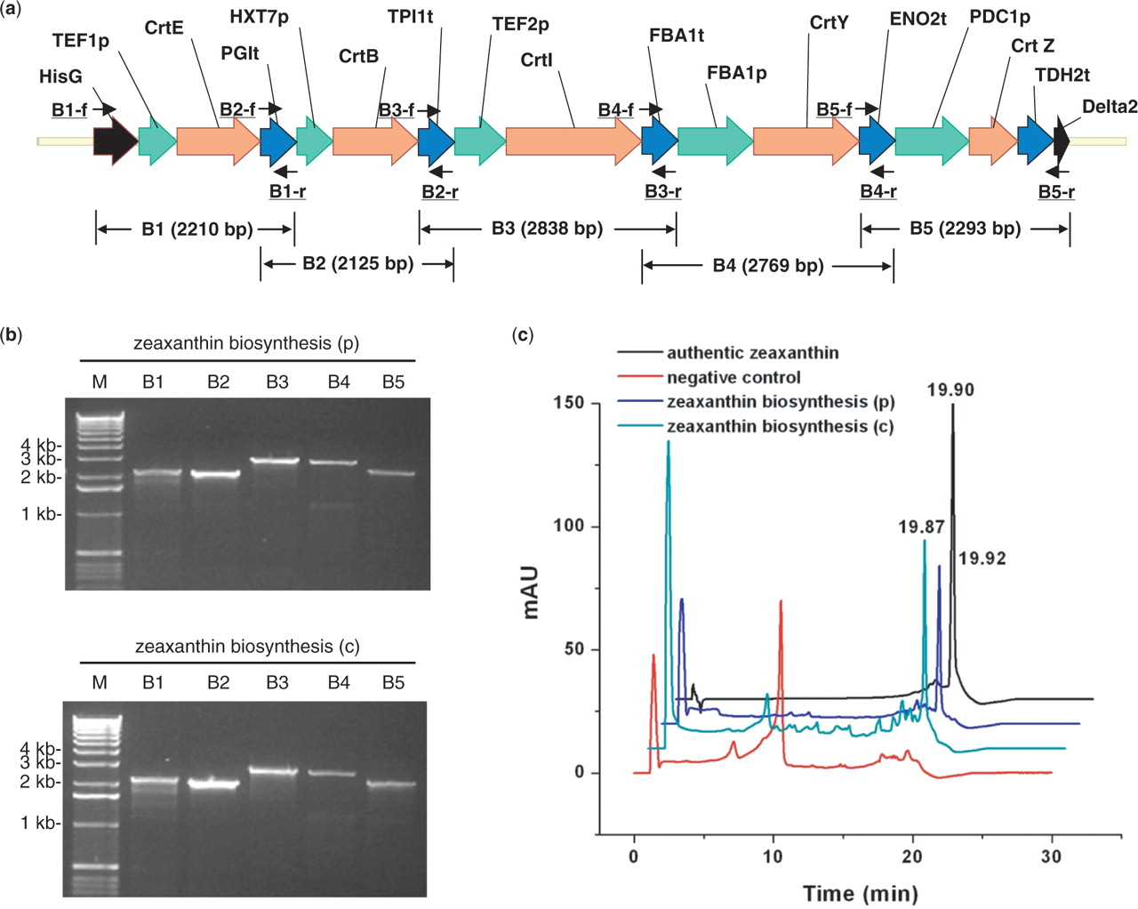
Figure 2. Construction of the zeaxanthin biosynthesis pathway in Saccharomyces cerevisiae . ( a ) The assembled ...
Notes:
Figure 2. Construction of the zeaxanthin biosynthesis pathway in Saccharomyces cerevisiae . ( a ) The assembled zeaxanthin biosynthesis pathway with its corresponding verification primers; ( b ) PCR analysis of the assembled zeaxanthin biosynthesis pathway on a plasmid [zeaxanthin biosynthesis (p), using pRS426m as a backbone] and on a chromosome [zeaxanthin biosynthesis (c), integrated to the δ site(s)]. M represents 1 kb DNA ladder from Invitrogen; ( c ) HPLC analysis of the cell extracts from S. cerevisiae carrying the zeaxanthin biosynthesis pathway. Cells carrying the empty vector pRS426 were used as the negative control.
Unless provided in the caption above, the following copyright applies to the content of this slide: © 2008 The Author(s)This is an Open Access article distributed under the terms of the Creative Commons Attribution Non-Commercial License (http://creativecommons.org/licenses/by-nc/2.0/uk/) which permits unrestricted non-commercial use, distribution, and reproduction in any medium, provided the original work is properly cited.

Slide 3
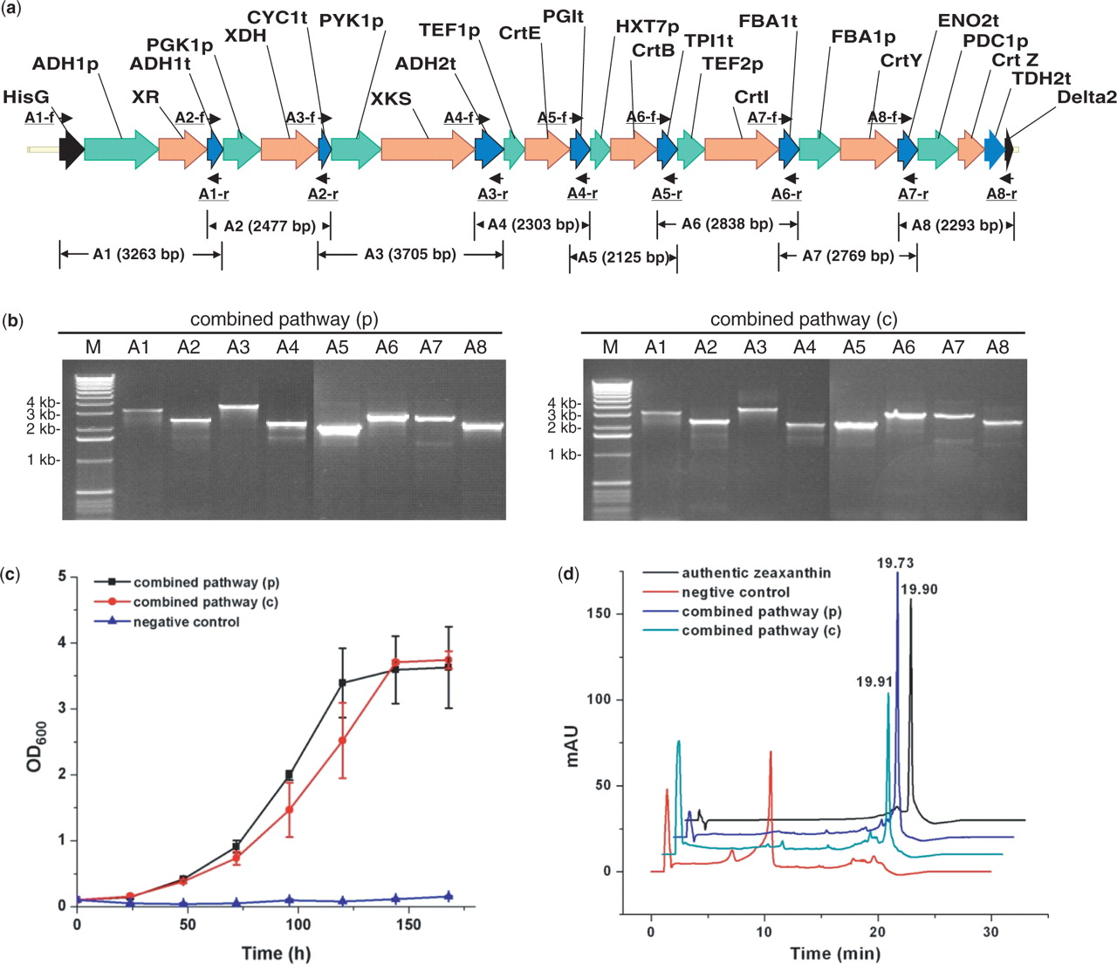
Figure 3. Construction of the combined d -xylose utilization and zeaxanthin biosynthesis pathway in Saccharomyces ...
Notes:
Figure 3. Construction of the combined d -xylose utilization and zeaxanthin biosynthesis pathway in Saccharomyces cerevisiae . ( a ) The assembled combined d -xylose utilization and zeaxanthin biosynthesis pathway with its corresponding verification primers; ( b ) PCR analysis of the assembled combined d -xylose utilization and zeaxanthin biosynthesis pathway on a plasmid [combined pathway (p), using pRS426m as a backbone] and on a chromosome [combined pathway (c), integrated to the δ site(s)]. M represents 1 kb DNA ladder from Invitrogen; ( c ) Growth of S. cerevisiae strains carrying the combined pathway using d -xylose as the sole carbon source; ( d ) HPLC analysis of the cell extracts from S. cerevisiae carrying the combined pathway. Cells carrying the empty vector pRS426 were used as the negative control.
Unless provided in the caption above, the following copyright applies to the content of this slide: © 2008 The Author(s)This is an Open Access article distributed under the terms of the Creative Commons Attribution Non-Commercial License (http://creativecommons.org/licenses/by-nc/2.0/uk/) which permits unrestricted non-commercial use, distribution, and reproduction in any medium, provided the original work is properly cited.

Slide 4
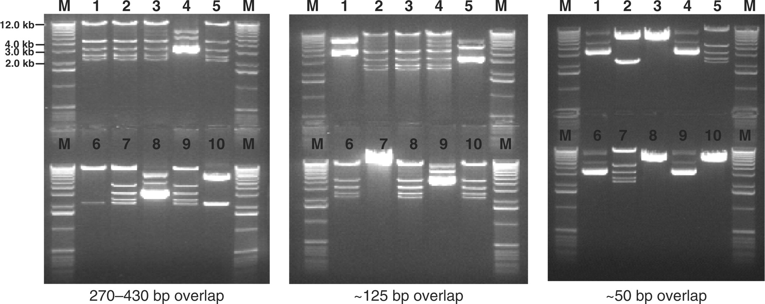
Figure 4. Physical characterization of the recombinant clones using pRS416m as a backbone through restriction ...
Notes:
Figure 4. Physical characterization of the recombinant clones using pRS416m as a backbone through restriction digestion. Plasmids corresponding to the clones from the eight-gene pathway with ∼50 bp, ∼125 bp and 270–430 bp overlaps were digested by BamHI and EcoRI . The correct clones should exhibit five bands with sizes of 2233, 2551, 3218, 4454 and 11 386 bp.
Unless provided in the caption above, the following copyright applies to the content of this slide: © 2008 The Author(s)This is an Open Access article distributed under the terms of the Creative Commons Attribution Non-Commercial License (http://creativecommons.org/licenses/by-nc/2.0/uk/) which permits unrestricted non-commercial use, distribution, and reproduction in any medium, provided the original work is properly cited.

Slide 5
Scheme 1. A one-step method for assembly and integration of a biochemical pathway using in vivo homologous ...
Notes:
Scheme 1. A one-step method for assembly and integration of a biochemical pathway using in vivo homologous recombination in S. cerevisiae . ( a ) One-step assembly into a vector. ( b ) One-step integration to a δ site on a S. cerevisia e chromosome. n represents the number of DNA fragments.
Unless provided in the caption above, the following copyright applies to the content of this slide: © 2008 The Author(s)This is an Open Access article distributed under the terms of the Creative Commons Attribution Non-Commercial License (http://creativecommons.org/licenses/by-nc/2.0/uk/) which permits unrestricted non-commercial use, distribution, and reproduction in any medium, provided the original work is properly cited.

