Slide 1
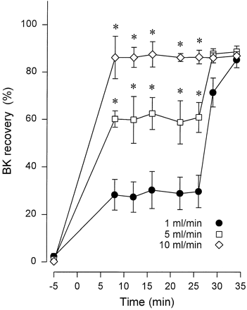
Fig. 1 Recovery (in %) of infused bradykinin (BK) into the aortic flow line of isolated rat hearts perfused at ...
Notes:
Fig. 1 Recovery (in %) of infused bradykinin (BK) into the aortic flow line of isolated rat hearts perfused at either 1 (closed circles, n=5), 5 (open squares, n=3), or 10 ml/min (open diamonds, n=3) as a function of time. The data points shown at −5 min represent the low endogenous concentrations of BK in the perfusate before the beginning of BK infusion, which started at 0 min. Perfusion rate was restored to 10 ml/min after 27 min in groups originally perfused at 5 or 1 ml/min. * p<0.05 compared with corresponding values in the group perfused at 1 ml/min.
Unless provided in the caption above, the following copyright applies to the content of this slide: Copyright © 1998, European Society of Cardiology

Slide 2
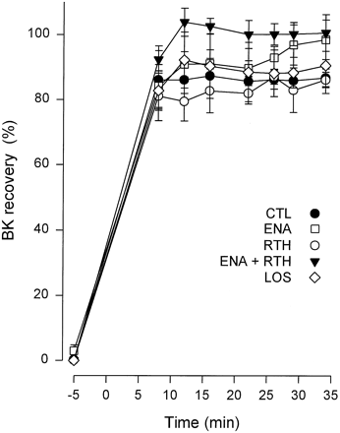
Fig. 4 Recovery (in %) of infused bradykinin (BK) into the aortic flow line of isolated rat hearts perfused at 10 ...
Notes:
Fig. 4 Recovery (in %) of infused bradykinin (BK) into the aortic flow line of isolated rat hearts perfused at 10 ml/min in absence (CTL, closed circles, n=3) or in presence of either enalaprilat (ENA, open squares, n=4), retrothiorphan (RTH, open circles, n=3), enalaprilat plus retrothiorphan (closed triangles, n=3), or losartan (LOS, open diamonds, n=5). The time-events described in the legend of Fig. 1 also apply to the present figure.
Unless provided in the caption above, the following copyright applies to the content of this slide: Copyright © 1998, European Society of Cardiology

Slide 3
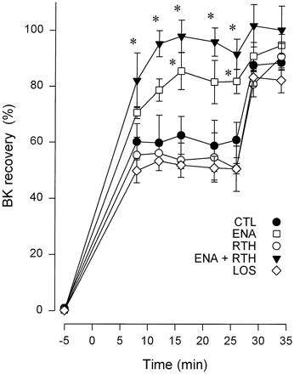
Fig. 3 Recovery (in %) of infused bradykinin (BK) into the aortic flow line of isolated rat hearts perfused at 5 ...
Notes:
Fig. 3 Recovery (in %) of infused bradykinin (BK) into the aortic flow line of isolated rat hearts perfused at 5 ml/min in absence (CTL, closed circles, n=3) or in presence of either enalaprilat (ENA, open squares, n=3), retrothiorphan (RTH, open circles, n=3), enalaprilat plus retrothiorphan (closed triangles, n=3), or losartan (LOS, open diamonds, n=5). The time-events described in the legend of Fig. 1 also apply to the present figure. * p<0.05 compared with corresponding values in the control group.
Unless provided in the caption above, the following copyright applies to the content of this slide: Copyright © 1998, European Society of Cardiology

Slide 4
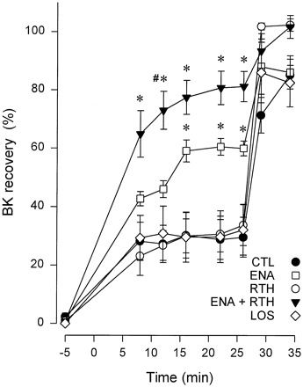
Fig. 2 Recovery (in %) of infused bradykinin (BK) into the aortic flow line of isolated rat hearts perfused at 1 ...
Notes:
Fig. 2 Recovery (in %) of infused bradykinin (BK) into the aortic flow line of isolated rat hearts perfused at 1 ml/min in absence (CTL, closed circles, n=5) or in presence of either enalaprilat (ENA, open squares, n=4), retrothiorphan (RTH, open circles, n=5), enalaprilat plus retrothiorphan (closed triangles, n=5), or losartan (LOS, open diamonds, n=5). The time-events described in the legend of Fig. 1 also apply to the present figure. * p<0.05 compared with corresponding values in the control group. # p<0.05 compared with corresponding values in the enalaprilat-treated group.
Unless provided in the caption above, the following copyright applies to the content of this slide: Copyright © 1998, European Society of Cardiology

Slide 5
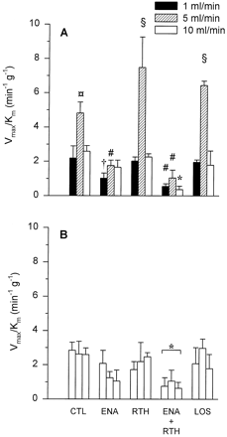
Fig. 5 Panel A shows the V_{max}/K_{m} ratio (min⁻¹ g⁻¹) for bradykinin in ...
Notes:
Fig. 5 Panel A shows the Vmax/Km ratio (min−1 g−1) for bradykinin in control hearts (CTL) and hearts treated with either enalaprilat (ENA), retrothiorphan (RTH), enalaprilat+retrothiorphan, and losartan (LOS), perfused at either 1 (black columns), 5 (hatched columns), or 10 ml/min (open columns). Panel B shows the Vmax/Km ratio in the corresponding groups after perfusion rate was restored to 10 ml/min. ⊗ p<0.05 compared with the corresponding hearts perfused at 1 ml/min; † p<0.05 compared with RTH and LOS; # p<0.05 compared with CTL, RTH, and LOS; § p<0.05 compared with the corresponding hearts perfused at 1 and 10 ml/min; * p<0.05 compared with CTL.
Unless provided in the caption above, the following copyright applies to the content of this slide: Copyright © 1998, European Society of Cardiology

Slide 6
Fig. 6 Panel A shows retention time for standard peptide: BK_{(5–9)} (1), 28 min; BK_{(4–9)} (2), 32 ...
Notes:
Fig. 6 Panel A shows retention time for standard peptide: BK(5–9) (1), 28 min; BK(4–9) (2), 32 min; BK(3–9) (3), 35 min; BK(2–9) (4), 36 min and BK (5), 41 min. Panels B, C and D represent the profiles of immunoreactivity after reverse-phase HPLC separation of BK and amino-terminal truncated metabolites generated after a single passage through the coronary bed without treatment (panel B), with enalaprilat (panel C), and with enalaprilat and retrothiorphan (panel D).
Unless provided in the caption above, the following copyright applies to the content of this slide: Copyright © 1998, European Society of Cardiology

