Slide 1
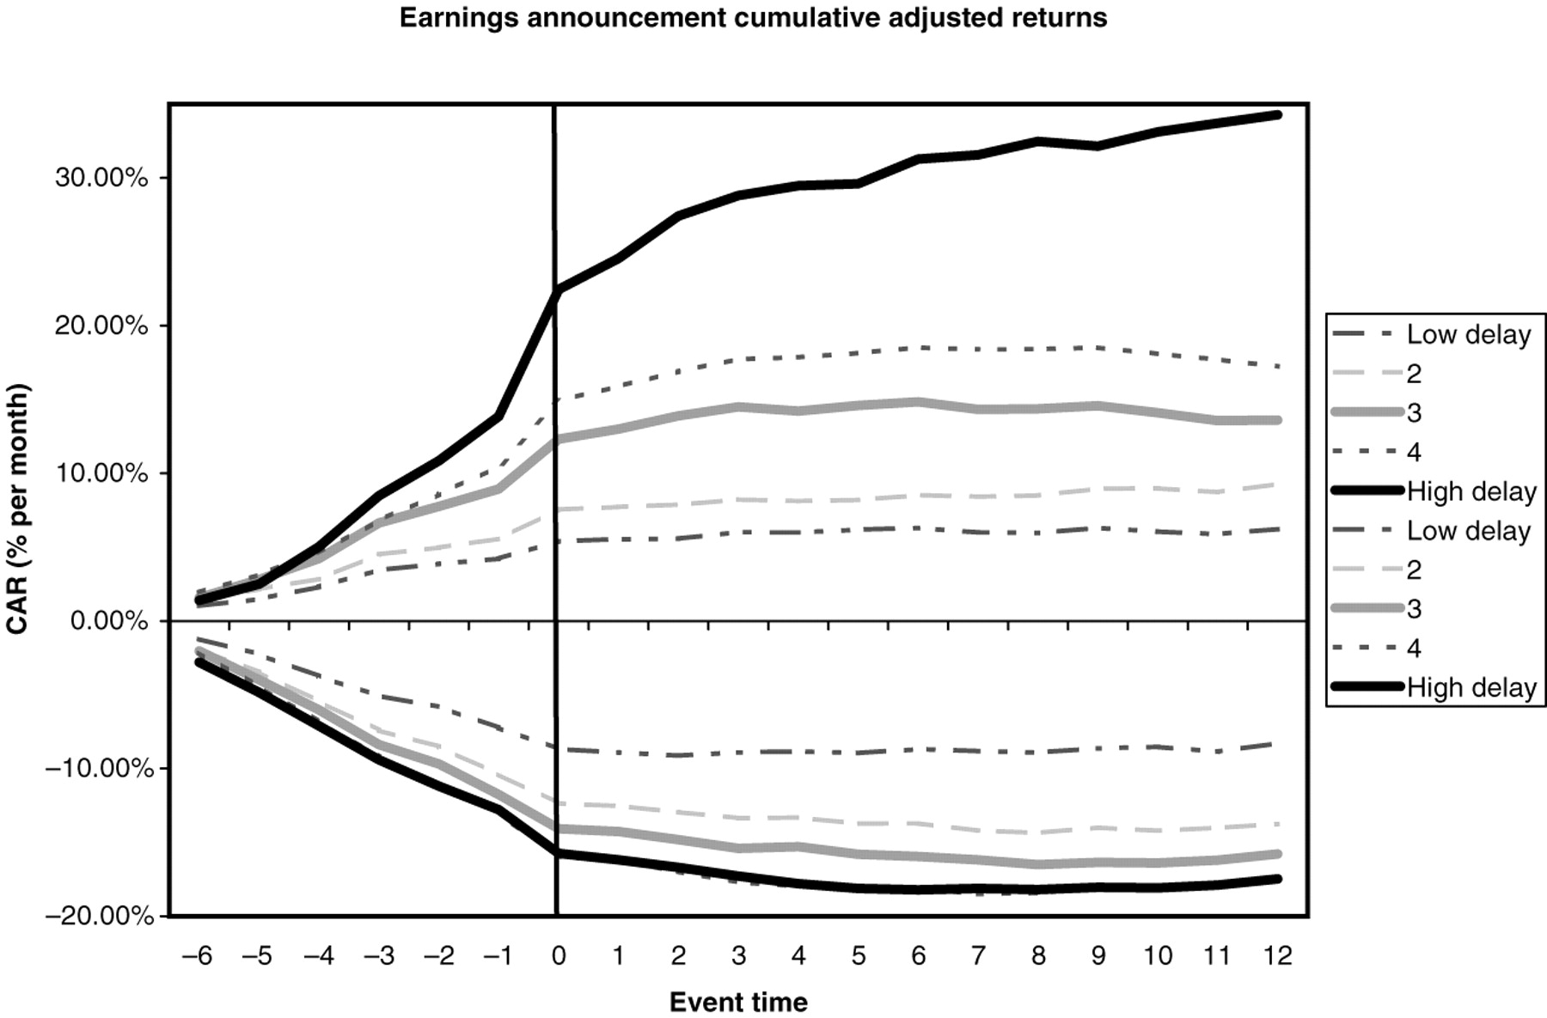
Figure 1 Post-earnings announcement drift across delay quintiles Adjusted returns [benchmarking against a ...
Notes:
Figure 1 Post-earnings announcement drift across delay quintiles Adjusted returns [benchmarking against a value-weighted portfolio of firms matched by size, book-to-market equity (BE/ME), and past one-year returns] following earnings surprises are reported and plotted. Earnings news is measured by standardized unexpected earnings (SUE), which is the difference between current quarter’s earnings and earnings four quarters prior divided by the standard deviation of unexpected earnings over the past eight quarters. Firms are sorted independently into quintiles based on their delay measure $(D1)$ and on SUE. The cumulative adjusted return (CAR) on the portfolio of firms in the top and bottom quintiles of SUE intersected with each delay quintile are plotted monthly from 6 months before the event to 12 months after for each delay quintile group. In addition, the average monthly adjusted return over the six months following each event is reported along with its $t$-statistic (in parentheses) using the event study approach of Jaffe (1974) and Mandelker (1974) as suggested by Fama (1998). For each calendar month $t,$ the value-weighted average abnormal return on all firms having an earnings announcement in calendar month $t - k,$ for $k = [- 6,12]$ is computed for each calendar month $t$ and averaged across time. An $F$-statistic on the joint equality of means across delay quintiles is also reported ($p$-value in parentheses). Calendar time portfolio returnsAverage-adjusted returns (% per month) over the 6 months following the eventEarnings surpriseLow delay234High delay$F$-statistic of equal mean ($p$-value)Positive0.07 (1.15)0.22 (1.67)0.38 (4.34)0.54 (5.22)1.10 (6.34)9.41 (0.0001)Negative0.04 (0.57)−0.23 (−2.51)−0.40 (−4.41)−0.41 (−4.18)−0.48 (−5.01)3.60 (0.0062)
Unless provided in the caption above, the following copyright applies to the content of this slide: © The Author 2005. Published by Oxford University Press. All rights reserved. For Permissions, please email: journals.permissions@oupjournals.org

