Slide 1
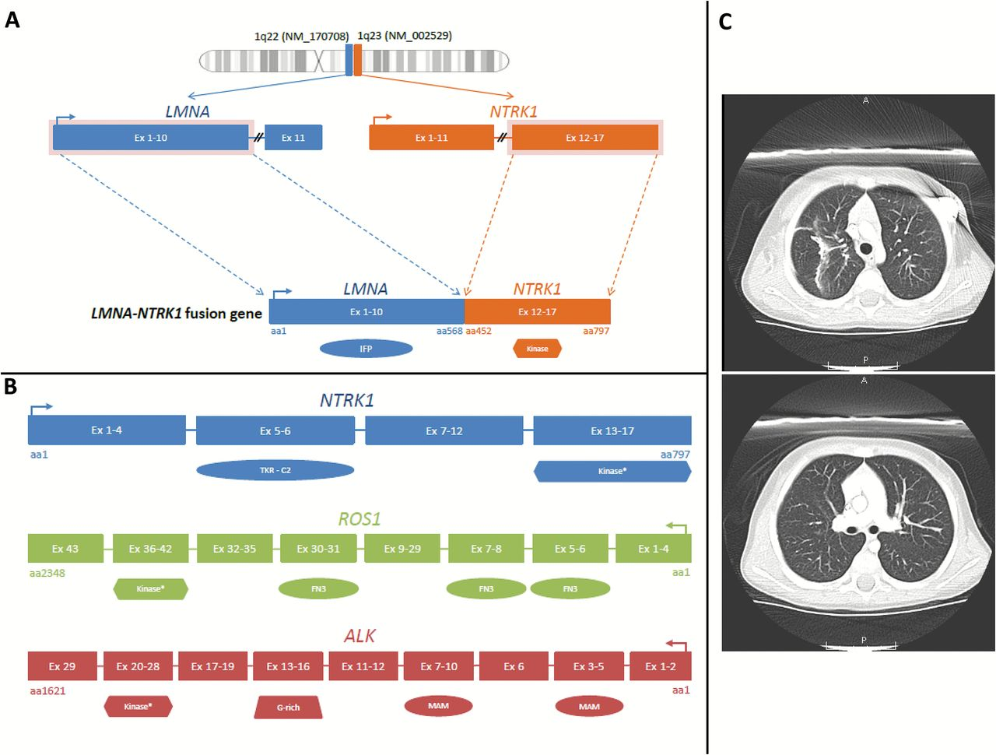
Figure 1. Analysis of NTRK1fusion and outcome of treatment with crizotinib. A) The LMNA-NTRK1 fusion gene encodes exons ...
Notes:
Figure 1. Analysis of NTRK1fusion and outcome of treatment with crizotinib. A) The LMNA-NTRK1 fusion gene encodes exons 1–10 of LMNA fused to the kinase domain of NTRK1 (exons 12–17). B) NTRK1, ROS1, and ALK each contain unique protein domains but commonly harbor similar tyrosine kinase domains. C) Pulmonary metastases notably regressed in size after six weeks of crizotinib monotherapy (top taken on November 17, 2014, precrizotinib; bottom taken on January 7, 2015, postcrizotinib). FN3 = fibronectin type III; G-rich = glycine-rich; TKR-C2 = tyrosine-protein kinase receptor C2.
Unless provided in the caption above, the following copyright applies to the content of this slide: © The Author 2015. Published by Oxford University Press. All rights reserved. For Permissions, please e-mail: journals.permissions@oup.com.

