Slide 1
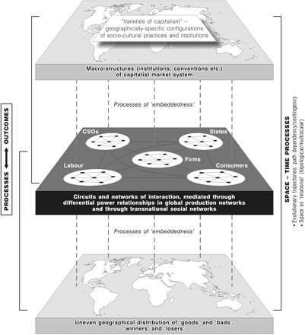
Figure 1. A heuristic framework for analysing the global economy. Source: adapted from Dicken, 2004, Figure 2.
Notes:
Figure 1. A heuristic framework for analysing the global economy. Source: adapted from Dicken, 2004, Figure 2.
Unless provided in the caption above, the following copyright applies to the content of this slide: © The Author (2008). Published by Oxford University Press. All rights reserved. For Permissions, please email: journals.permissions@oxfordjournals.org

Slide 2
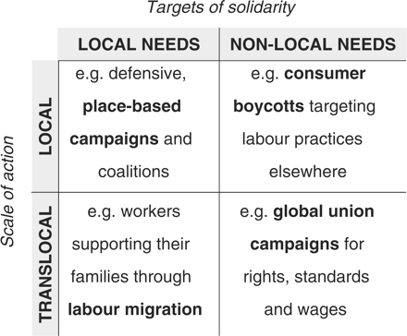
Figure 2. Potential spatial strategies of labour. Source: Lier, 2007, Figure 2.
Notes:
Figure 2. Potential spatial strategies of labour. Source: Lier, 2007, Figure 2.
Unless provided in the caption above, the following copyright applies to the content of this slide: © The Author (2008). Published by Oxford University Press. All rights reserved. For Permissions, please email: journals.permissions@oxfordjournals.org

