Slide 1
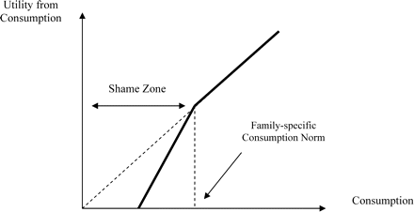
Figure 1: Utility from Consumption with a Risk of Shame
Notes:
Figure 1: Utility from Consumption with a Risk of Shame
Unless provided in the caption above, the following copyright applies to the content of this slide: © The author 2006. Published by Oxford University Press on behalf of the Centre for the Study of African Economies. All rights reserved. For permissions, please email: journals.permissions@oxfordjournals.org

Slide 2
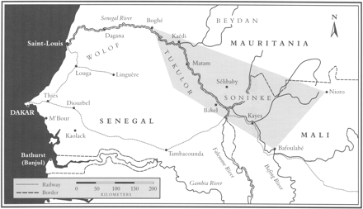
Map 1: Geographical Origin of the Soninke MigrantsSource: Manchuelle (1997) [originally from Diarra (1969)].
Notes:
Map 1: Geographical Origin of the Soninke MigrantsSource: Manchuelle (1997) [originally from Diarra (1969)].
Unless provided in the caption above, the following copyright applies to the content of this slide: © The author 2006. Published by Oxford University Press on behalf of the Centre for the Study of African Economies. All rights reserved. For permissions, please email: journals.permissions@oxfordjournals.org

Slide 3
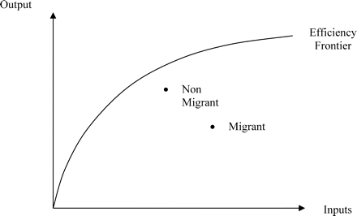
Figure 2: Migrant- and Non-Migrant Households' Productive Efficiency
Notes:
Figure 2: Migrant- and Non-Migrant Households' Productive Efficiency
Unless provided in the caption above, the following copyright applies to the content of this slide: © The author 2006. Published by Oxford University Press on behalf of the Centre for the Study of African Economies. All rights reserved. For permissions, please email: journals.permissions@oxfordjournals.org

