Slide 1
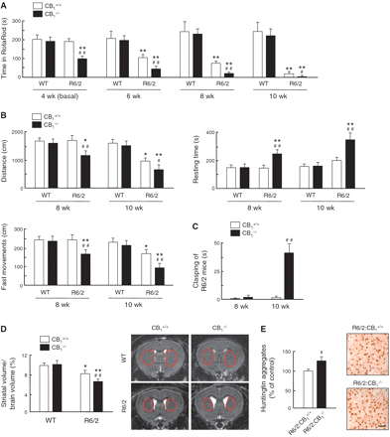
Figure 1 Genetic deletion of CB₁ cannabinoid receptors aggravates Huntington’s disease-like symptomatology ...
Notes:
Figure 1 Genetic deletion of CB1 cannabinoid receptors aggravates Huntington’s disease-like symptomatology and neuropathology in R6/2 mice. (A) RotaRod performance of CB1+/+, CB1−/− (WT), R6/2:CB1+/+ and R6/2:CB1−/− (R6/2) mice at the indicated ages (n = 10–12 animals per group). (B) Motor activity at Weeks 8 and 10 as determined by total distance, resting time, and fast movements (n = 14–18 animals per group). (C) Clasping of R6/2 mice at Weeks 8 and 10 (n = 16–20 animals per group). (Clasping was not observed in wild-type littermates at those ages.) (D) Striatal volume relative to total brain volume at Week 8 (n = 10–12 animals per group). (E) Huntingtin aggregates in the striatum at Week 8 (n = 8–10 animals per group). (Aggregates were not detected in wild-type littermates at that age.) In all panels *P < 0.05, **P < 0.01 from the corresponding wild-type group; #P < 0.05, ##P < 0.01 from the corresponding CB1+/+ group. Representative images are shown in panels D and E (scale bar 50 μm).
Unless provided in the caption above, the following copyright applies to the content of this slide: © The Author (2010). Published by Oxford University Press on behalf of the Guarantors of Brain. All rights reserved. For Permissions, please email: journals.permissions@oxfordjournals.org

Slide 2
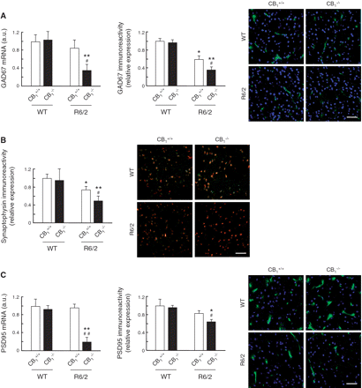
Figure 2 Genetic deletion of CB₁ cannabinoid receptors aggravates Huntington’s disease-like molecular ...
Notes:
Figure 2 Genetic deletion of CB1 cannabinoid receptors aggravates Huntington’s disease-like molecular pathology in R6/2 mice. (A) Striatal GAD67 mRNA levels and immunoreactivity [given as relative values of GAD67+ area (in green)/total cell number (nuclei in blue)]. (B) Striatal synaptophysin immunoreactivity [given as relative values of synaptophysin+ intensity (in red)/NeuN+ area (in green)]. (Striatal synaptophysin messenger RNA levels were not significantly different in wild-type, CB1−/− (WT), R6/2:CB1+/+ and R6/2:CB1−/− (R6/) mice; data not shown.) (C) Striatal PSD95 messenger RNA levels and immunoreactivity [given as relative values of PSD95+ area (in green)/total cell number (nuclei in blue)]. In all panels samples were taken at Week 8 of life (n = 6–8 animals per group; *P < 0.05, **P < 0.01 from the corresponding wild-type group; #P < 0.05, ##P < 0.01 from the corresponding CB1+/+ group). Representative confocal microscopy images are shown. Scale bar 50 μm.
Unless provided in the caption above, the following copyright applies to the content of this slide: © The Author (2010). Published by Oxford University Press on behalf of the Guarantors of Brain. All rights reserved. For Permissions, please email: journals.permissions@oxfordjournals.org

Slide 3
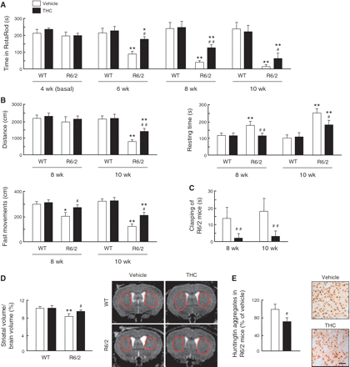
Figure 3 Pharmacological activation of CB₁ cannabinoid receptors ameliorates Huntington’s disease-like ...
Notes:
Figure 3 Pharmacological activation of CB1 cannabinoid receptors ameliorates Huntington’s disease-like symptomatology and neuropathology in R6/2 mice. R6/2 mice and wild-type (WT) littermates were treated daily with vehicle (white bars) or THC (2 mg/kg body weight per day; black bars) from Week 4. (A) RotaRod performance at the indicated ages (n = 10–14 animals per group). (B) Motor activity at Weeks 8 and 10 as determined by total distance, resting time and fast movements (n = 14–18 animals per group). (C) Clasping of R6/2 mice at Weeks 8 and 10 (n = 16–20 animals per group). (Clasping was not observed in wild-type littermates at those ages.) (D) Striatal volume relative to total brain volume at Week 8 (n = 10–12 animals per group). (E) Huntingtin aggregates in the striatum at Week 8 (n = 8–10 animals per group). (Aggregates were not detected in wild-type littermates at that age.) In all panels, *P < 0.05, **P < 0.01 from the corresponding wild-type group; #P < 0.05, ##P < 0.01 from the corresponding vehicle-treated group. Representative images are shown in panels D and E (scale bar 50 μm).
Unless provided in the caption above, the following copyright applies to the content of this slide: © The Author (2010). Published by Oxford University Press on behalf of the Guarantors of Brain. All rights reserved. For Permissions, please email: journals.permissions@oxfordjournals.org

Slide 4
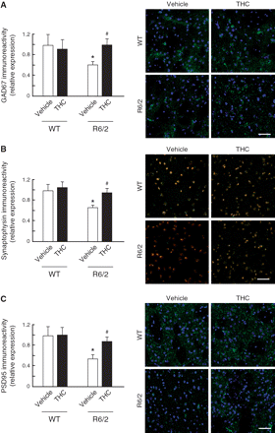
Figure 4 Pharmacological activation of CB₁ cannabinoid receptors ameliorates Huntington’s disease-like ...
Notes:
Figure 4 Pharmacological activation of CB1 cannabinoid receptors ameliorates Huntington’s disease-like molecular pathology in R6/2 mice. R6/2 mice and wild-type (WT) littermates were treated daily with vehicle (white bars) or THC (2 mg/kg body weight per day; black bars) from Week 4 of life. (A) Striatal GAD67 immunoreactivity [given as relative values of GAD67+ area (in green)/total cell number (nuclei in blue)]. (B) Striatal synaptophysin immunoreactivity [given as relative values of synaptophysin+ intensity (in red)/NeuN+ area (in green)]. (C) Striatal PSD95 immunoreactivity [given as relative values of PSD95+ intensity (in green)/total cell number (nuclei in blue)]. (Striatal GAD67, synaptophysin and PSD95 messenger RNA levels were not significantly different in wild-type or R6/2 mice treated with vehicle or THC; data not shown.) In all panels samples were taken at Week 8 of life (n = 6–8 animals per group; *P < 0.05, **P < 0.01 from the corresponding wild-type group; #P < 0.05, ##P < 0.01 from the corresponding vehicle-treated group). Representative confocal microscopy images are shown. Scale bar 50 μm.
Unless provided in the caption above, the following copyright applies to the content of this slide: © The Author (2010). Published by Oxford University Press on behalf of the Guarantors of Brain. All rights reserved. For Permissions, please email: journals.permissions@oxfordjournals.org

Slide 5
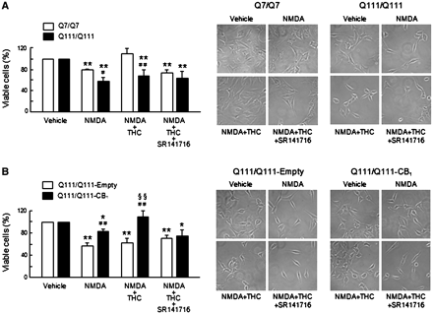
Figure 5 CB₁ cannabinoid receptors protect striatal cells from excitotoxic damage. (A) ...
Notes:
Figure 5 CB1 cannabinoid receptors protect striatal cells from excitotoxic damage. (A) STHdhQ7/Q7 and STHdhQ111/Q111 cells were preincubated for 5 h in Locke’s solution with or without 1 mM NMDA together with vehicle, 0.5 μM THC and/or 0.25 μM SR141716, and subsequently incubated for 24 h in NMDA-free medium. Relative numbers of viable cells are shown (n = 6 experiments; **P < 0.01 from the corresponding vehicle-treated cells; #P < 0.05, ##P < 0.01 from the corresponding STHdhQ7/Q7 cells). (THC alone or SR141716 alone did not exert any significant effect on STHdhQ7/Q7 or STHdhQ111/Q111 cell viability; data not shown.) (B) STHdhQ111/Q111 cells were transfected with a mouse CB1 receptor-expressing vector or with empty vector and subsequently treated with or without NMDA, THC and/or SR141716 as above (n = 6 experiments; *P < 0.05, **P < 0.01 from the corresponding vehicle-treated cells; ##P < 0.01 from the corresponding empty vector-transfected cells; §§P < 0.01 from NMDA alone or from NMDA + THC + SR141716). (THC alone or SR141716 alone did not exert any significant effect on STHdhQ111/Q111-Empty or STHdhQ111/Q111-CB1 cell viability; data not shown.) Representative micrographs of the different experimental conditions are shown.
Unless provided in the caption above, the following copyright applies to the content of this slide: © The Author (2010). Published by Oxford University Press on behalf of the Guarantors of Brain. All rights reserved. For Permissions, please email: journals.permissions@oxfordjournals.org

Slide 6
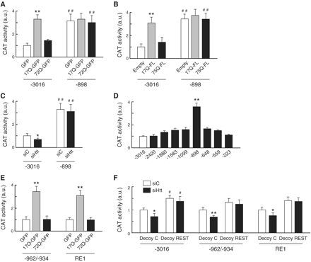
Figure 6 Transient regulation of huntingtin expression controls CB₁ cannabinoid receptor gene promoter ...
Notes:
Figure 6 Transient regulation of huntingtin expression controls CB1 cannabinoid receptor gene promoter activity via repressor element 1 silencing transcription factor. (A and B) CB1 receptor promoter activity in STHdhQ7/Q7 cells transfected with GFP, 17Q-GFP or 72Q-GFP (A), or with empty vector, 17Q-FL or 75Q-FL (B) and CAT reporter constructs encoding a 3016- or an 898-bp human CB1 receptor promoter (n = 4 experiments; **P < 0.01 from empty construct; ##P < 0.01 from the corresponding −3016 construct). (C) CB1 receptor promoter activity in STHdhQ7/Q7 cells transfected with control small interfering RNA (siC) or huntingtin-directed small interfering RNA (siHtt) and the aforementioned reporter constructs (n = 4 experiments; *P < 0.05 from siC; ##P < 0.01 from the corresponding −3016 construct). (D) CB1 receptor promoter activity in STHdhQ7/Q7 cells transfected with reporter constructs encoding sequential 5′-promoter deletions (n = 4 experiments; **P < 0.01 from −3016 construct). (E) Promoter activity in STHdhQ7/Q7 cells transfected with GFP, 17Q-GFP or 72Q-GFP, and reporter constructs encoding the CB1 receptor promoter −962/−934 sequence or a RE1 consensus sequence (n = 4 experiments; ** P < 0.01 from the corresponding empty construct). (F) Promoter activity in STHdhQ7/Q7 cells transfected with siC or siHtt, control (C) or REST-directed decoy oligonucleotides, and reporter constructs encoding a 3016-bp CB1 receptor promoter, the CB1 receptor promoter −962/−934 sequence or a RE1 consensus sequence (n = 4 experiments; *P < 0.05, **P < 0.01 from siC; #P < 0.05 from the corresponding decoy C). a.u = arbitrary units.
Unless provided in the caption above, the following copyright applies to the content of this slide: © The Author (2010). Published by Oxford University Press on behalf of the Guarantors of Brain. All rights reserved. For Permissions, please email: journals.permissions@oxfordjournals.org

Slide 7
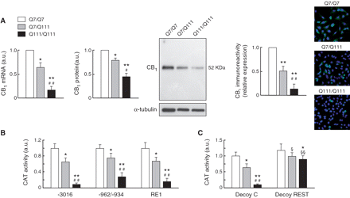
Figure 7 Endogenous huntingtin controls CB₁ cannabinoid receptor gene promoter activity via repressor ...
Notes:
Figure 7 Endogenous huntingtin controls CB1 cannabinoid receptor gene promoter activity via repressor element 1 silencing transcription factor. (A) CB1 receptor expression in wild-type huntingtin striatal neuroblasts (STHdhQ7/Q7 cells, white bars) and mutant huntingtin knock-in striatal neuroblasts [both heterozygous (STHdhQ7/Q111 cells, grey bars) and homozygous (STHdhQ111/Q111 cells, black bars)] as determined by real-time quantitative PCR (left), western blot [middle; quantification of optical density values relative to those of loading controls (α-tubulin) as well as a representative blot with the Mr of the selected protein bands are shown] and immunofluorescence [right; given as relative values of CB1+ area (in green)/total cell number (nuclei in blue), n = 4 experiments; *P < 0.05, **P < 0.01 from STHdhQ7/Q7 cells; #P < 0.05, ##P < 0.01 from STHdhQ7/Q111 cells]. (B) Promoter activity in STHdh cells transfected with CAT reporter constructs encoding a 3016-bp human CB1 receptor promoter, the CB1 receptor promoter −962/−934 sequence or a RE1 consensus sequence (n = 6 experiments; *P < 0.05, **P < 0.01 from STHdhQ7/Q7 cells; ##P < 0.01 from STHdhQ7/Q111 cells). (C) Promoter activity in STHdh cells transfected with control (C) or REST-directed decoy oligonucleotides and a reporter construct encoding a 3016-bp CB1 receptor promoter (n = 4 experiments; *P < 0.05, **P < 0.01 from the corresponding STHdhQ7/Q7 cells; ##P < 0.01 from STHdhQ7/Q111 cells; §P < 0.05, §§P < 0.01 from the corresponding decoy C). a.u = arbitrary units.
Unless provided in the caption above, the following copyright applies to the content of this slide: © The Author (2010). Published by Oxford University Press on behalf of the Guarantors of Brain. All rights reserved. For Permissions, please email: journals.permissions@oxfordjournals.org

Slide 8
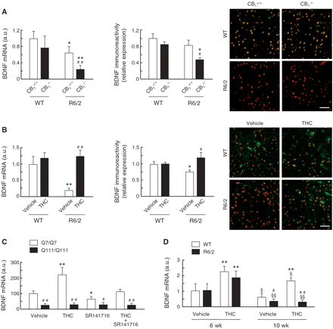
Figure 8 CB₁ cannabinoid receptors control striatal brain-derived neurotrophic factor expression. (A) ...
Notes:
Figure 8 CB1 cannabinoid receptors control striatal brain-derived neurotrophic factor expression. (A) Striatal BDNF messenger RNA levels and immunoreactivity [given as relative values of BDNF+ area (in red)/NeuN+ area (in green)] in 8-week-old wild-type (WT), CB1−/−, R6/2:CB1+/+ and R6/2:CB1−/− mice (n = 6–8 animals per group; *P < 0.05, **P < 0.01 from the corresponding wild-type group; #P < 0.05, ##P < 0.01 from the corresponding CB1+/+ group). Representative confocal microscopy images are shown. Scale bar 50 μm. (B) Striatal BDNF messenger RNA levels and immunoreactivity [given as relative values of BDNF+ area (in red)/NeuN+ area (in green)] in 8-week-old R6/2 mice and wild-type (WT) littermates treated daily with vehicle (white bars) or THC (2 mg/kg body weight/day; black bars) from Week 4 of life (n = 6–8 animals per group; *P < 0.05, **P < 0.01 from the corresponding wild-type group; #P < 0.05, ##P < 0.01 from the corresponding vehicle-treated group). Representative confocal microscopy images are shown. Scale bar 50 μm. (C) BDNF expression in wild-type huntingtin striatal neuroblasts (STHdhQ7/Q7 cells) and mutant huntingtin knock-in striatal neuroblasts (STHdhQ111/Q111 cells), as determined by real-time quantitative PCR, after incubation for 12 h with vehicle, 0.5 μM THC and/or 0.25 μM SR141716 (n = 6 experiments; *P < 0.05, **P < 0.01 from the corresponding vehicle-treated cells; #P < 0.05, ##P < 0.01 from the corresponding STHdhQ7/Q7 cells). (D) BDNF expression in striatal slices from wild-type (WT) and R6/2 mice of the indicated ages, as determined by real-time quantitative PCR, after incubation for 24 h with vehicle or 1 μM THC (n = 4 animals per group; **P < 0.01 from the corresponding vehicle-treated slices; #P < 0.05, ##P < 0.01 from the corresponding wild-type group; §P < 0.05, §§P < 0.01 from the corresponding 6-week-old group). a.u = arbitrary units.
Unless provided in the caption above, the following copyright applies to the content of this slide: © The Author (2010). Published by Oxford University Press on behalf of the Guarantors of Brain. All rights reserved. For Permissions, please email: journals.permissions@oxfordjournals.org

Slide 9
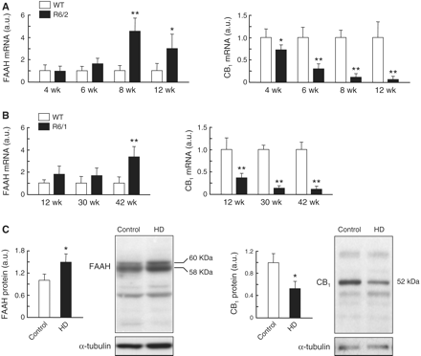
Figure 9 Striatal fatty acid amide hydrolase expression increases in R6 mice and patients with Huntington’s disease. ...
Notes:
Figure 9 Striatal fatty acid amide hydrolase expression increases in R6 mice and patients with Huntington’s disease. (A, B) Striatal FAAH (left) and CB1 receptor (right) messenger RNA levels in R6/2 (A) and R6/1 (B) mice at different ages as determined by real-time quantitative PCR (n = 6–8 animals per group; *P < 0.05, **P < 0.01 from the corresponding wild-type (WT) group). (C) Western blot analysis of FAAH (left) and CB1 receptor (right) expression in caudate-putamen specimens from patients with Huntington’s disease (HD) and control subjects. Quantification of optical density values relative to those of loading controls (α-tubulin) as well as representative blots with the relative molecular mass (Mr) of the selected protein bands are shown (n = 6 patients with Huntington’s disease and n = 6 control subjects; *P < 0.05 from control subjects). a.u = arbitrary units.
Unless provided in the caption above, the following copyright applies to the content of this slide: © The Author (2010). Published by Oxford University Press on behalf of the Guarantors of Brain. All rights reserved. For Permissions, please email: journals.permissions@oxfordjournals.org

