Slide 1
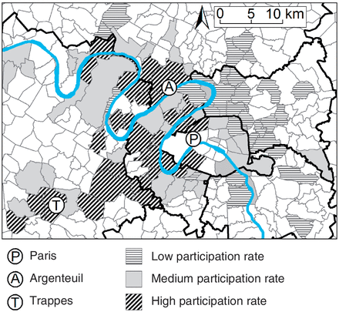
Figure 1 Geographic variations between municipalities in the rate of participation in the RECORD Cohort Study, ...
Notes:
Figure 1 Geographic variations between municipalities in the rate of participation in the RECORD Cohort Study, estimated from a multi-level model for study participation (only the central part of the RECORD Study territory is shown on the map; the fourth recruiting centre—Mantes-la-Jolie—is located outside the map). Based on the number of residents (from the 2006 population census) and number of participants per age group and sex per municipality, we estimated a multi-level Poisson model only adjusted for age and sex with people nested within municipalities. The map plots the municipality-level random effect of the multi-level model, interpretable as a log rate ratio for participation in each municipality compared with the whole study territory. High- and low-participation municipalities are areas with a rate ratio of participation respectively higher than 1.25 and lower than 1/1.25 = 0.80 (compared with the whole study territory). Municipalities in white colour are not part of the pre-defined study territory
Unless provided in the caption above, the following copyright applies to the content of this slide: Published by Oxford University Press on behalf of the International Epidemiological Association © The Author 2011; all rights reserved.

Slide 2
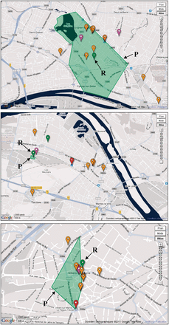
Figure 2 Assessment of the perception of the boundaries of the residential neighbourhood and geocoding of the network ...
Notes:
Figure 2 Assessment of the perception of the boundaries of the residential neighbourhood and geocoding of the network of regular destinations of participants through the VERITAS application: examples for three different participants (R for the residence and P for the perceived neighbourhood on the maps). As an example, the destinations geocoded on the first map include, from the left to the right, a hairdresser, a gym, a post office, another hairdresser, a cheese merchant, a fish store, a fruit and vegetable shop, a butcher, an outdoor market, a bakery, the place of residence, a train station, another bakery, a jogging site, a language school, a supermarket and another fruit and vegetable shop. The place of residence of the participant's parents was also geocoded but is outside the map
Unless provided in the caption above, the following copyright applies to the content of this slide: Published by Oxford University Press on behalf of the International Epidemiological Association © The Author 2011; all rights reserved.

