Slide 1
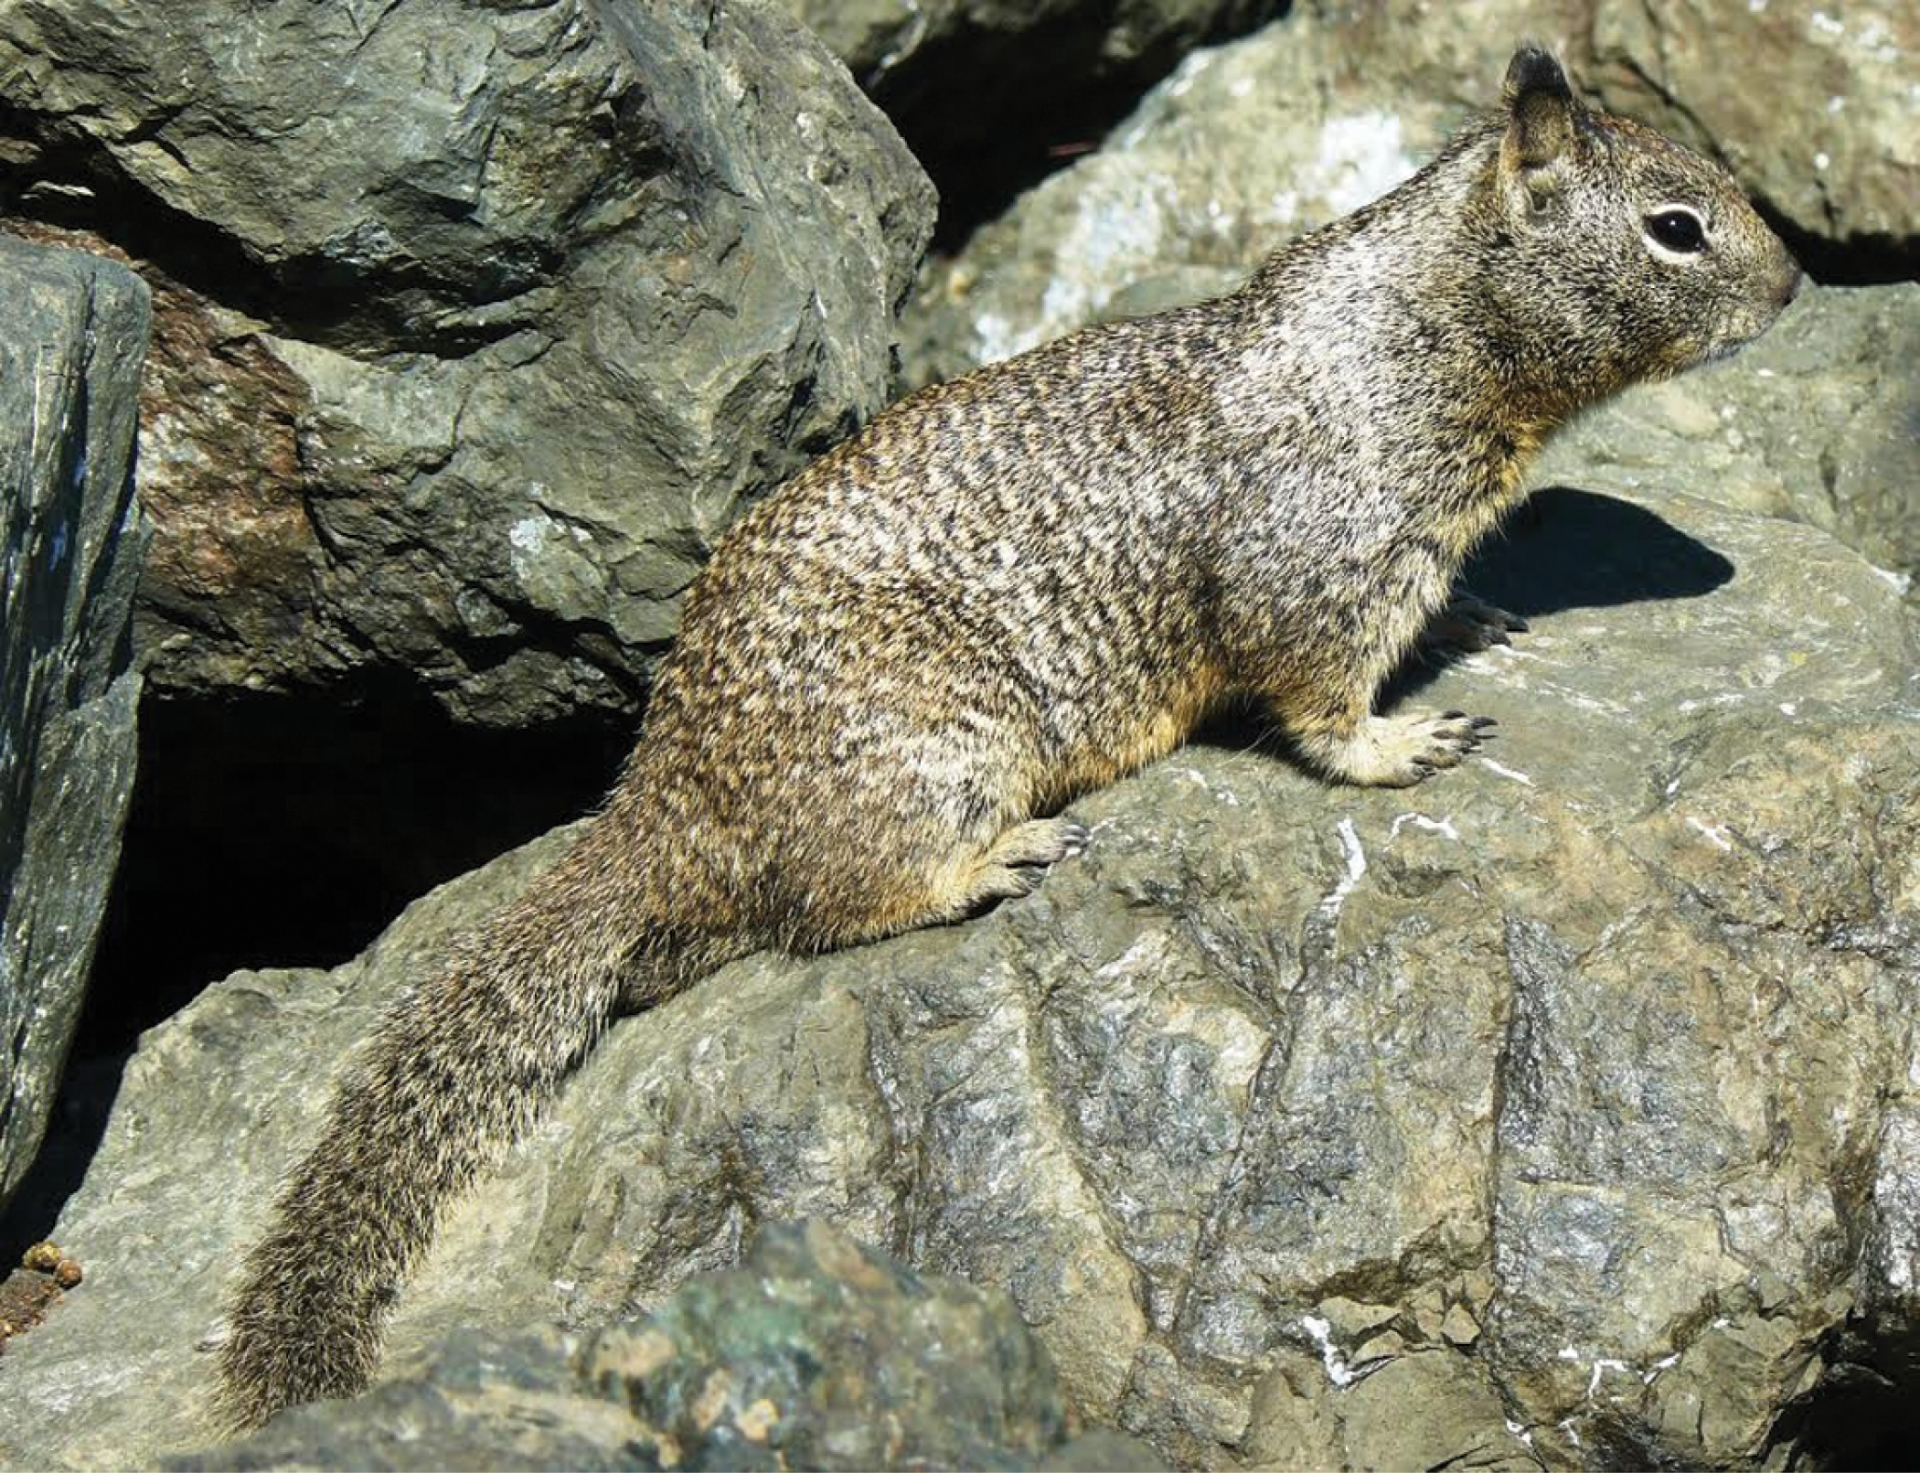
Fig. 1. An adult male Otospermophilus beecheyi from Berkeley Marina, Berkeley, Alameda County, California, United ...
Notes:
Fig. 1. An adult male Otospermophilus beecheyi from Berkeley Marina, Berkeley, Alameda County, California, United States. Photograph by D. J. Long.
Unless provided in the caption above, the following copyright applies to the content of this slide: © 2016 by American Society of Mammalogists.

Slide 2
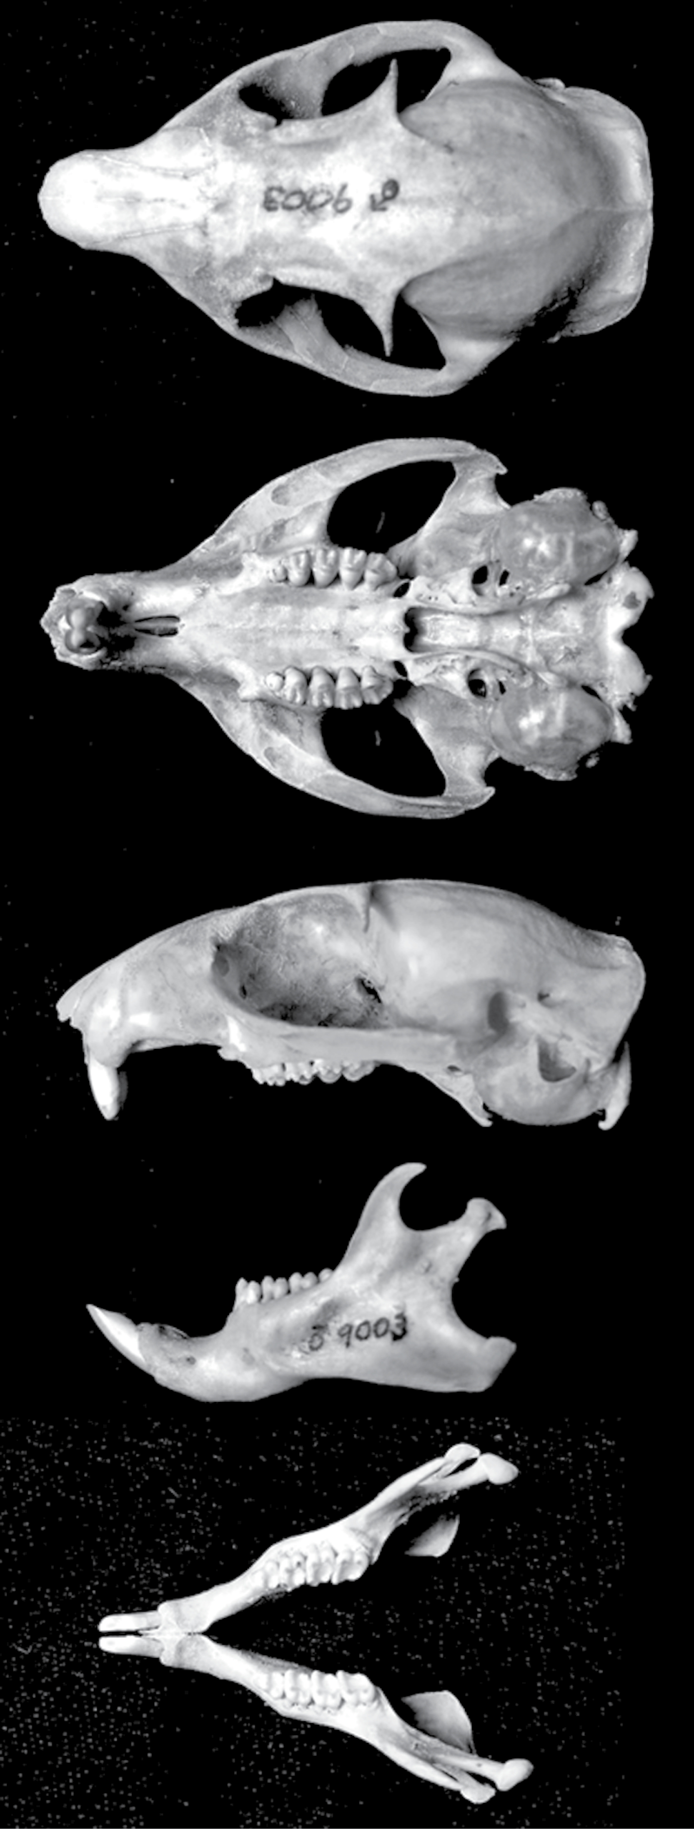
Fig. 2. Dorsal, ventral, and lateral views of the skull and lateral and dorsal views of the mandible from an adult ...
Notes:
Fig. 2. Dorsal, ventral, and lateral views of the skull and lateral and dorsal views of the mandible from an adult male Otospermophilus beecheyi (California Academy of Sciences Mammalogy Collections 9003) collected by K. Staeger on 11 July 1940, Calaveras Dam, Alameda Co., California, United States; 59.2 mm total skull length. Greatest skull length is 59.2 mm.
Unless provided in the caption above, the following copyright applies to the content of this slide: © 2016 by American Society of Mammalogists.

Slide 3
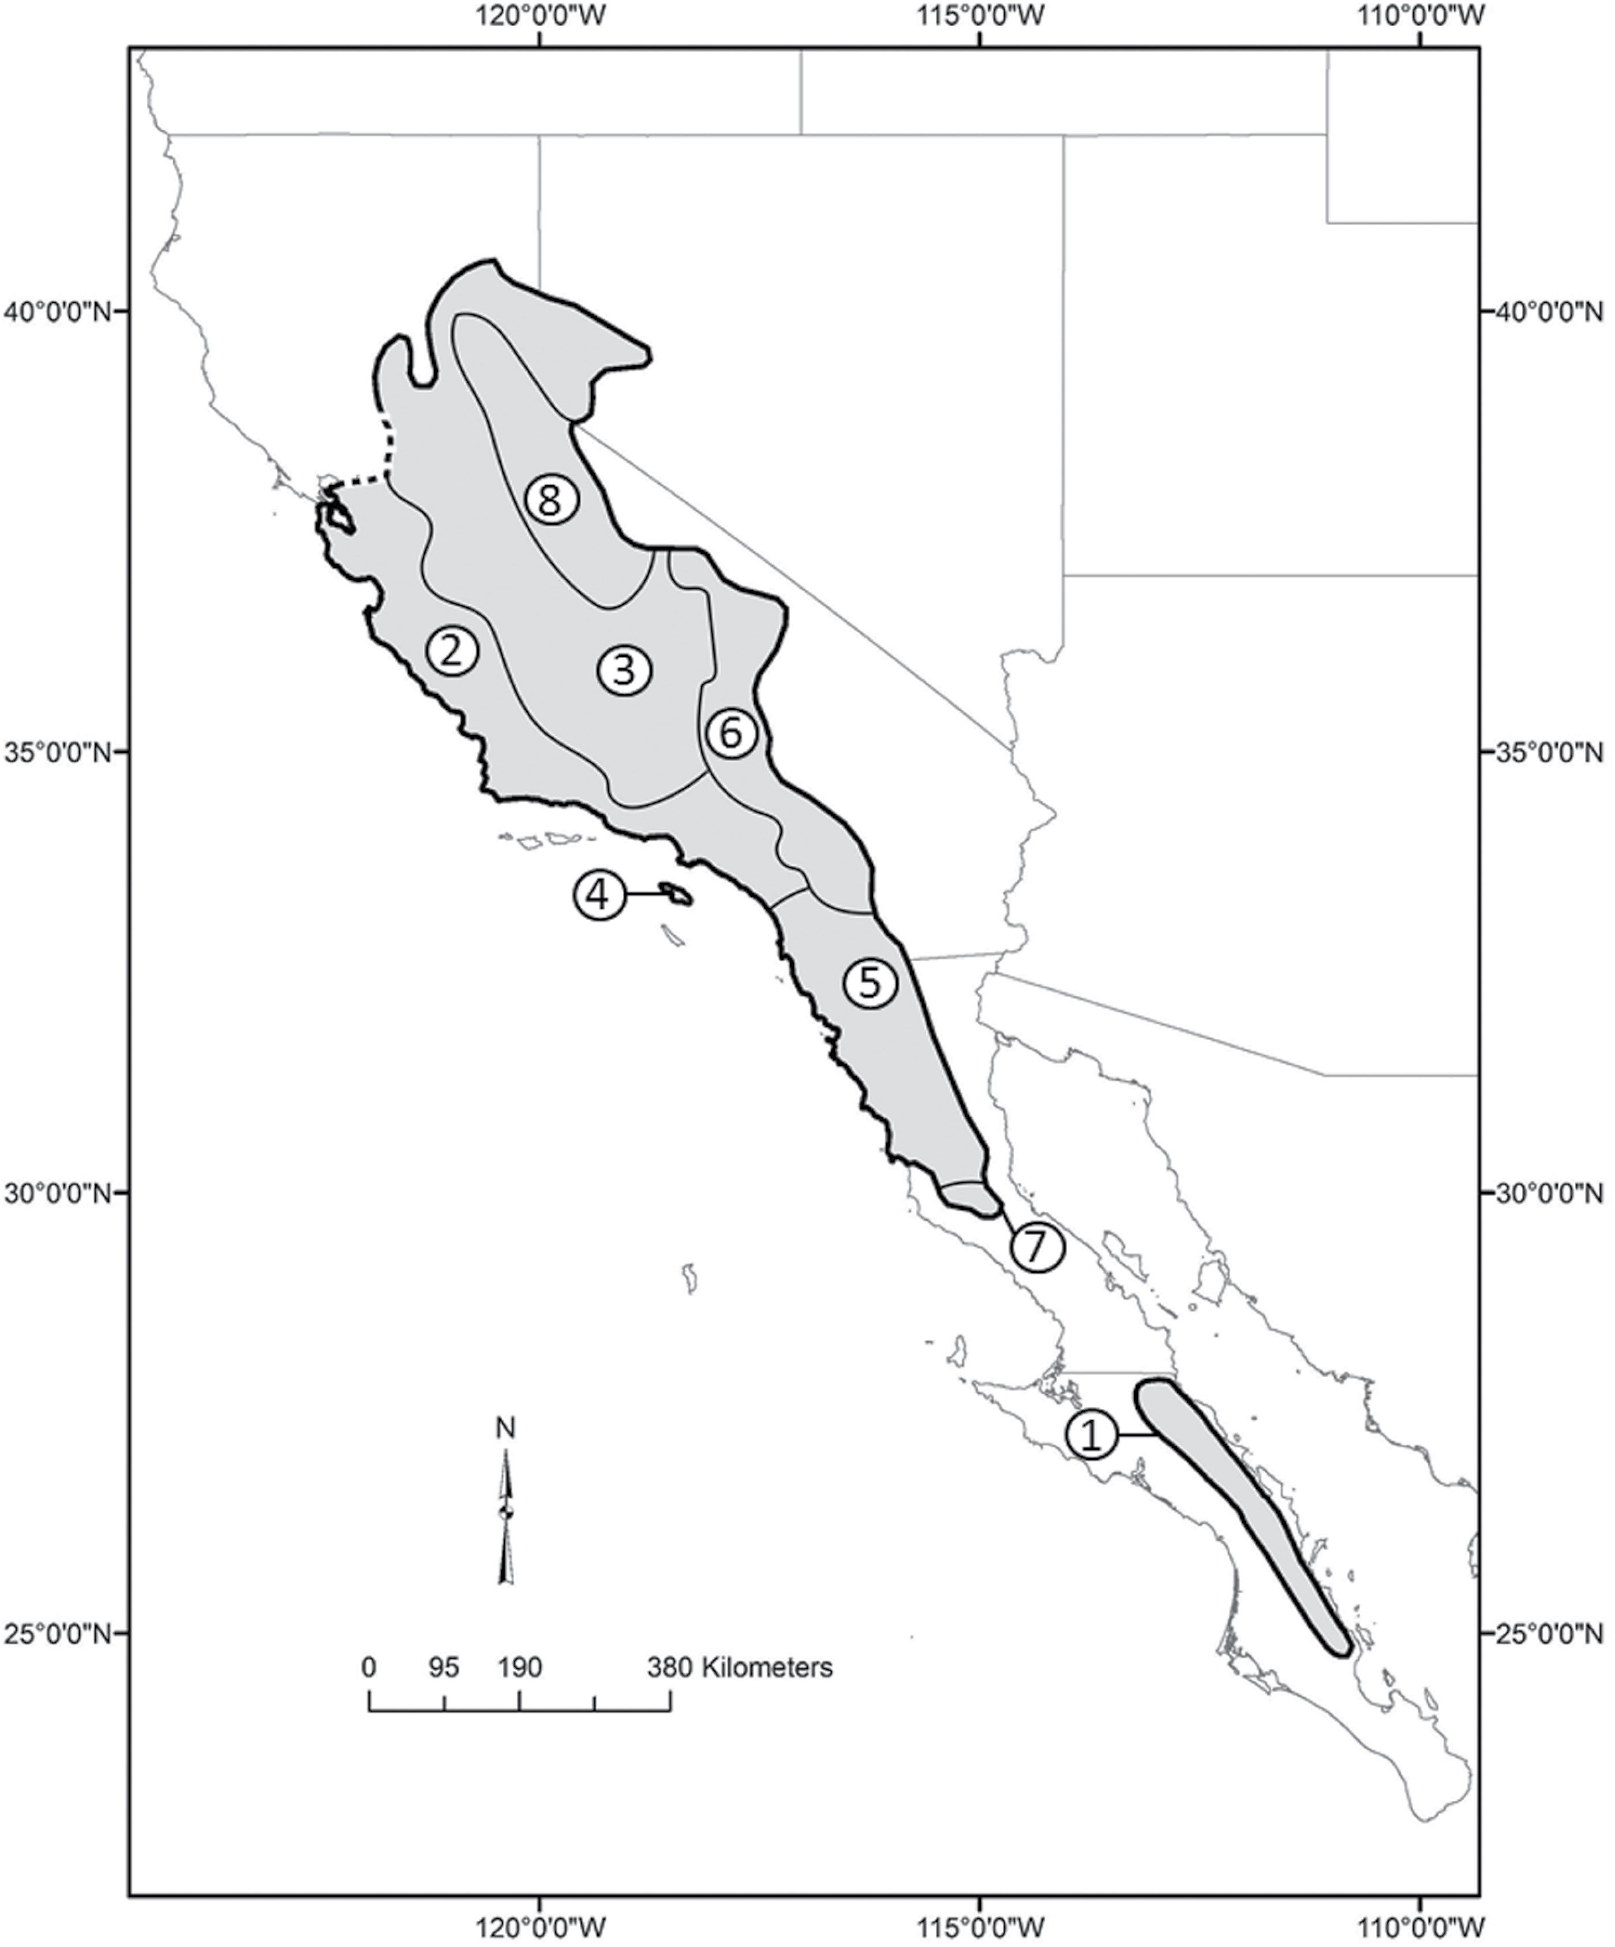
Fig. 3. Geographic distribution of the 8 subspecies of Otospermophilus beecheyi: 1, O. b. atricapillus; 2, O. b. ...
Notes:
Fig. 3. Geographic distribution of the 8 subspecies of Otospermophilus beecheyi: 1, O. b. atricapillus; 2, O. b. beecheyi; 3, O. b. fisheri; 4, O. b. nesioticus; 5, O. b. nudipes; 6, O. b. parvulus; 7, O. b. rupinarum; 8, O. b. sierrae (modified from Hall 1981 and Álvarez-Castañeda et al. 1996, and Phuong et al. 2014). The dotted line in the northwest edge of the O. beecheyi range represents an imprecise boundary between O. b. beecheyi and O. douglasii due to genetic uncertainty about the specific geographic division between these 2 species (Phuong et al. 2014). This map should therefore serve as a tentative boundary for O. beecheyi until further genetic data confirm a species division in that region.
Unless provided in the caption above, the following copyright applies to the content of this slide: © 2016 by American Society of Mammalogists.

Slide 4
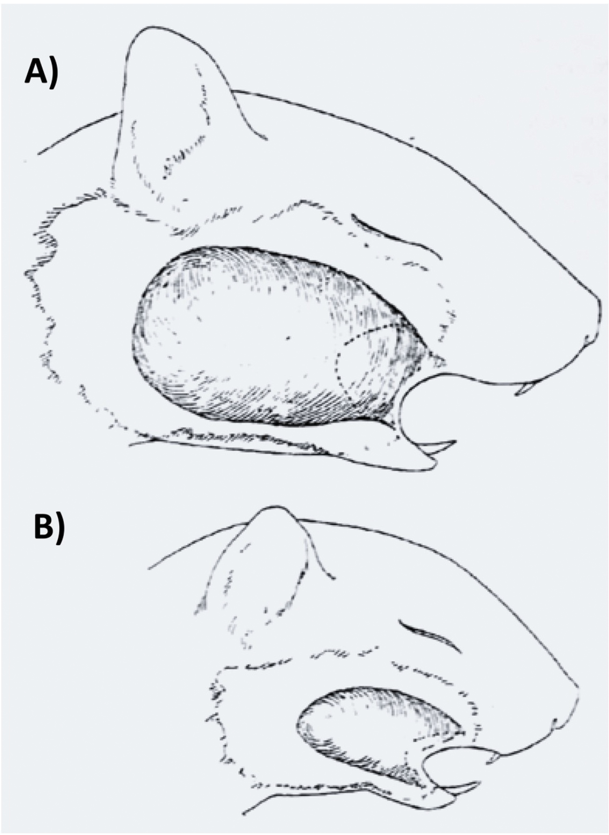
Fig. 4. Drawings from dissections of the cheek pouches of A) Otospermophilus beecheyi and B) Belding’s ground ...
Notes:
Fig. 4. Drawings from dissections of the cheek pouches of A) Otospermophilus beecheyi and B) Belding’s ground squirrel (Urocitellus beldingi) from non-copyrighted material of Grinnell and Dixon (1918) demonstrate the enhanced capacity for O. beecheyi to cache seeds in its cheek pouches.
Unless provided in the caption above, the following copyright applies to the content of this slide: © 2016 by American Society of Mammalogists.

Slide 5
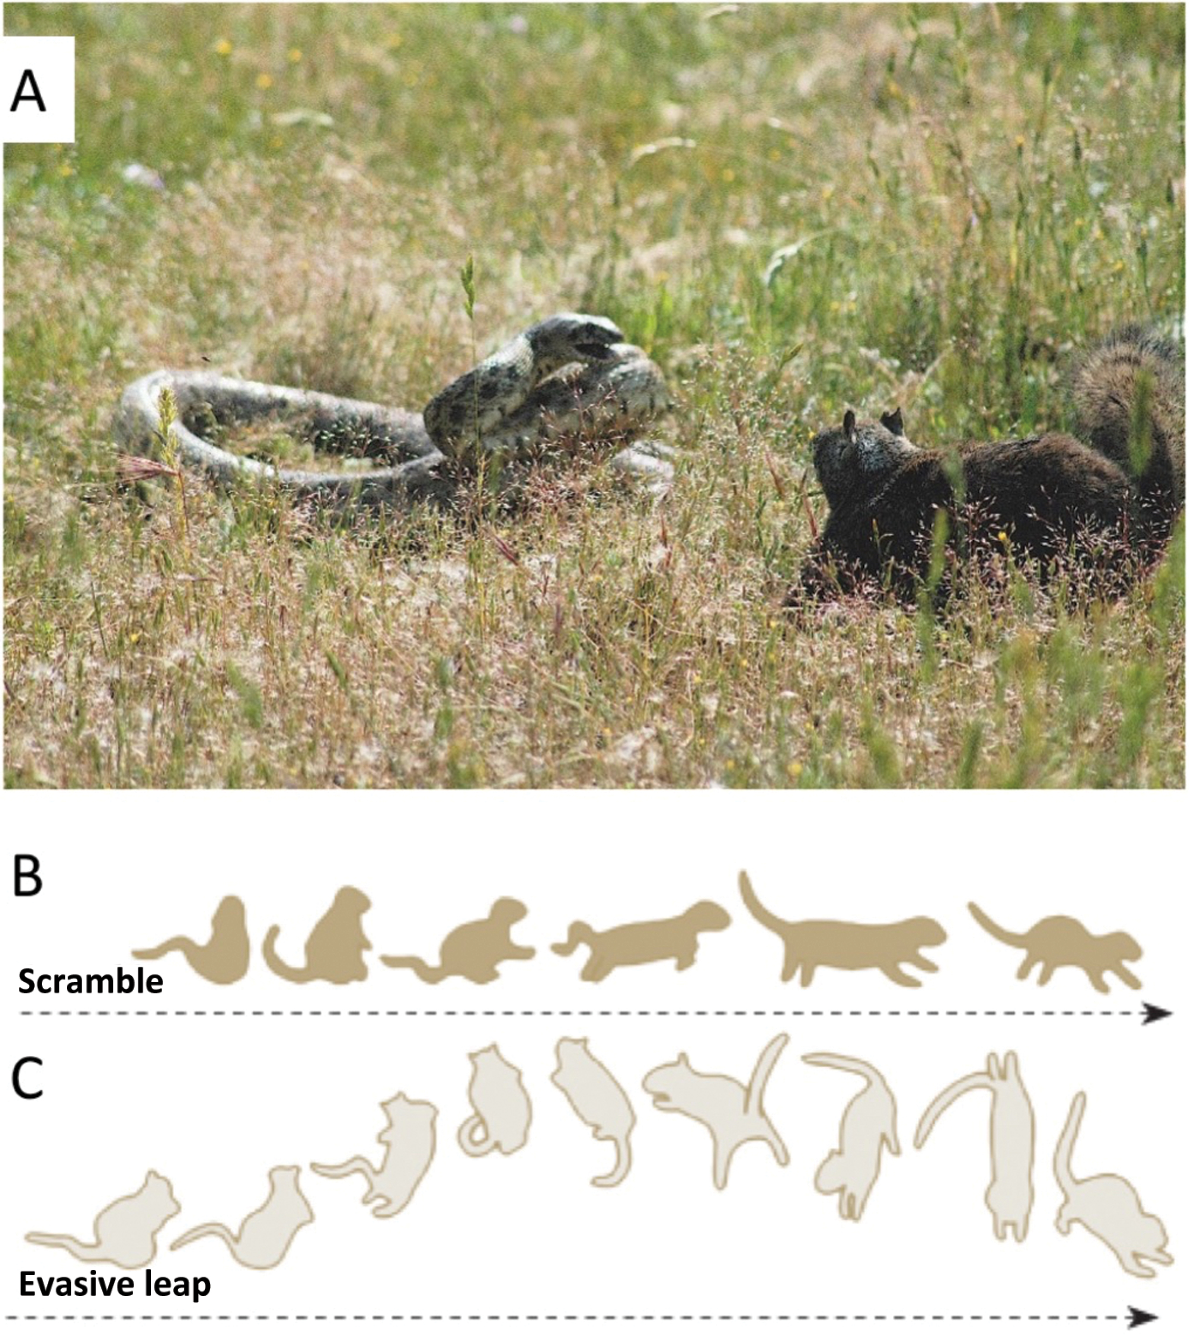
Fig. 5. Otospermophilus beecheyi interactions with rattlesnakes may include: A) harassing snakes by mobbing, and ...
Notes:
Fig. 5. Otospermophilus beecheyi interactions with rattlesnakes may include: A) harassing snakes by mobbing, and throwing or kicking sand at it and B) responding by scrambling away when surprised, and C) engaging in an evasive leap if the squirrel perceives increased danger of the snake. Photograph, taken by Jerry Kirkhart, is a freely available image licensed under the Creative Commons Attribution 2.0 Generic (CC by 2) license. Schematic reprinted with permission from Putman and Clark (2015).
Unless provided in the caption above, the following copyright applies to the content of this slide: © 2016 by American Society of Mammalogists.

