Slide 1
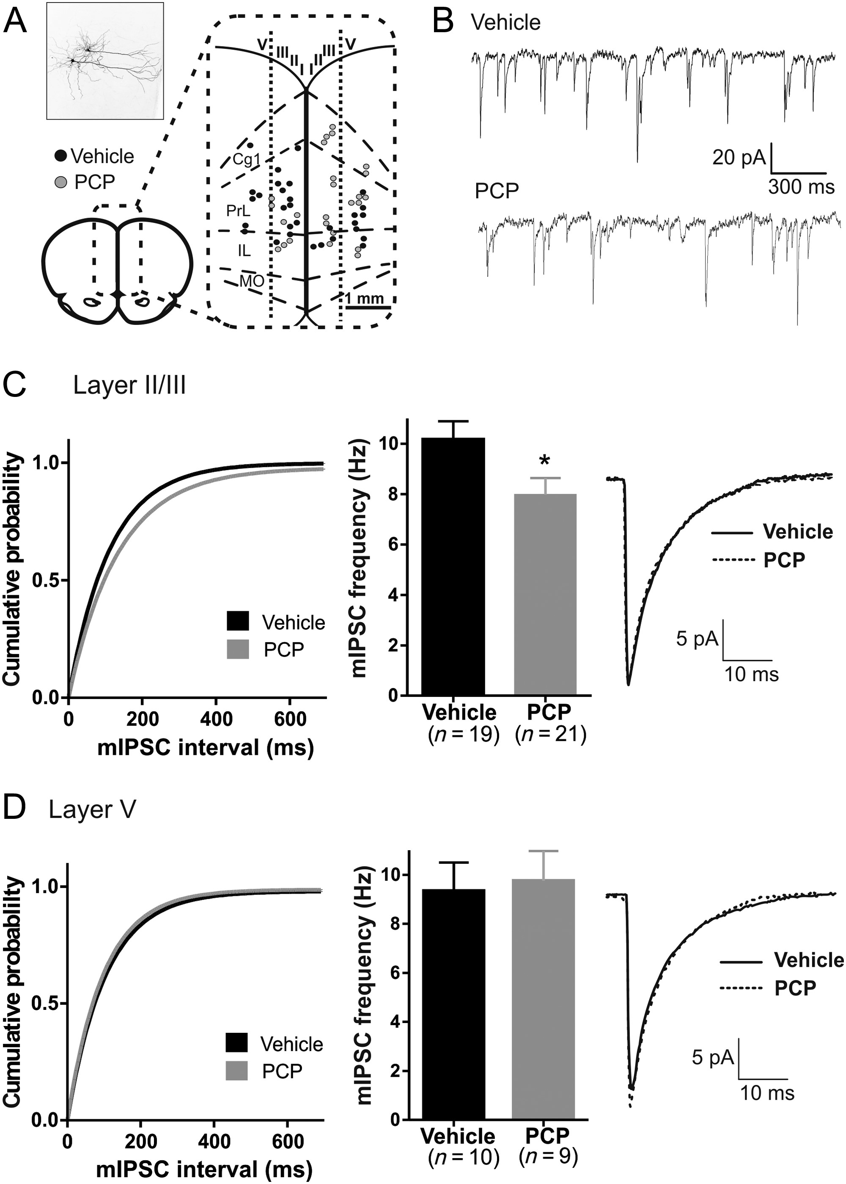
Figure 1. The frequency of miniature inhibitory postsynaptic currents (mIPSCs) in layer II/III is decreased in early ...
Notes:
Figure 1. The frequency of miniature inhibitory postsynaptic currents (mIPSCs) in layer II/III is decreased in early postnatal PCP-treated animals. (A) mIPSCs was recorded in medial PFC defined as frontal cingulate (Cg1), prelimbic (PrL), and infralimbic (IL) cortices (Paxinos and Watson 1998). Recordings from cells in the medial orbital cortex (MO) were discarded. Recorded cells were loaded with biocytin in order to confirm identity as pyramidal neurons (upper left) and were subsequently divided according to location in middle (approximately layer II/III) or deeper layers (approximately layer V). (B) Representative mIPSC traces of layer II/III pyramidal neurons of vehicle- and PCP-treated animals. (C) The cumulative probability plot indicates a right shift in the curve of the interevent interval of mIPSCs in layer II/III of PCP-treated animals. The summary plot of the mIPSC frequencies shows a lower frequency of mIPSCs in PCP animals (P < 0.05). To the right is shown the average noncontaminated event for vehicle and PCP animals, which reveal no difference in the kinetic characteristics (Table 1). (D) In layer V, no differences in mIPSC frequency and kinetics (Table 1) of the average noncontaminated event are evident between PCP and vehicle animals. *P < 0.05. Layer II/III: vehicle, n = 19; PCP, n = 21. Layer V: vehicle, n = 10; PCP, n = 9.
Unless provided in the caption above, the following copyright applies to the content of this slide: © The Author 2013. Published by Oxford University Press. All rights reserved. For Permissions, please e-mail: journals.permissions@oup.com

Slide 2
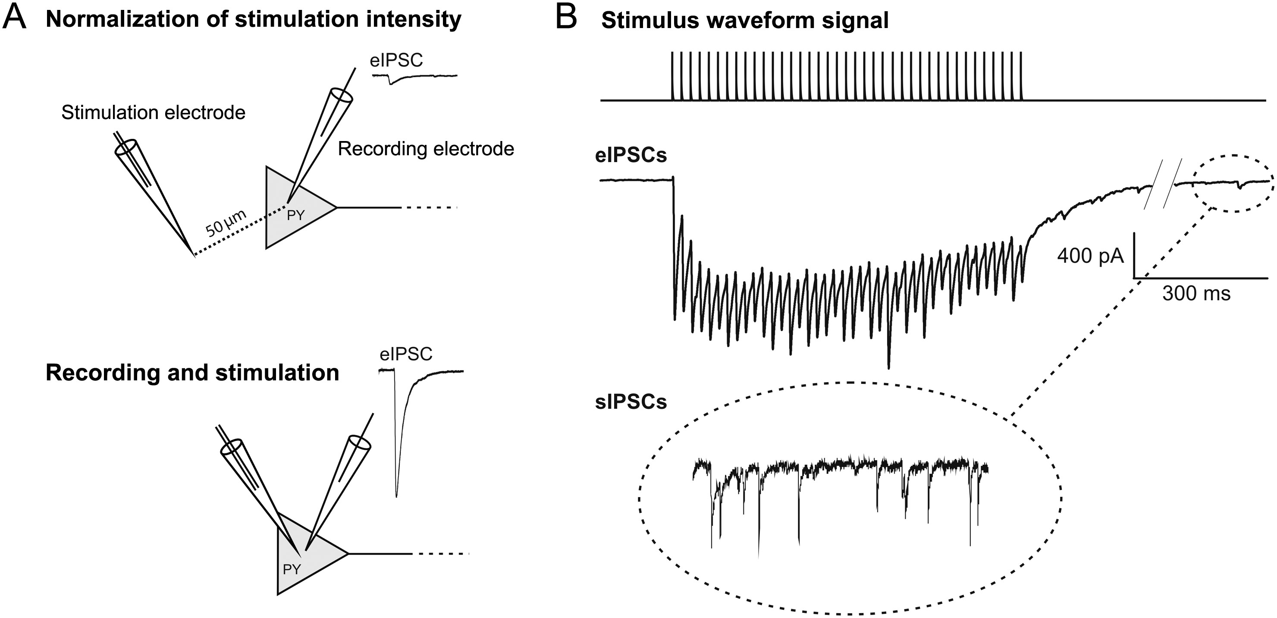
Figure 2. Experimental set-up during HFS. (A) Top: stimulation intensity was normalized by placing the stimulation ...
Notes:
Figure 2. Experimental set-up during HFS. (A) Top: stimulation intensity was normalized by placing the stimulation electrode 50 μm from the patched pyramidal neuron (PY) and by adjusting the intensity of stimulation to yield an eIPSC of 2–3 times the size of the average sIPSC amplitude. Bottom: the electrode was then moved to a location <5 μm from the patched soma and recording was initiated. (B) Stimulation consisted of a train of 40 pulses, each of 50 µs duration, in 0.8 s (50 Hz). eIPSCs were recorded and followed by measurement of sIPSCs 5 s after the last eIPSC of each HFS train.
Unless provided in the caption above, the following copyright applies to the content of this slide: © The Author 2013. Published by Oxford University Press. All rights reserved. For Permissions, please e-mail: journals.permissions@oup.com

Slide 3
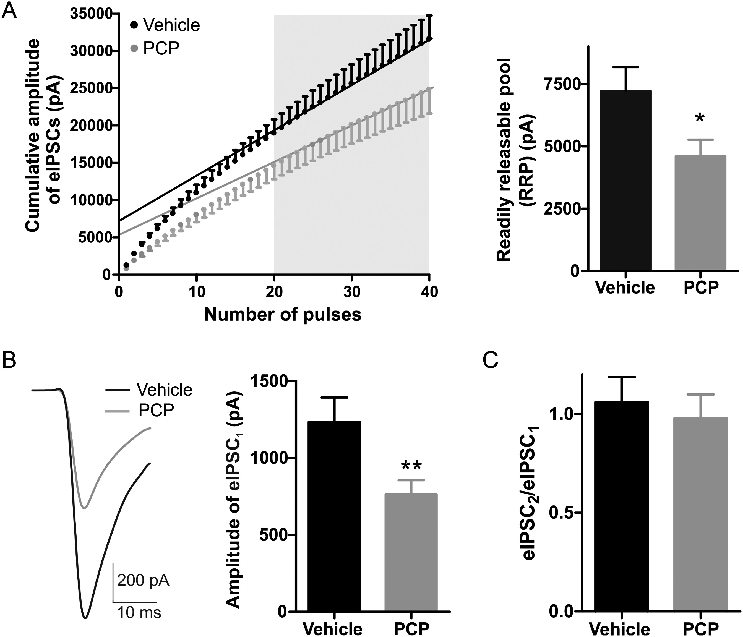
Figure 3. High-frequency stimulations (HFS) disclose a reduction in the RRP, and the first eIPSC₁. (A) Plot ...
Notes:
Figure 3. High-frequency stimulations (HFS) disclose a reduction in the RRP, and the first eIPSC1. (A) Plot of the cumulative amplitude of eIPSCs versus the number of stimuli. A straight line was fitted to the linear part of the graph of the cumulated amplitudes (stimulation 20–40 in the train) and back-extrapolated to the y-axis to obtain the estimate for the RRP. The RRP was reduced in PCP animals (P < 0.05). (B) Representative current trace of the first eIPSC (eIPSC1) in vehicle and PCP rats. eIPSC1 was reduced in PCP animals (P < 0.01). (D) The ratio between eIPSC2 and eIPSC1 of the HFS train (interstimulus interval of 20 ms) was not significant different from 1 in either vehicle- or PCP-treated animals. *P < 0.05; **P < 0.01; vehicle, n = 24; PCP, n = 37.
Unless provided in the caption above, the following copyright applies to the content of this slide: © The Author 2013. Published by Oxford University Press. All rights reserved. For Permissions, please e-mail: journals.permissions@oup.com

Slide 4
Figure 4. Nonstationary fluctuation analysis (NSFA). It shows NSFA from a representative cell performed on sIPSCs ...
Notes:
Figure 4. Nonstationary fluctuation analysis (NSFA). It shows NSFA from a representative cell performed on sIPSCs recordings obtained from the HFS experiments. The displayed summary graphs show no difference between vehicle and PCP animals in the amount of single-channel current (i), the number of open channels (N), or in conductance (y). Vehicle, n = 11; PCP, n = 11.
Unless provided in the caption above, the following copyright applies to the content of this slide: © The Author 2013. Published by Oxford University Press. All rights reserved. For Permissions, please e-mail: journals.permissions@oup.com

Slide 5
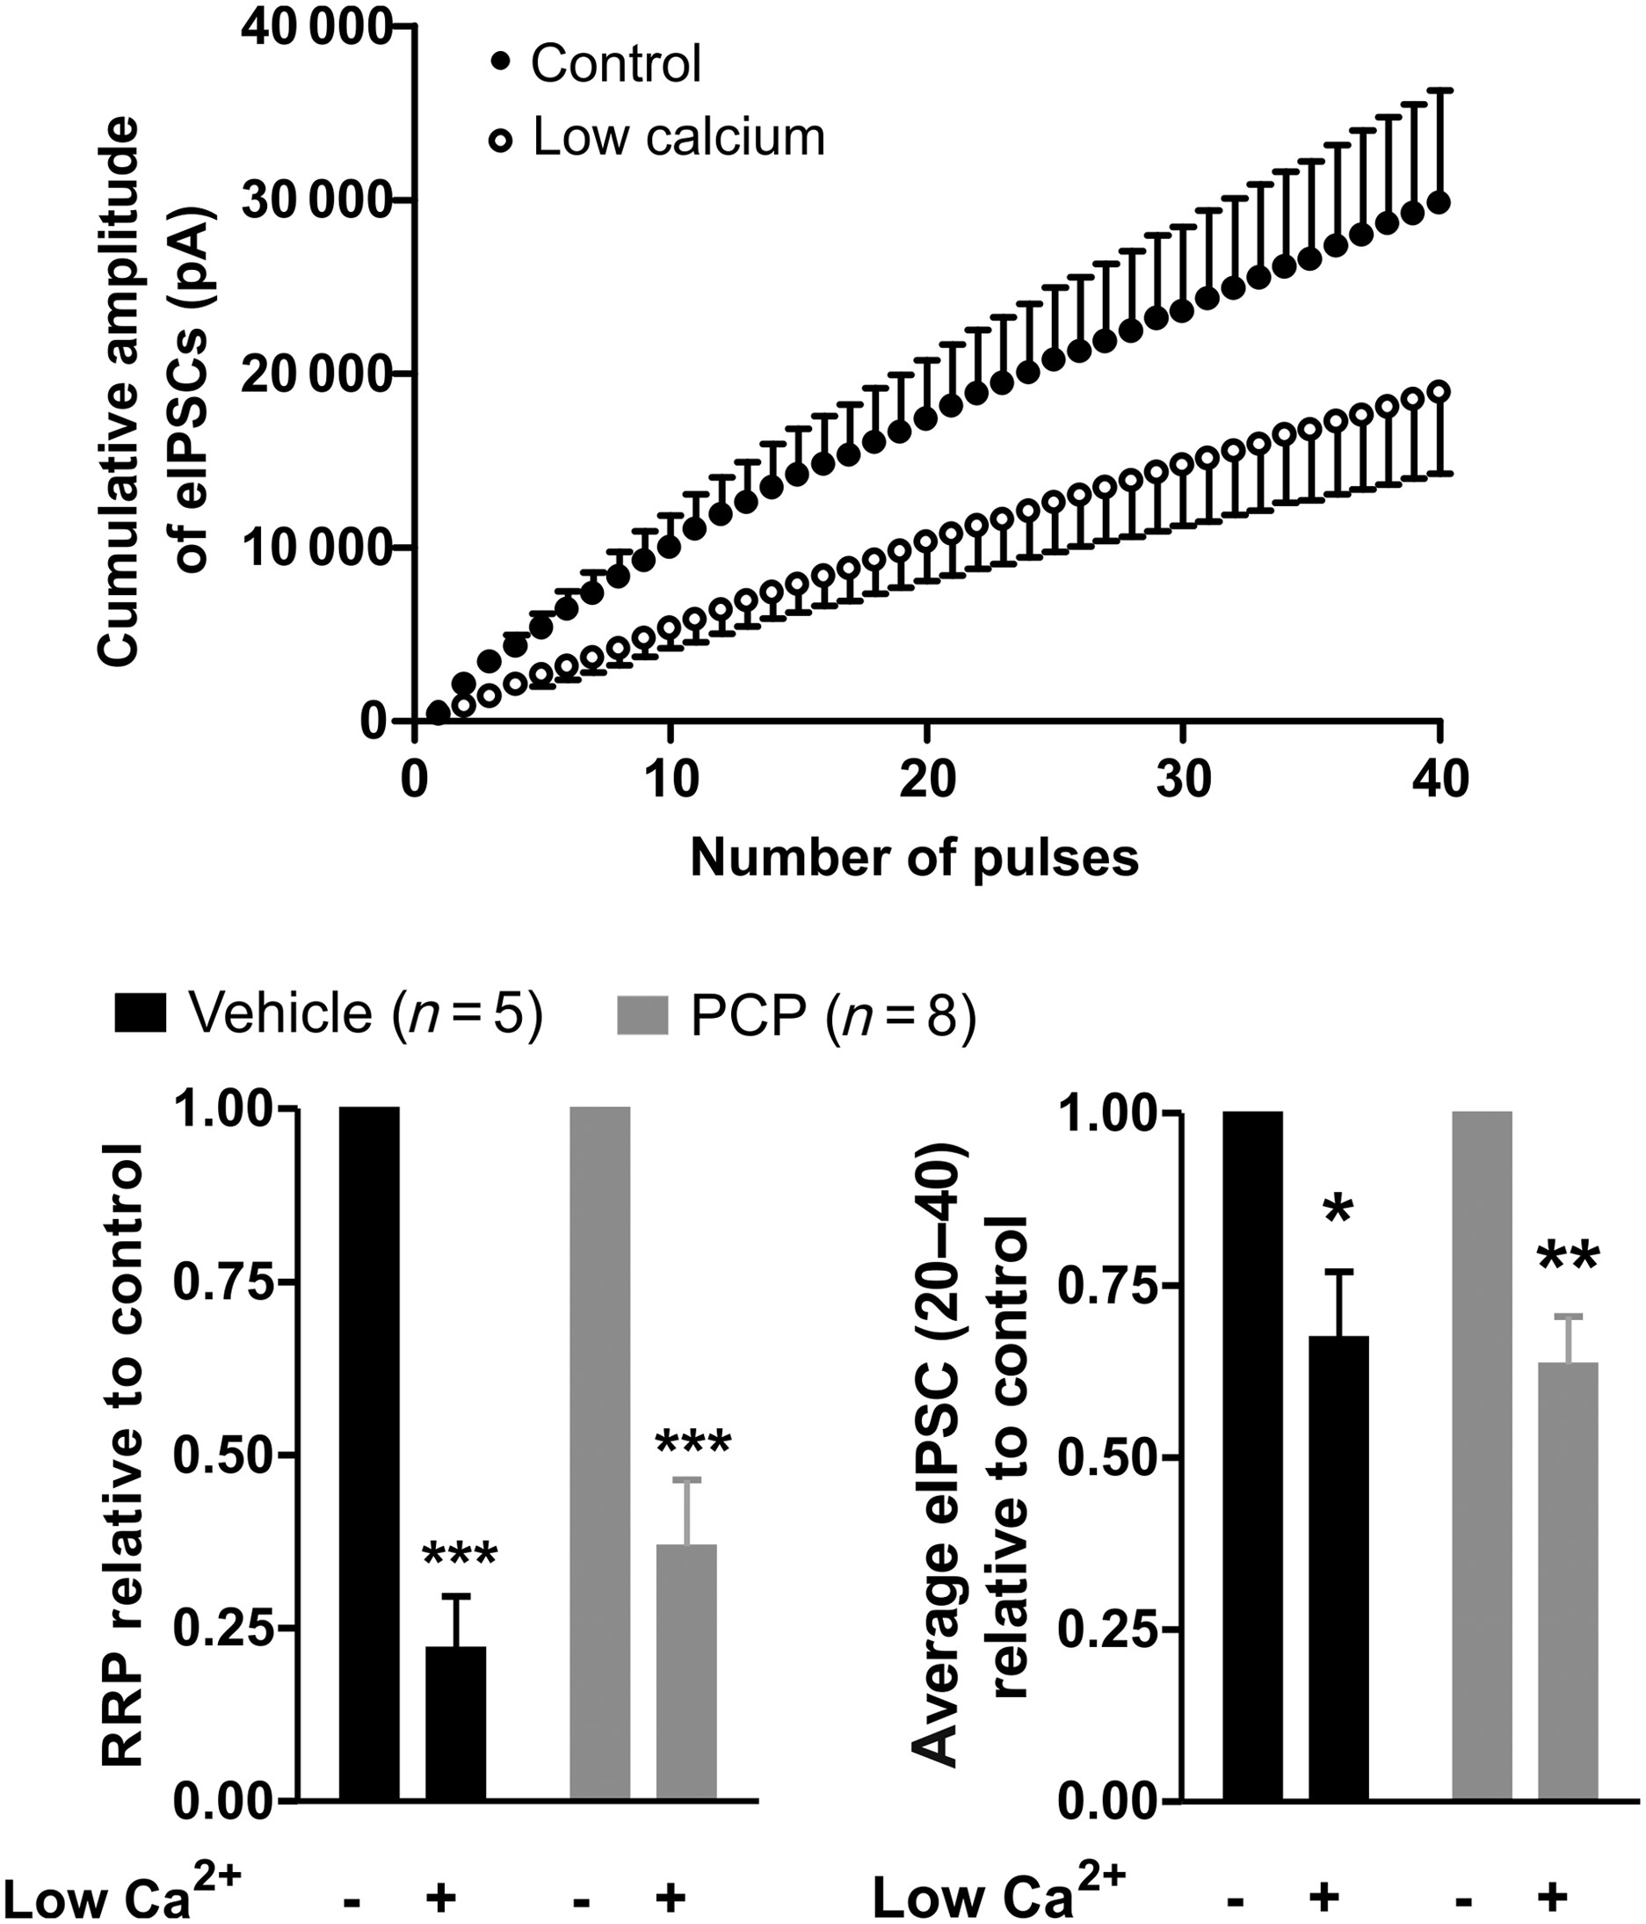
Figure 5. PCP animals display no difference in the response to low calcium in the extracellular medium. Top: A plot ...
Notes:
Figure 5. PCP animals display no difference in the response to low calcium in the extracellular medium. Top: A plot showing the effect of reducing the Ca2+/Mg2+ ratio from 2:2 to 1:3 on the accumulated eIPSC amplitude in vehicle animals. Bottom: in response to low Ca2+, a relative reduction was observed in RRP (vehicle, P < 0.001 and PCP, P < 0.001) and amplitude of the average eIPSC 20–40 (vehicle, P < 0.05 and PCP, P < 0.01). *P < 0.05, **P < 0.01, ***P < 0.001. Vehicle: n = 5, PCP: n = 8.
Unless provided in the caption above, the following copyright applies to the content of this slide: © The Author 2013. Published by Oxford University Press. All rights reserved. For Permissions, please e-mail: journals.permissions@oup.com

Slide 6
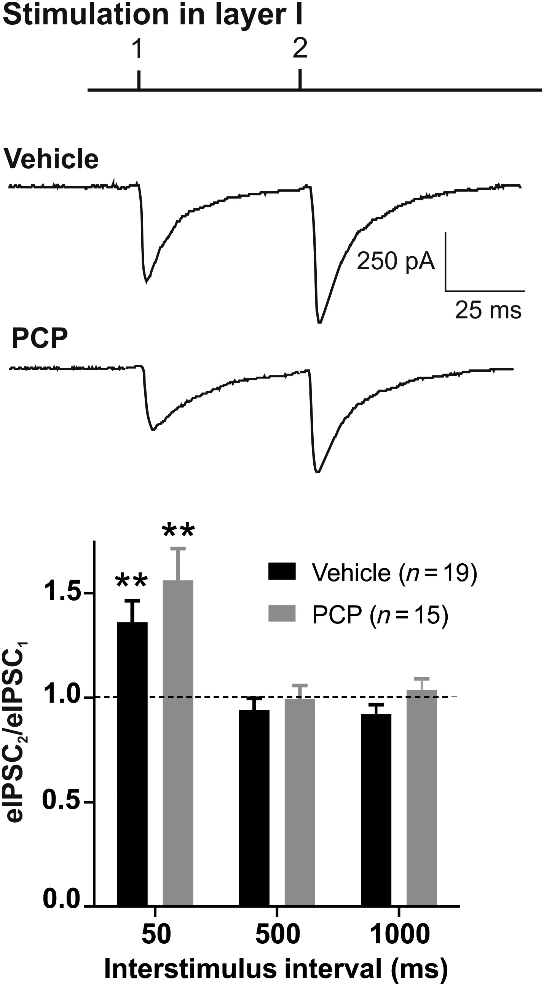
Figure 6. Paired-pulse facilitation was observed in both vehicle and PCP animals. Top: a representative trace ...
Notes:
Figure 6. Paired-pulse facilitation was observed in both vehicle and PCP animals. Top: a representative trace displaying eIPSCs in layer II/III pyramidal neurons following paired stimulations with an ISI of 50 ms in vehicle and PCP animals. The eIPSC2/eIPSC1 ratio was increased at a 50-ms ISI (P < 0.01), but displayed no significant deviation from 1 at longer ISIs in either vehicle or PCP. **P < 0.01. Vehicle, n = 19, PCP, n = 15.
Unless provided in the caption above, the following copyright applies to the content of this slide: © The Author 2013. Published by Oxford University Press. All rights reserved. For Permissions, please e-mail: journals.permissions@oup.com

Slide 7
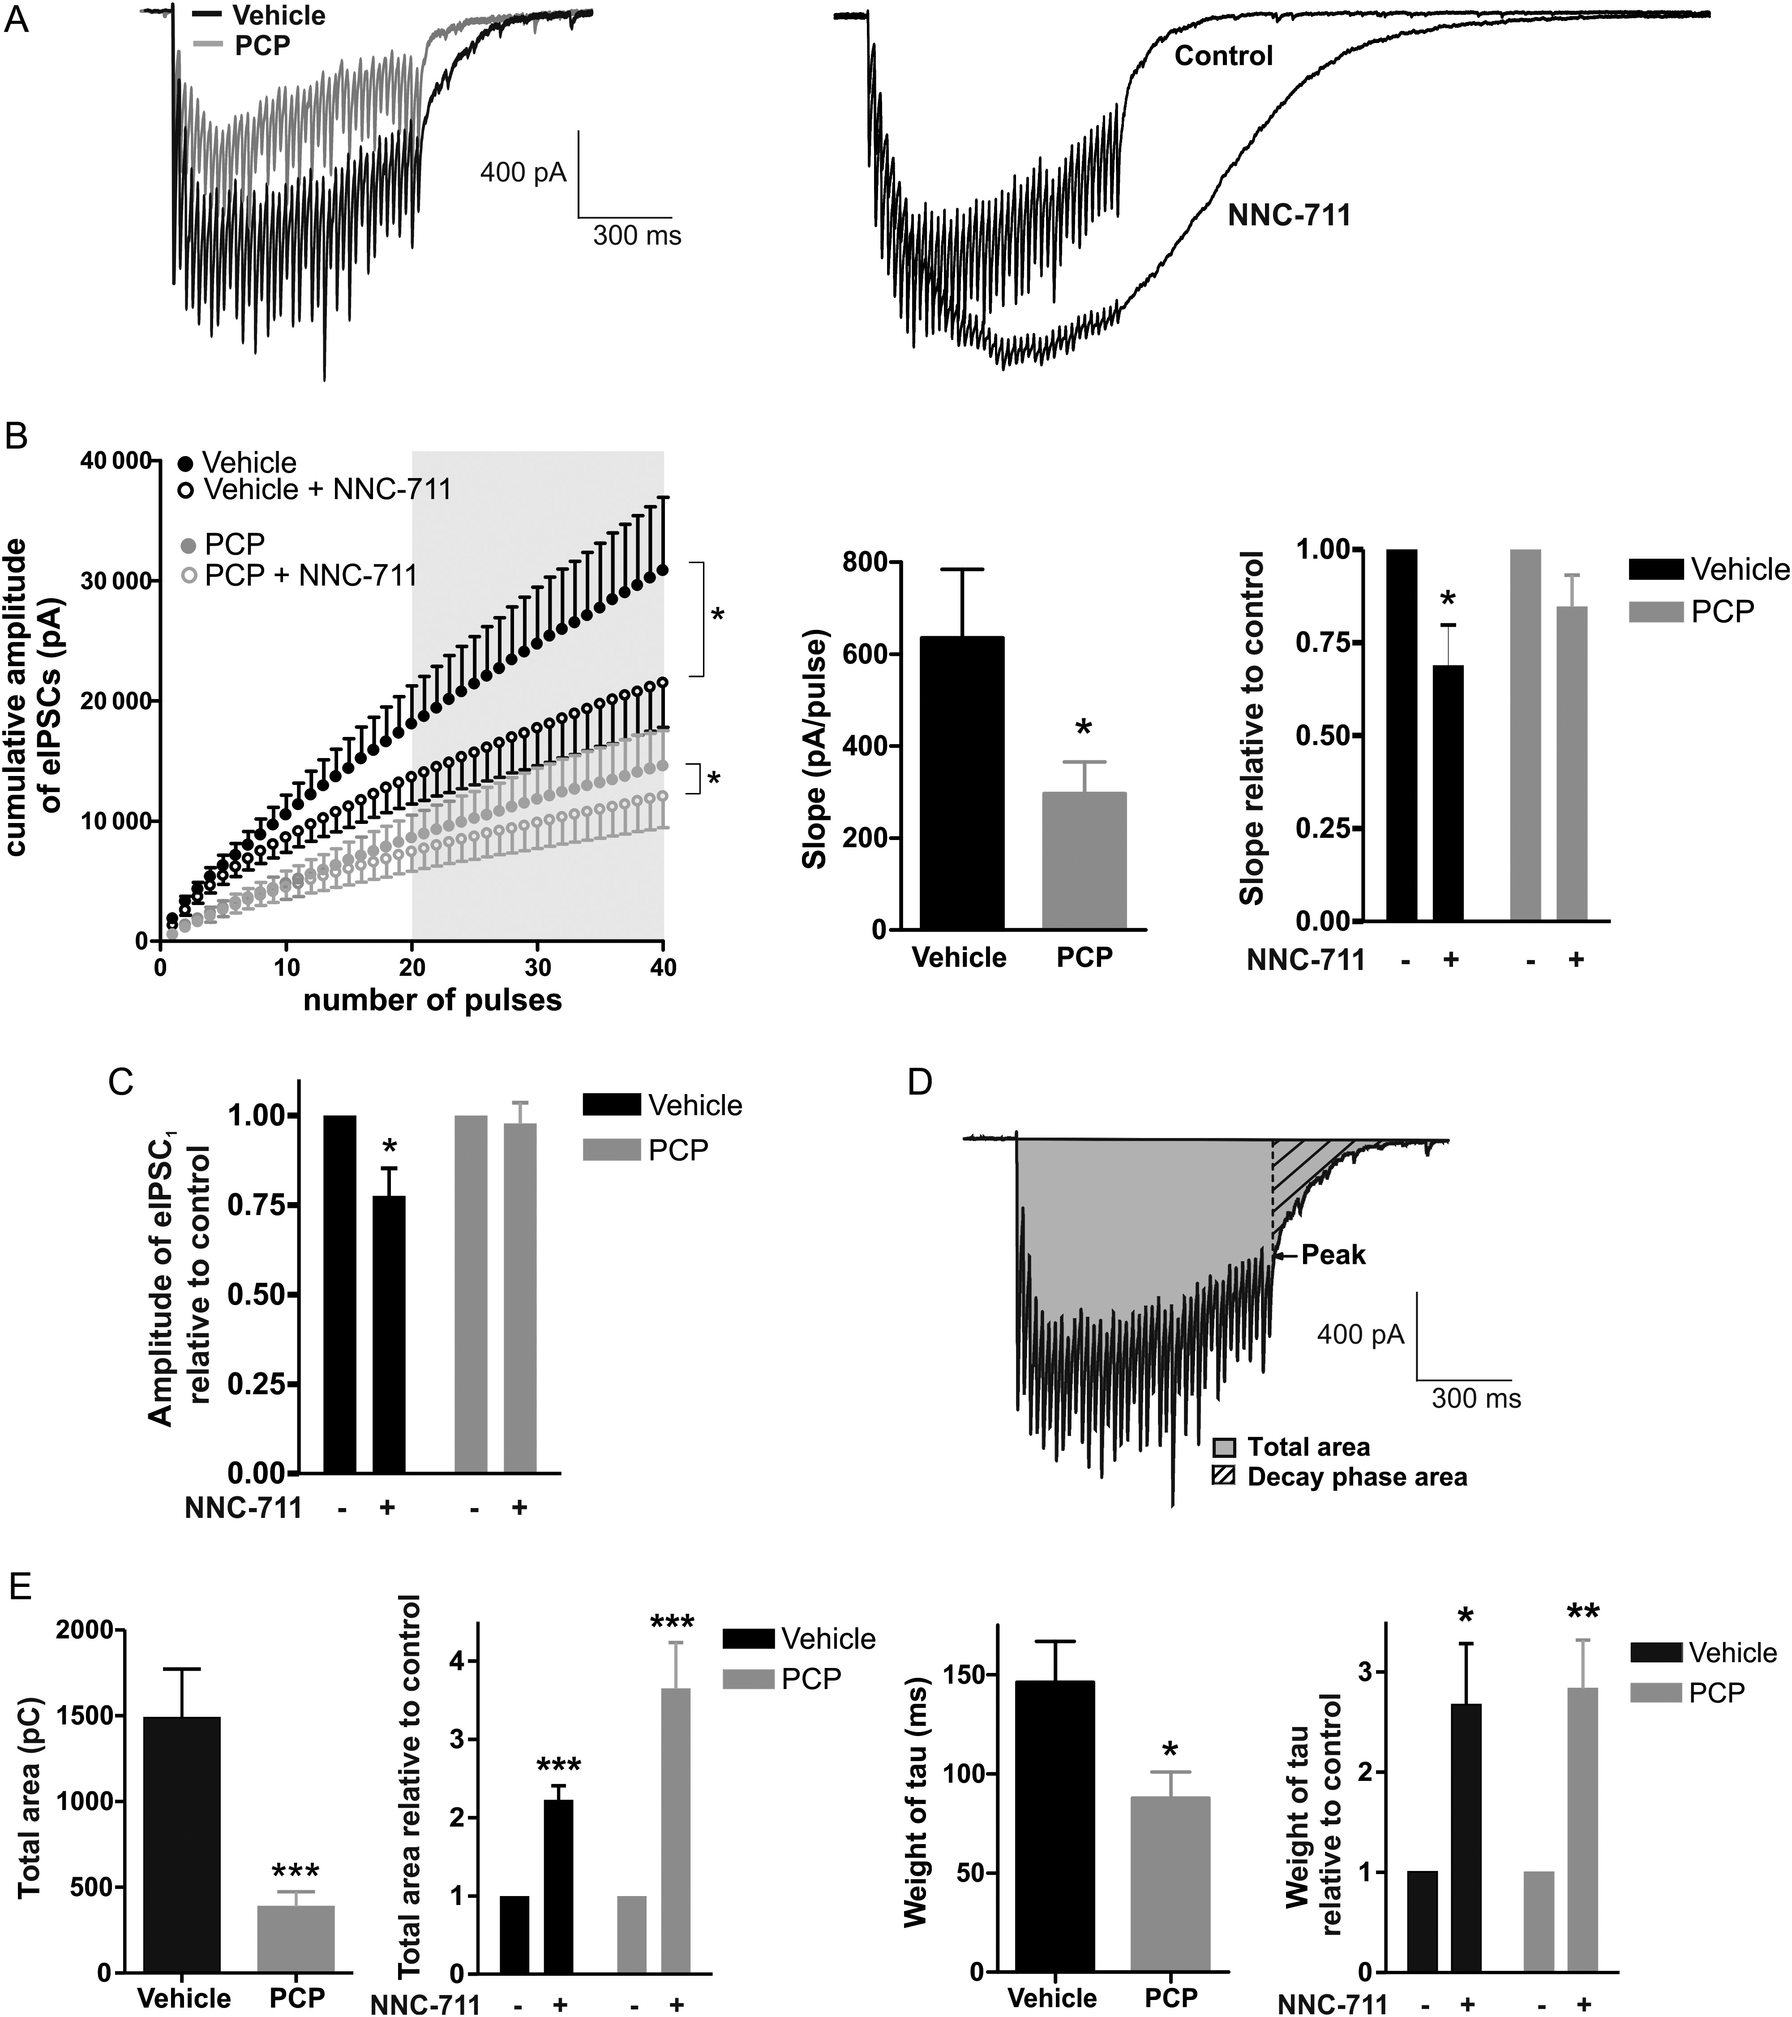
Figure 7. GABA recycling and extrasynaptic GABA_{A}-mediated current assessed during HFS are affected following ...
Notes:
Figure 7. GABA recycling and extrasynaptic GABAA-mediated current assessed during HFS are affected following PCP treatment. (A) Representative traces showing eIPSCs during HFS are displayed for vehicle- and PCP-treated animals, and before and after wash-in of 1,2,5,6-tetrahydro-1-[2-[[(diphenylmethylene)amino]oxy]ethyl]-3-pyridinecarboxylic acid (NNC-711) in vehicle animals. (B) Left: in response to wash-in of the inhibitor of the GABA transporter 1 (GAT-1), NNC-711, the slope of the linear part of the cumulative amplitude plot (pulses 20–40) is reduced in both vehicle (P < 0.05) and PCP (P < 0.05) rats. Middle: The slopes before NNC-711 wash-in are significantly different between vehicle and PCP animals (P < 0.05). Right: The NNC-711 slope values relative to control are significantly different from 1 in vehicle (P < 0.05) and with a strong trend in PCP animals (P = 0.0982). (C) The amplitude of the first eIPSC1 is reduced in response to NNC-711 in vehicle (P < 0.05), but not in PCP, animals. (D) The total area of HFS-induced current and the weight of tau for the decay phase (ratio between decay-phase area and peak after last eIPSC) were calculated as illustrated for vehicle. (E) The total area is reduced in PCP animals (P < 0.001) in comparison to vehicle. Upon NNC-711 wash-in, a pronounced relative increase in total area is evident for both vehicle (P < 0.001) and PCP (P < 0.001) animals. Furthermore, PCP animals display a reduction in weight of tau (P < 0.05). The addition of NNC-711 produces a relative increase in weight of tau in both vehicle (P < 0.05) and PCP (P < 0.01) animals. *P < 0.05; **P < 0.01; ***P < 0.001. Vehicle, n = 9; PCP, n = 12.
Unless provided in the caption above, the following copyright applies to the content of this slide: © The Author 2013. Published by Oxford University Press. All rights reserved. For Permissions, please e-mail: journals.permissions@oup.com

Slide 8
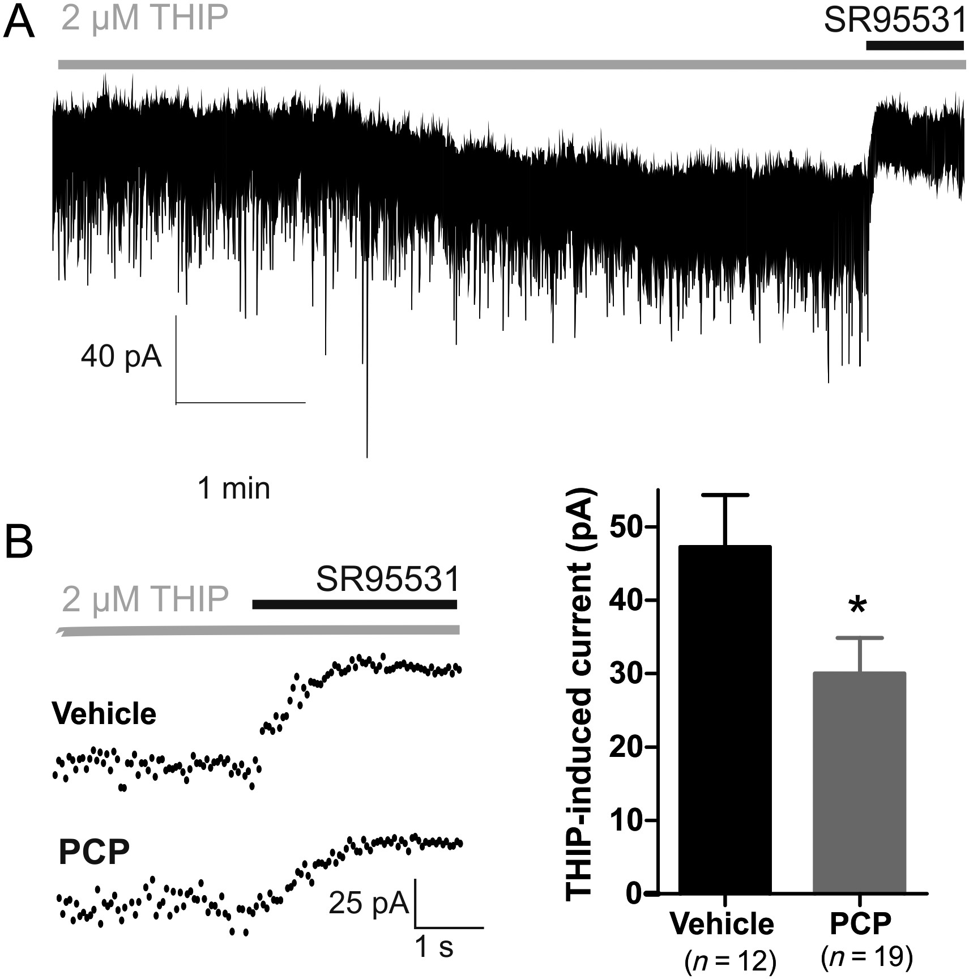
Figure 8. Extrasynaptic GABA_{A}-mediated current is reduced in PCP-treated animals. (A) Representative current ...
Notes:
Figure 8. Extrasynaptic GABAA-mediated current is reduced in PCP-treated animals. (A) Representative current trace (sampling interval: 50 ms) showing 5-min perfusion with 2 μM of the δ-containing extrasynaptic GABAA receptor agonist, THIP, followed by the addition of the GABAA receptor antagonist, SR95531. The change in holding current was measured for assessment of THIP-induced current. (B) Representative traces showing shift in holding current in response to SR95531 in vehicle- and PCP-treated animals. THIP-induced GABAA-mediated current was significantly reduced in PCP animals (P < 0.05). *P < 0.05. Vehicle: n = 12; PCP: n = 19.
Unless provided in the caption above, the following copyright applies to the content of this slide: © The Author 2013. Published by Oxford University Press. All rights reserved. For Permissions, please e-mail: journals.permissions@oup.com

