Slide 1
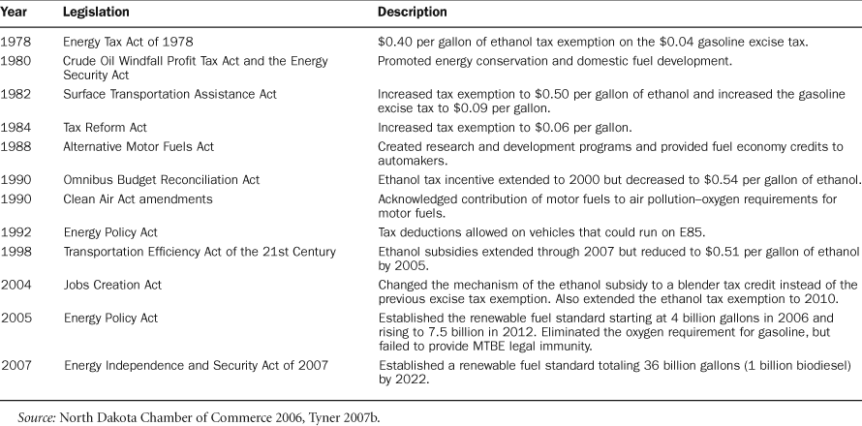
Table 1. History of ethanol subsidy legislation.
Notes:
Table 1. History of ethanol subsidy legislation.
Unless provided in the caption above, the following copyright applies to the content of this slide: © 2008 American Institute of Biological Sciences

Slide 2
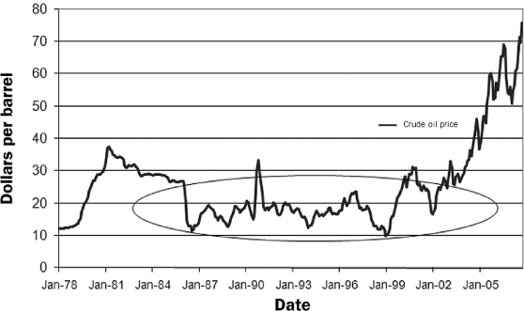
Figure 1. Composite refiner acquisition cost of crude oil, 1978 through September 2007 (Tyner 2007b).
Notes:
Figure 1. Composite refiner acquisition cost of crude oil, 1978 through September 2007 (Tyner 2007b).
Unless provided in the caption above, the following copyright applies to the content of this slide: © 2008 American Institute of Biological Sciences

Slide 3
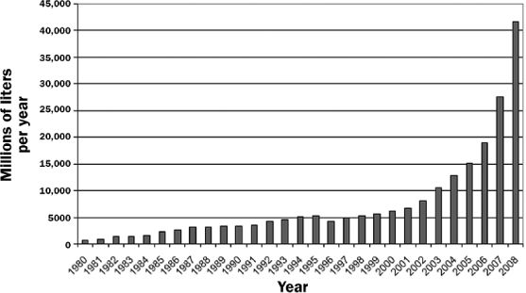
Figure 2. US ethanol production (millions of liters per year) from 1980 through 2008 (projected) (Tyner 2007b).
Notes:
Figure 2. US ethanol production (millions of liters per year) from 1980 through 2008 (projected) (Tyner 2007b).
Unless provided in the caption above, the following copyright applies to the content of this slide: © 2008 American Institute of Biological Sciences

Slide 4
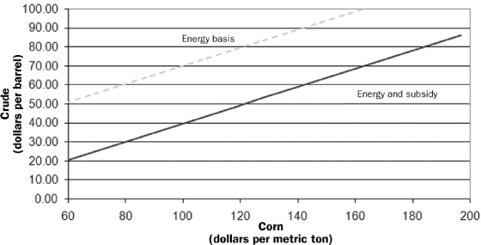
Figure 3. Breakeven prices of crude oil and corn with energy-equivalent pricing and with energy-equivalent pricing plus ...
Notes:
Figure 3. Breakeven prices of crude oil and corn with energy-equivalent pricing and with energy-equivalent pricing plus the federal ethanol subsidy.
Unless provided in the caption above, the following copyright applies to the content of this slide: © 2008 American Institute of Biological Sciences

Slide 5
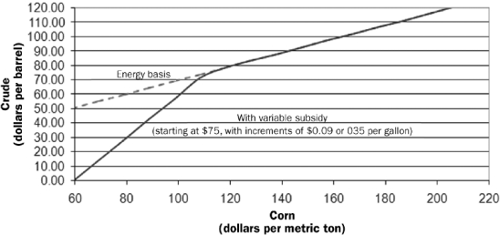
Figure 4. Breakeven prices of crude oil and corn with ethanol priced on an energy-equivalent basis with gasoline, with ...
Notes:
Figure 4. Breakeven prices of crude oil and corn with ethanol priced on an energy-equivalent basis with gasoline, with and without a subsidy that varies with the price of crude oil.
Unless provided in the caption above, the following copyright applies to the content of this slide: © 2008 American Institute of Biological Sciences

Slide 6
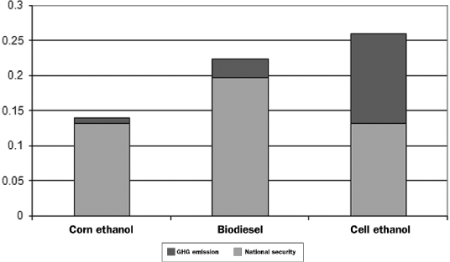
Figure 5. Illustration of a two-part subsidy with the two parts being based on contribution to energy security and ...
Notes:
Figure 5. Illustration of a two-part subsidy with the two parts being based on contribution to energy security and contribution to reduction in greenhouse gas emissions (Tyner 2007b).
Unless provided in the caption above, the following copyright applies to the content of this slide: © 2008 American Institute of Biological Sciences

Slide 7
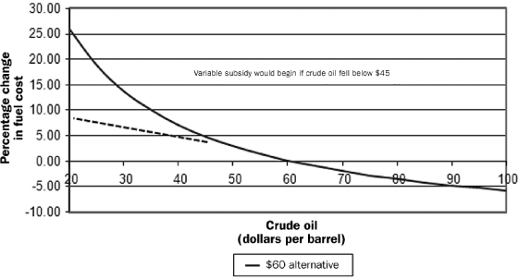
Figure 7. Illustration of a renewable fuel standard combined with a variable subsidy that begins at $45 per barrel of ...
Notes:
Figure 7. Illustration of a renewable fuel standard combined with a variable subsidy that begins at $45 per barrel of oil (Tyner 2007b).
Unless provided in the caption above, the following copyright applies to the content of this slide: © 2008 American Institute of Biological Sciences

Slide 8
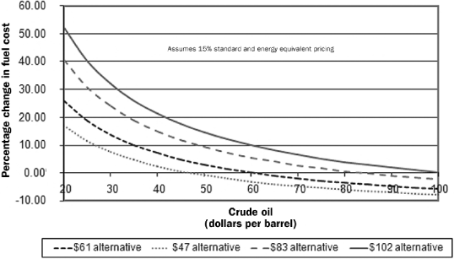
Figure 6. Illustration of the impacts on consumer fuel purchases of a renewable fuel standard of 15 percent under ...
Notes:
Figure 6. Illustration of the impacts on consumer fuel purchases of a renewable fuel standard of 15 percent under different assumptions of cost of renewable fuel alternatives and crude oil (Tyner 2007b).
Unless provided in the caption above, the following copyright applies to the content of this slide: © 2008 American Institute of Biological Sciences

