Slide 1
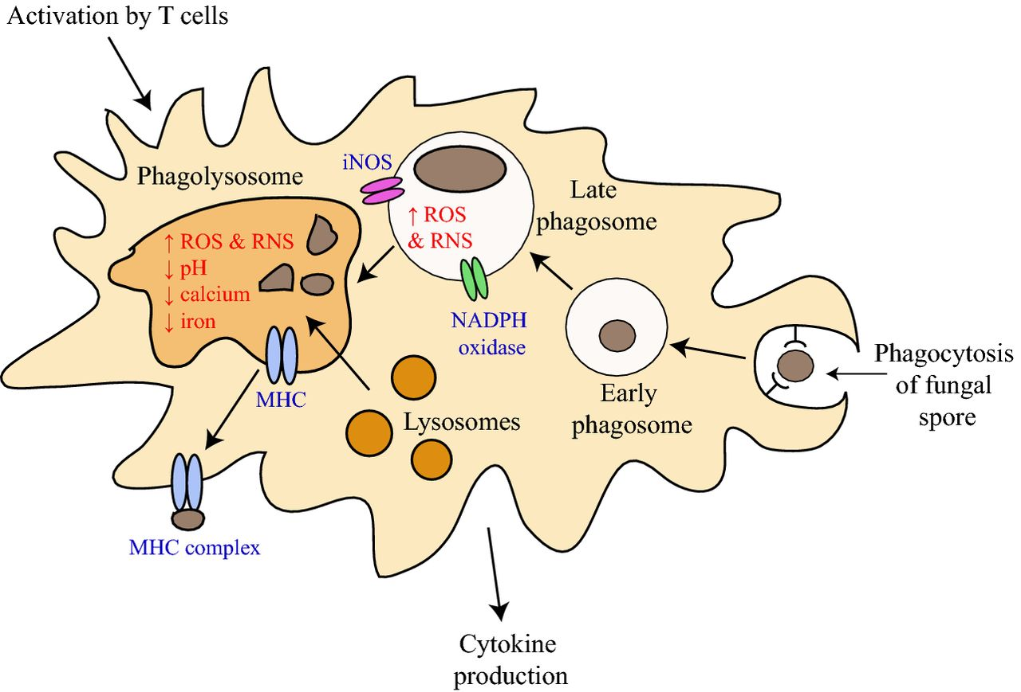
Figure 1. Phagocytes of the host immune system destroy fungal cells through the phagolysosomal pathway. In the lungs of ...
Notes:
Figure 1. Phagocytes of the host immune system destroy fungal cells through the phagolysosomal pathway. In the lungs of an immunocompetent host, the fungal infectious propagules (usually asexual spores) are recognized by host innate immune cells such as macrophages and neutrophils. Specific fungal cell-wall components termed PAMPs are recognized via membrane-associated PRRs on macrophage membranes. Once recognized, fungal cells are phagocytosed into an early phagosome. The early phagosome matures to a late phagosome by producing both ROS and RNS to damage the fungal cell from NADPH oxidase and iNOS. Lysosomes fuse with the late phagosome to produce the phagolysosome, a compartment with low pH and which contains hydrolytic enzymes to further damage the fungal cell. The MHC complex displays peptide fragments from the destroyed fungal cell for recognition by T cells. The activated macrophage releases cytokines to stimulate other cells of the immune system. Fungal cells may survive within the macrophage by the neutralization or adaptation to ROS and RNS production, by preventing the release of cytokines and by inducing genes allowing the acquisition of iron and calcium.
Unless provided in the caption above, the following copyright applies to the content of this slide: © FEMS 2015. All rights reserved. For permissions, please e-mail: journals.permissions@oup.com

Slide 2
Figure 2. Cellular morphologies of dimorphic human fungal pathogens. The growth morphologies of the dimorphic ...
Notes:
Figure 2. Cellular morphologies of dimorphic human fungal pathogens. The growth morphologies of the dimorphic ascomycetes Histoplasma capsulatum (Ajellomyces capsulatum), Blastomyces dermatitidis (Ajellomyces dermatitidis), Talaromyces marneffei (Penicillium marneffei), Coccidioides immitis, Paracoccidioides brasiliensis and Sporothrix schenckii (Ophiostoma schenckii). In general, these fungi grow in a multicellular hyphal form at 25°C and switch to producing unicellular yeast growth forms at 37°C, with the exception of Coccidioides species that produce spherules. For a number of these fungi, the yeast form serves to accommodate intracellular growth within host phagocytes.
Unless provided in the caption above, the following copyright applies to the content of this slide: © FEMS 2015. All rights reserved. For permissions, please e-mail: journals.permissions@oup.com

Slide 3
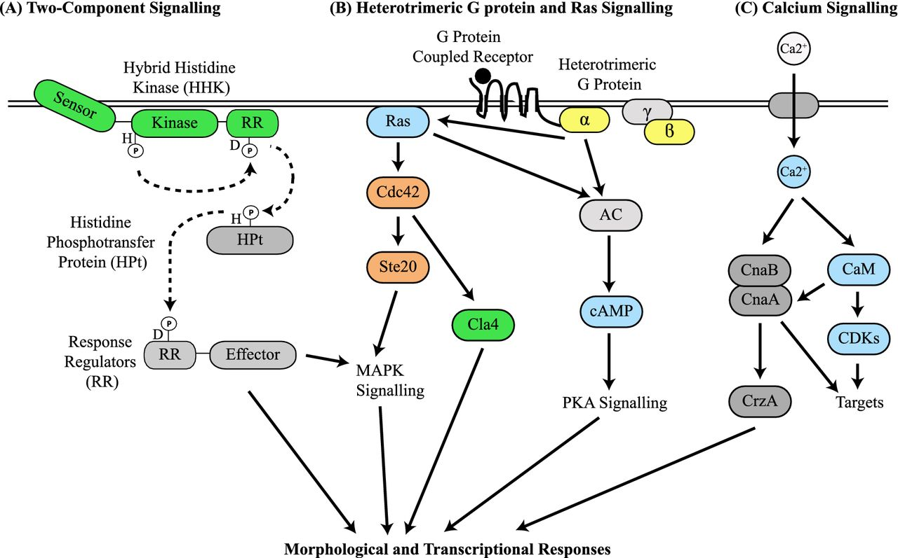
Figure 3. Model of the signalling pathways controlling dimorphic switching and yeast growth at 37°C. The colours ...
Notes:
Figure 3. Model of the signalling pathways controlling dimorphic switching and yeast growth at 37°C. The colours indicate characterized roles in dimorphism: green, mutation or RNAi inhibition affects dimorphism; yellow, expression is induced during the dimorphic switch, blue, chemical inhibition or exogenous addition affects the dimorphic switch; and orange, mutation indicates no role in dimorphism. (A) Two-component signalling systems in fungi require four sequential phosphorylation events (H→D→H→D) and comprising one or multiple membrane-associated HHK, an intermediate histidine phosphotransfer protein (HPt) and two RRs. The HK perceives the environmental stimulus and is autophosphorylated at a conserved histidine in the kinase domain. The phosphate group is then transferred to a conserved aspartate in the HHK's RR domain and then to a conserved histidine in the HPt phosphotransfer protein (HPt). The HPt protein transfers the phosphate to an aspartate residue in the RR. The RR can either bind DNA directly or activate MAPK pathways to elucidate a morphological and transcriptional response. (B) Binding of the ligand to the G protein coupled receptor triggers GDP to GTP exchange in the Gα subunit of a heterotrimeric G protein which dissociates from the ß and γ subunits. The Gα subunit activates adenylate cyclase (AC) and subsequent cAMP/protein kinase A (PKA) signalling, in addition to, the Ras GTPase. Ras activates the Rho GTPase Cdc42, which in addition to controlling actin-mediated polarized growth, regulates the p21 activated kinases Ste20 and Cla4 to signal via MAPK pathways and regulate cellular division. (C) Entry of calcium (Ca2+) into the cell or release from internal stores acts as a transient intracellular signal. Binding of Ca2+ to calmodulin (CaM) enables it to activate the calmodulin-dependent kinases (CDKs) and the calcineurin phosphatase (CnaB/CnaA). Ca2+ binding to the regulatory subunit of calcineurin (CnaB) allows activation of the catalytic subunit (CnaA). CnaA dephosphorylates the CrzA transcription factor to allow entry into the nucleus to activate genes controlling processes such as cell-wall synthesis, germination of spores (conidia), ion homeostasis, pH adaptation, polarity and conidiophore development.
Unless provided in the caption above, the following copyright applies to the content of this slide: © FEMS 2015. All rights reserved. For permissions, please e-mail: journals.permissions@oup.com

Slide 4
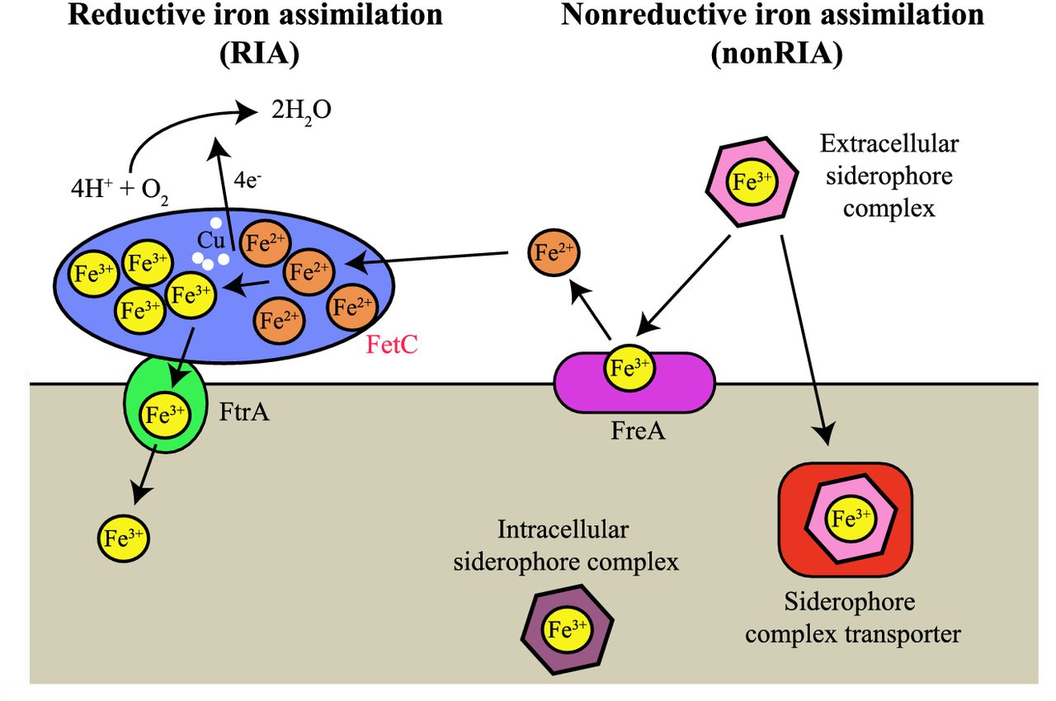
Figure 4. High-affinity iron uptake systems in dimorphic fungi. Most dimorphic fungi utilize both RIA and non-RIA ...
Notes:
Figure 4. High-affinity iron uptake systems in dimorphic fungi. Most dimorphic fungi utilize both RIA and non-RIA systems to mediate high-affinity iron uptake when bioavailable iron is low, such as within host phagocytes. In the RIA system, ferric iron (Fe3+) is reduced to ferrous iron (Fe2+) by FreA (orthologous to S. cerevisiae Fet1). Subsequently, in a copper and oxygen-dependent reaction, ferrous iron (Fe2+) is oxidized by the multi-copper oxidase FetC (orthologous to S. cerevisiae Fet3) and the ferric iron (Fe3+) is transported across the membrane by the FtrA permease (orthologous to S. cerevisiae Ftr1). C. immitis and P. brasiliensis lack both ftrA and fetC homologues. fetC is upregulated during yeast growth in T. marneffei. Non-RIA iron uptake requires the biosynthesis of extracellular ferric iron (Fe3+) chelators called siderophores. Siderophores can provide scavenged ferric iron (Fe3+) to FreA for the RIA uptake system or be transported into the cell by siderophore complex transporters.
Unless provided in the caption above, the following copyright applies to the content of this slide: © FEMS 2015. All rights reserved. For permissions, please e-mail: journals.permissions@oup.com

