Slide 1
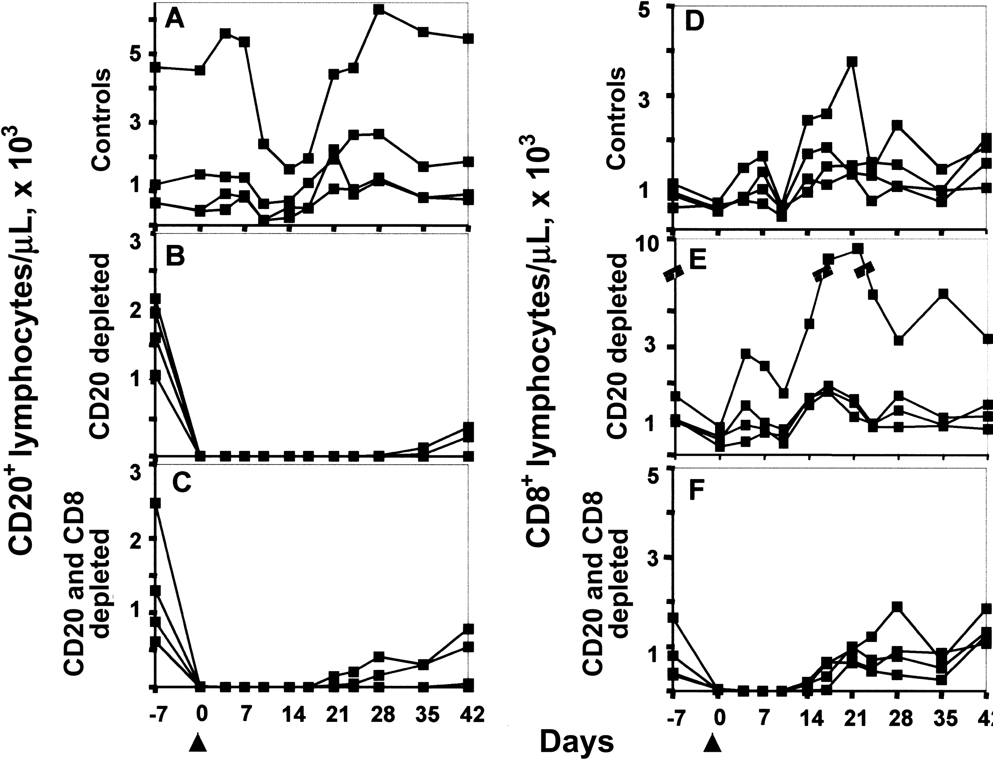
Figure 1. Depletion of CD20⁺ and CD8⁺ lymphocytes in peripheral blood from rhesus monkeys, by ...
Notes:
Figure 1. Depletion of CD20+ and CD8+ lymphocytes in peripheral blood from rhesus monkeys, by intravenous infusion of the monoclonal mouse/human chimeric anti-human CD20 antibody (Rituxan) alone or with monoclonal mouse/human chimeric anti-CD8 antibody (cM-T807). Infusion of the control monoclonal antibody (MAb) had no effect on the number of CD20+ or CD8+ lymphocytes in peripheral blood from monkeys. A, CD20+ lymphocyte counts in control MAb-treated monkeys. B, CD20+ lymphocyte counts in monkeys treated with anti-CD20 MAb. C, CD20+ lymphocyte counts in monkeys treated with both anti-CD20 and anti-CD8 MAbs. D, CD8+ T lymphocyte counts in control MAb-treated monkeys. E, CD8+ T lymphocyte counts in monkeys treated with anti-CD20 MAb. F, CD8+ T lymphocyte counts in monkeys treated with both anti-CD20 and anti-CD8 MAbs. Arrows indicate the time of inoculation of measles virus.
Unless provided in the caption above, the following copyright applies to the content of this slide: © 2004 by the Infectious Diseases Society of America

Slide 2
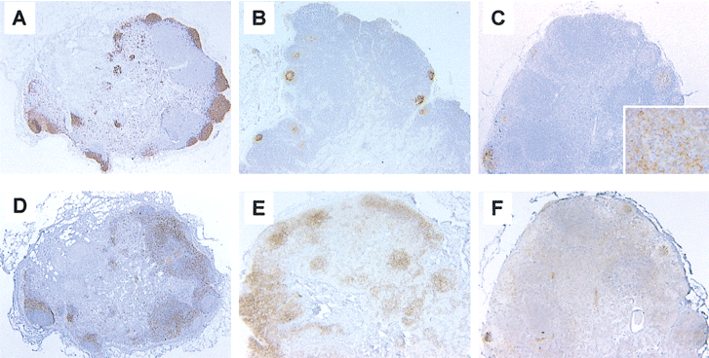
Figure 2. Near elimination of CD20⁺ or CD8⁺ lymphocytes from inguinal lymph nodes of rhesus ...
Notes:
Figure 2. Near elimination of CD20+ or CD8+ lymphocytes from inguinal lymph nodes of rhesus monkeys on day 7 after infection, by treatment with anti-CD20 or anti-CD8 monoclonal antibody (MAb). Shown are lymph nodes from a control MAb-treated monkey (A), an anti-CD20 MAb-treated monkey (B), and an anti-CD8 and anti-CD20 MAb-treated monkey (C), stained for expression of CD20 (original magnification, ×20). Inset, High magnification (×400) of CD20 staining, showing a noncellular, reticular pattern, indicating that the majority of the CD20 staining in this lymph node is in the follicular dendritic cell network. Shown are lymph nodes from a control MAb-treated monkey (D), an anti-CD20 MAb-treated monkey (E), and an anti-CD8 and anti-CD20 MAb-treated monkey (F), stained for expression of CD8 (original magnification, ×20).
Unless provided in the caption above, the following copyright applies to the content of this slide: © 2004 by the Infectious Diseases Society of America

Slide 3
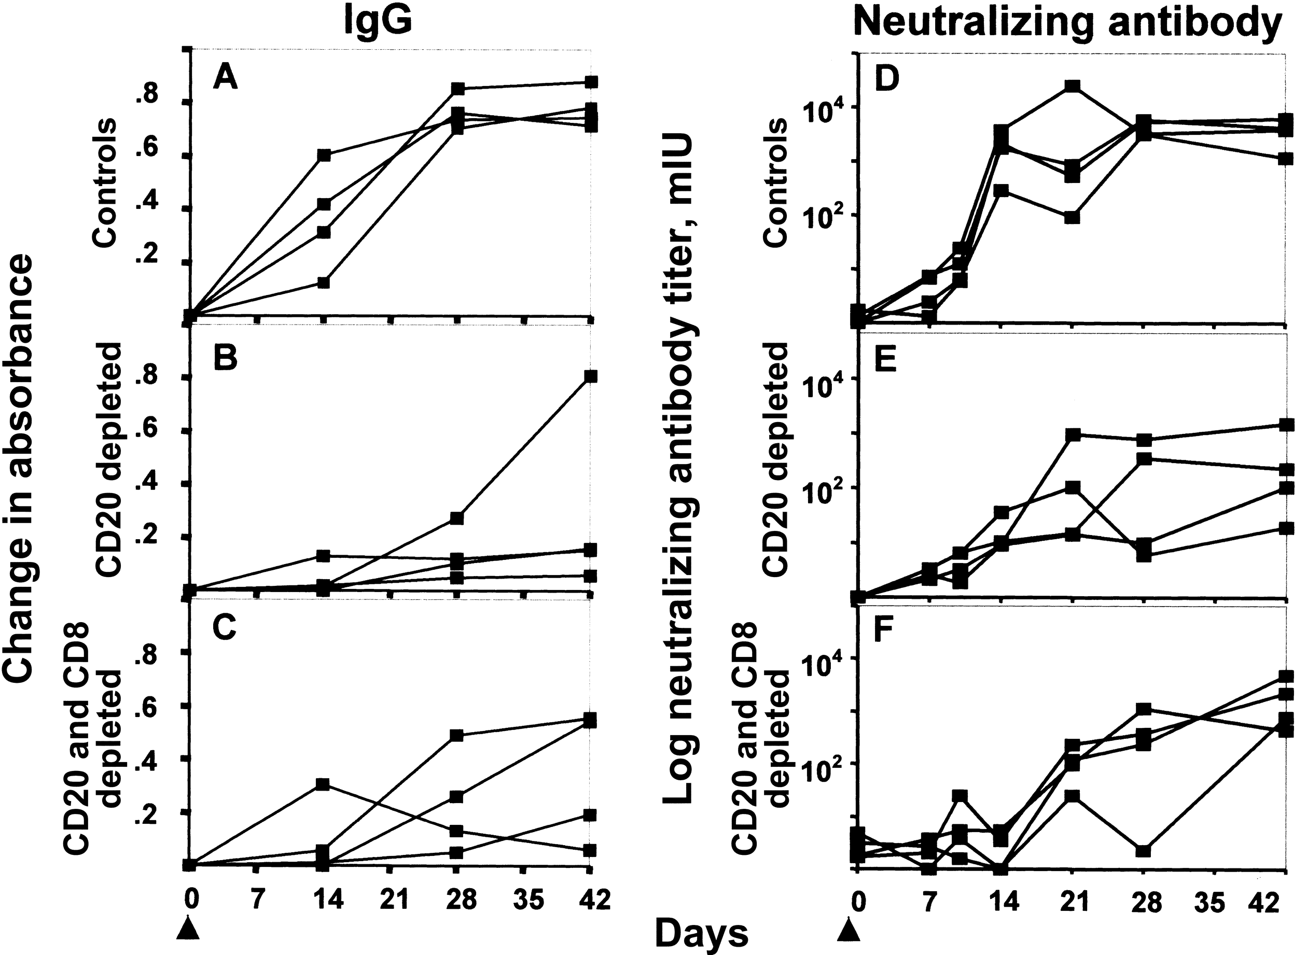
Figure 3. Delayed anti-measles virus (MV) antibody response in CD20⁺ lymphocyte-depleted monkeys, compared ...
Notes:
Figure 3. Delayed anti-measles virus (MV) antibody response in CD20+ lymphocyte-depleted monkeys, compared with that in control monkeys. Serum IgG antibodies were measured by ELISA, and neutralizing antibodies were measured by plaque-reduction assay. A, MV-specific IgG in control monkeys. B, MV-specific IgG in CD20+ lymphocyte-depleted monkeys. C, MV-specific IgG in CD20+ and CD8+ lymphocyte-depleted monkeys. D, MV neutralizing antibody titer in control monkeys. E, MV neutralizing antibody titer in CD20+ lymphocyte-depleted monkeys. F, MV neutralizing antibody titer in CD20+ and CD8+ lymphocyte-depleted monkeys. Arrows indicate the time of inoculation of MV.
Unless provided in the caption above, the following copyright applies to the content of this slide: © 2004 by the Infectious Diseases Society of America

Slide 4
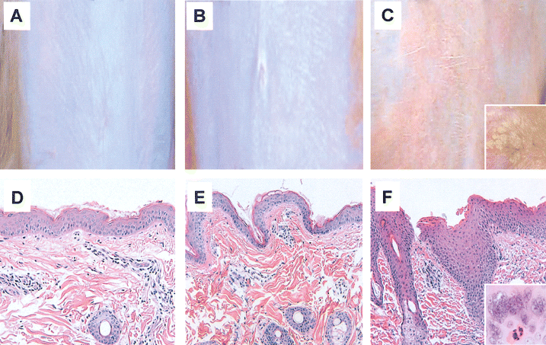
Figure 4. Development of a desquamating rash covering the abdomen, chest, and face, which appeared, in histologic ...
Notes:
Figure 4. Development of a desquamating rash covering the abdomen, chest, and face, which appeared, in histologic terms, as epidermal hyperplasia with hyperkeratosis, in CD20+ and CD8+ lymphocyte-depleted monkeys. Shown are the abdomens, during the peak of rash (days 14–17), of a control monoclonal antibody (MAb)-treated monkey (A), an anti-CD20 MAb-treated monkey (B), and an anti-CD8 and anti-CD20 MAb-treated monkey (C). Inset, Desquamating scaling on the cheek of an anti-CD8 and anti-CD20 MAb-treated monkey on day 17 after infection (C). Shown is abdominal skin, during the peak of rash (days 14–17), from a control MAb-treated monkey (D), an anti-CD20 MAb-treated monkey (E), and an anti-CD8 and anti-CD20 MAb-treated monkey (F), stained with hematoxylin-eosin (original magnification, ×100). Inset, Epithelial multinucleated giant cells in a hair follicle of an anti-CD8 and anti-CD20 MAb-treated monkey (F) (original magnification, ×400).
Unless provided in the caption above, the following copyright applies to the content of this slide: © 2004 by the Infectious Diseases Society of America

Slide 5
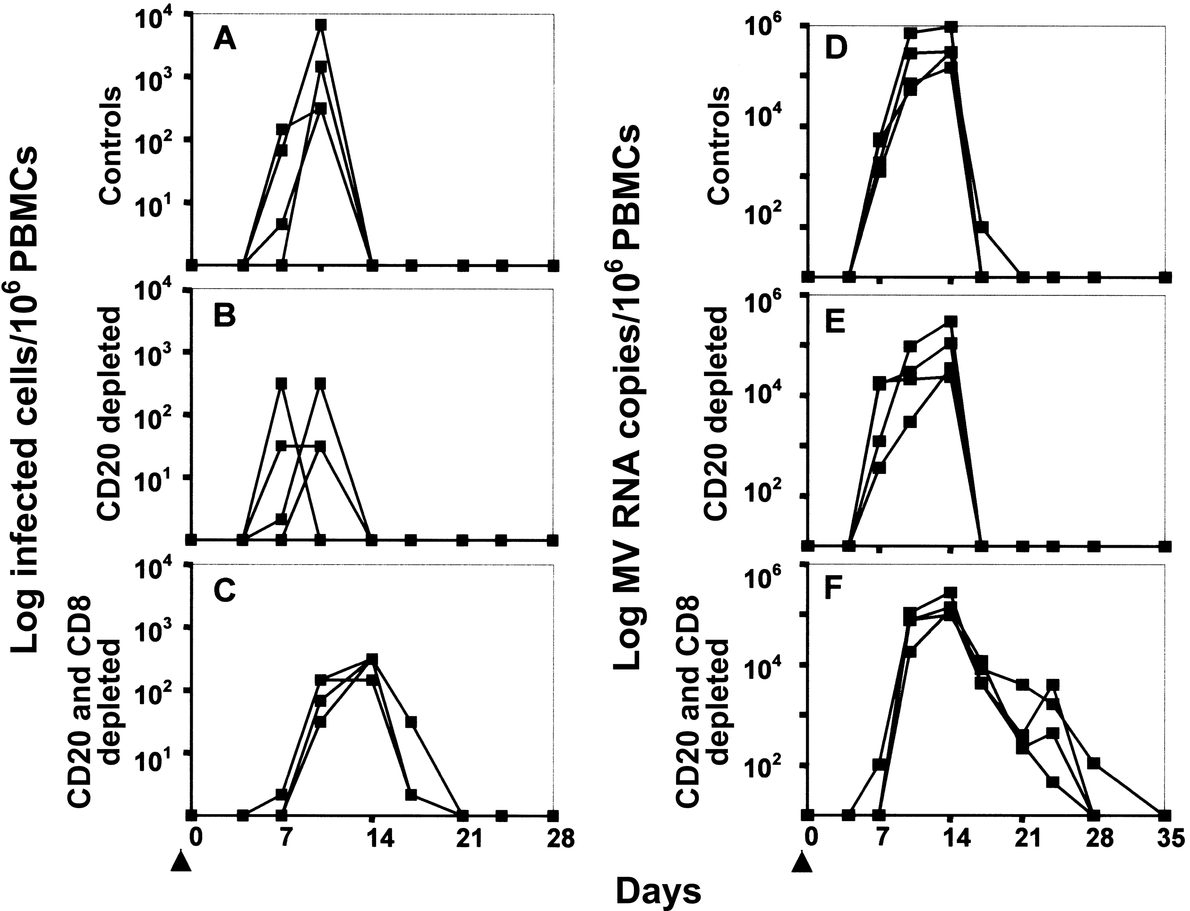
Figure 5. Titers of infectious measles virus (MV) and MV RNA copies in peripheral blood mononuclear cells (PBMCs) from ...
Notes:
Figure 5. Titers of infectious measles virus (MV) and MV RNA copies in peripheral blood mononuclear cells (PBMCs) from control, CD20+ lymphocyte-depleted, and CD20+ and CD8+ lymphocyte-depleted monkeys. Infectious virus was measured by cocultivation of PBMCs with B95-8 cells. MV RNA copies were measured by quantitative MV-specific reverse-transcriptase polymerase chain reaction assessment of PBMCs. A, MV infectious titers in control monkeys. B, MV infectious titers in CD20+ lymphocyte-depleted monkeys. C, MV infectious titers in CD20+ and CD8+ lymphocyte-depleted monkeys. D, MV RNA copies in control monkeys. E, MV RNA copies in CD20+ lymphocyte-depleted monkeys. F, MV RNA copies in CD20+ and CD8+ lymphocyte-depleted monkeys. Arrows indicate the time of inoculation of MV.
Unless provided in the caption above, the following copyright applies to the content of this slide: © 2004 by the Infectious Diseases Society of America

