Slide 1
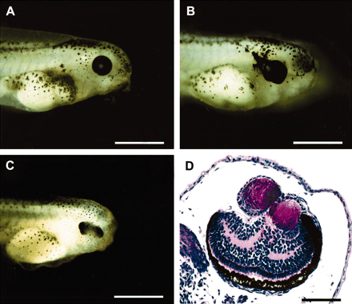
Figure 6. Induction of ectopic eye structures in Xenopus embryos by injection of Drosophila ey and toy mRNA at the ...
Notes:
Figure 6. Induction of ectopic eye structures in Xenopus embryos by injection of Drosophila ey and toy mRNA at the two-cell stage (Onuma et al. 2002). (A) Control embryo noninjected. (B) Embryo injected with 0.5 ng ey mRNA showing expansion of the retinal pigment epithelium. (C) Embryo injected with 2 ng toy mRNA showing a duplication of the retina. (D) Cross-section of an embryo injected with 0.25 ng ey mRNA showing a duplication of the lens and retina.
Unless provided in the caption above, the following copyright applies to the content of this slide: © 2005 The American Genetic Association

Slide 2
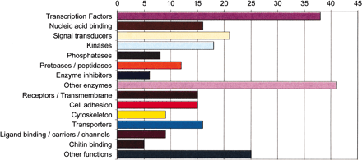
Figure 5. Repartition of ey-induced genes in third instar larval leg discs in which an eye morphogenetic field is ...
Notes:
Figure 5. Repartition of ey-induced genes in third instar larval leg discs in which an eye morphogenetic field is induced (Michaut et al. 2003).
Unless provided in the caption above, the following copyright applies to the content of this slide: © 2005 The American Genetic Association

Slide 3
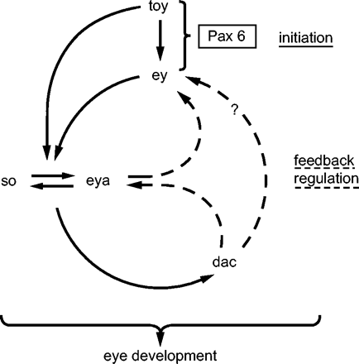
Figure 4. Gene regulatory network controlling eye determination in Drosophila.
Notes:
Figure 4. Gene regulatory network controlling eye determination in Drosophila.
Unless provided in the caption above, the following copyright applies to the content of this slide: © 2005 The American Genetic Association

Slide 4
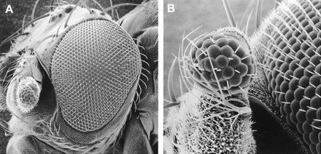
Figure 3. Ectopic Drosophila compound eye induced on the antenna by targeted expression of the mouse Small eye (Sey) (= ...
Notes:
Figure 3. Ectopic Drosophila compound eye induced on the antenna by targeted expression of the mouse Small eye (Sey) (= Pax6) gene. (A) Overview. (B) Higher magnification. Scanning electron micrograph (REM Laboratory, University of Basel).
Unless provided in the caption above, the following copyright applies to the content of this slide: © 2005 The American Genetic Association

Slide 5
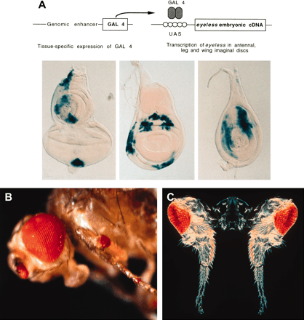
Figure 2. Targeted expression of eyeless and twin of eyeless and induction of ectopic eyes in Drosophila (Halder et al. ...
Notes:
Figure 2. Targeted expression of eyeless and twin of eyeless and induction of ectopic eyes in Drosophila (Halder et al. 1995). (A) Targeted expression of ey cDNA using a genomic enhancer to induce the gal4 transcription factor in various imaginal discs. Gal 4 binds to the upstream activating sequences (UAS) and drives the expression of ey into the respective areas of eye-antennal, wing, and leg discs. (B) Ectopic eyes induced by eyeless (ey). (C) Ectopic eyes induced by twin of eyeless (toy). Courtesy of Urs Kloter and Georg Halder.
Unless provided in the caption above, the following copyright applies to the content of this slide: © 2005 The American Genetic Association

Slide 6
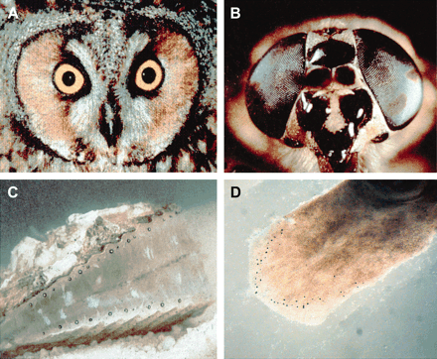
Figure 1. Different eye types. (A) Camera-type eye of an owl. (B) Compound eye of a horsefly. (C) Mirror-type eye of a ...
Notes:
Figure 1. Different eye types. (A) Camera-type eye of an owl. (B) Compound eye of a horsefly. (C) Mirror-type eye of a scallop. (D) Prototypic eyes consisting of a single photoreceptor cell and a pigment cell in the planarian Polycelis auricularia.
Unless provided in the caption above, the following copyright applies to the content of this slide: © 2005 The American Genetic Association

Slide 7
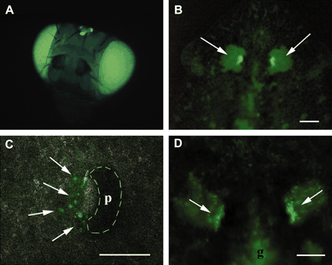
Figure 7. Planarians transformed by electroporation with GFP constructs with the Pax6-responsive P3-enhancer in the ...
Notes:
Figure 7. Planarians transformed by electroporation with GFP constructs with the Pax6-responsive P3-enhancer in the hermes transposon vector of Horn et al. (2000). (A) Transgenic Drosophila control. (B) Transgenic planarian line with homogenously green eyes 12 months after electroporation (after González-Estévez et al. 2003). (C) Transformed neoblasts turn green as they enter the eye field. (D) Mosaic eyes in which a large fraction of the original photoreceptor cells are replaced by transformed neoblasts.
Unless provided in the caption above, the following copyright applies to the content of this slide: © 2005 The American Genetic Association

Slide 8
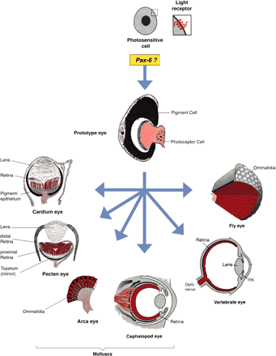
Figure 8. Hypothetical evolution of photosensitive cells containing rhodopsin as a light receptor and monophyletic ...
Notes:
Figure 8. Hypothetical evolution of photosensitive cells containing rhodopsin as a light receptor and monophyletic evolution of the various eye types. The eye prototype consisting of a photoreceptor cell and a pigment cell is assembled under the control of Pax6 (after Gehring and Ikeo 1999).
Unless provided in the caption above, the following copyright applies to the content of this slide: © 2005 The American Genetic Association

Slide 9
Figure 12. The colonial organization of Volvox and the structure of its photoreceptor organelle located in the ...
Notes:
Figure 12. The colonial organization of Volvox and the structure of its photoreceptor organelle located in the chloroplast of Eudorina. (A) Colonial organization. (B) Structure of a single flagellate (somatic cell). (C) Ultrastructure of the photoreceptor organelle in the chlorplast (thylakoid membranes) of Eudorina californica (after Grell 1973).
Unless provided in the caption above, the following copyright applies to the content of this slide: © 2005 The American Genetic Association

Slide 10
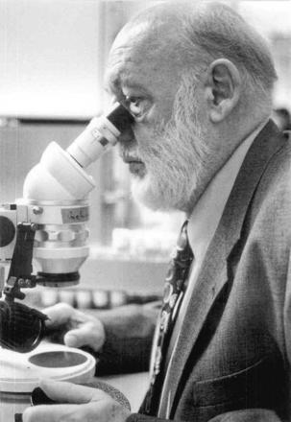
(Photograph by Ch. Scholz.) Walter J. Gehring is Professor at the Biozentrum of the University of Basel, ...
Notes:
(Photograph by Ch. Scholz.) Walter J. Gehring is Professor at the Biozentrum of the University of Basel, Switzerland. He obtained his Ph.D. at the University of Zurich in 1965 and after two years as a research assistant of Professor Ernst Hadorn he joined Professor Alan Garen's group at Yale University in New Haven as a postdoctoral fellow. In 1969 he was appointed as an associate professor at the Yale Medical School and 1972 he returned to Switzerland to become a professor of developmental biology and genetics at the Biozentrum of the University of Basel. He has served as Secretary General of the European Molecular Biology Organization and President of the International Society for Developmental Biologists. He was elected as a Foreign Associate of the US National Academy of Sciences, the Royal Swedish Academy of Science, the Leopoldina, a Foreign Member of the Royal Society of London for Improving Natural Knowledge and the French Académie des Sciences. Walter Gehring has been involved in studies of Drosophila genetics and development, particularly in the analysis of cell determination in the embryo and transdetermination of imaginal discs. He has made significant contributions to the study of the heat shock genes, various transposons and the homeotic genes which are involved in the genetic control of development. He and his group have discovered the homeobox, a DNA segment characteristic for homeotic genes which is not only present in arthropods and their ancestors, but also in vertebrates up to man. He has been involved in the development and application of enhancer trapping methods. He and his collaborators have identified Pax 6 as a master control gene for eye development, which led to a new theory about the monophyletic origin of the eyes in evolution.
Unless provided in the caption above, the following copyright applies to the content of this slide: © 2005 The American Genetic Association

Slide 11
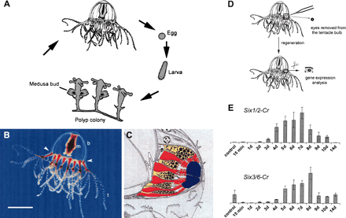
Figure 9. Life cycle and eye structure and regeneration of the eyes in the hydrozoan jellyfish Cladonema (after ...
Notes:
Figure 9. Life cycle and eye structure and regeneration of the eyes in the hydrozoan jellyfish Cladonema (after Stierwald 2004). (A) Life cycle. (B) Location of the eyes at the base of the tentacle (arrowheads). (C) Eye structure: photoreceptor cells (red), pigment cells (yellow), lens cells (blue). (D) Removal of an eye from the tentacle bulb and eye regeneration. (E) Gene expression analysis by quantitative PCR; both six 1 and 3 homologs are induced.
Unless provided in the caption above, the following copyright applies to the content of this slide: © 2005 The American Genetic Association

Slide 12
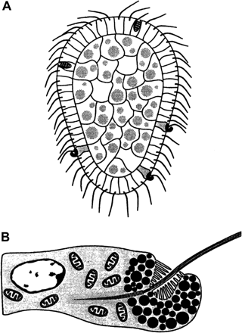
Figure 10. Unicellular photoreceptors in the planula larva of the box jellyfish Tripedalia (after Nordström et al. ...
Notes:
Figure 10. Unicellular photoreceptors in the planula larva of the box jellyfish Tripedalia (after Nordström et al. 2003). (A) Planula larva. (B) Unicellular photoreceptor with pigment granules, microvilli, and a flagellum.
Unless provided in the caption above, the following copyright applies to the content of this slide: © 2005 The American Genetic Association

Slide 13
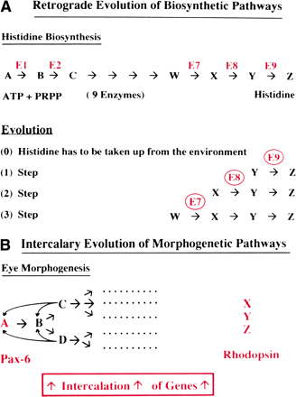
Figure 11. Models for the evolution of biosynthetic and morphogenetic pathways. (A) Retrograde evolution of biosynthetic ...
Notes:
Figure 11. Models for the evolution of biosynthetic and morphogenetic pathways. (A) Retrograde evolution of biosynthetic pathways (after Horowitz 1945). (B) Intercalary evolution of the eye morphogenetic pathway (after Gehring and Ikeo 1999).
Unless provided in the caption above, the following copyright applies to the content of this slide: © 2005 The American Genetic Association

Slide 14
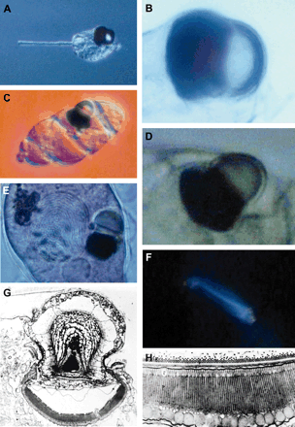
Figure 13. Eye organelle of the unicelllular dinoflagellates Erythropsis and Warnowia. (A) Erythropsis. (B) Eye ...
Notes:
Figure 13. Eye organelle of the unicelllular dinoflagellates Erythropsis and Warnowia. (A) Erythropsis. (B) Eye organelle of Erythropsis. (C) Warnowia. (D) Eye organelle of Warnowia. (E) Nucleus and eye organelle of Warnowia. (F) Birefringence, the retina-like structure detected in polarized light in Warnowia. (G) Ultrastructure of the eye organelle of Warnowia. (H) Ultrastructure of the retina-like structure with stacked membranes and large pigment granules. A–F courtesy of Makiko Seimiya and Jean and Colette Febvre; G–H from Greuet 1969.
Unless provided in the caption above, the following copyright applies to the content of this slide: © 2005 The American Genetic Association

