Slide 1
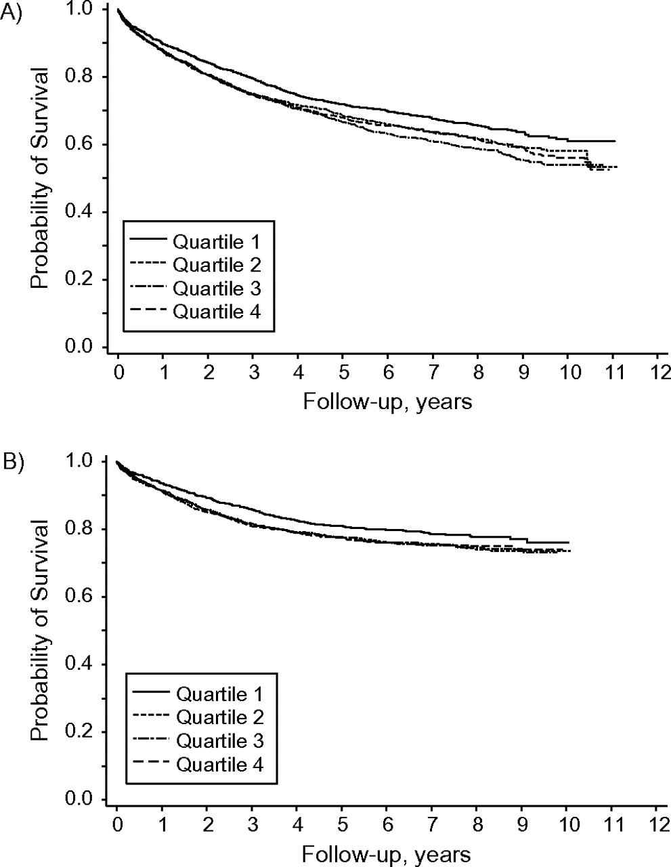
Figure 1. Kaplan-Meier survival curves for colorectal cancer (CRC) patients in the NIH-AARP Diet and Health Study, ...
Notes:
Figure 1. Kaplan-Meier survival curves for colorectal cancer (CRC) patients in the NIH-AARP Diet and Health Study, 1995–2005/2006. Neighborhood socioeconomic deprivation score was categorized into 4 quartiles (least deprived (quartile 1) to most deprived (quartile 4)). A) All-cause survival, 1995–December 31, 2006; B) CRC-specific survival, 1995–December 31, 2005. The log-rank test indicated highly significant statistical differences (P = 0.001 for all-cause survival and P = 0.008 for CRC survival). NIH, National Institutes of Health.
Unless provided in the caption above, the following copyright applies to the content of this slide: American Journal of Epidemiology © The Author 2011. Published by Oxford University Press on behalf of the Johns Hopkins Bloomberg School of Public Health. All rights reserved. For permissions, please e-mail: journals.permissions@oup.com.

