Slide 1
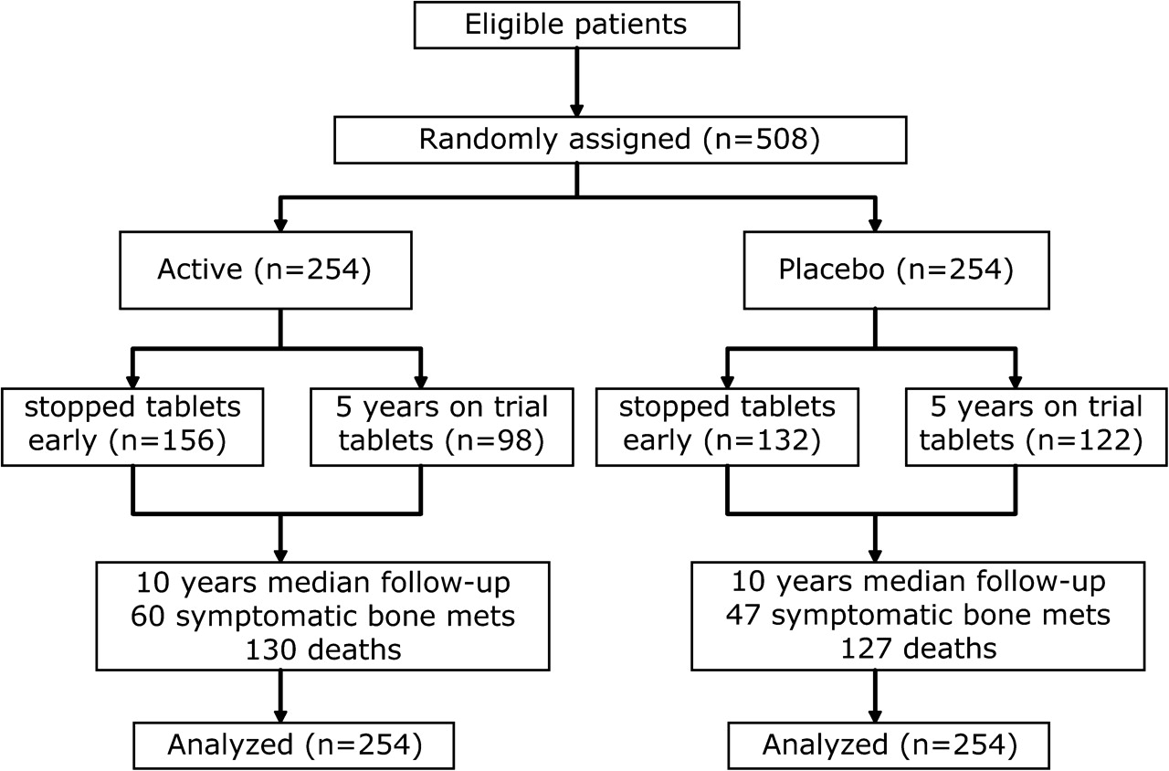
Fig. 1 CONSORT diagram showing the flow of patients through the trial, expressing the maturity of the trial data and ...
Notes:
Fig. 1 CONSORT diagram showing the flow of patients through the trial, expressing the maturity of the trial data and the number of randomly assigned patients who are included in these analyses.
Unless provided in the caption above, the following copyright applies to the content of this slide: © 2007 The Author(s).This is an Open Access article distributed under the terms of the Creative Commons Attribution Non-Commercial License (http://creativecommons.org/licenses/by-nc/2.0/uk/), which permits unrestricted non-commercial use, distribution, and reproduction in any medium, provided the original work is properly cited.

Slide 2
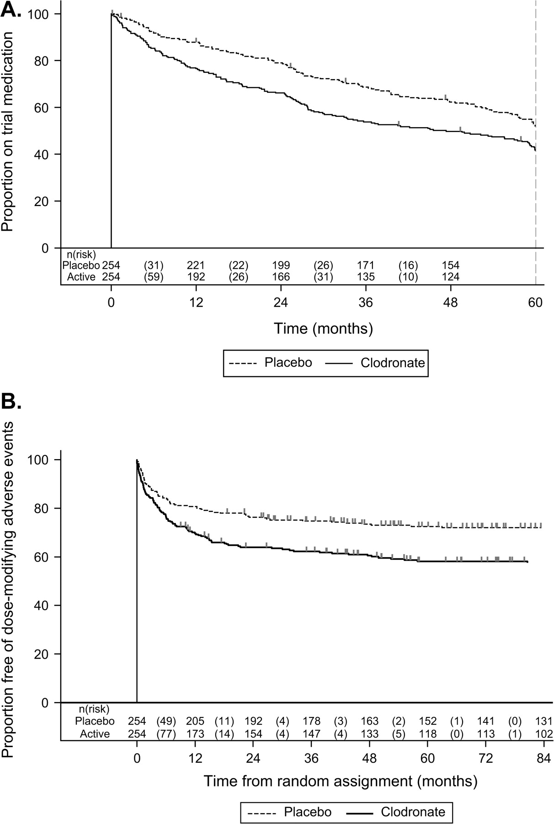
Fig. 2 Time on trial medication and time to dose-modifying adverse events. A ) Kaplan–Meier plot of time from ...
Notes:
Fig. 2 Time on trial medication and time to dose-modifying adverse events. A ) Kaplan–Meier plot of time from random assignment to the time of confirmed cessation of trial medication. At random assignment, all patients are presented as being on trial medication; each downward step in the curves represents an event, i.e., a patient stopping trial medication. More time was spent on trial medication by the control group (hazard ratio [HR] = 1.40, 95% confidence interval [CI] = 1.11 to 1.79; P = .005). The graph is capped at 5 years, which is the maximum time permitted on trial medication. B ) Kaplan–Meier plot of time from random assignment to the time of the first reported adverse event that led to any modification or cessation of trial medication, whether temporarily or permanently. At random assignment, all patients are presented as being free from dose-modifying adverse events; each downward step in the curves represents a patient reported as having a dose-modifying adverse event. The risk of dose-modifying adverse events was higher on the clodronate arm (HR = 1.63, 95% CI = 1.21 to 2.19), and by 3 years, 74% (95% CI = 68% to 79%) of men in the placebo arm and 62% (95% CI = 54% to 68%) in the active arm remained free of having experienced such an event. Estimates and statistics were determined using two-sided log-rank tests.
Unless provided in the caption above, the following copyright applies to the content of this slide: © 2007 The Author(s).This is an Open Access article distributed under the terms of the Creative Commons Attribution Non-Commercial License (http://creativecommons.org/licenses/by-nc/2.0/uk/), which permits unrestricted non-commercial use, distribution, and reproduction in any medium, provided the original work is properly cited.

Slide 3
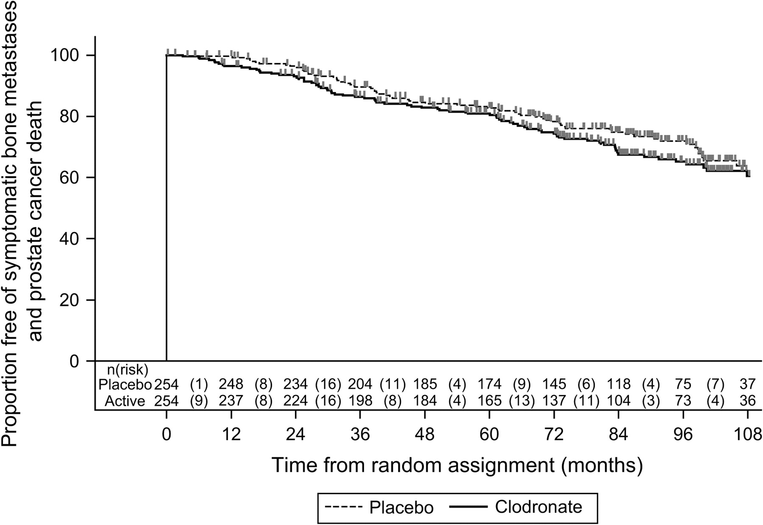
Fig. 3 Kaplan–Meier plot of time from random assignment to the first report of symptomatic bone metastases or death ...
Notes:
Fig. 3 Kaplan–Meier plot of time from random assignment to the first report of symptomatic bone metastases or death from prostate cancer. Each downward step in the curves represents an event. More such events were reported among men in the clodronate arm than in the placebo arm (hazard ratio = 1.22, 95% confidence interval [CI] = 0.88 to 1.68; P = .23). The proportion of patients event free at 2 years was 96% (95% CI = 93% to 98%) in the placebo arm and, from the hazard ratio, 96% (95% CI = 92% to 98%) in the clodronate arm, and at 5 years was 83% (95% CI = 77% to 87%) in the placebo arm and, from the hazard ratio, 79% (95% CI = 73% to 84%) in the clodronate arm.
Unless provided in the caption above, the following copyright applies to the content of this slide: © 2007 The Author(s).This is an Open Access article distributed under the terms of the Creative Commons Attribution Non-Commercial License (http://creativecommons.org/licenses/by-nc/2.0/uk/), which permits unrestricted non-commercial use, distribution, and reproduction in any medium, provided the original work is properly cited.

Slide 4
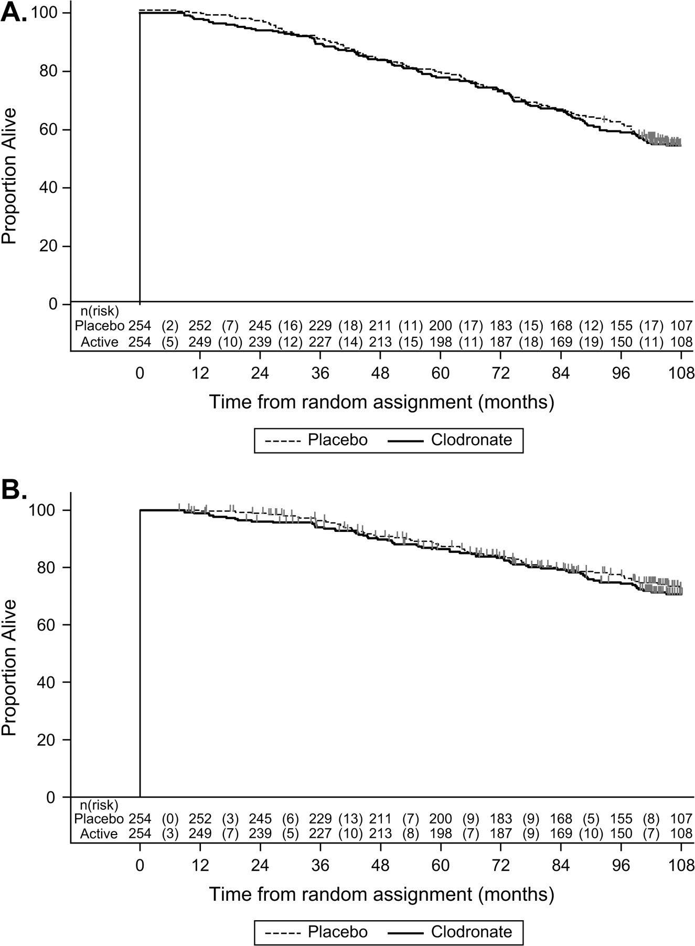
Fig. 4 Kaplan–Meier plot of time from random assignment to death from prostate cancer or from any cause. Each ...
Notes:
Fig. 4 Kaplan–Meier plot of time from random assignment to death from prostate cancer or from any cause. Each downward step in the curves represents a death; patients are censored when assumed to be last alive using National Health Service Central Register data (A only) or at death from causes other than prostate cancer. The hazard ratios (HRs) were similar in each arm. A ) Death from any cause. For overall survival, HR = 1.02 (95% confidence interval [CI] = 0.80 to 1.30; P = .90); the proportion alive at 2 years was 96% (95% CI = 93% to 98%) in the placebo arm and also 96% (95% CI = 93% to 98%) in the clodronate arm and 5 years was 79% (95% CI = 73% to 83%) in the placebo arm and 78% (95% CI = 73% to 83%) in the clodronate arm. B ) Death from prostate cancer. For death from prostate cancer, HR = 1.07 (95% CI = 0.76 to 1.49; P = .71); the proportion of patients not having died of prostate cancer by 2 years was 99% (95% CI = 96% to 100%) in the placebo arm and, from the hazard ratio, also 99% (95% CI = 96% to 100%) in the clodronate arm; and the proportion of patients not having died of prostate cancer at 5 years was 88% (95% CI = 83% to 91%) in the placebo arm and, from the hazard ratio, 87% (95% CI = 82% to 91%) in the clodronate arm. These estimates and statistics were determined using two-sided log-rank tests.
Unless provided in the caption above, the following copyright applies to the content of this slide: © 2007 The Author(s).This is an Open Access article distributed under the terms of the Creative Commons Attribution Non-Commercial License (http://creativecommons.org/licenses/by-nc/2.0/uk/), which permits unrestricted non-commercial use, distribution, and reproduction in any medium, provided the original work is properly cited.

Slide 5
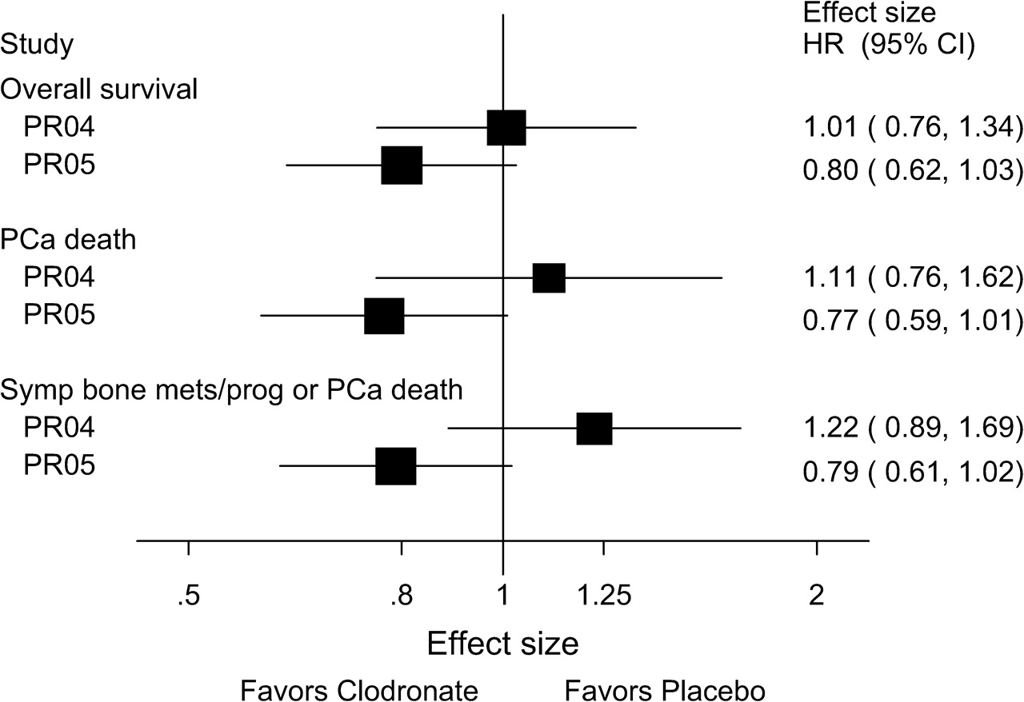
Fig. 5 Forest plots comparing the relative effects in this trial, PR04, and its sister trial, PR05. PR04 included ...
Notes:
Fig. 5 Forest plots comparing the relative effects in this trial, PR04, and its sister trial, PR05. PR04 included 508 patients with locally advanced disease who received local standard treatment and were randomly assigned to additionally receive 5 years of sodium clodronate or placebo. PR05 ( 29 ) included 311 patients with bony metastatic disease who received standard hormone therapy and were randomly assigned to additionally receive 3 years of sodium clodronate or placebo. Three pairs of plots are shown representing the main clinical outcome measures in these trials. The x -axis is the hazard ratio (HR) for the comparison, in which a hazard ratio less than 1.0 represents an advantageous effect for the active arm compared with the placebo arm. The box represents the point estimate of the hazard ratio, the lines are the 95% confidence intervals (CIs), and the size of the box is proportional to the number of events. There is some evidence of heterogeneity of effect between the trials for these outcome measures: for overall survival, heterogeneity χ 2(1df) = 1.41, P = .23; for prostate cancer death, heterogeneity χ 2(1df) = 2.32, P = .13; for symptomatic bone metastases/progression (mets/prog) or prostate cancer (PCa) death, heterogeneity χ 2(1df) = 4.29, P = .038. These statistics were determined using two-sided tests.
Unless provided in the caption above, the following copyright applies to the content of this slide: © 2007 The Author(s).This is an Open Access article distributed under the terms of the Creative Commons Attribution Non-Commercial License (http://creativecommons.org/licenses/by-nc/2.0/uk/), which permits unrestricted non-commercial use, distribution, and reproduction in any medium, provided the original work is properly cited.

