Slide 1
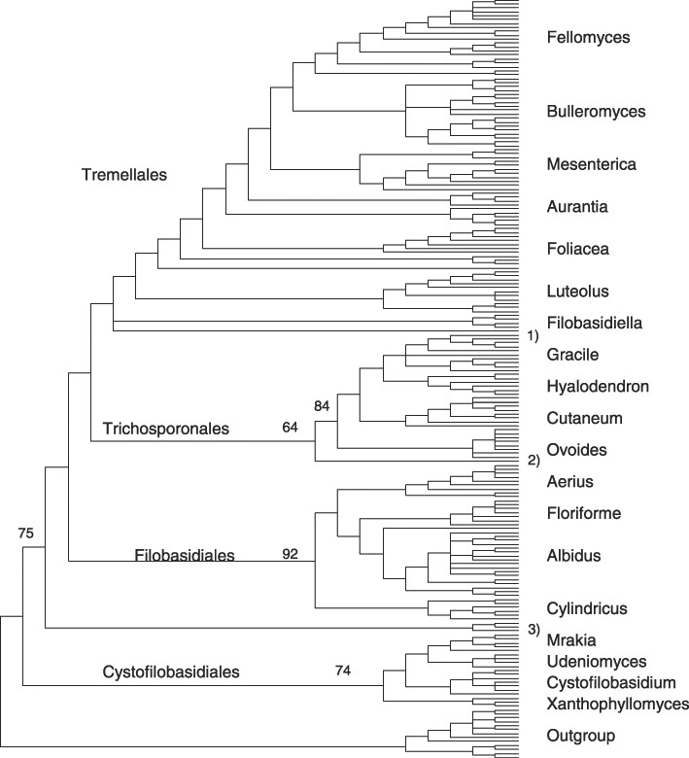
1 Hymenomycetes. Strict consensus of 100 equally parsimonious trees of the D1/D2 region of the large subunit ...
Notes:
1 Hymenomycetes. Strict consensus of 100 equally parsimonious trees of the D1/D2 region of the large subunit rDNA (PAUP 4.0). Numbers on branches represent bootstrap percentages (>50%) from 100 full heuristic replications for the four lineages. Clades are signified to indicate their orientation within the lineages. Number of ingroup taxa=180, number of characters (NC)=632, constant characters (CC)=220, parsimony uninformative characters (PUC)=53, parsimony informative characters (PIC)=359, tree length (TL)=3353, consistency index (CI)=0.228, retention index (RI)=0.790. Legend: (1) C. marinus, (2) C. humicola, (3) H. corniformis. Outgroup=members of the Agaricostilbum lineage.
Unless provided in the caption above, the following copyright applies to the content of this slide: © 2002 Federation of European Microbiological Societies. Published by Elsevier Science B.V. All rights reserved.

Slide 2
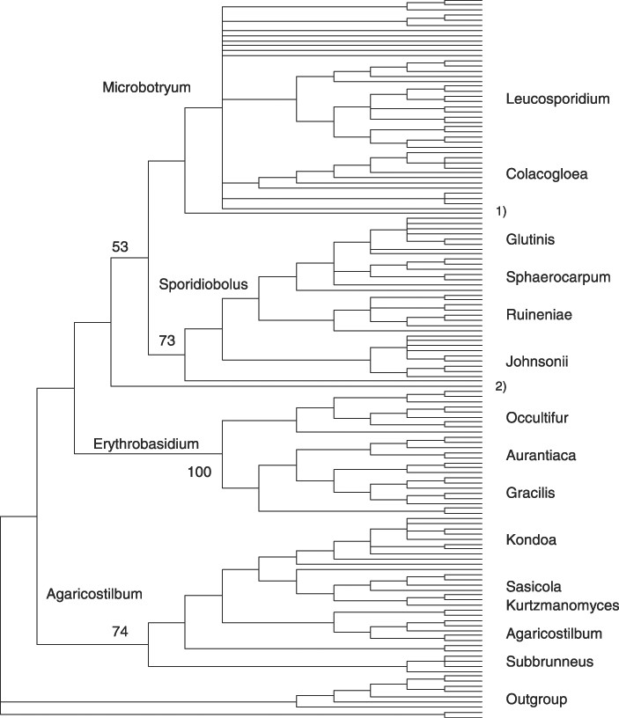
2 Urediniomycetes. Strict consensus of 100 equally parsimonious trees of the D1/D2 region of the large subunit ...
Notes:
2 Urediniomycetes. Strict consensus of 100 equally parsimonious trees of the D1/D2 region of the large subunit rDNA (PAUP 4.0). Numbers on branches represent bootstrap percentages (>50%) from 100 full heuristic replications for the four lineages. Clades are signified to indicate their orientation within the lineages. Number of ingroup taxa=142, NC=632, CC=207, PUC=54, PIC=362, TL=2639, CI=0.285, RI=0.795. Legend: (1) S. griseoflavus, (2) R. strues. Outgroup=members of the Cystofilobasidium lineage.
Unless provided in the caption above, the following copyright applies to the content of this slide: © 2002 Federation of European Microbiological Societies. Published by Elsevier Science B.V. All rights reserved.

Slide 3
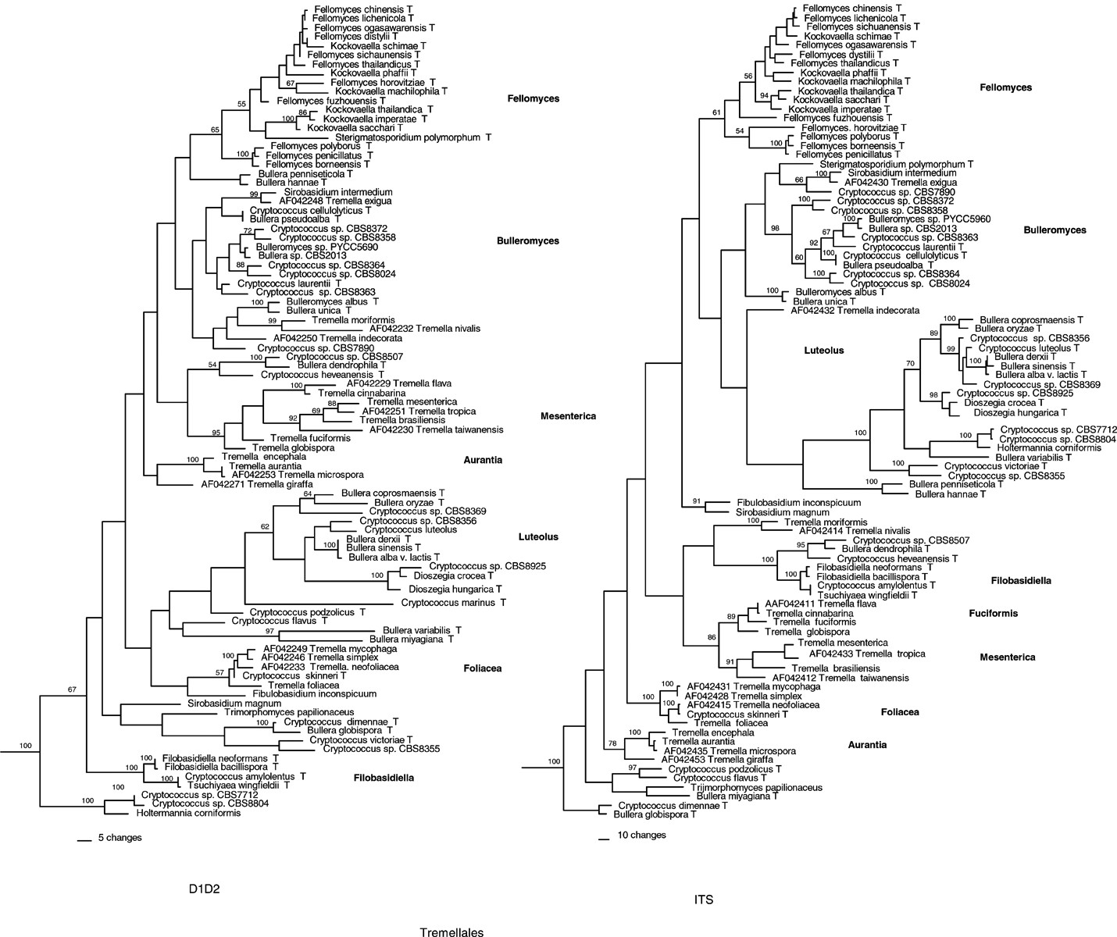
3 Tremellales. Phylogenetic analysis (PAUP 4 0b8) of the D1/D2 region of the large subunit rDNA. One of 100 ...
Notes:
3 Tremellales. Phylogenetic analysis (PAUP 4 0b8) of the D1/D2 region of the large subunit rDNA. One of 100 equally parsimonious trees. NC=617, CC=317, PUC=59, PIC=241, TL=1588, CI=0.297, RI=0.674. ITS: phylogenetic analysis (PAUP 4 0b8) of the ITS regions and 5.8S. Eleven equally parsimonious trees. NC=641, CC=208, PUC=34, PIC=399, TL=3179, CI=0.297, RI=0.688. Numbers on branches are the bootstrap percentages (>50%) from 100 full heuristic replications. Trichosporon cutaneum, Trichosporon jirovecii and Trichosporon moniliiforme were used as the outgroup. Due to space considerations the outgroup is not shown in this figure. T=type strain.
Unless provided in the caption above, the following copyright applies to the content of this slide: © 2002 Federation of European Microbiological Societies. Published by Elsevier Science B.V. All rights reserved.

Slide 4
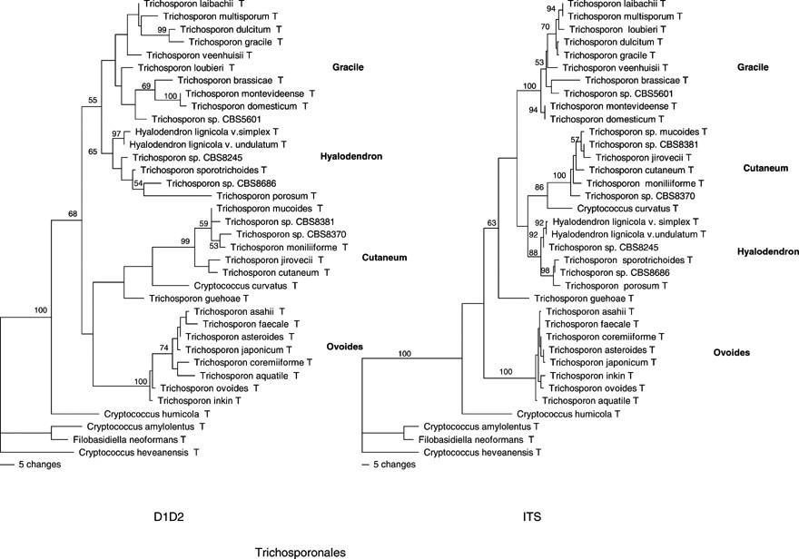
4 Trichosporonales. D1D2: 88 equally parsimonious trees. NC=610, CC=441, PUC=52, PIC=117, TL=392, CI=0.523, ...
Notes:
4 Trichosporonales. D1D2: 88 equally parsimonious trees. NC=610, CC=441, PUC=52, PIC=117, TL=392, CI=0.523, RI=0.759. ITS: 100 equally parsimonious trees. NC=589, CC=351, PUC=59, PIC=179, TL=530, CI=0.655, RI=0.853. 100 heuristic replications. Outgroup=C. amylolentus, F. neoformans var. neoformans and C. heveanensis. See Fig. 1 for abbreviations.
Unless provided in the caption above, the following copyright applies to the content of this slide: © 2002 Federation of European Microbiological Societies. Published by Elsevier Science B.V. All rights reserved.

Slide 5
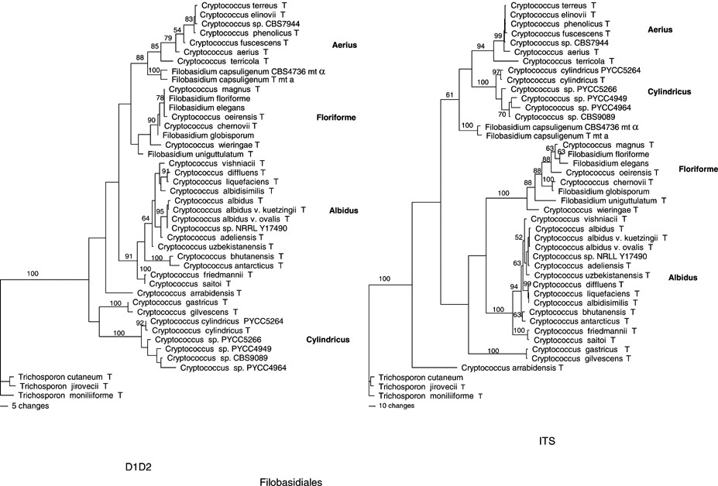
5 Filobasidiales. D1D2: 100 equally parsimonious trees. NC=611, CC=441, PUC=19, PIC=151, TL=408, CI=0.532, ...
Notes:
5 Filobasidiales. D1D2: 100 equally parsimonious trees. NC=611, CC=441, PUC=19, PIC=151, TL=408, CI=0.532, RI=0.832. ITS: 100 equally parsimonious trees. NC=694, CC=317, PUC=36, PIC=341, TL=1057, CI=0.605, RI=0.859. 100 heuristic replications. Outgroup=T. cutaneum, T. jirovecii and T. moniliiforme. See Fig. 1 for abbreviations.
Unless provided in the caption above, the following copyright applies to the content of this slide: © 2002 Federation of European Microbiological Societies. Published by Elsevier Science B.V. All rights reserved.

Slide 6
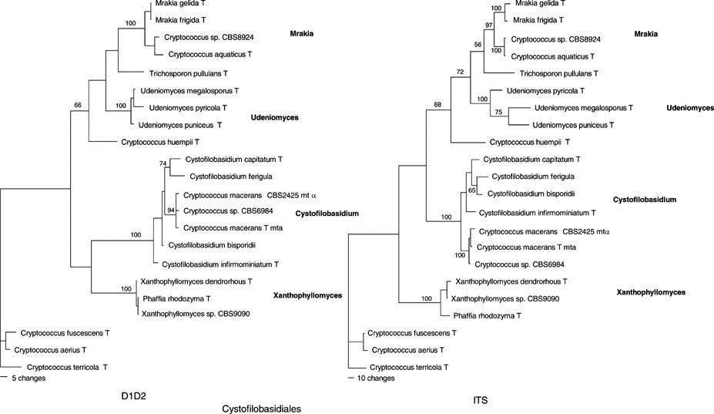
6 Cystofilobasidiales. D1D2: 78 equally parsimonious trees. NC=608, CC=428, PUC=28, PIC=152, TL=355, CI=0.704, ...
Notes:
6 Cystofilobasidiales. D1D2: 78 equally parsimonious trees. NC=608, CC=428, PUC=28, PIC=152, TL=355, CI=0.704, RI=0.864. ITS: two equally parsimonious trees. NC=818, CC=388, PUC=64, PIC=366, TL=1050, CI=0.642, RI=0.777. 100 full heuristic replications. Outgroup=C. fuscescens, Cryptococcus aerius and Cryptococcus terricola. See Fig. 1 for abbreviations.
Unless provided in the caption above, the following copyright applies to the content of this slide: © 2002 Federation of European Microbiological Societies. Published by Elsevier Science B.V. All rights reserved.

Slide 7
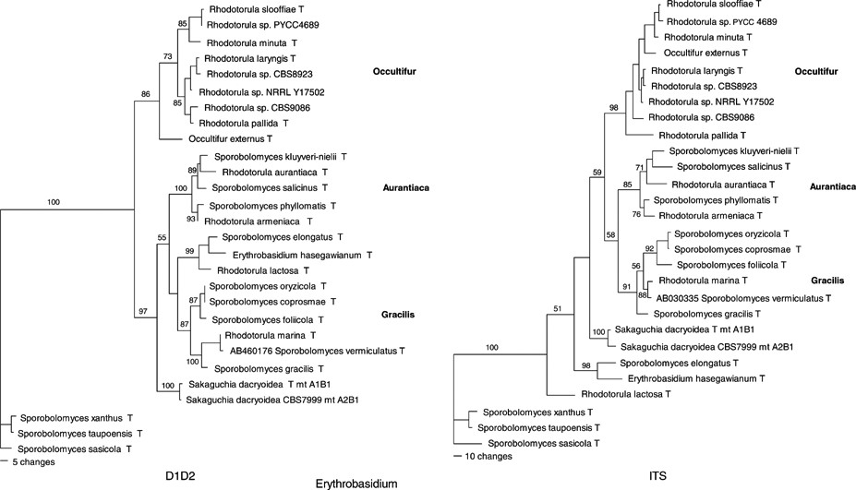
7 Erythrobasidium. D1D2: one parsimony tree. NC=589, CC=387, PUC=21, PIC=181, TL=415, CI=0.639, RI=0.840. ITS: ...
Notes:
7 Erythrobasidium. D1D2: one parsimony tree. NC=589, CC=387, PUC=21, PIC=181, TL=415, CI=0.639, RI=0.840. ITS: two equally parsimonious trees. NC=721, CC=360, PUC=88, PIC=273, TL=847, CI=0.616, RI=0.734. 100 heuristic replications. Outgroup=S. xanthus, S. taupoensis and Sporobolomyces sasicola. See Fig. 1 for abbreviations.
Unless provided in the caption above, the following copyright applies to the content of this slide: © 2002 Federation of European Microbiological Societies. Published by Elsevier Science B.V. All rights reserved.

Slide 8
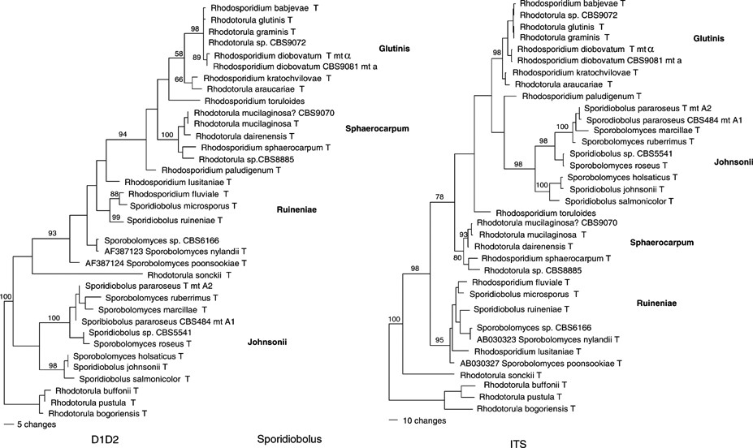
8 Sporidiobolus. D1D2: 24 equally parsimonious trees. NC=599, CC=426, PUC=44, PIC=129, TL=386, CI=0.560, ...
Notes:
8 Sporidiobolus. D1D2: 24 equally parsimonious trees. NC=599, CC=426, PUC=44, PIC=129, TL=386, CI=0.560, RI=0.837. ITS: five equally parsimonious trees. NC=607, CC=326, PUC=54, PIC=227, TL=741, CI=0.571, RI=0.806. 100 full heuristic replications. Outgroup=R. buffonii, R. pustula and Rhodotorula bogoriensis. See Fig. 1 for abbreviations.
Unless provided in the caption above, the following copyright applies to the content of this slide: © 2002 Federation of European Microbiological Societies. Published by Elsevier Science B.V. All rights reserved.

Slide 9
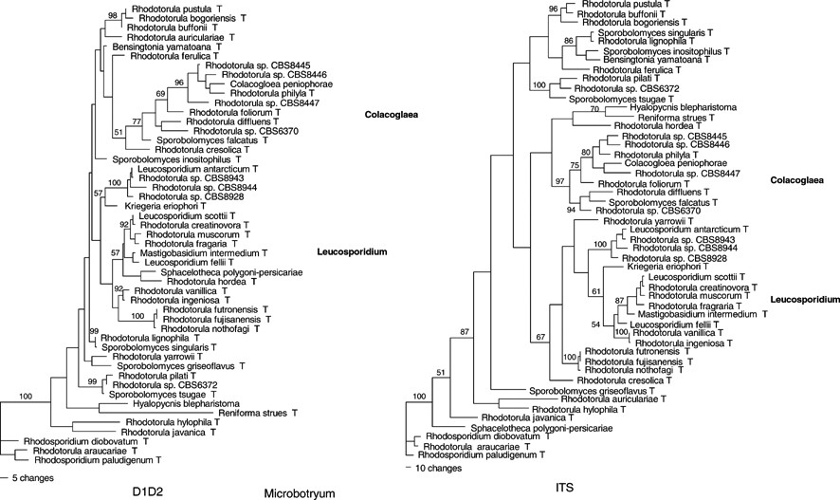
9 Microbotryum. D1D2: 100 equally parsimonious trees. NC=611, CC=362, PUC=78, PIC=171, TL=767, CI=0.454, ...
Notes:
9 Microbotryum. D1D2: 100 equally parsimonious trees. NC=611, CC=362, PUC=78, PIC=171, TL=767, CI=0.454, RI=0.665. ITS: two equally parsimonious trees. NC=728, CC=244, PUC=95, PIC=389, TL=2711, CI=0. 362, RI=0. 571. 100 full heuristic replications. Outgroup=R. diobovatum, Rhodotorula araucariae and R. paludigenum. See Fig. 1 for abbreviations.
Unless provided in the caption above, the following copyright applies to the content of this slide: © 2002 Federation of European Microbiological Societies. Published by Elsevier Science B.V. All rights reserved.

Slide 10
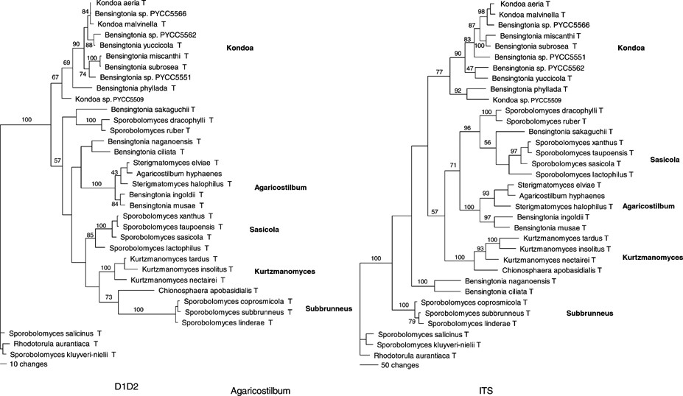
10 Agaricostilbum. D1D2: six equally parsimonious trees. NC=640, CC=305, PUC=43, PIC=292, TL=1050, CI=0.513, ...
Notes:
10 Agaricostilbum. D1D2: six equally parsimonious trees. NC=640, CC=305, PUC=43, PIC=292, TL=1050, CI=0.513, RI=0.751. ITS: one parsimony tree. NC=758, CC=197, PUC=61, PIC=500, TL=2388, CI=0.469, RI=0.627. 100 full heuristic replications. Outgroup=Sporobolomyces salicinus, Rhodotorula aurantiaca and Sporobolomyces kluyveri-nielii. See Fig. 1 for abbreviations.
Unless provided in the caption above, the following copyright applies to the content of this slide: © 2002 Federation of European Microbiological Societies. Published by Elsevier Science B.V. All rights reserved.

