Slide 1
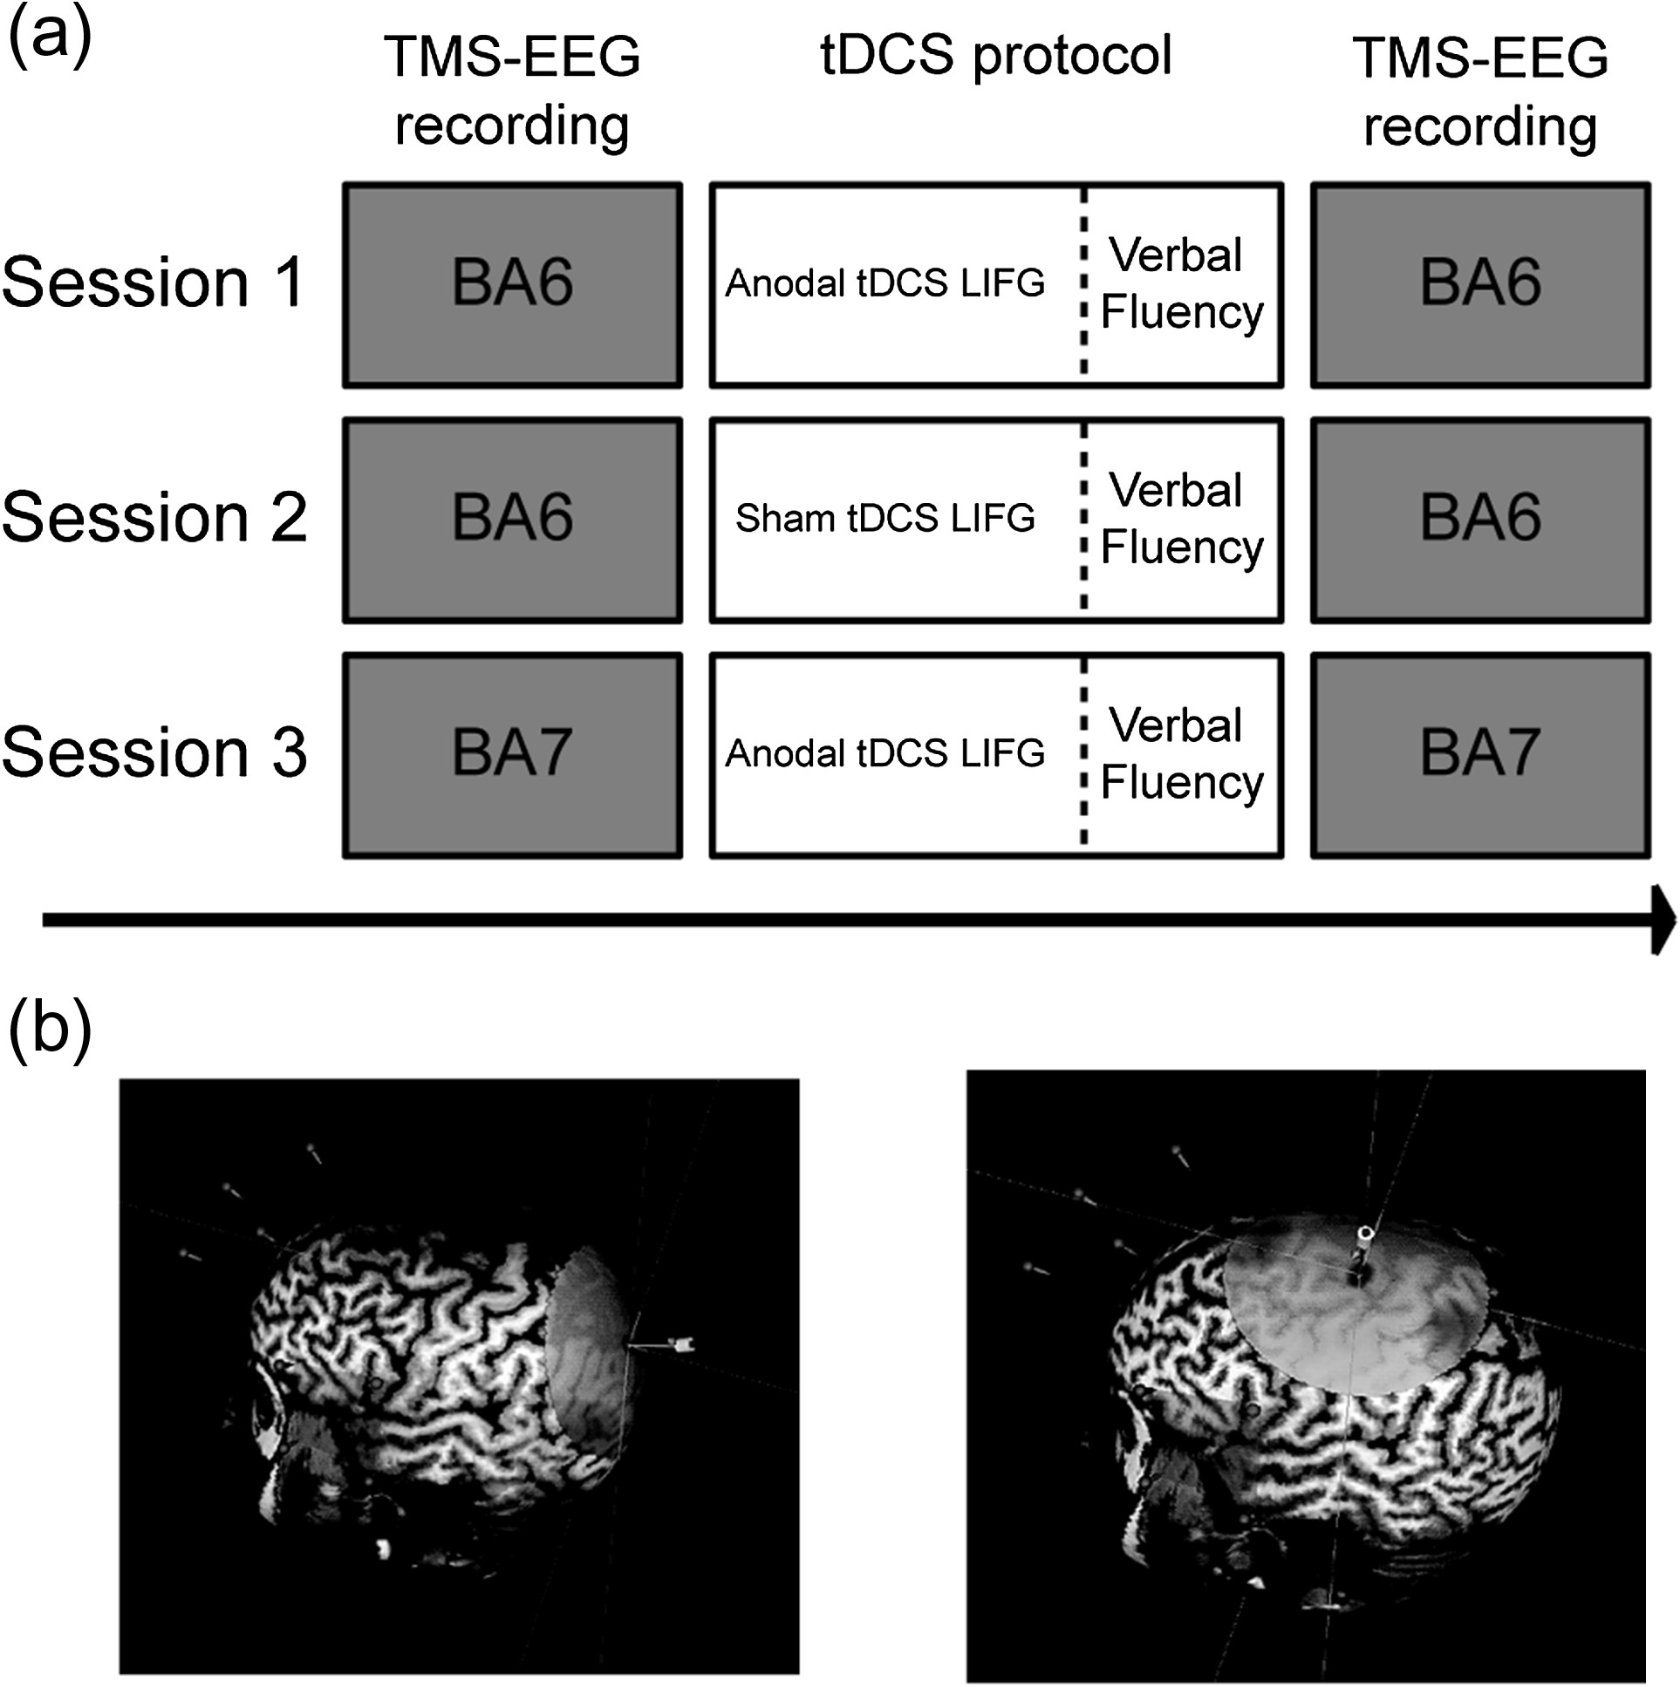
Figure 1. (a) Schematic representation of the experimental sessions. (b) NBS screenshots of the left frontal (BA6) and ...
Notes:
Figure 1. (a) Schematic representation of the experimental sessions. (b) NBS screenshots of the left frontal (BA6) and parietal (BA7) TMS hotspots in a representative subject.
Unless provided in the caption above, the following copyright applies to the content of this slide: © The Author 2017. Published by Oxford University Press. All rights reserved. For Permissions, please e-mail: journals.permissions@oup.comThis article is published and distributed under the terms of the Oxford University Press, Standard Journals Publication Model (https://academic.oup.com/journals/pages/about_us/legal/notices)

Slide 2
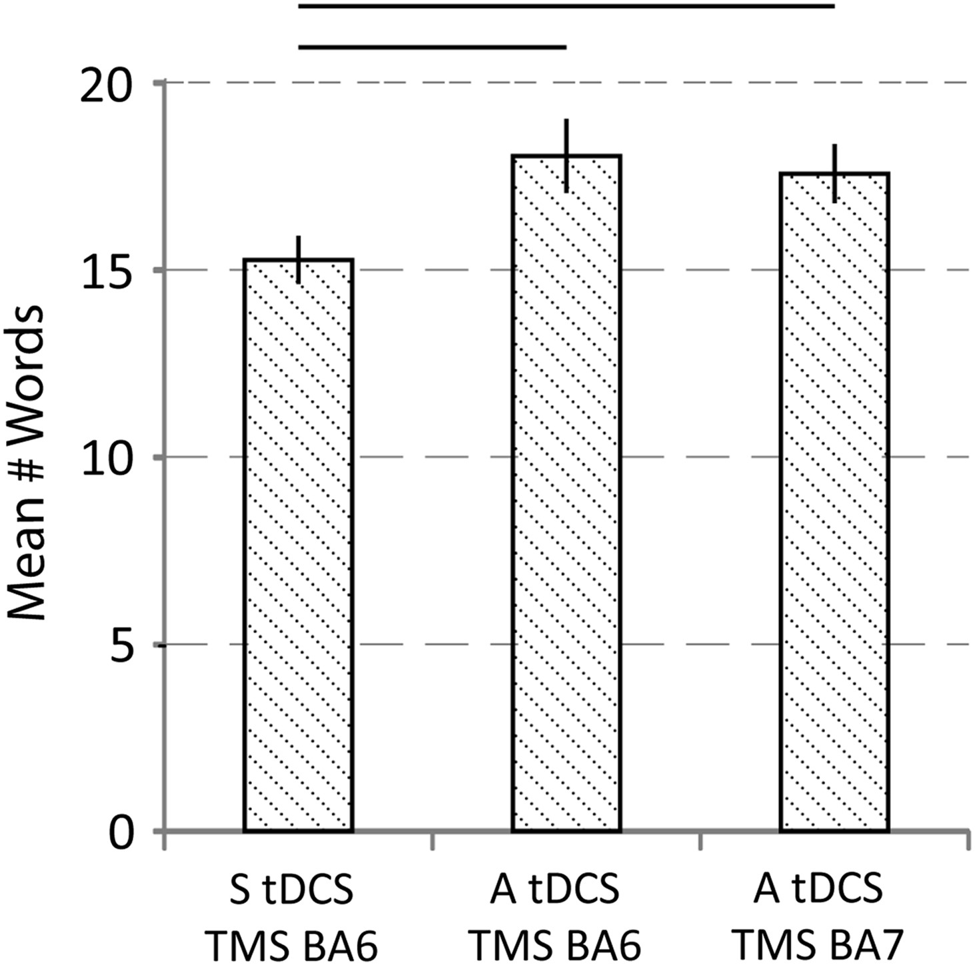
Figure 2. Behavioral results of the verbal fluency tasks: mean produced words in the 3 experimental sessions. ...
Notes:
Figure 2. Behavioral results of the verbal fluency tasks: mean produced words in the 3 experimental sessions. Performance improved after anodal tDCS. Error bars represent ± 1 SEM.
Unless provided in the caption above, the following copyright applies to the content of this slide: © The Author 2017. Published by Oxford University Press. All rights reserved. For Permissions, please e-mail: journals.permissions@oup.comThis article is published and distributed under the terms of the Oxford University Press, Standard Journals Publication Model (https://academic.oup.com/journals/pages/about_us/legal/notices)

Slide 3
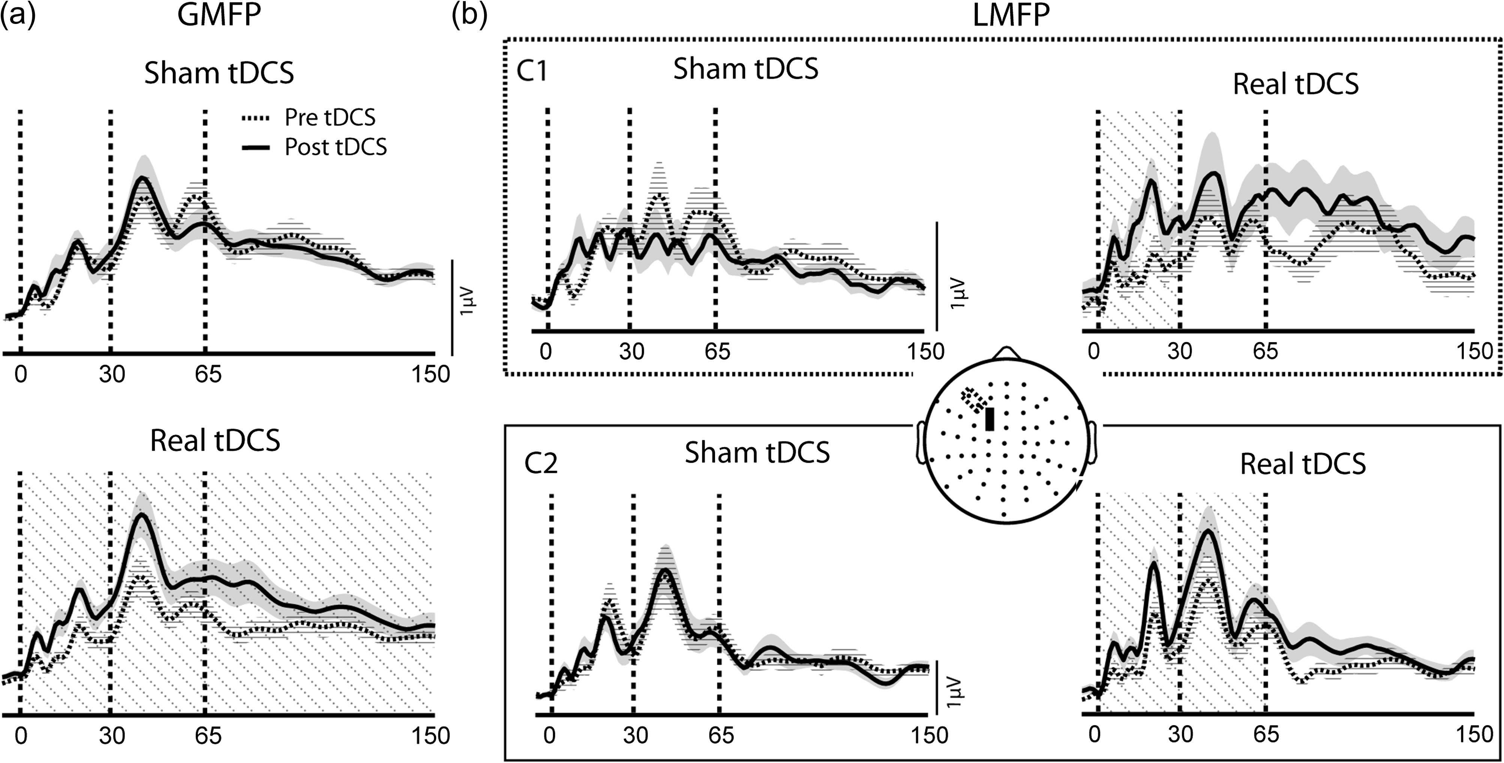
Figure 3. Grand average results from the GMFP and LMFP analyses. Traces represent mean GMFP/LMFP ± 1 SEM. Dot-shaded ...
Notes:
Figure 3. Grand average results from the GMFP and LMFP analyses. Traces represent mean GMFP/LMFP ± 1 SEM. Dot-shaded areas indicate significant differences. (a) GMFP in pre- and post-tDCS recordings in Sham (upper row) and anodal tDCS/TMS over left BA6 (lower row) sessions. Global cortical excitability increased after real stimulation in the early and middle TEP component. (b) LMFP of Cluster 1 (dotted box) and Cluster 2 (solid box), as highlighted in the central head model. In C1, LMFP increased after anodal tDCS/TMS over BA6 in the early component. In C2, LMFP increased after anodal tDCS/TMS over BA6 in the early- and middle-latency component.
Unless provided in the caption above, the following copyright applies to the content of this slide: © The Author 2017. Published by Oxford University Press. All rights reserved. For Permissions, please e-mail: journals.permissions@oup.comThis article is published and distributed under the terms of the Oxford University Press, Standard Journals Publication Model (https://academic.oup.com/journals/pages/about_us/legal/notices)

Slide 4
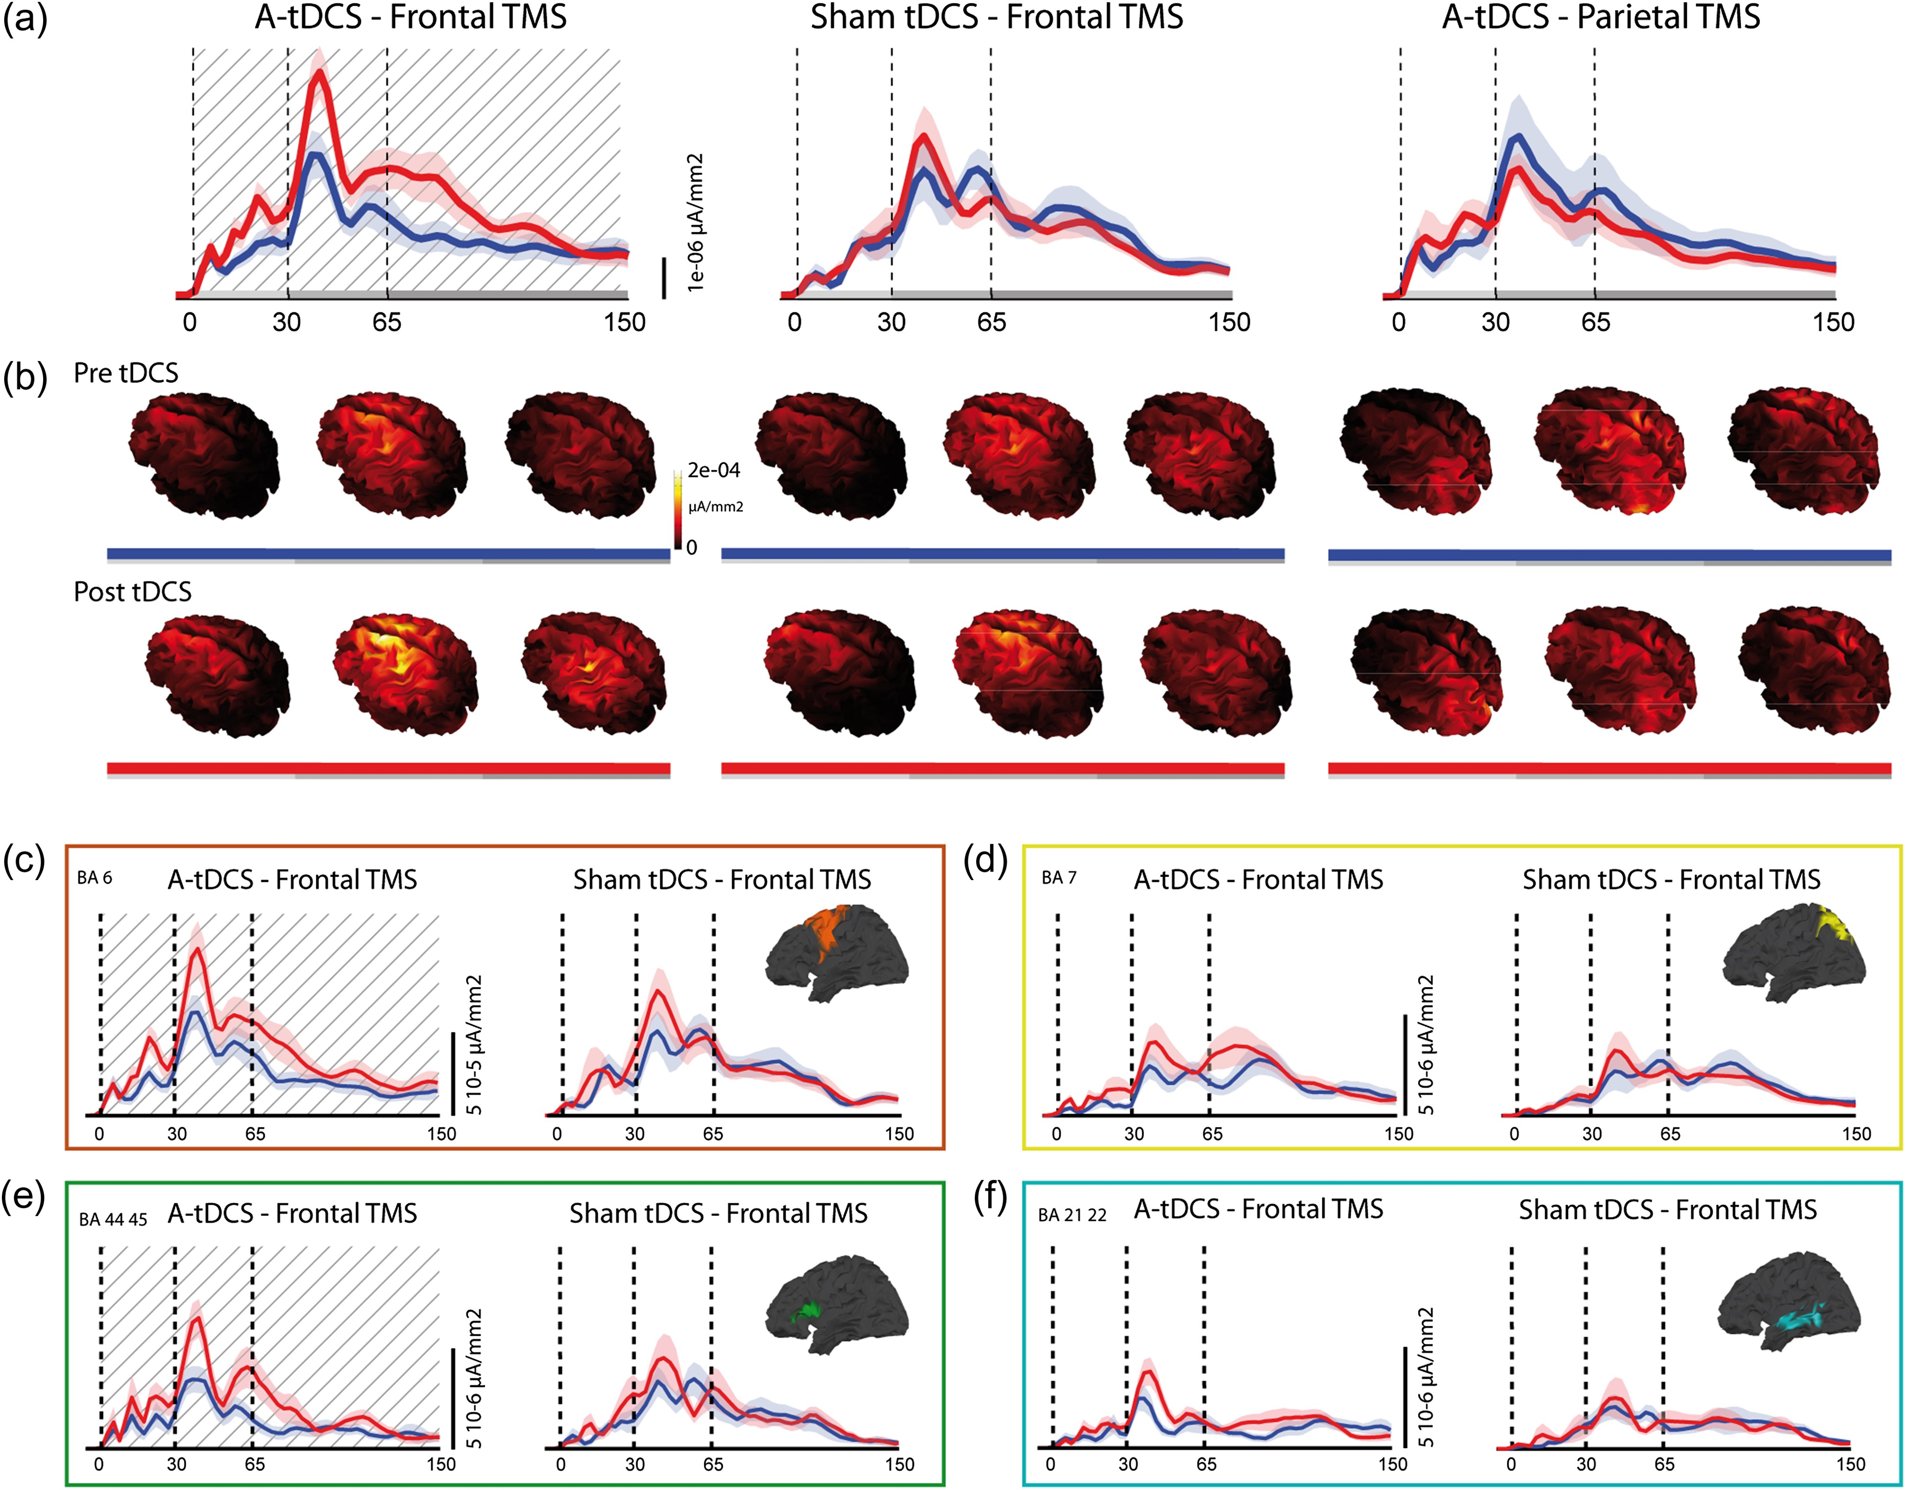
Figure 4. Grand average results from the global and local source modeling. Traces represent mean SCD/Local SCD ± 1 SEM. ...
Notes:
Figure 4. Grand average results from the global and local source modeling. Traces represent mean SCD/Local SCD ± 1 SEM. Dot-shaded areas indicate significant differences. (a) Plots of the SCD over time in pre- (blue line) and post- (red line) tDCS recordings. Significant difference in pre–post-tDCS cortical activity is evident only for anodal tDCS sessions with TMS applied over left BA6 (first plot), while no difference is highlighted for sham tDCS sessions (second plot) or when TMS was applied over the left BA7. (b) Source localization of the global cortical activity. The increment in local SCD is evident in left premotor areas after anodal tDCS with TMS over left BA6. (c–f) SCD in left BA6 (c, orange box), left BA44,45 (e, green box), left BA7 (d, yellow box), and left BA21/22 (f, cyan box) in pre (blue line) and post (red line) sham and anodal tDCS sessions, while probing cortical excitability from left BA6. Differences between pre- and post-tDCS sessions are highlighted only for anodal tDCS sessions in left BA6 and 44/45.
Unless provided in the caption above, the following copyright applies to the content of this slide: © The Author 2017. Published by Oxford University Press. All rights reserved. For Permissions, please e-mail: journals.permissions@oup.comThis article is published and distributed under the terms of the Oxford University Press, Standard Journals Publication Model (https://academic.oup.com/journals/pages/about_us/legal/notices)

Slide 5
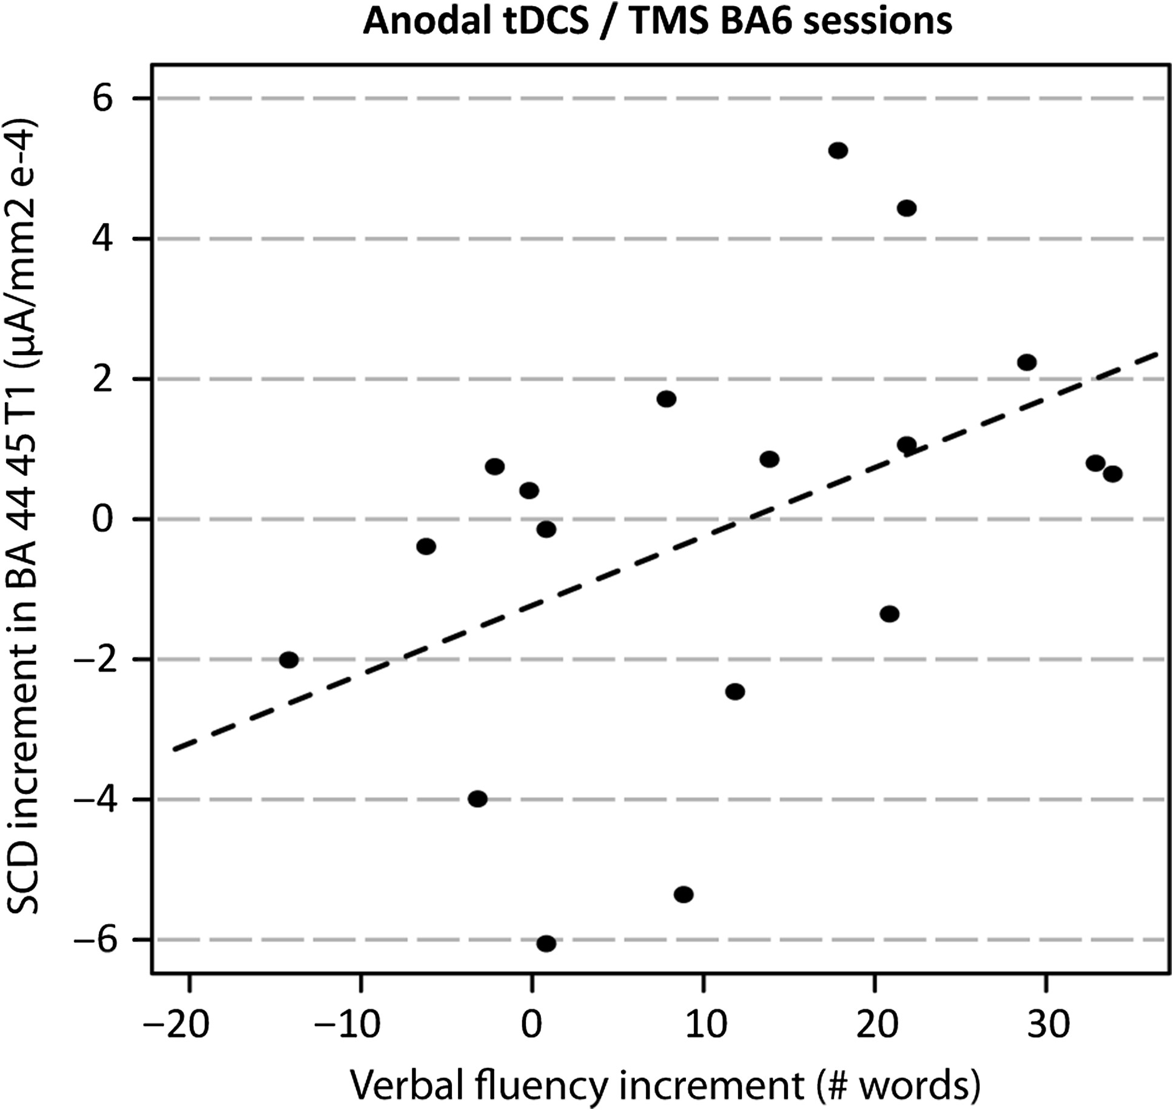
Figure 5. Scatterplot illustrating the significant correlation between the increase in verbal fluency performance, ...
Notes:
Figure 5. Scatterplot illustrating the significant correlation between the increase in verbal fluency performance, compared with sham sessions, and the increase in SCD in left BAs 44/45 during the anodal tDCS session with cortical excitability probed from left BA6.
Unless provided in the caption above, the following copyright applies to the content of this slide: © The Author 2017. Published by Oxford University Press. All rights reserved. For Permissions, please e-mail: journals.permissions@oup.comThis article is published and distributed under the terms of the Oxford University Press, Standard Journals Publication Model (https://academic.oup.com/journals/pages/about_us/legal/notices)

