Slide 1
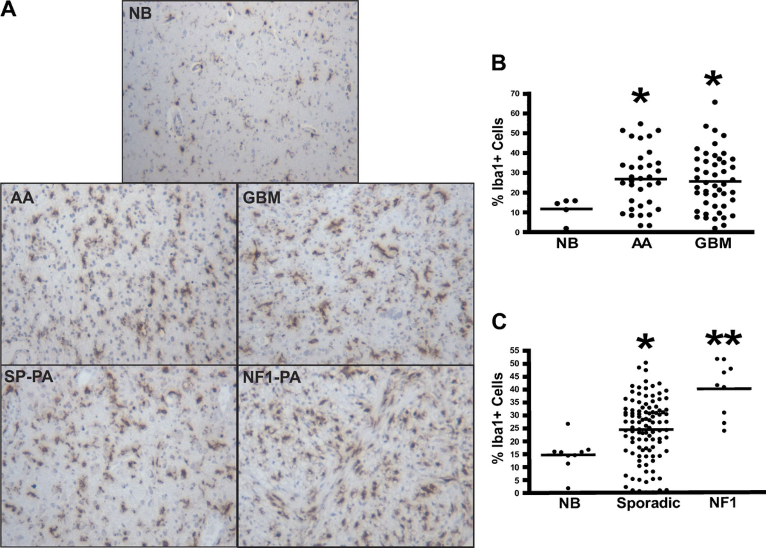
FIGURE 1. Increased microglia in neurofibromatosis type 1 (NF1)-associated pilocytic astrocytomas. (A-C) Iba1 ...
Notes:
FIGURE 1. Increased microglia in neurofibromatosis type 1 (NF1)-associated pilocytic astrocytomas. (A-C) Iba1 immunohistochemistry demonstrates increased percentages of microglia in anaplastic astrocytomas (AA) (p = 0.0236) and glioblastoma multiforme(GBM) tumors (p = 0.0377) versus nonneoplastic brain (NB). (C) Sporadic pilocytic astrocytomas (SP-PA) have a greater percentage of Iba1+ cells compared with NB (p < 0.0001) (A, C), but the greatest percentage of microglia is seen in NF1-associated pilocytic astrocytomas (NF1-PA) (p < 0.0001 versus NB) (p = 0.0008 versus SP-PA).
Unless provided in the caption above, the following copyright applies to the content of this slide: Copyright © 2011 by the American Association of Neuropathologists, Inc.

Slide 2
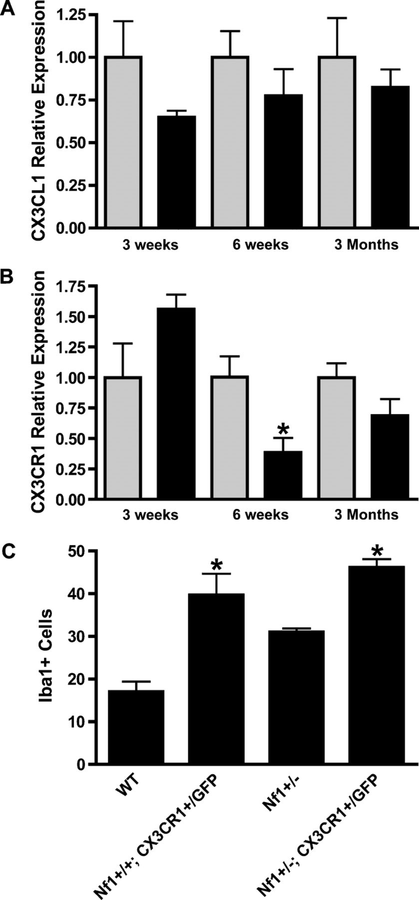
FIGURE 6. Reduced CX3CR1 expression in the Nf1^{+/−} optic nerve (ON). (A) Real-time quantitative polymerase ...
Notes:
FIGURE 6. Reduced CX3CR1 expression in the Nf1+/− optic nerve (ON). (A) Real-time quantitative polymerase chain reaction (PCR) reveals no change in Cx3cl1 mRNA levels in ONs from Nf1+/− (n = 5) (black bars) and wild-type (WT) (n = 5) (gray bars) mice at 3 weeks (p = 0.1558), 6 weeks (p = 0.3478), or 3 months (p = 0.4788). (B) Quantitative PCR reveals a greater than 2-fold decrease in Cx3cr1 mRNA expression in theONs of 6-week-old Nf1+/− mice (n = 5) versus WT controls(n = 5) (p = 0.0181). There is no difference in Cx3cr1 expressionin the ONs from Nf1+/− versus WT mice at 3 weeks (p = 0.0855) or 3 months (p = 0.1413). (C) There is a 2-fold increase in numbers of Iba1+ microglia in ONs of NF+/+Cx3cr1+/GFPmice (n = 6) versus WT controls (n = 5) (p = 0.0042). Nf1+/+−Cx3cr1+/GFP mice (n = 7) have greater numbers of microglia versus WT (p < 0.0001) and Nf1+/− mice (n = 5) (p < 0.0001).
Unless provided in the caption above, the following copyright applies to the content of this slide: Copyright © 2011 by the American Association of Neuropathologists, Inc.

Slide 3
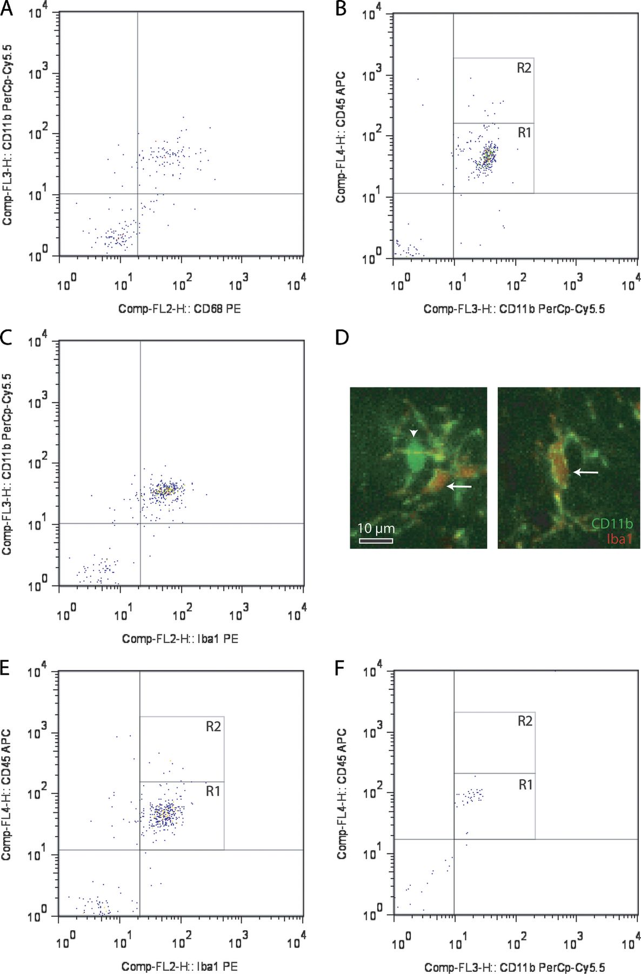
FIGURE 2. Microglia in the mouse optic nerve at 6 weeks and in mouse optic gliomas at 3 months are mainly resident ...
Notes:
FIGURE 2. Microglia in the mouse optic nerve at 6 weeks and in mouse optic gliomas at 3 months are mainly resident microglia. (A) Flow cytometry demonstrates that most cells from 6-week-old wild-type (WT) optic nerves (10 pooled optic nerves) are doubly positive for both CD11b and CD68. (B) Most of these CD11b+ cells express low levels of CD45 (R1). (C) CD11b+ microglia in the 6-week-old optic nerve are also Iba1+. (D) Using double-labeling immunofluorescence, there are rare cells in the 6-week-old WT optic nerve that label with CD11b antibodies (green) alone (inset, arrowhead), whereas most (∼99%) of the microglia colabel with both CD11b and Iba1 antibodies (inset, arrows) (n = 5). (E) Iba1+ cells express low levels of CD45 (R1). (F) CD11b magnetic cell capture of microglia from 3-month-old Nf1+/−GFAPCKO mouse optic gliomas (7 pooled optic nerves) followed by flow cytometry demonstrates that the CD11b+ cells are also almost exclusively CD45low (R1).
Unless provided in the caption above, the following copyright applies to the content of this slide: Copyright © 2011 by the American Association of Neuropathologists, Inc.

Slide 4
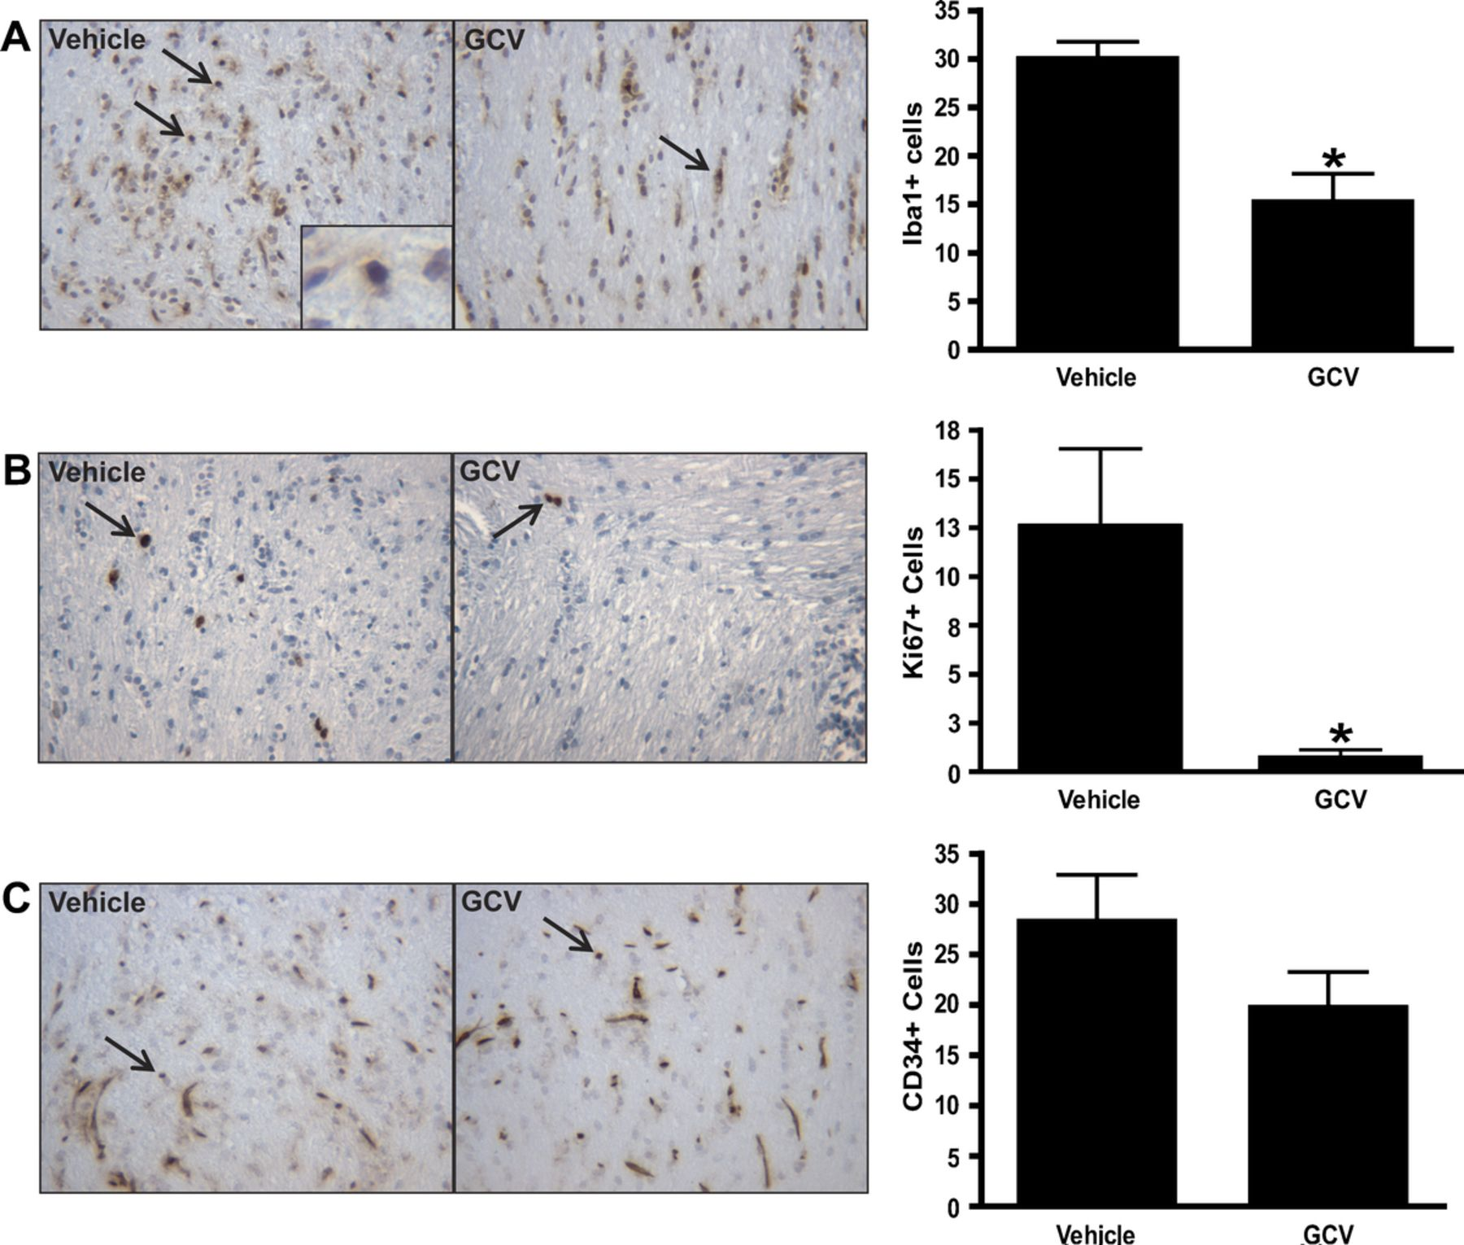
FIGURE 3. Microglia ablation at 3 months reduces optic glioma proliferation. (A, B) Treatment of ...
Notes:
FIGURE 3. Microglia ablation at 3 months reduces optic glioma proliferation. (A, B) Treatment of Nf1+/−GFAPCKO-TK mice (n = 7) with ganciclovir (GCV) at 3 months reduces the number of Iba1+ cells by 49% (p = 0.0280) and results in a 94% decrease in the number of Ki67-positive cells in the optic nerve (p = 0.0118) versus Nf1+/−GFAPCKO-TK mice treated with vehicle (n = 7). (C) Ganciclovir treatment did not affect endothelial cell numbers, as assessed by CD34 immunohistochemistry (p = 0.2864).
Unless provided in the caption above, the following copyright applies to the content of this slide: Copyright © 2011 by the American Association of Neuropathologists, Inc.

Slide 5
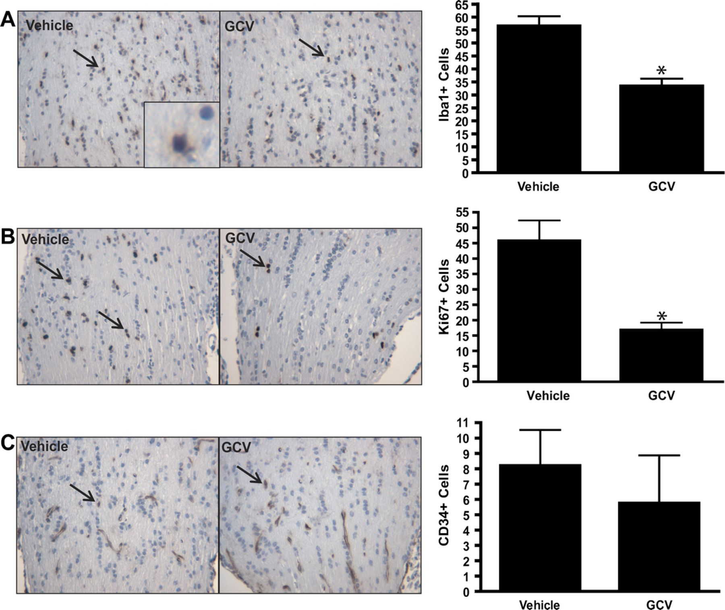
FIGURE 4. Microglia ablation at 3 weeks reduces early optic glioma proliferation. (A, B)Nf1^{+/−GFAP}CKO-TK ...
Notes:
FIGURE 4. Microglia ablation at 3 weeks reduces early optic glioma proliferation. (A, B)Nf1+/−GFAPCKO-TK mice (n = 6) treated with ganciclovir (GCV) beginning at 3 weeks reduces the number of Iba1+ cells by 43% (p = 0.0012) and results in a 63% decrease in Ki67-positive cells in the optic nerve versus Nf1+/−GFAPCKO-TK mice (n = 6) treated with vehicle (p = 0.0013). (C) Ganciclovir treatment did not affect endothelial cell numbers as assessed by CD34 immunohistochemistry (p = 0.5405).
Unless provided in the caption above, the following copyright applies to the content of this slide: Copyright © 2011 by the American Association of Neuropathologists, Inc.

Slide 6
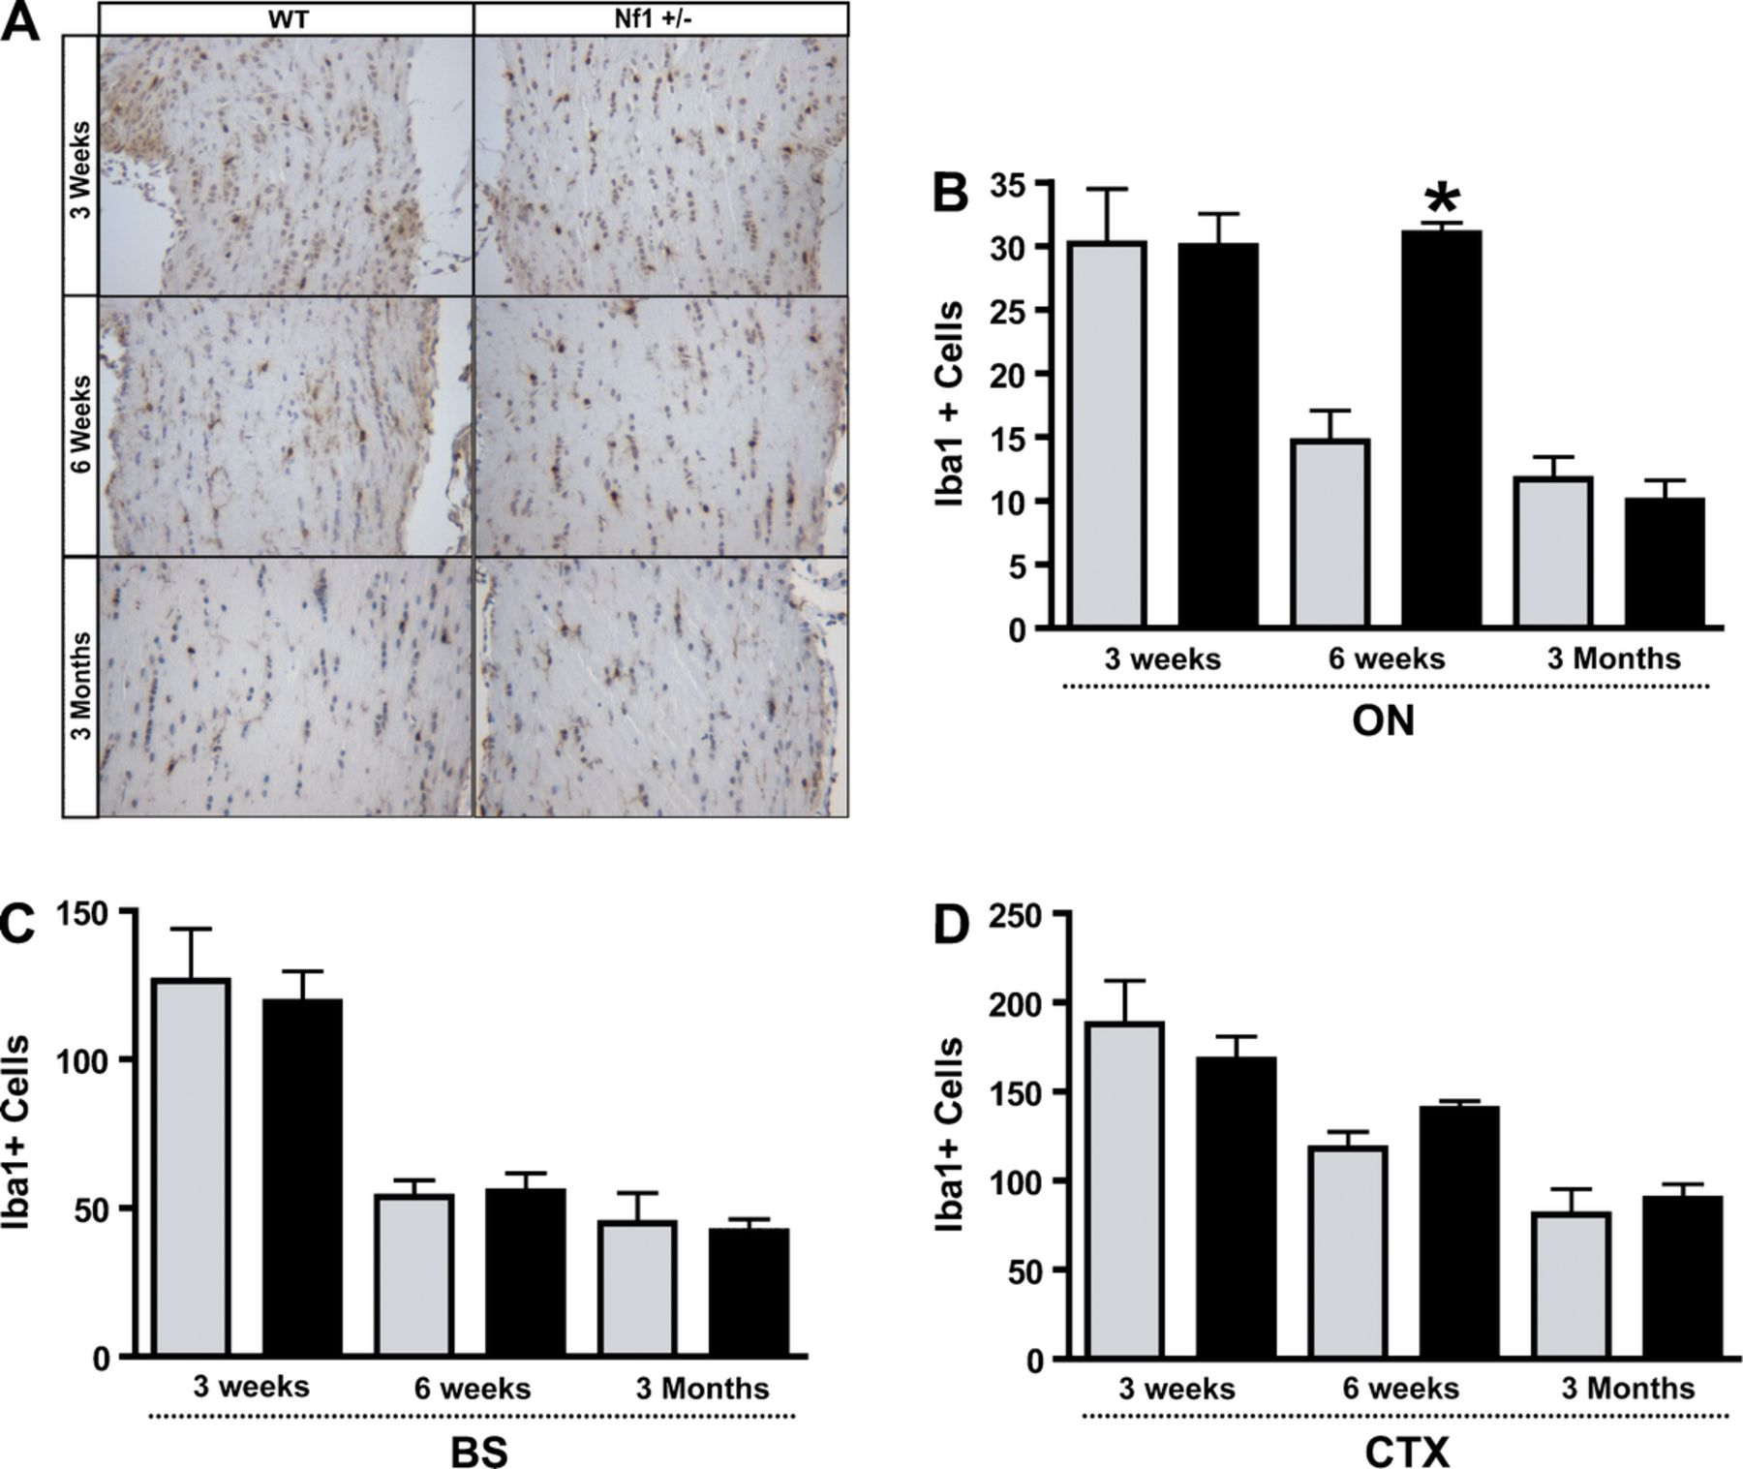
FIGURE 5. Iba1⁺ cells are increased in Nf1^{+/−} optic nerve (ON) at 6 weeks but not at 3 weeks or 3 ...
Notes:
FIGURE 5. Iba1+ cells are increased in Nf1+/− optic nerve (ON) at 6 weeks but not at 3 weeks or 3 months. (A, B) Equivalent numbers of Iba1+ cells were found in the ON of Nf1+/− (n = 5) (black bars) and wild-type (WT) (gray bars) mice (n = 5) at 3 weeks (p = 0.9712). By 6 weeks, there was a 2-fold increase in the number of Iba1+ microglia in the ONs of Nf1+/− mice (n = 5) versus WT littermates (n = 5) (p = 0.0002). By 3 months, Nf1+/− (n = 4) and WT (n = 4) mice had equivalent numbers of Iba1+ cells (p = 0.5155). (C, D)Nf1+/− mice (n = 5) have similar numbers of Iba1+ microglia in the brainstem (BS) and cortex (CTX) versus WT (n = 5) at 3 weeks (BS, p = 0.7531) (CTX, p = 0.5248), 6 weeks (BS, p = 0.8260) (CTX, p = 0.0911), and 3 months (BS, p = 0.8138) (CTX, p = 0.6162).
Unless provided in the caption above, the following copyright applies to the content of this slide: Copyright © 2011 by the American Association of Neuropathologists, Inc.

