Slide 1
Figure 1 Outcome to infliximab treatment in Crohn's disease patients — flowchart. IFX, infliximab; CD, Crohn's ...
Notes:
Figure 1 Outcome to infliximab treatment in Crohn's disease patients — flowchart. IFX, infliximab; CD, Crohn's disease.
Unless provided in the caption above, the following copyright applies to the content of this slide: © 2013 European Crohn's and Colitis Organisation

Slide 2
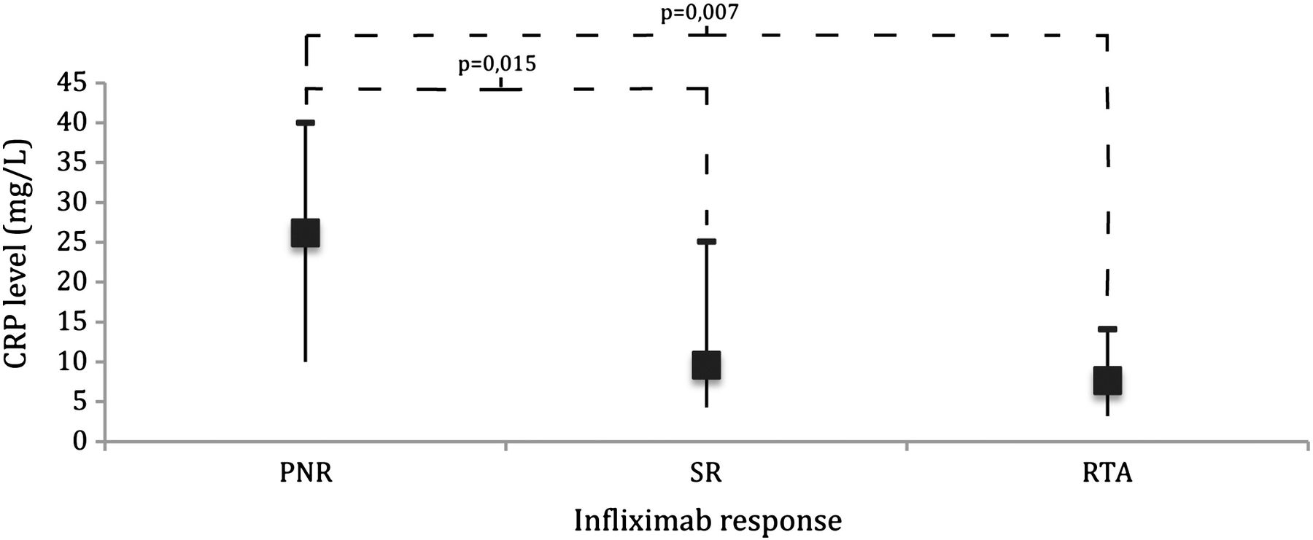
Figure 2 C-reactive protein levels (mg/L) at baseline median and interquartile range (Mann Whitney test). CRP, ...
Notes:
Figure 2 C-reactive protein levels (mg/L) at baseline median and interquartile range (Mann Whitney test). CRP, C-reactive protein; PNR, primary nonresponse; SR, sustained response; RTA, response after therapeutic adjustment.
Unless provided in the caption above, the following copyright applies to the content of this slide: © 2013 European Crohn's and Colitis Organisation

Slide 3
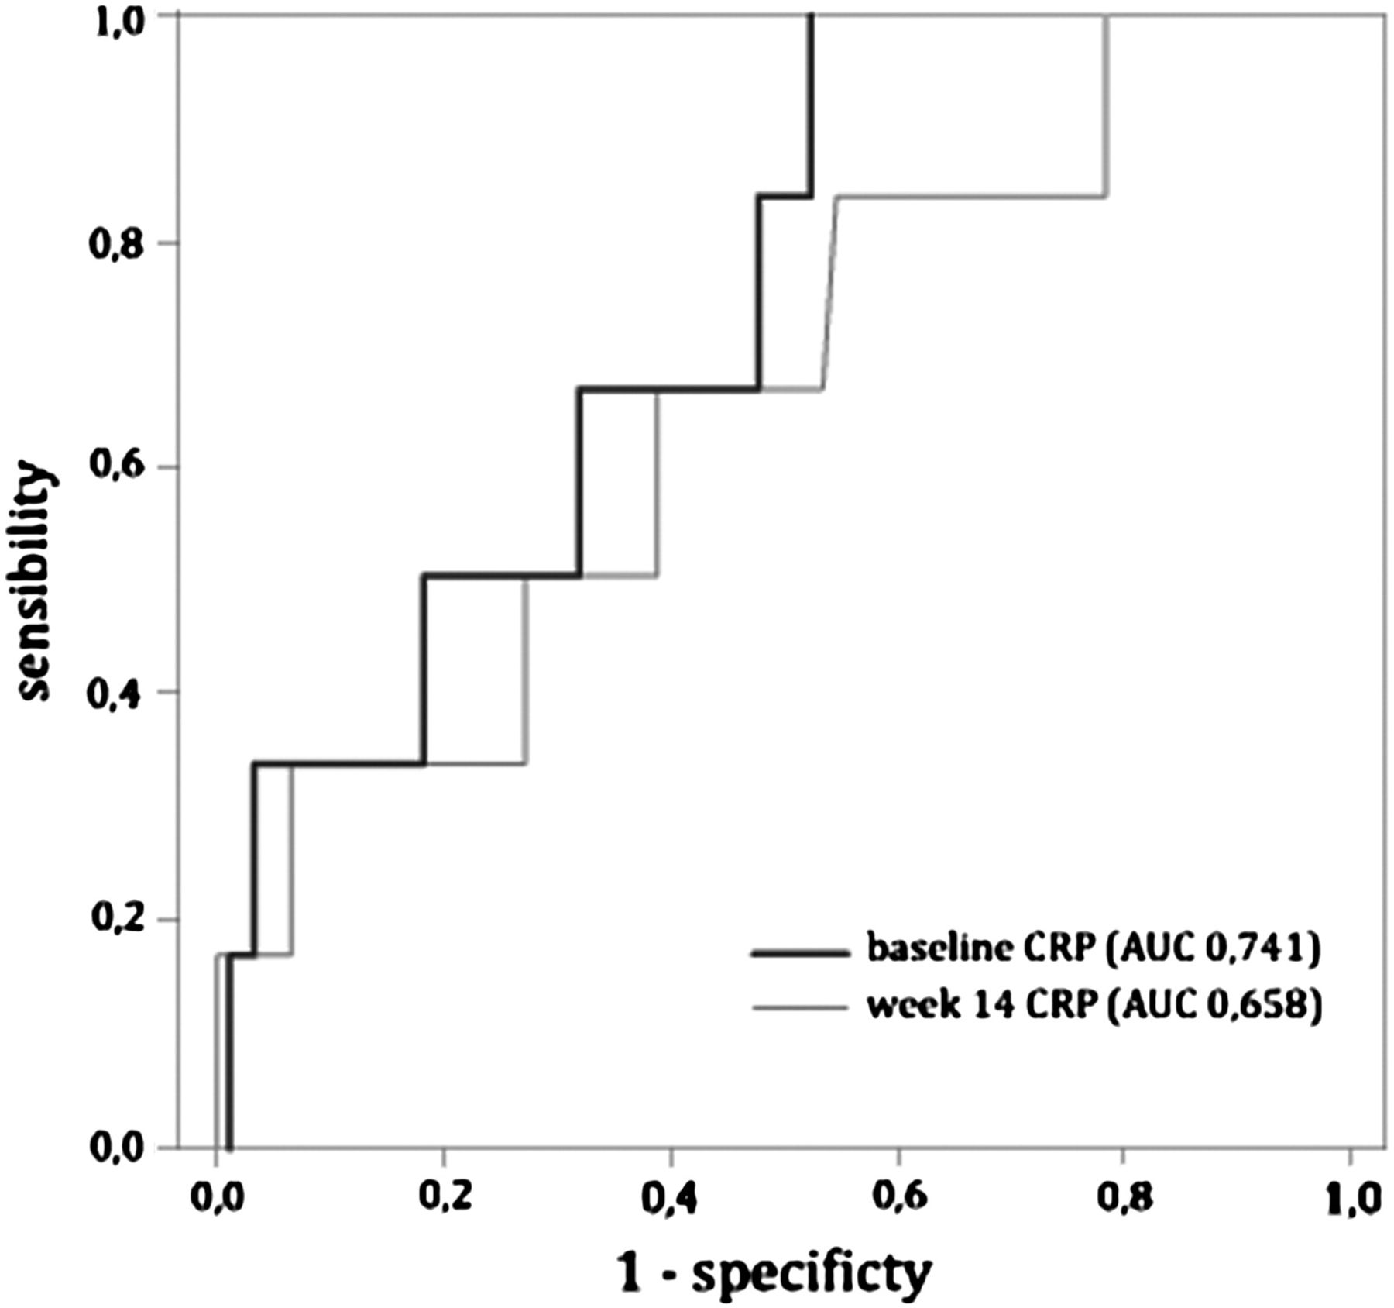
Figure 3 Receiver operating characteristic curves for baseline serum C-reactive protein and primary non response at ...
Notes:
Figure 3 Receiver operating characteristic curves for baseline serum C-reactive protein and primary non response at week 14. CRP, C-reactive protein.
Unless provided in the caption above, the following copyright applies to the content of this slide: © 2013 European Crohn's and Colitis Organisation

Slide 4
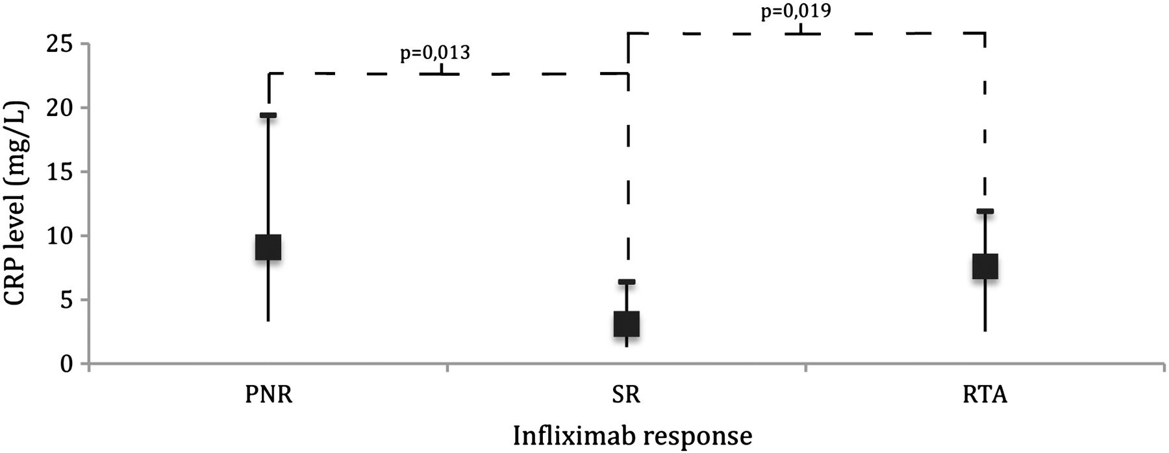
Figure 4 C-reactive protein levels (mg/L) at week 14 — median and interquartile range (Mann Whitney test). CRP, ...
Notes:
Figure 4 C-reactive protein levels (mg/L) at week 14 — median and interquartile range (Mann Whitney test). CRP, C-reactive protein; PNR, primary nonresponse; SR, sustained response; RTA, response after therapeutic adjustment.
Unless provided in the caption above, the following copyright applies to the content of this slide: © 2013 European Crohn's and Colitis Organisation

Slide 5
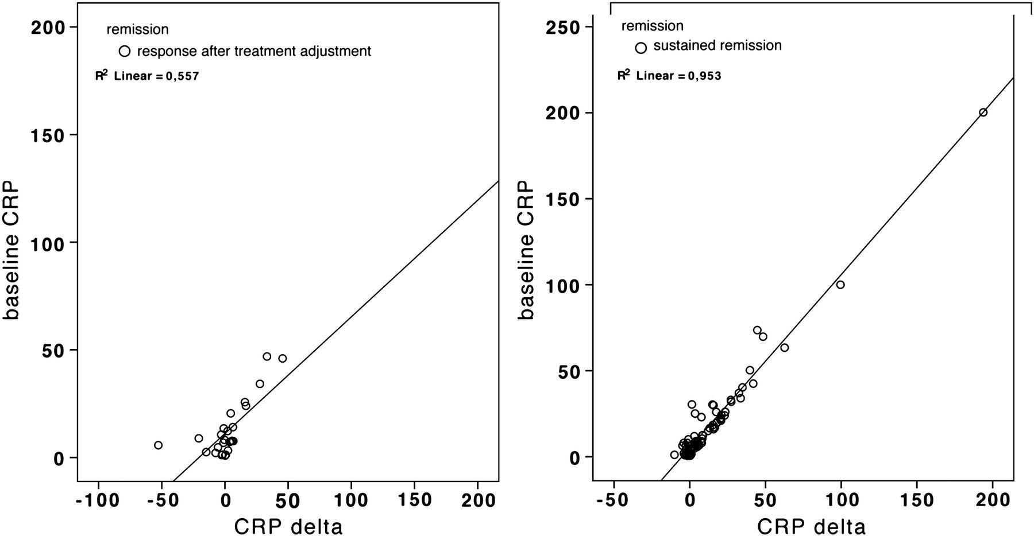
Figure 5 Baseline C-reactive protein and C-reactive protein delta scatter dot — response after therapeutic adjustment ...
Notes:
Figure 5 Baseline C-reactive protein and C-reactive protein delta scatter dot — response after therapeutic adjustment and sustained response. CRP, C-reactive protein.
Unless provided in the caption above, the following copyright applies to the content of this slide: © 2013 European Crohn's and Colitis Organisation

