Slide 1
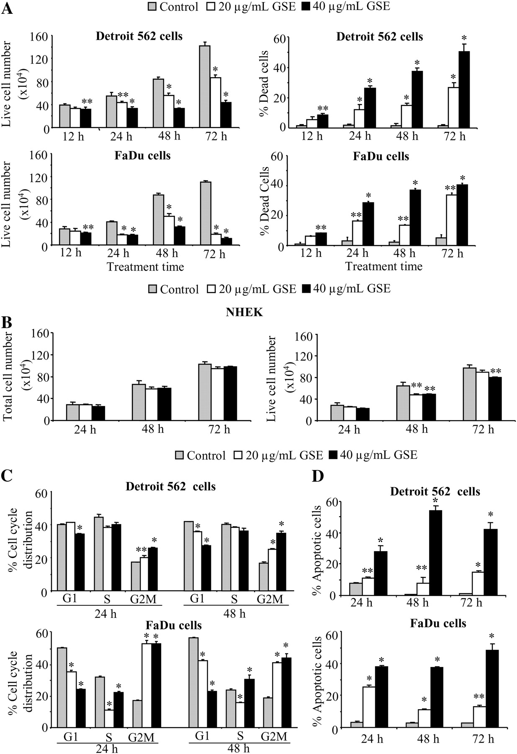
Fig. 1. Effect of GSE on growth, death and cell cycle distribution in HNSCC and normal human epidermal keratinocytes ...
Notes:
Fig. 1. Effect of GSE on growth, death and cell cycle distribution in HNSCC and normal human epidermal keratinocytes (NHEK) cells. Detroit 562, FaDu and NHEK cells were treated with either dimethyl sulfoxide or different concentrations of GSE (20 and 40 μg/ml) for 12–72 h. Thereafter, cells were collected and processed as detailed in ‘Materials and methods’ to analyze GSE effects on ( A ) live and dead HNSCC cell number, ( B ) total and live NHEK cell number, ( C ) cell cycle distribution and ( D ) apoptosis. Each bar is a representative of mean ± SEM of three samples for each treatment. * P < 0.001; ** P < 0.05.
Unless provided in the caption above, the following copyright applies to the content of this slide: © The Author 2012. Published by Oxford University Press. All rights reserved. For Permissions, please email: journals.permissions@oup.com

Slide 2
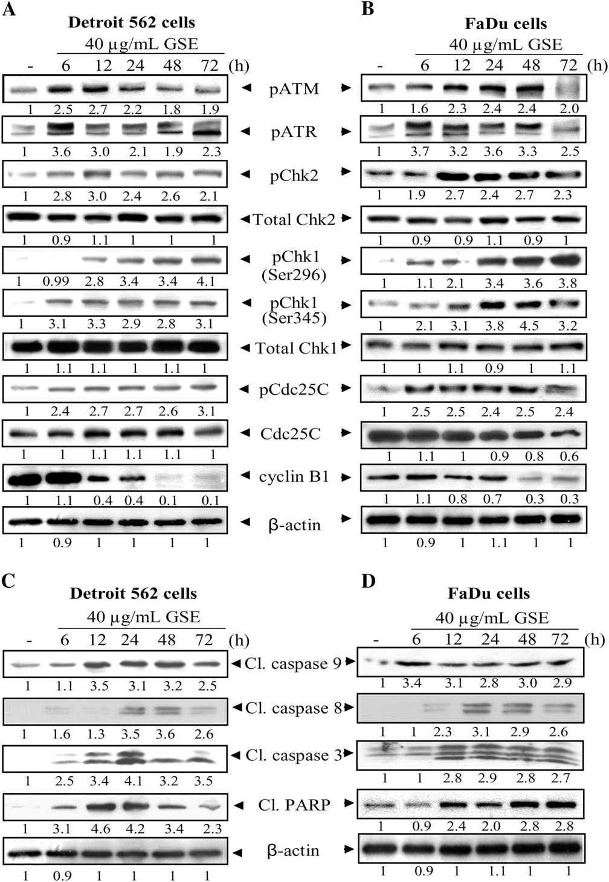
Fig. 2. Effect of GSE on the expression of DNA damage sensors, checkpoint signaling and apoptosis in HNSCC cells. ...
Notes:
Fig. 2. Effect of GSE on the expression of DNA damage sensors, checkpoint signaling and apoptosis in HNSCC cells. Detroit 562 and FaDu cells were treated with GSE (40 μg/ml) for 6–72 h, and total cell lysates were prepared and subjected to sodium dodecyl sulfate–polyacrylamide gel electrophoresis and western blotting. The membranes were then analyzed for ( A and B ) DNA damage sensors, Chks and cell cycle regulators, and ( C and D ) cleaved caspases and PARP levels. Equal protein loading was confirmed by reprobing the membrane with β-actin. The densitometry data below the bands represents ‘fold change’ as compared with vehicle control after normalization with respective loading control.
Unless provided in the caption above, the following copyright applies to the content of this slide: © The Author 2012. Published by Oxford University Press. All rights reserved. For Permissions, please email: journals.permissions@oup.com

Slide 3
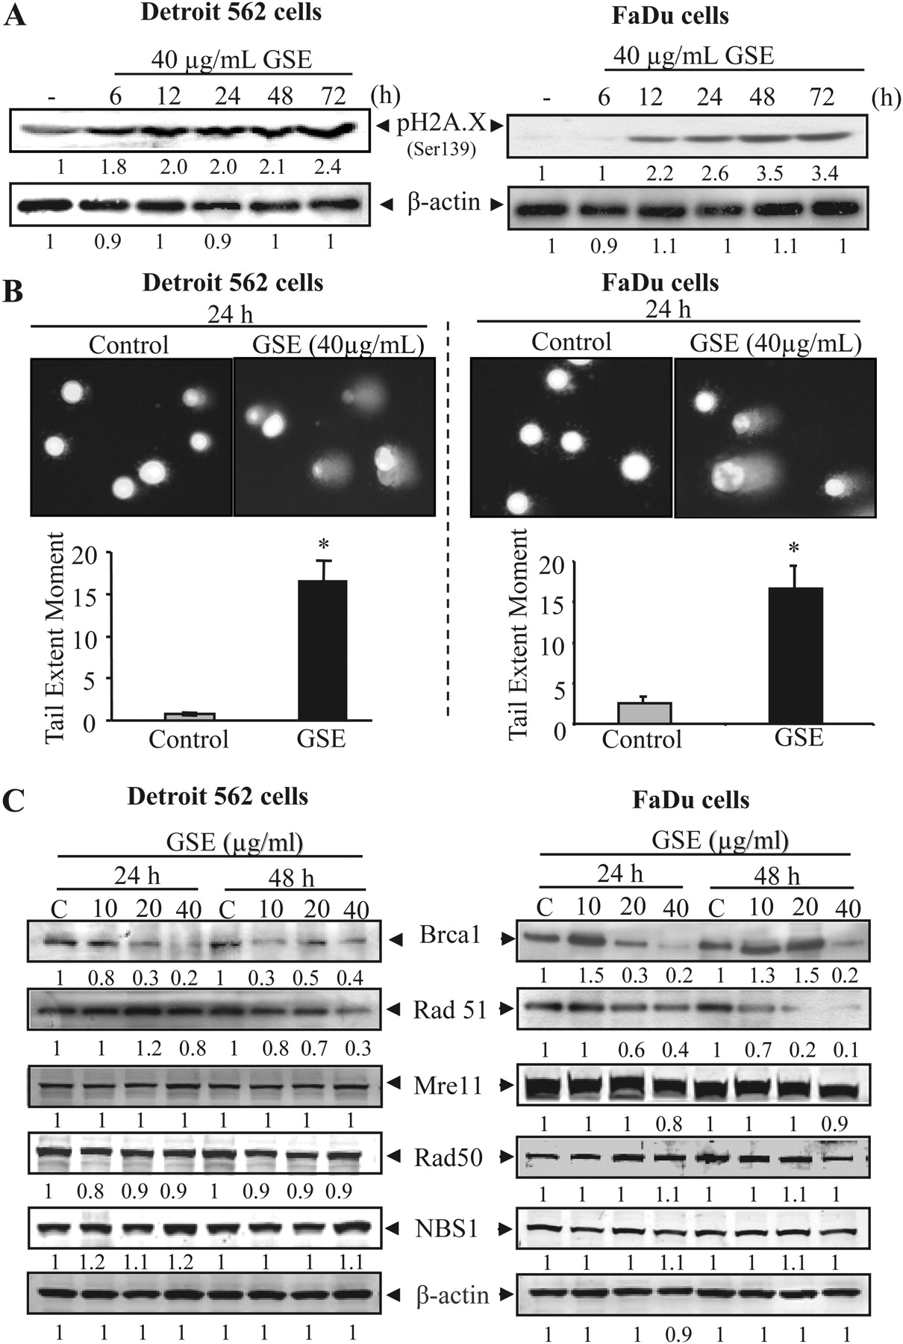
Fig. 3. Effect of GSE on DNA damage and DNA damage repair molecules in HNSCC cells. ( A ) Detroit 562 and FaDu cells ...
Notes:
Fig. 3. Effect of GSE on DNA damage and DNA damage repair molecules in HNSCC cells. ( A ) Detroit 562 and FaDu cells were treated with either dimethyl sulfoxide or GSE (40 μg/ml) for 6–72 h. Total cell lysates were prepared and analyzed for phospho-H2A.X (Ser139). ( B ) Comet assay was performed in Detroit 562 and FaDu cells after 24 h of GSE treatment (40 μg/ml), tail extent moment was measured and photomicrographs were captured at ×200 as described in ‘Materials and methods’. Each bar is representative of mean ± SEM of three samples for each treatment. * P < 0.001 ( C ) Detroit 562 and FaDu cells were treated with GSE (40 μg/ml) for 24 and 48 h and total cell lysates were analyzed for the expression of DNA damage repair molecules Brca1, Rad51, Mre11, Rad50 and Nbs1. (A and C) Equal protein loading was confirmed by reprobing the membrane with β-actin after stripping. The densitometry data below the bands represent fold change as compared with vehicle control after normalization with respective loading control.
Unless provided in the caption above, the following copyright applies to the content of this slide: © The Author 2012. Published by Oxford University Press. All rights reserved. For Permissions, please email: journals.permissions@oup.com

Slide 4
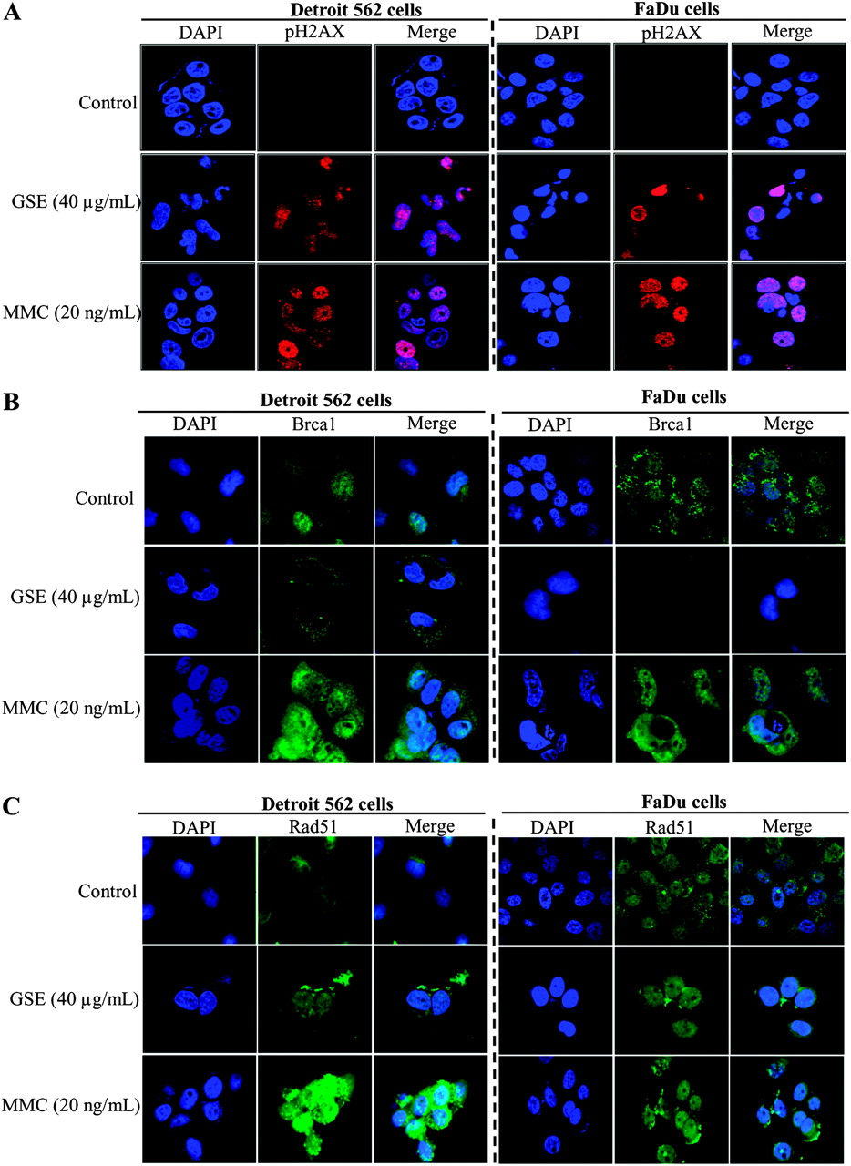
Fig. 4. Effect of GSE on phospho-H2A.X, Brca1 and Rad51 foci formation in HNSCC cells. Detroit 562 and FaDu cells ...
Notes:
Fig. 4. Effect of GSE on phospho-H2A.X, Brca1 and Rad51 foci formation in HNSCC cells. Detroit 562 and FaDu cells were treated with GSE (40 μg/ml) for 24 h and then probed with specific primary antibodies for ( A ) phospho-H2A.X (Ser139), ( B ) Brca1 and ( C ) Rad51 as detailed in ‘Materials and methods’. Thereafter, cells were incubated with fluorescein isothiocyanate-tagged secondary antibodies and counterstained with 4′,6′-diamidino-2-phenylindole (DAPI). Cells were finally visualized under Nikon D eclipse C1 confocal microscope and images were processed using EZ-C1 Free-viewer software. Data, representative of experiment done in triplicate, show the subnuclear foci formation for phospho-H2A.X, Brca1 and Rad51 after GSE treatment. Mitomycin C (20 ng/ml for 24 h)-treated cells were used as positive control.
Unless provided in the caption above, the following copyright applies to the content of this slide: © The Author 2012. Published by Oxford University Press. All rights reserved. For Permissions, please email: journals.permissions@oup.com

Slide 5
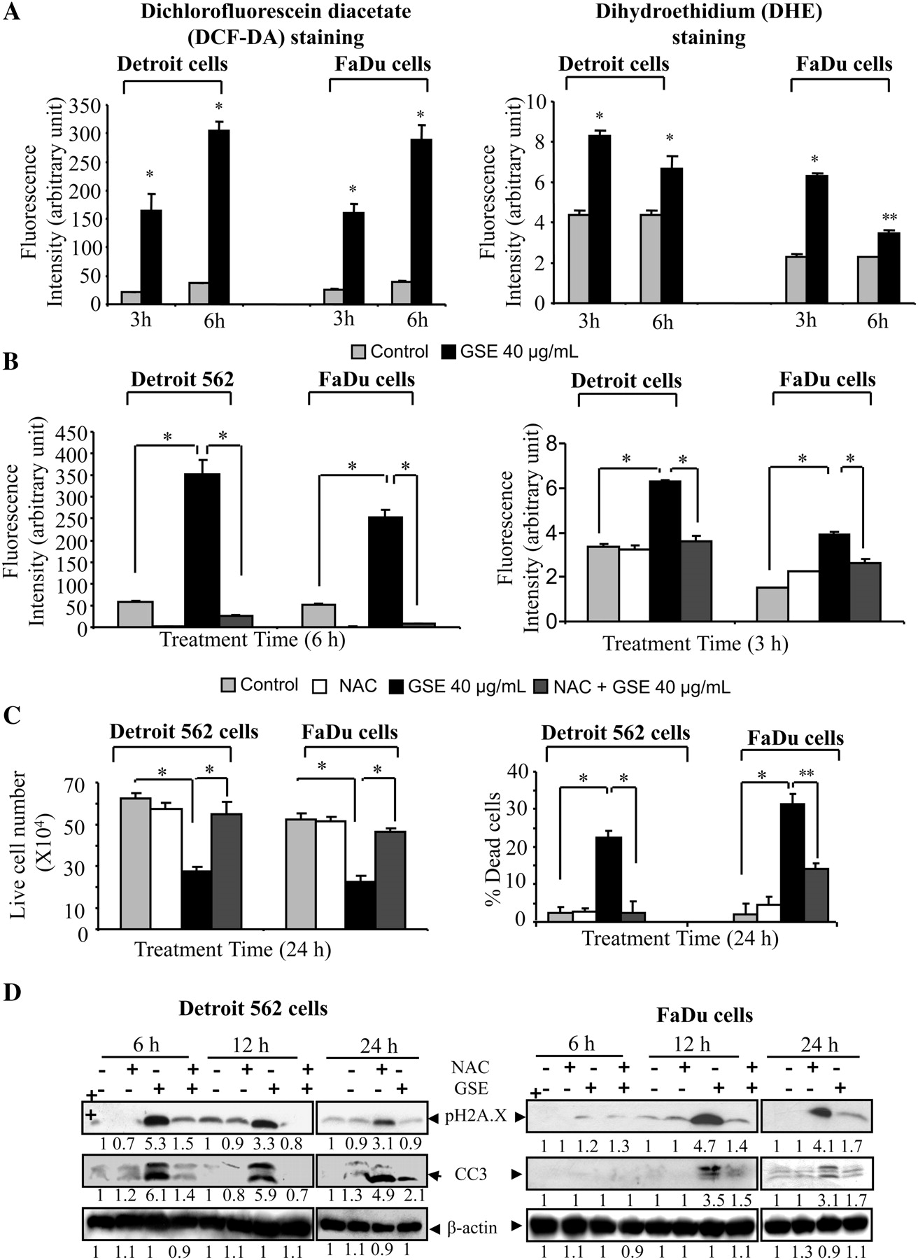
Fig. 5. Effect of GSE on intracellular ROS levels and their role in biological efficacy of GSE in HNSCC cells. ( A ) ...
Notes:
Fig. 5. Effect of GSE on intracellular ROS levels and their role in biological efficacy of GSE in HNSCC cells. ( A ) Detroit 562 and FaDu cells were treated with 20 μM of DCF-DA or 10 μM of DHE in dark, followed by GSE (40 μg/ml), and DCF-DA fluorescence intensity was measured using fluorescence plate reader and DHE intensity was analyzed using flow cytometry as described in the ‘Materials and methods’. ( B ) NAC (5 mM for Detroit 562 and 15 mM for FaDu cells) was added 15 min prior to GSE and cells were processed after 6 h (DCF-DA) and 3 h (DHE) for measuring the ROS level. ( C and D ) Detroit 562 and FaDu cells were pretreated with NAC for 15 min followed by 40 μg/ml of GSE. Experiment was terminated after 24 h and cell number and cell death were determined. Under similar experimental conditions, total cell lysates were prepared after 6, 12 and 24 h and analyzed for phospho-H2A.X (Ser139) and cleaved caspase 3 levels. The data shown in (A–C) are representative of mean ± SEM of three samples for each treatment. * P < 0.001; ** P < 0.05. The immunoblots were stripped and reprobed with β-actin to ensure equal protein loading. The densitometry values represent fold change as compared with vehicle control after normalization with respective loading control.
Unless provided in the caption above, the following copyright applies to the content of this slide: © The Author 2012. Published by Oxford University Press. All rights reserved. For Permissions, please email: journals.permissions@oup.com

Slide 6
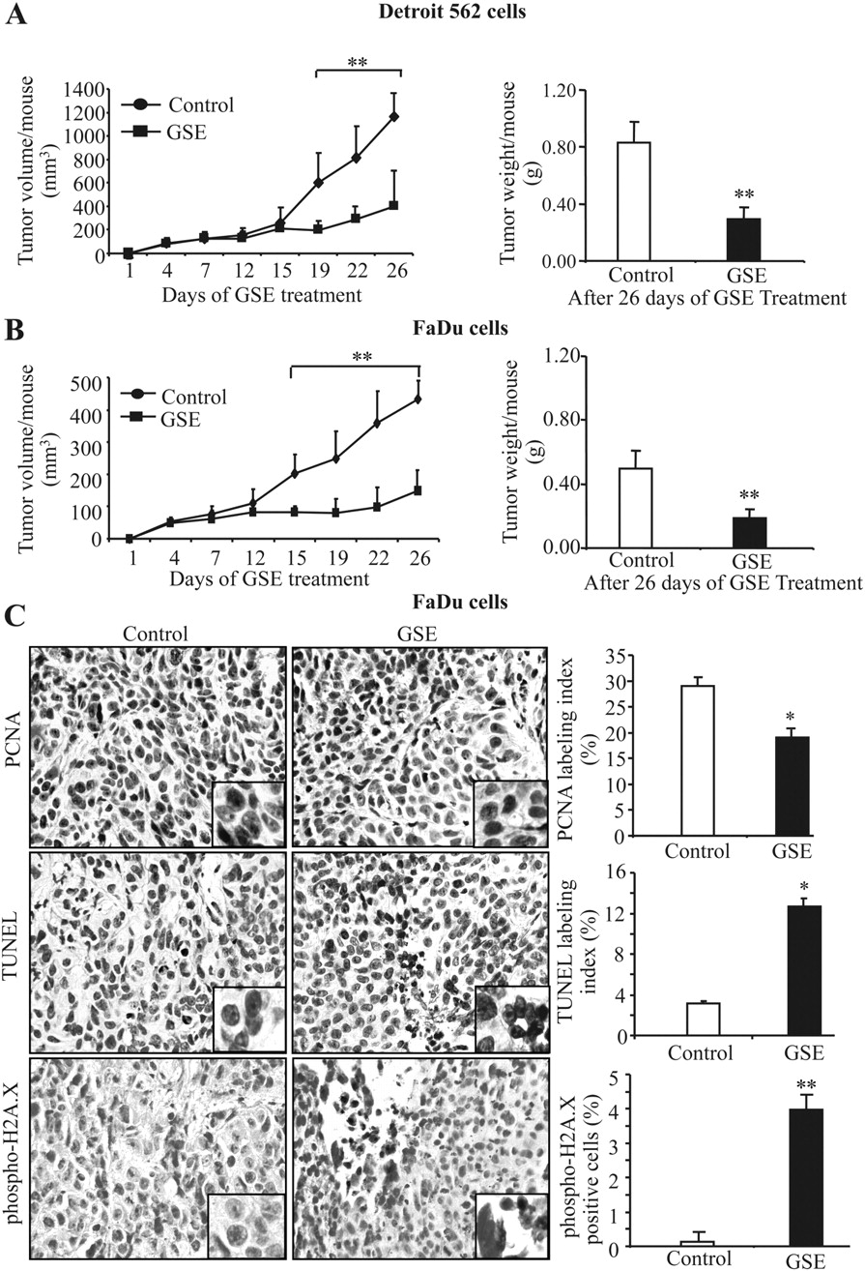
Fig. 6. Effect of dietary feeding of GSE on HNSCC Detroit 562 and FaDu tumor xenograft growth in athymic nude mice ...
Notes:
Fig. 6. Effect of dietary feeding of GSE on HNSCC Detroit 562 and FaDu tumor xenograft growth in athymic nude mice along with in vivo proliferation, apoptosis and DNA damage. Nude mice were injected with Detroit 562 or FaDu cells, fed with 0.2% GSE (wt/wt) in diet and animals analyzed for ( A ) tumor volume (in mm 3 ) and ( B ) tumor weight as mentioned in Material and methods. The data shown are average tumor volume ± SEM of seven mice per group. ( C ) FaDu xenograft tissue samples from both control and GSE-fed groups were subjected to IHC analysis, and representative photographs are shown for PCNA-, TUNEL- and phospho-H2A.X (Ser139)-positive cells at ×400 magnification. The quantitative data shown are mean ± SEM of five individual tumor samples from each group. * P < 0.001; ** P < 0.05.
Unless provided in the caption above, the following copyright applies to the content of this slide: © The Author 2012. Published by Oxford University Press. All rights reserved. For Permissions, please email: journals.permissions@oup.com

