Slide 1
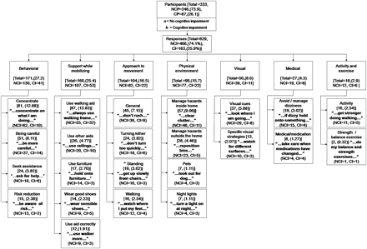
Figure 1. Participants’ suggested strategies to reduce falls after discharge.
Notes:
Figure 1. Participants’ suggested strategies to reduce falls after discharge.
Unless provided in the caption above, the following copyright applies to the content of this slide: © The Author 2011. Published by Oxford University Press on behalf of The Gerontological Society of America. All rights reserved. For permissions, please e-mail: journals.permissions@oup.com.

