Slide 1
Figure 1 The standard inverse RNA folding problem and the generalized inverse RNA folding problem that is shape aware ...
Notes:
Figure 1 The standard inverse RNA folding problem and the generalized inverse RNA folding problem that is shape aware and fragment-based (i.e. fragment selection enabled) are illustrated on the purine riboswitch aptamer in the middle (A). The predicted structure of an output designed sequence is shown on the right (C) for the standard inverse folding problem and on the left (B) for the generalized inverse RNA folding problem.
Unless provided in the caption above, the following copyright applies to the content of this slide: © The Authors 2017. Published by Oxford University Press.This is an Open Access article distributed under the terms of the Creative Commons Attribution License (http://creativecommons.org/licenses/by/4.0/), which permits unrestricted reuse, distribution, and reproduction in any medium, provided the original work is properly cited.

Slide 2
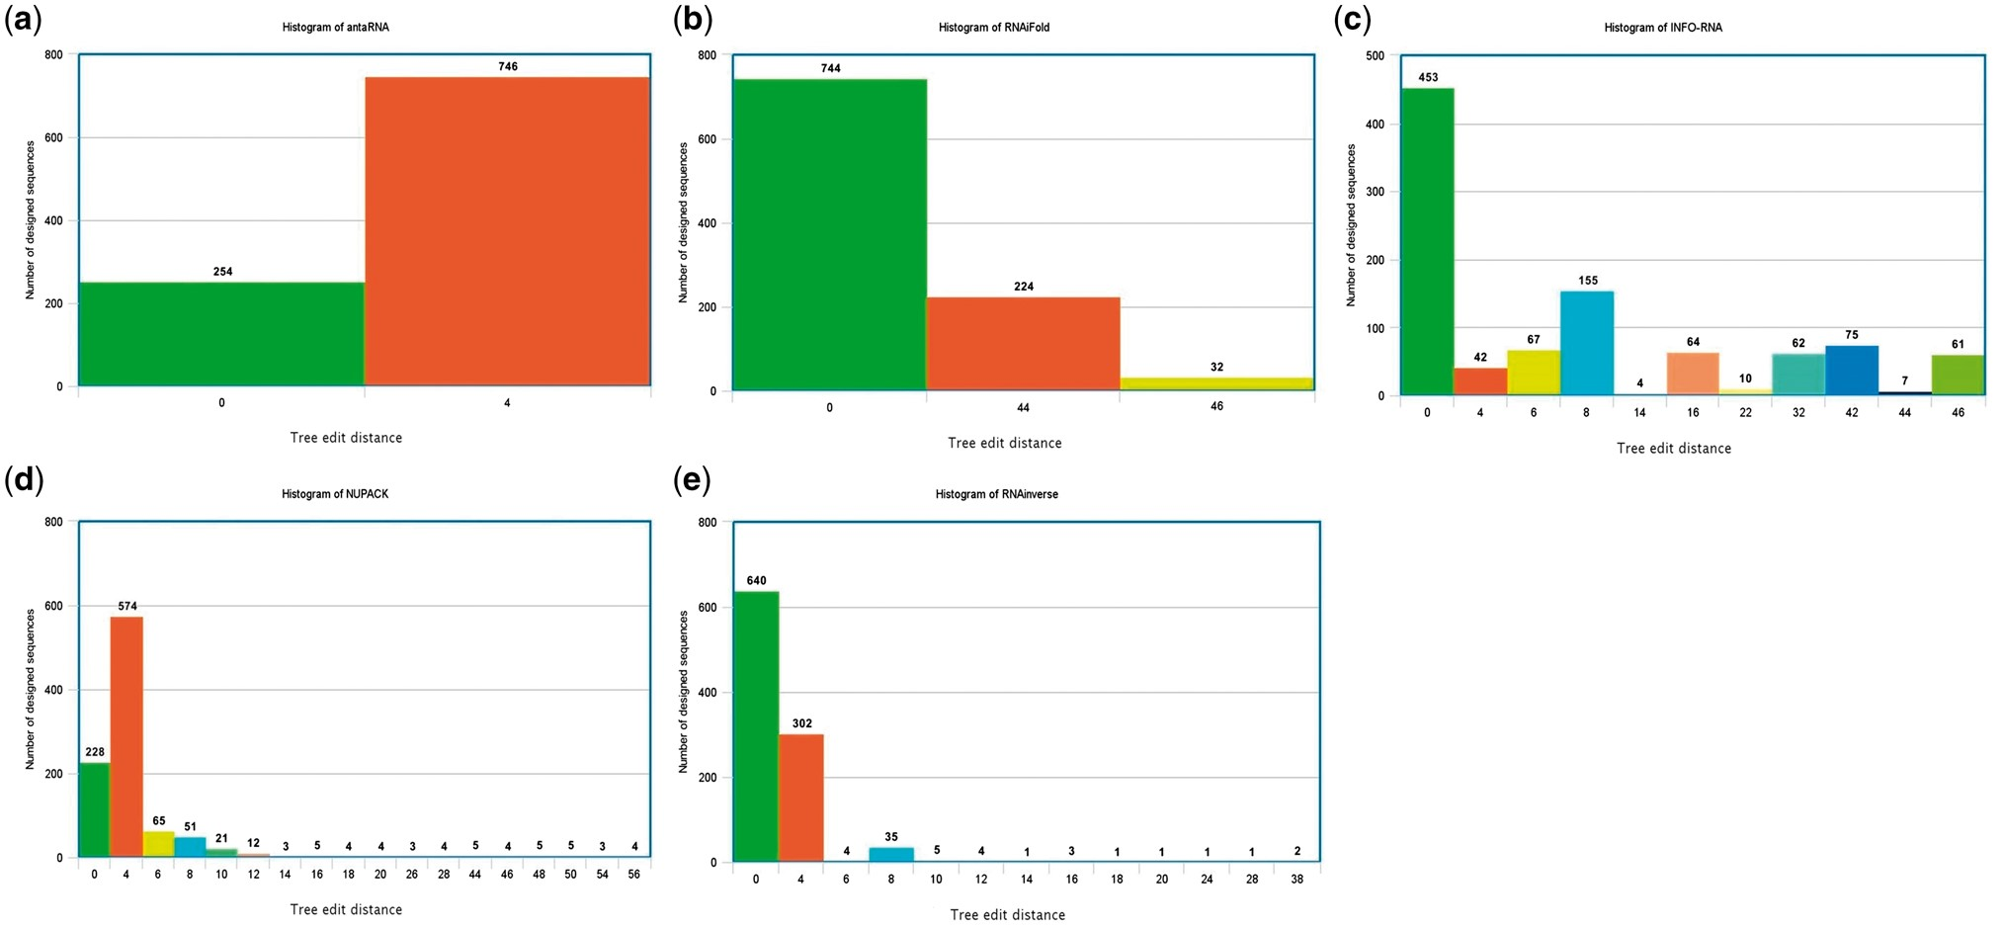
Figure 3 Histogram comparison between the five selected programs is available in Table 2 for the example test case ...
Notes:
Figure 3 Histogram comparison between the five selected programs is available in Table 2 for the example test case that is designated as (2) in the Details of Use Section and for which the runtimes are reported in the second column of Table 2.
Unless provided in the caption above, the following copyright applies to the content of this slide: © The Authors 2017. Published by Oxford University Press.This is an Open Access article distributed under the terms of the Creative Commons Attribution License (http://creativecommons.org/licenses/by/4.0/), which permits unrestricted reuse, distribution, and reproduction in any medium, provided the original work is properly cited.

Slide 3
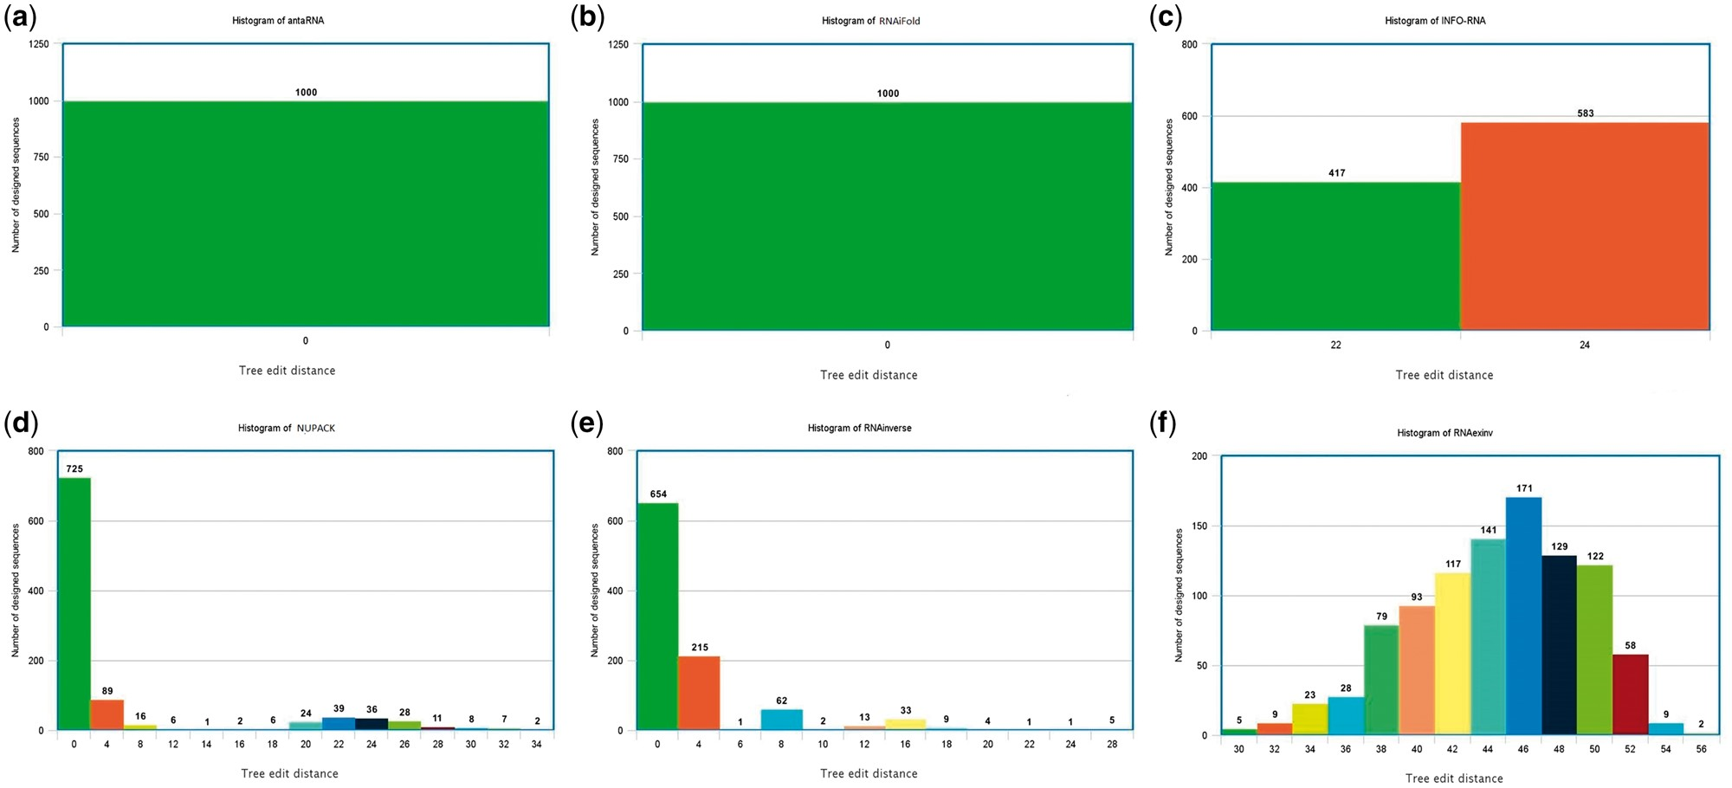
Figure 2 Histogram comparison between the six selected programs is available in Table 2 for the example test case that ...
Notes:
Figure 2 Histogram comparison between the six selected programs is available in Table 2 for the example test case that is designated as (1) in the Details of Use Section and for which the runtimes are reported in the first column of Table 2.
Unless provided in the caption above, the following copyright applies to the content of this slide: © The Authors 2017. Published by Oxford University Press.This is an Open Access article distributed under the terms of the Creative Commons Attribution License (http://creativecommons.org/licenses/by/4.0/), which permits unrestricted reuse, distribution, and reproduction in any medium, provided the original work is properly cited.

