Slide 1
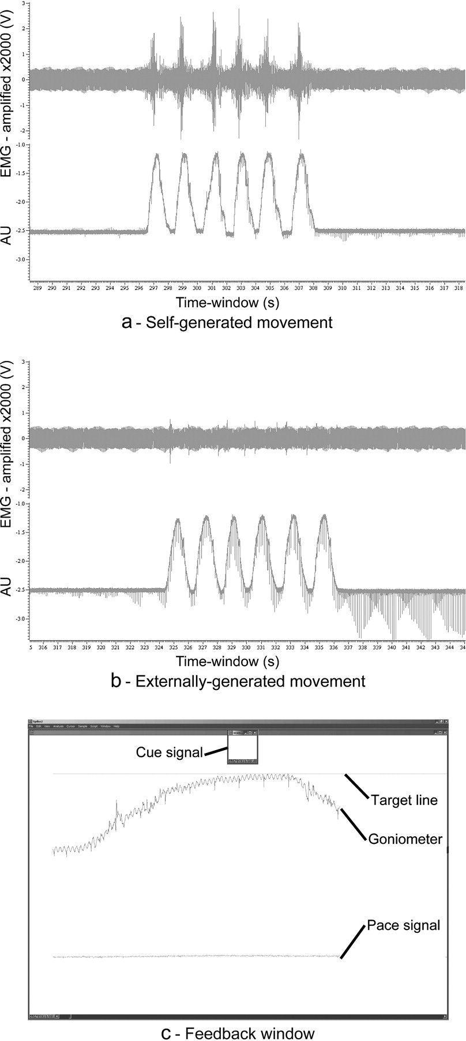
Figure 1. Kinematical data and feedback. Kinematical data from (a) self-generated movement and (b) externally generated ...
Notes:
Figure 1. Kinematical data and feedback. Kinematical data from (a) self-generated movement and (b) externally generated movement. The upper curve in each display shows the EMG activity and the lower curve the goniometer signal. Notice that none of the curves are filtered after they are recorded. (c) Shows the visual feedback during a self- or externally generated movement of the ankle. The feedback was made similar in all subjects such that they had to move the goniometer signal up to the upper horizontal line (target line) for each contraction. This window was shown for 2 s. The line below the goniometer signal indicates the pace (pace signal). When the line traversed from left to right, one full contraction and relaxation had to be made. In the upper center, the cue signal was displayed for 2 s in the respective color (red, green, or blue) before the block lasting 12 s. During movement, the goniometer had to be moved up to the target line, preferably, such that it just touched the target line in the center of the screen. The feedback window has been color inverted for display reasons and converted into gray scale.
Unless provided in the caption above, the following copyright applies to the content of this slide: © The Author 2006. Published by Oxford University Press. All rights reserved. For permissions, please e-mail: journals.permissions@oxfordjournals.org

Slide 2
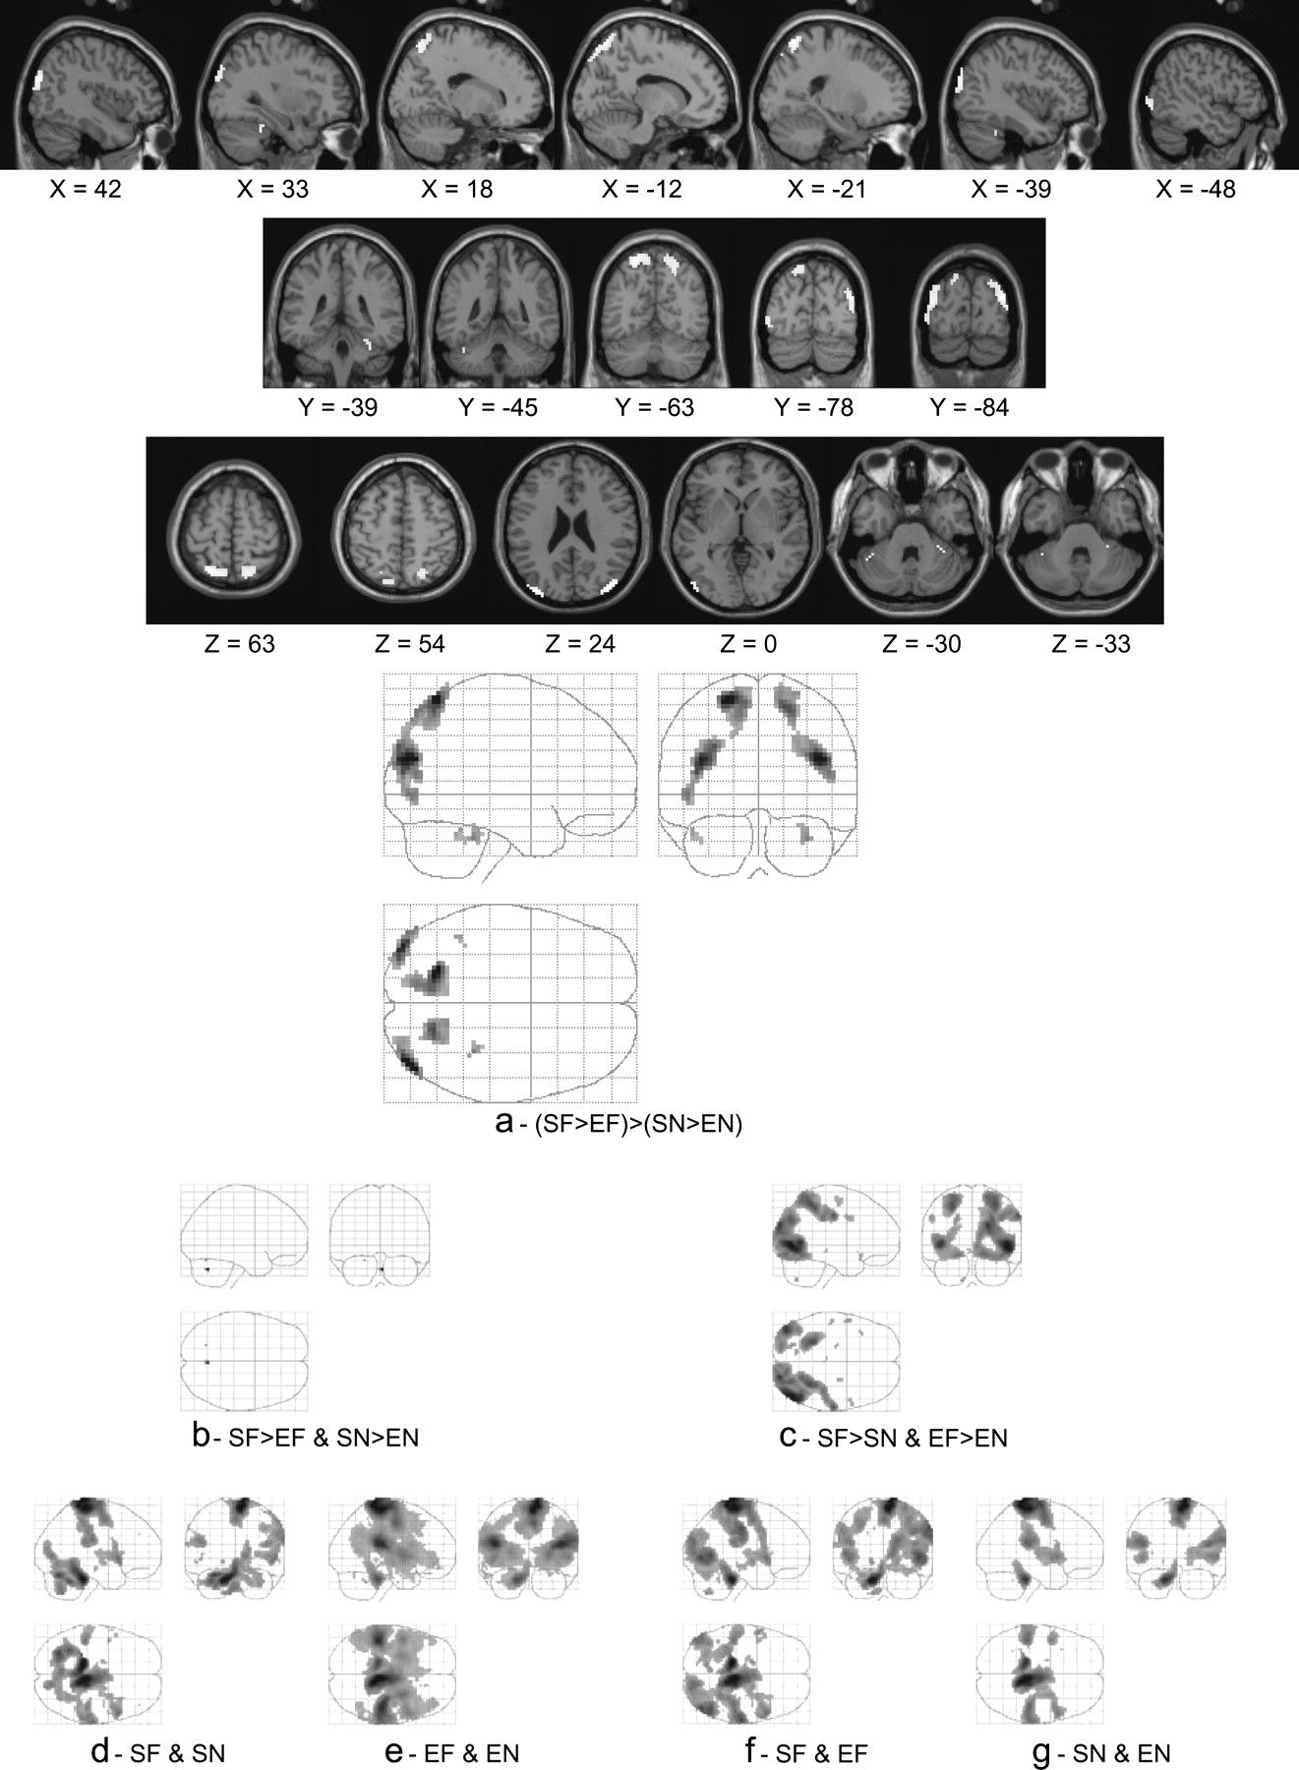
Figure 2. Self-generated visual feedback. (a) Shows the interaction (SF > EF > (SN > EN) presented as an overlayed ...
Notes:
Figure 2. Self-generated visual feedback. (a) Shows the interaction (SF > EF > (SN > EN) presented as an overlayed activation map onto a template structural MRI and as a MIP. This map shows areas where there is an extra effect on the visual feedback due to the self-generated movement. (b) Shows areas more activated during self-generated than during externally generated movements, regardless of whether feedback was present or absent. (c) Shows areas where there was more activation with than without feedback. Activation displayed in (a) show the integration of the activation in (b) and (c). (d) Shows the common activation for self-generated movements and subpanel (e) the common activation for externally generated movements. Activation shown in (b) can then be considered as the difference in activation between the maps in subpanels (d) and (e). (f) Shows common activation for movements with feedback. (g) Shows common activation for movements without feedback. Subpanel (c) can then be considered as the difference between the maps presented in subpanels (f) and (g). All maps are corrected for multiple comparisons using FDR and thresholded at q < 0.05.
Unless provided in the caption above, the following copyright applies to the content of this slide: © The Author 2006. Published by Oxford University Press. All rights reserved. For permissions, please e-mail: journals.permissions@oxfordjournals.org

Slide 3
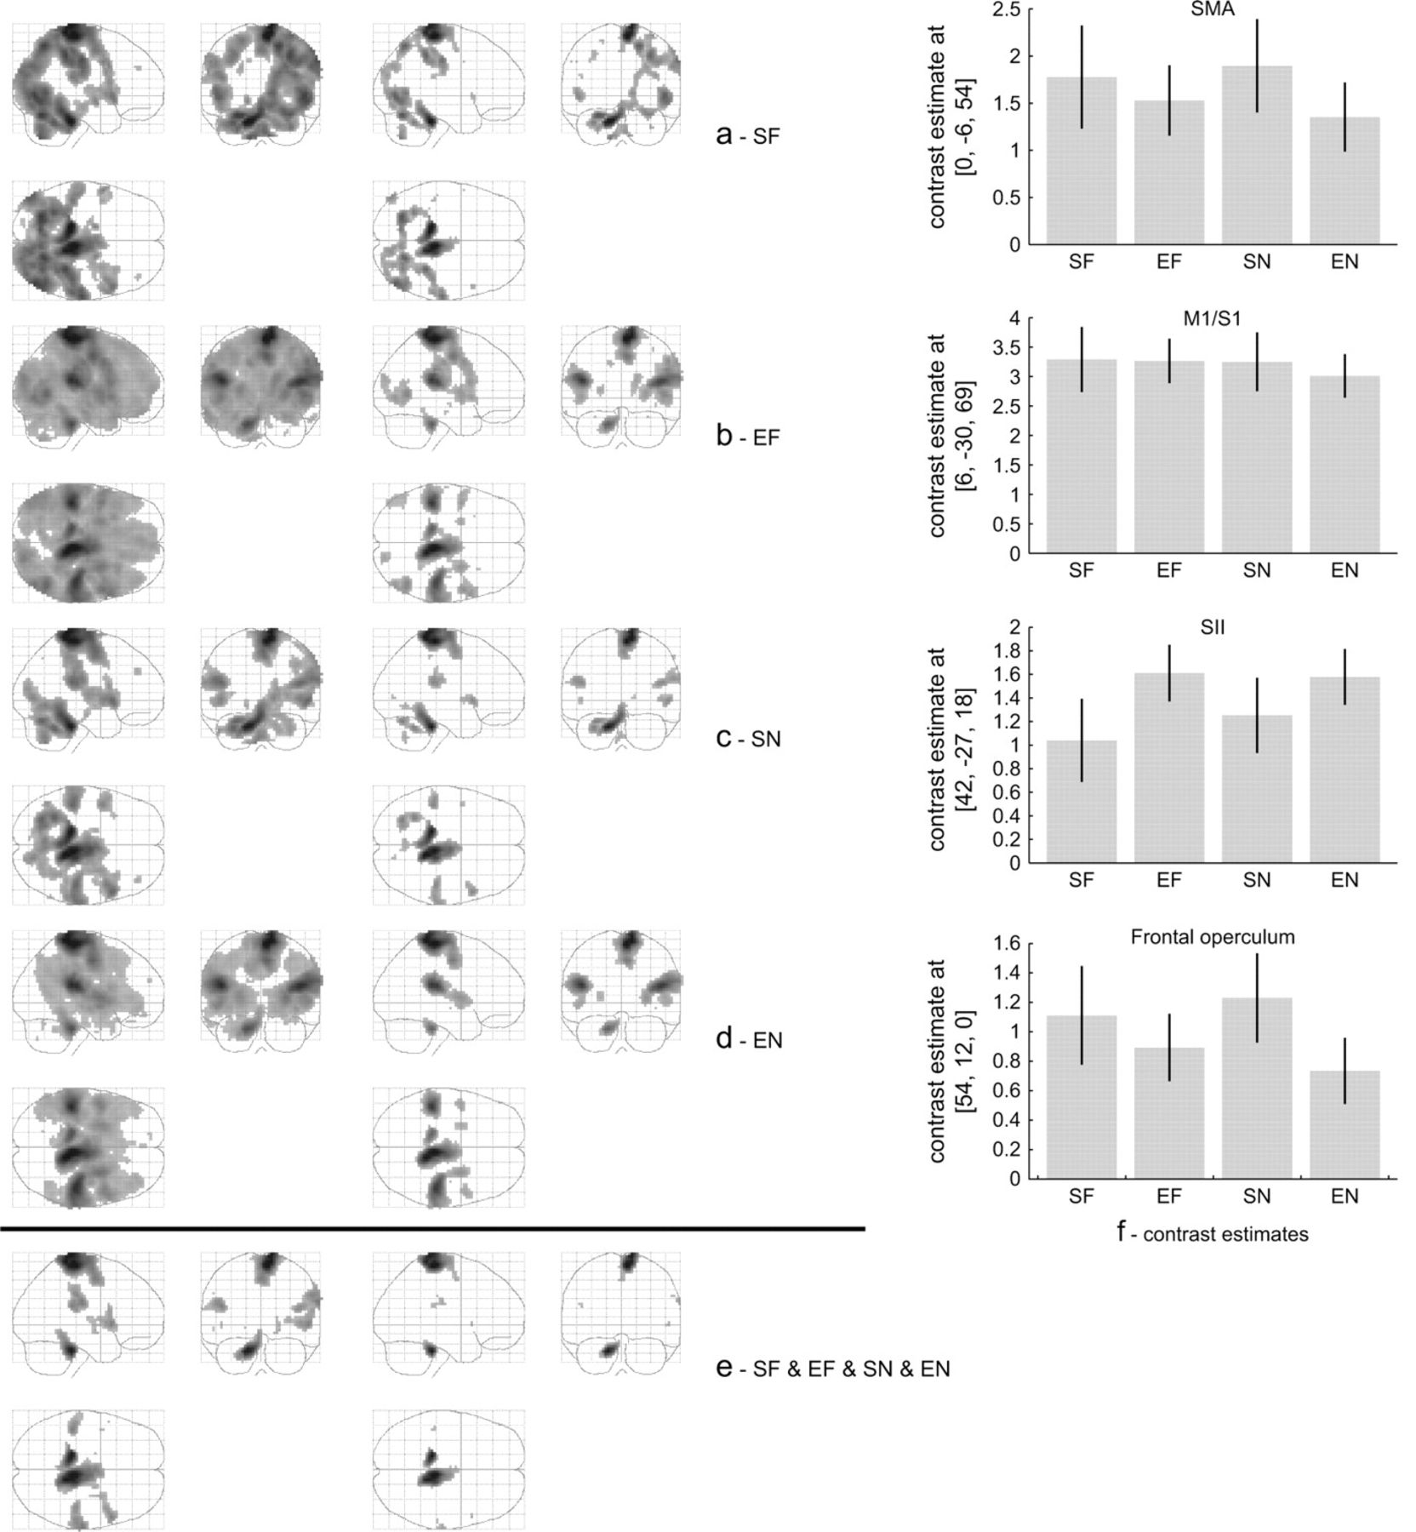
Figure 3. Main effects and conjunctions of main effects. (a)–(d) Show maps of the main effects SF, EF, SN, and EN ...
Notes:
Figure 3. Main effects and conjunctions of main effects. (a)–(d) Show maps of the main effects SF, EF, SN, and EN against the implicit rest condition thresholded at q < 0.05, using FDR correction in the first column and using GRF theory (p SF ∧ EN > SN displayed in Supplementary Figure 1b and Supplementary Table 2.
Unless provided in the caption above, the following copyright applies to the content of this slide: © The Author 2006. Published by Oxford University Press. All rights reserved. For permissions, please e-mail: journals.permissions@oxfordjournals.org

Slide 4
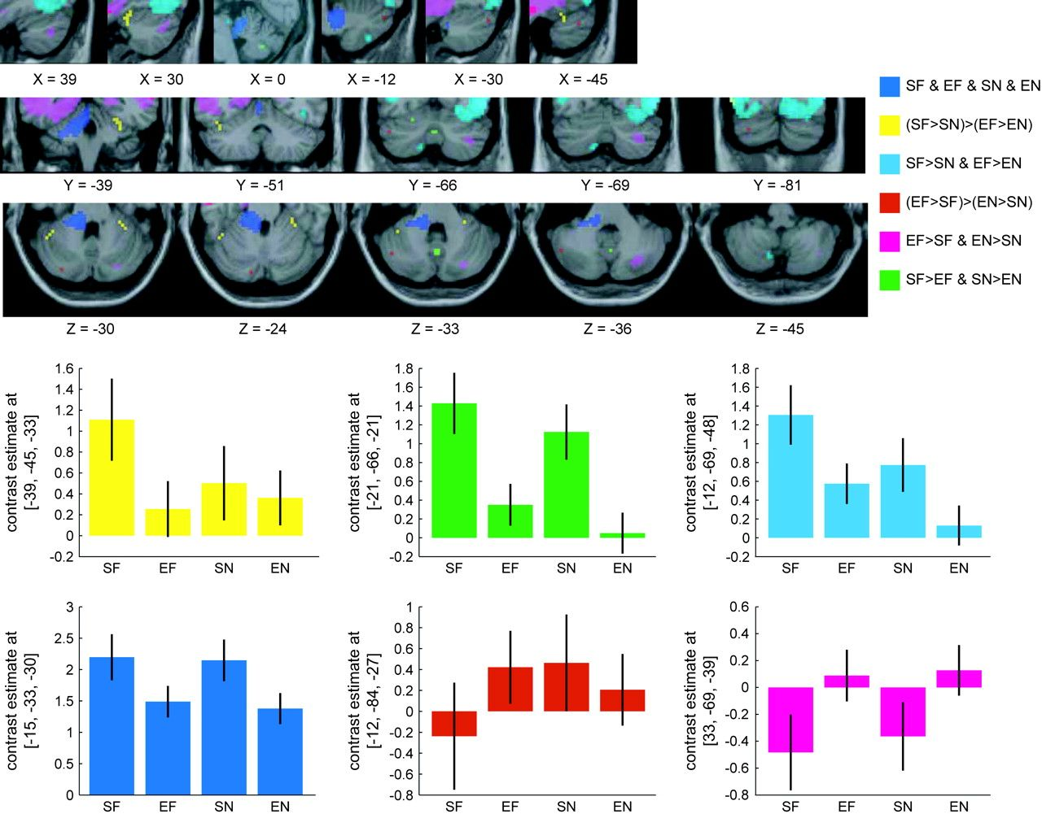
Figure 4. Cerebellar activations. The top display shows activations in the cerebellum from 6 different contrasts, ...
Notes:
Figure 4. Cerebellar activations. The top display shows activations in the cerebellum from 6 different contrasts, interactions, or conjunctions in different colors. Yellow—(SF > SN) > (EF > EN) found in left cerebellum crus 1 and right cerebellum (VI). Red—(EF > SF) > (EN > SN) found in left crus 1 and crus 2. Green—SF > EF ∧ SN > EN found in cerebellar vermis (9) and left cerebellar hemisphere (VI). Dark blue—SF ∧ EF ∧ SN ∧ EN found in left medial cerebellar peduncle. Light blue (cyan)—SF > SN ∧ EF > EN found in left cerebellum (VIII). Magenta—EF > SF ∧ EN > SN found in right cerebellum crus 1 and crus 2. The same threshold is used in all maps (q < 0.05, FDR). The bottom display shows contrast estimates of the 4 regressors for all subjects from the different cerebellar regions. The colors correspond to those used in the activation maps.
Unless provided in the caption above, the following copyright applies to the content of this slide: © The Author 2006. Published by Oxford University Press. All rights reserved. For permissions, please e-mail: journals.permissions@oxfordjournals.org

