Slide 1
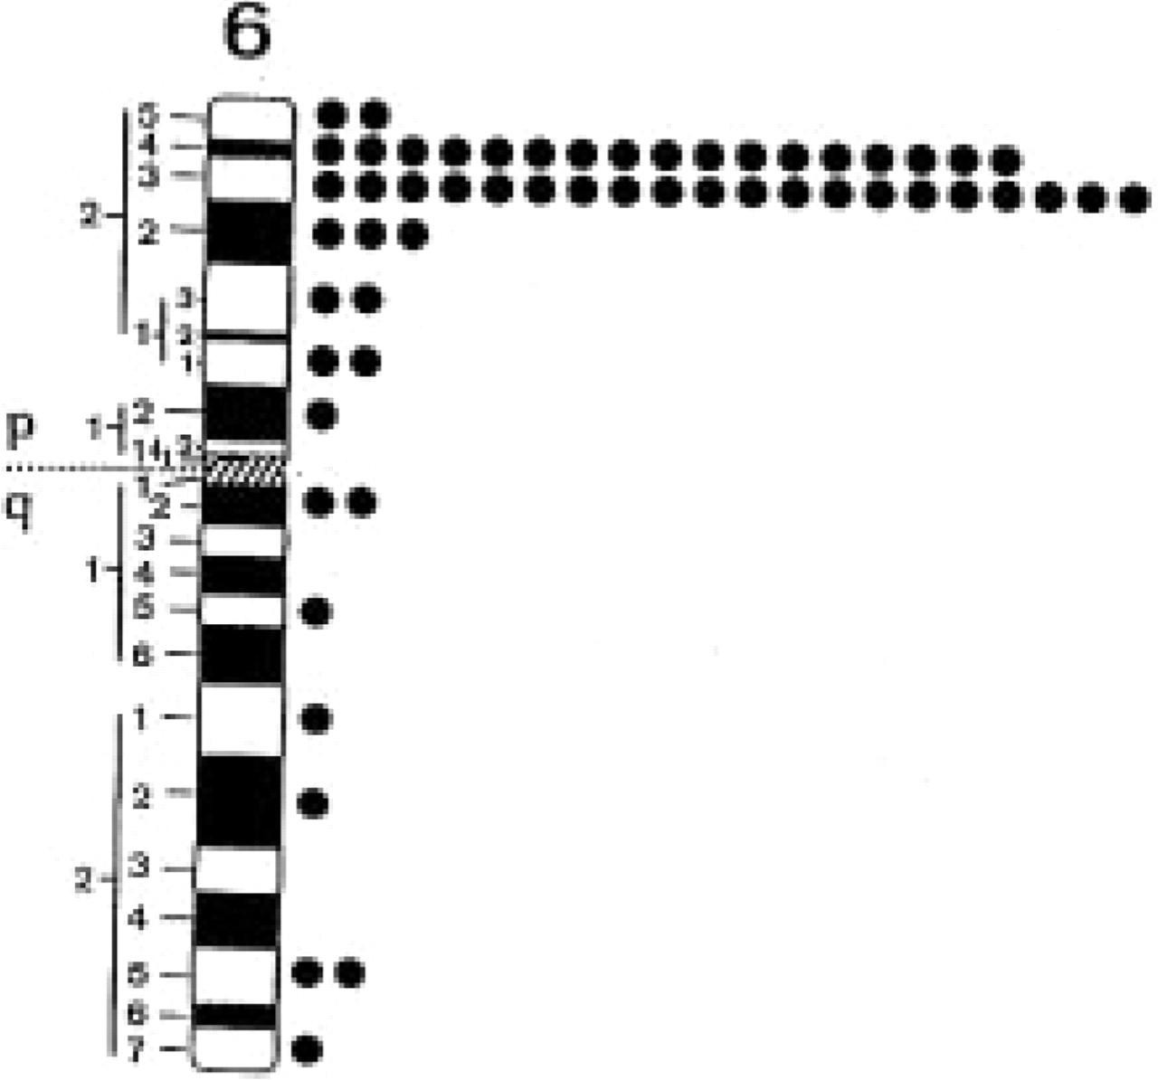
Figure 4 Mapping of JMJ by in situ hybridization. JMJ cDNA was hybridized to metaphase cells. The diagram shows the ...
Notes:
Figure 4 Mapping of JMJ by in situ hybridization. JMJ cDNA was hybridized to metaphase cells. The diagram shows the localization of silver grains on chromosome 6.
Unless provided in the caption above, the following copyright applies to the content of this slide: © 1996 Oxford University Press

Slide 2
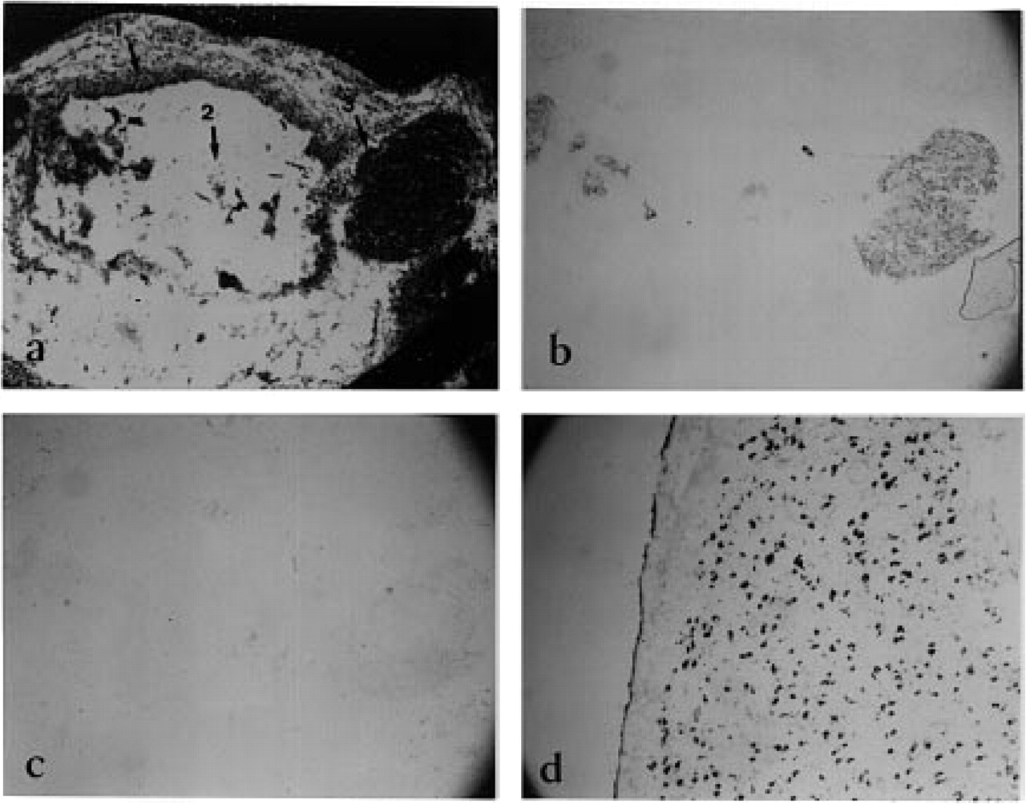
Figure 3 Expression of JMJ in human embryos and adult brains as revealed by non-radioactive in situ hybridization. ...
Notes:
Figure 3 Expression of JMJ in human embryos and adult brains as revealed by non-radioactive in situ hybridization. Tissues sections of embryos were stained with Nissl blue (a). 1, neural tube; 2, spinal cord; 3, dorsal root ganglion cell. Adjacent sections were fixed and hybridized to JMJ cRNA probe (b). As a control of background staining, sections were hybridized to a sense RNA probe (c). Similarly, sections of human adult brain were hybridized to antisense probes (d).
Unless provided in the caption above, the following copyright applies to the content of this slide: © 1996 Oxford University Press

Slide 3
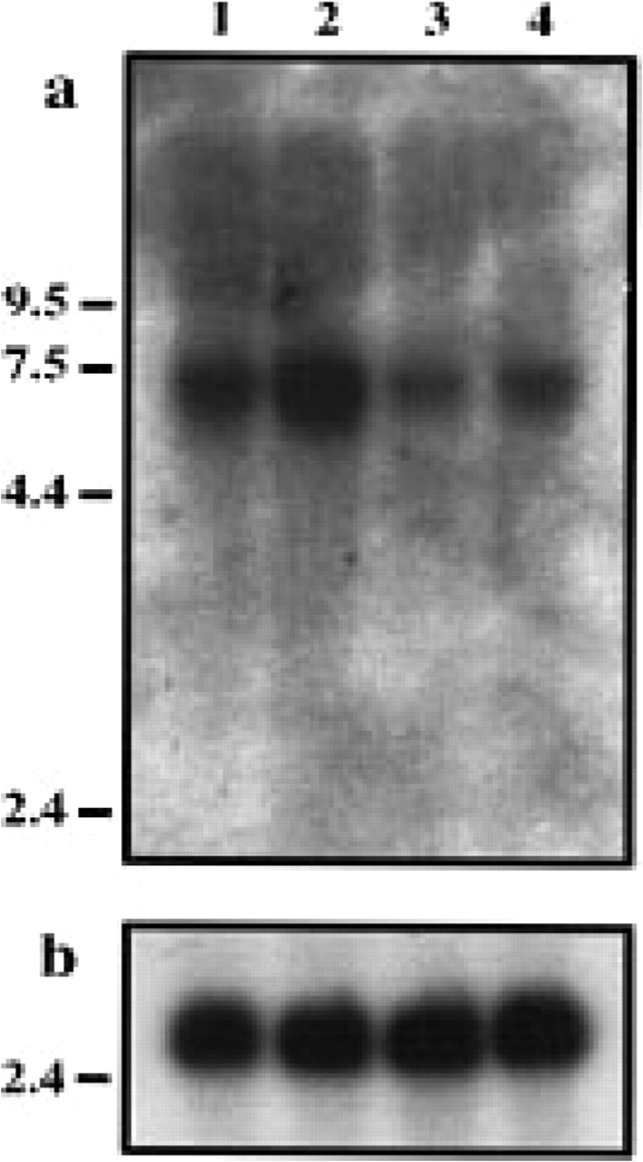
Figure 2 Northern blot analyses of the JMJ transcript. About 2 µg of poly(A)⁺ RNA from the following fetal ...
Notes:
Figure 2 Northern blot analyses of the JMJ transcript. About 2 µg of poly(A)+ RNA from the following fetal tissues were electrophoresed and hybridized to (a) JMJ cDNA and (b) a control human actin probe: lane 1, kidney; lane 2, liver; lane 3, lung; lane 4, brain. The blot in (a) was deliberately overexposed.
Unless provided in the caption above, the following copyright applies to the content of this slide: © 1996 Oxford University Press

Slide 4
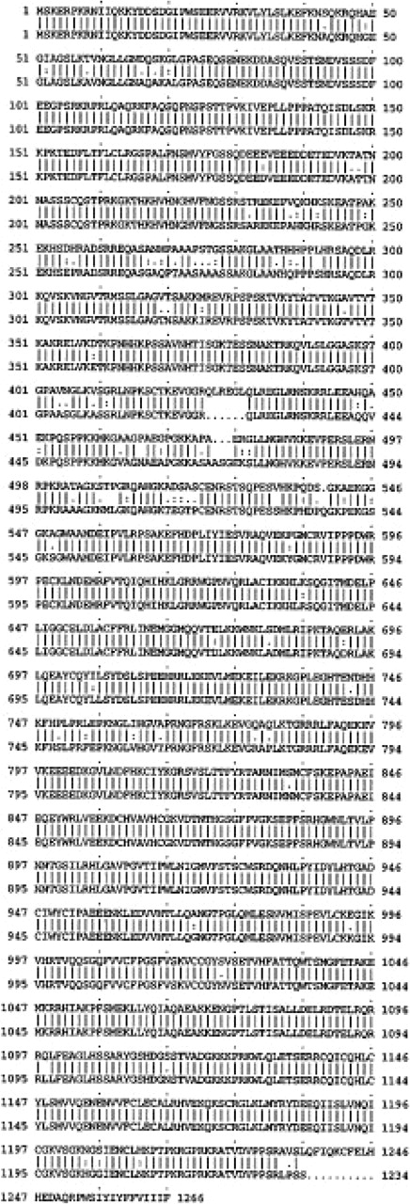
Figure 1 Comparison of human (upper lane) and mouse (lower lane) jumonji putative proteins. The predicted amino acid ...
Notes:
Figure 1 Comparison of human (upper lane) and mouse (lower lane) jumonji putative proteins. The predicted amino acid sequence of the human jumonji gene product was deduced from analysis of the JMJ cDNA sequences (GenBank accession no. U57592).
Unless provided in the caption above, the following copyright applies to the content of this slide: © 1996 Oxford University Press

