Slide 1
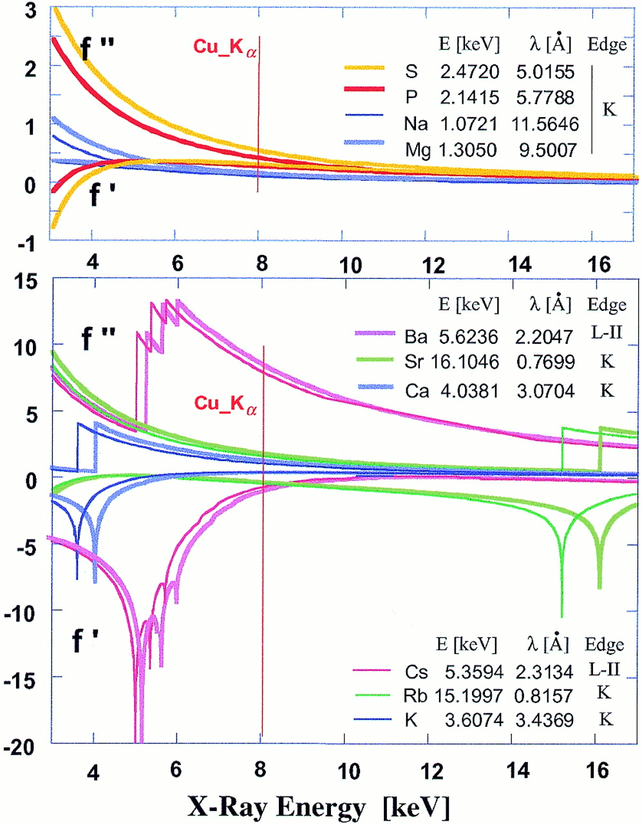
Figure 1. Idealized curves for the real (f′) and imaginary (f′′) anomalous scattering components of alkali ...
Notes:
Figure 1. Idealized curves for the real (f′) and imaginary (f′′) anomalous scattering components of alkali and earth alkali metal ions as a function of X-ray energy (taken from 29). Data for elements P, S and the CuKα wavelength (1.5418 Å) are included for comparison. The energy E and the corresponding wavelength λ of absorption edges are shown together with the color code for each ion/element. The wavelength of the beam at the Advanced Photon Source ID beamlines can easily be tuned within the 2–0.66 Å (third harmonic) range. Absorption edges below 6 keV correspond to X-ray wavelengths >2 Å, which present difficulties for use in crystallography. Among alkali metal ions only the K absorption edges of Rb+ and Sr2+, located near the right-hand side border, are suitable for use in high energy SAD experiments. The anomalous signals of Ba2+ and Cs+ as well as of Ca2+ and K+ can be used at low energy.
Unless provided in the caption above, the following copyright applies to the content of this slide:

Slide 2
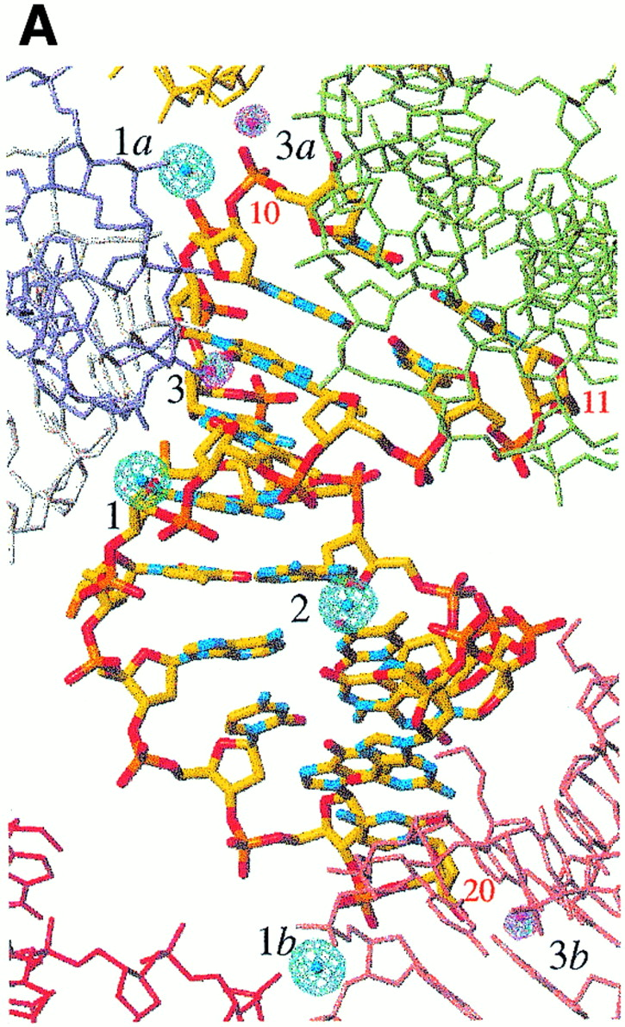
Figure 2. Maps calculated at 1.8 Å resolution with SAD phases for the Rb-FET structure and superimposed on ...
Notes:
Figure 2. Maps calculated at 1.8 Å resolution with SAD phases for the Rb-FET structure and superimposed on the final structure (selected DNA residues are numbered). (A) The anomalous difference Fourier (blue) and double-difference (red) maps contoured at the 4σ level. Ion-binding sites 1 and 2 (shown with their symmetry mates, designated by lower case letters) were located in the anomalous difference Patterson map and used for phasing. Ion-binding site 3 was found at this stage and is characterized by a significantly greater peak height than the remaining peaks in the double-difference density map. (B) Stereo diagram of the density-modified electron density map contoured at the 1σ level and superimposed on the central TAT portion of the structure. DNA atoms are colored yellow, red, cyan, orange and green for carbon, oxygen, nitrogen, phosphorus and fluorine, respectively. Electron density for the FET substituent of T6 is clearly visible in this map.
Unless provided in the caption above, the following copyright applies to the content of this slide:

Slide 3
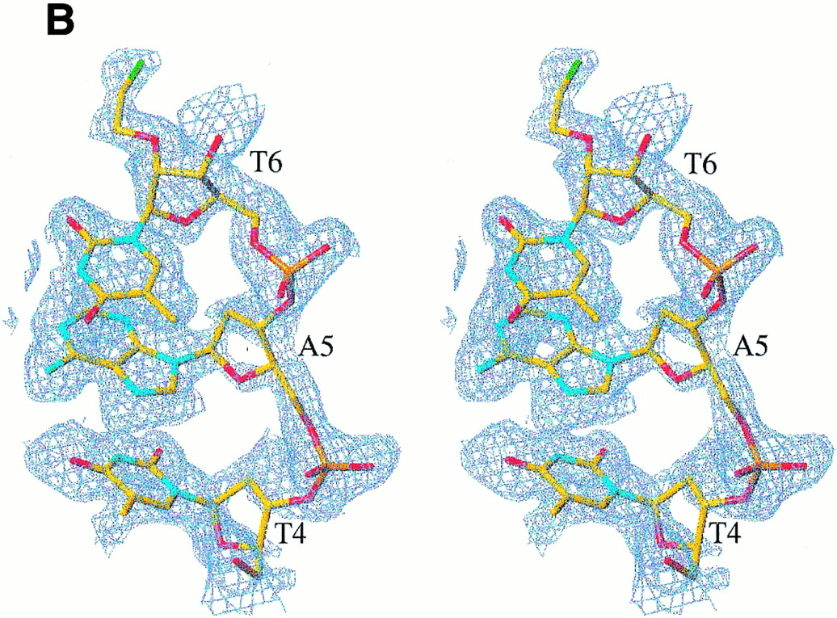
Figure 2. Maps calculated at 1.8 Å resolution with SAD phases for the Rb-FET structure and superimposed on ...
Notes:
Figure 2. Maps calculated at 1.8 Å resolution with SAD phases for the Rb-FET structure and superimposed on the final structure (selected DNA residues are numbered). (A) The anomalous difference Fourier (blue) and double-difference (red) maps contoured at the 4σ level. Ion-binding sites 1 and 2 (shown with their symmetry mates, designated by lower case letters) were located in the anomalous difference Patterson map and used for phasing. Ion-binding site 3 was found at this stage and is characterized by a significantly greater peak height than the remaining peaks in the double-difference density map. (B) Stereo diagram of the density-modified electron density map contoured at the 1σ level and superimposed on the central TAT portion of the structure. DNA atoms are colored yellow, red, cyan, orange and green for carbon, oxygen, nitrogen, phosphorus and fluorine, respectively. Electron density for the FET substituent of T6 is clearly visible in this map.
Unless provided in the caption above, the following copyright applies to the content of this slide:

Slide 4
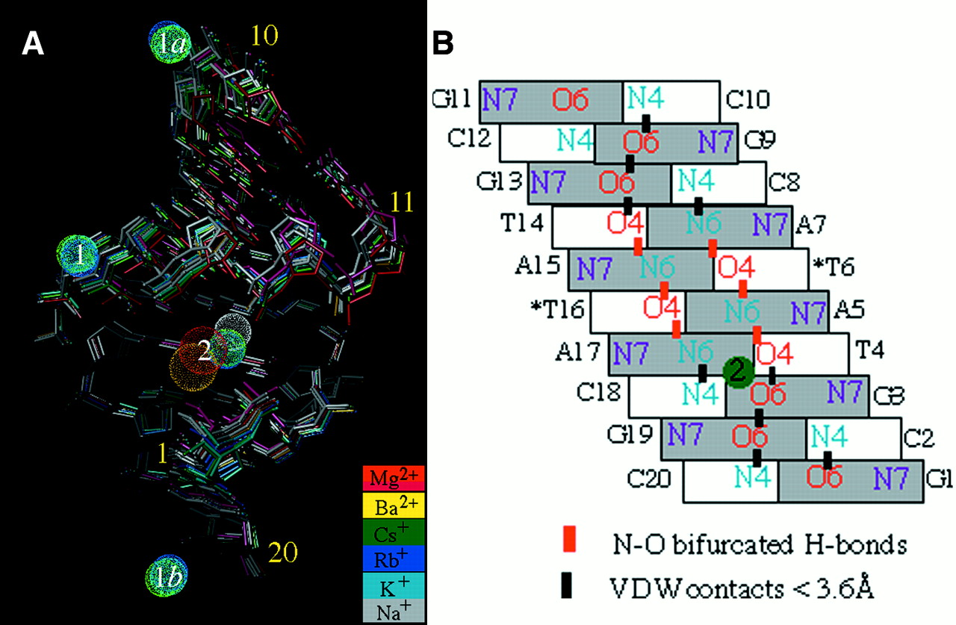
Figure 3. (A) Superposition of A-DNA decamer duplexes crystallized in the presence of different alkali or ...
Notes:
Figure 3. (A) Superposition of A-DNA decamer duplexes crystallized in the presence of different alkali or earth alkali metal ions. The bottom halves of duplexes were used in the superposition (r.m.s.d. <0.5 Å). The view depicts binding site 2 in the major groove common for all ions and demonstrates similar kinks for duplexes at the T4pA5 base-pair steps. Binding site 1 involving phosphate groups is exclusively occupied by alkali metal ions and is shown along with symmetry-related sites (1a and 1b). DNA duplexes listed in Table 1 are drawn as stick models with color codes indicated. The low salt Mg-MEP (21) and Mg-TOE (22) forms were also included in the superposition and are colored red and magenta, respectively. Mg2+ and Ba2+ coordinated in the major groove are shown as spheres with larger radius. Alkali metal ions are drawn as smaller spheres. (B) Schematic of the major groove of the A-DNA decamer with sequence GCGTATACGC. A green circle indicates ions binding at the G3pT4 step. No ion was found at the chemically identical G13pA14 step. Asterisks indicate 2′-O-modified nucleotides.
Unless provided in the caption above, the following copyright applies to the content of this slide:

Slide 5
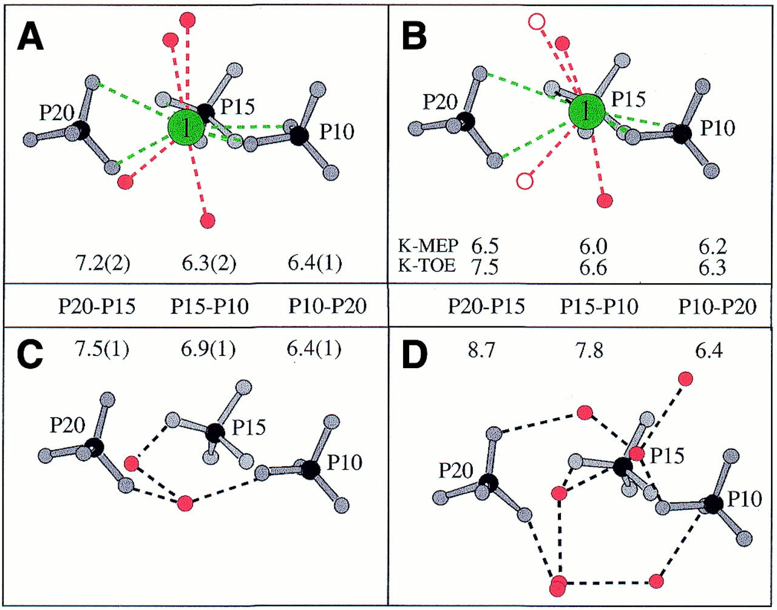
Figure 4. Coordination geometry of alkali metal ions bound at site 1, involving phosphate groups from three ...
Notes:
Figure 4. Coordination geometry of alkali metal ions bound at site 1, involving phosphate groups from three adjacent duplexes. (A) Cs-MEP, Rb-FET (high salt), Cs-TOE and Rb-TOE (medium salt) structures. (B) K-MEP (high salt) and K-TOE (medium salt) structures. Ordered ions (green) are arranged in the plane defined by P10, P15 and P20 (A and B) and ion–DNA (green) and ion–water contacts (red) are represented by dashed lines. (C) Na-TOE and Na-FET structures (medium salt). (D) Mg-MEP (low salt). No ordered ions were found in the structures depicted in (C) and (D). P…P distances are in Å and correspond to average values with standard deviations in parentheses (A and C). Water molecules are red and open circles in (B) are waters absent in K-MEP due to limited resolution.
Unless provided in the caption above, the following copyright applies to the content of this slide:

Slide 6
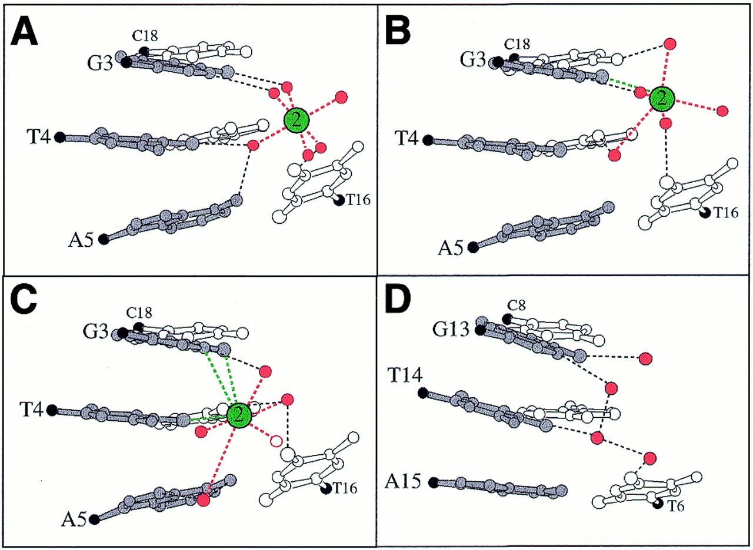
Figure 5. Major groove solvation around GpTpA portions. (A) G3pT4pA5: Mg-MEP and Mg-TOE (low salt). (B) ...
Notes:
Figure 5. Major groove solvation around GpTpA portions. (A) G3pT4pA5: Mg-MEP and Mg-TOE (low salt). (B) G3pT4pA5: Ba-AOE. (C) G3pT4pA5: consensus geometry of site 2 in the Cs-MEP and Rb-FET (high salt) as well as in Cs-, Rb-, K- and Na-TOE (medium salt) crystals. The water drawn with an open circle is absent in all medium salt forms. (D) Hydration of the chemically equivalent G13pT14pA15 portion. Residues from strands one and two are drawn with solid and open bonds, respectively, C1′ atoms are black and ion–DNA (green) and ion–water contacts (red) are represented by dashed lines.
Unless provided in the caption above, the following copyright applies to the content of this slide:

Slide 7
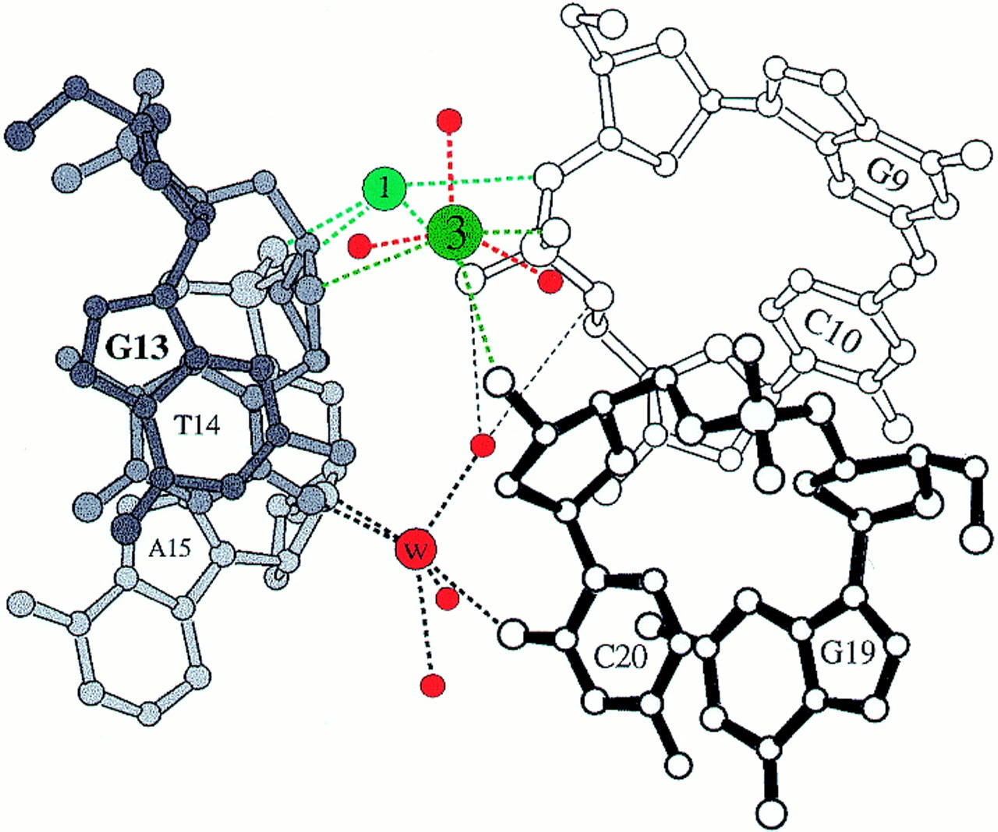
Figure 6. Coordination geometry of Cs⁺ and Rb⁺ at binding site 3 in the Cs-MEP and ...
Notes:
Figure 6. Coordination geometry of Cs+ and Rb+ at binding site 3 in the Cs-MEP and Rb-FET (high salt) structures. Residues from three adjacent duplexes at the minor groove–terminal base pair interface are drawn with solid, gray and open bonds and are numbered. Ion–DNA and ion–water contacts are drawn with green and red dashed lines, respectively. An ion bound at site 1 and the water molecule (W) corresponding to the peak indicated by red arrows and lines in Figures 7 and 8, respectively, are included. In the Rb-, K- and Na-TOE (medium salt) structures, the peak at site 3 was found to be shifted from its position in the Cs-MEP and Rb-FET structures (see Table S4)..
Unless provided in the caption above, the following copyright applies to the content of this slide:

Slide 8
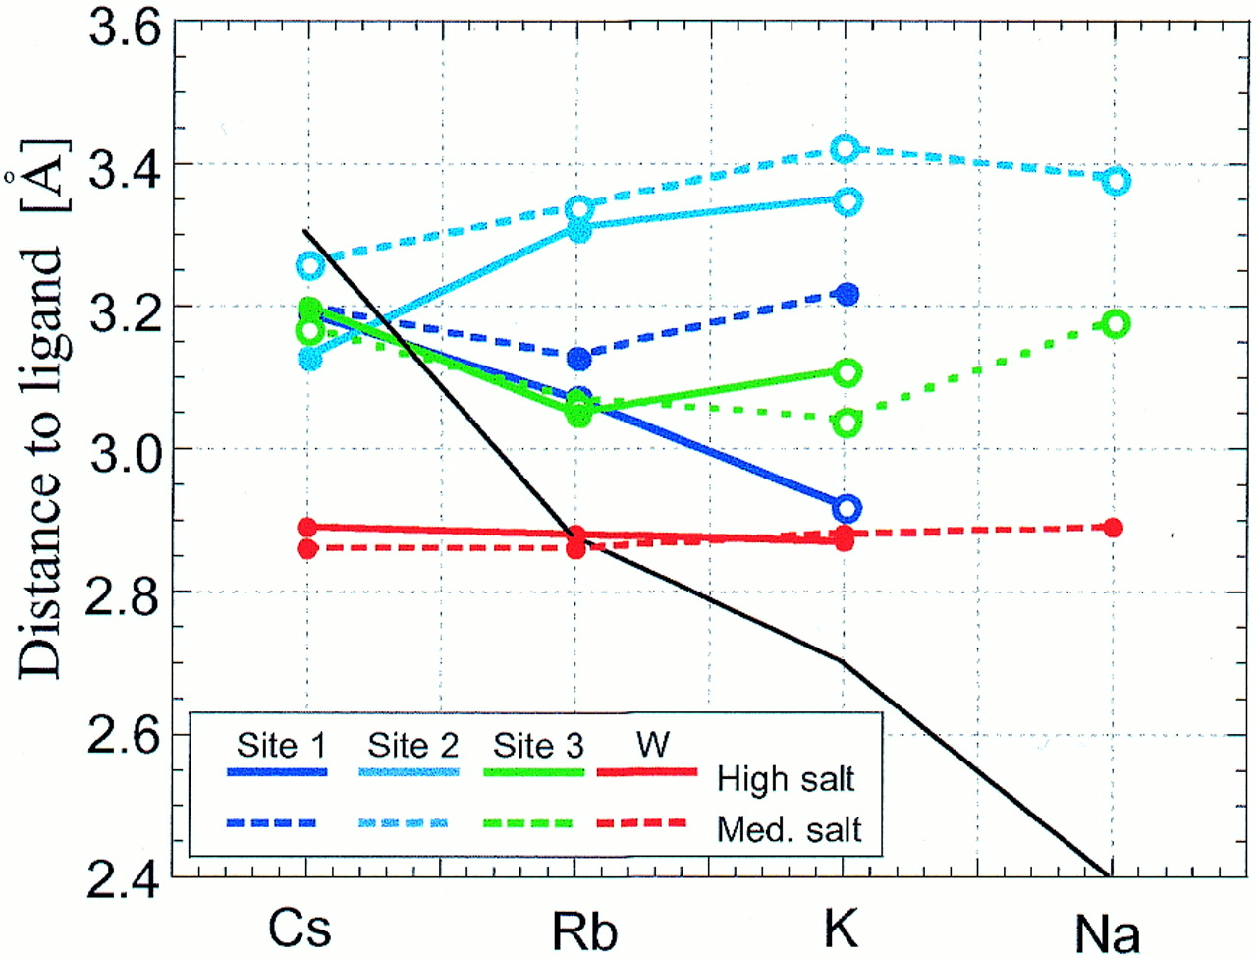
Figure 7. Average distances between alkali metal ions and oxygen atoms (DNA or water) plotted as a function ...
Notes:
Figure 7. Average distances between alkali metal ions and oxygen atoms (DNA or water) plotted as a function of ion type for high and medium salt concentrations. The black solid line indicates ideal coordination distances for individual alkali metal ions. Open circles indicate coordination spheres that lack water molecules compared with fully occupied sites (high salt Cs-MEP and Rb-FET; see Tables S2–S4).
Unless provided in the caption above, the following copyright applies to the content of this slide:

Slide 9
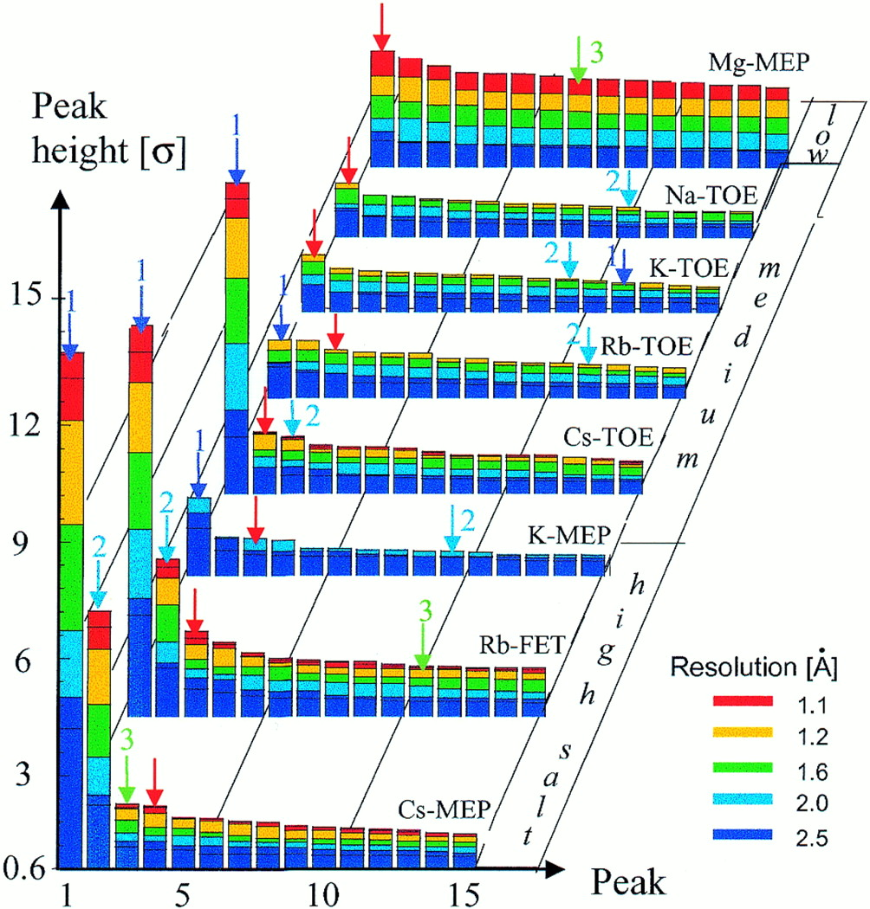
Figure 8. Dependence of ‘solvent’ peak height in electron density maps of selected DNA decamers as a function ...
Notes:
Figure 8. Dependence of ‘solvent’ peak height in electron density maps of selected DNA decamers as a function of X-ray data resolution, nature of alkali metal ion and ion concentration. Blue, cyan and green arrows represent ions coordinated at sites 1, 2 and 3, respectively, and red arrows represent hydration site W (Fig. 6).
Unless provided in the caption above, the following copyright applies to the content of this slide:

