Slide 1
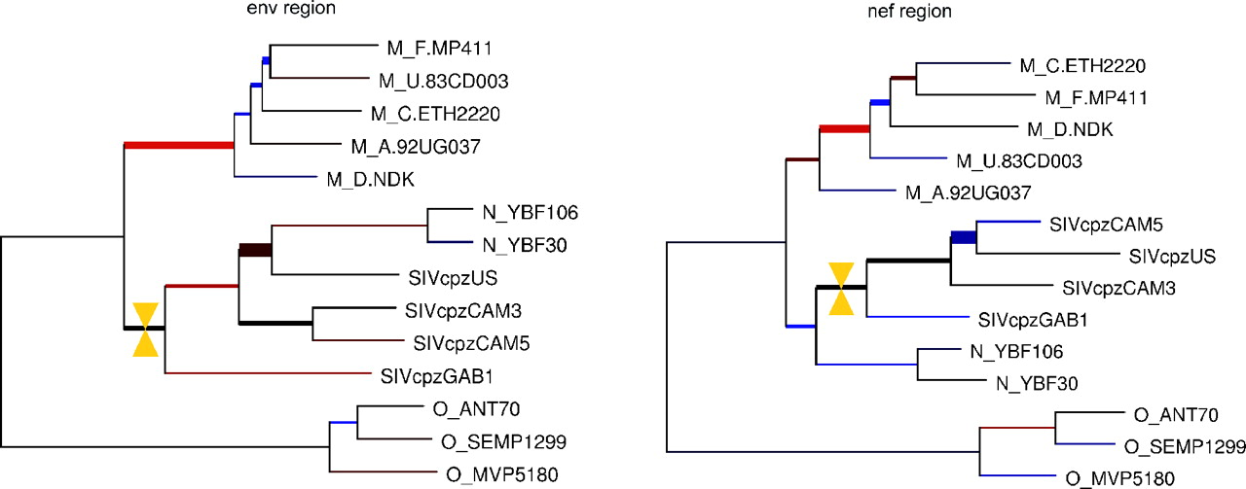
Fig. 1 Comparison of alternative phylogenies for HIV strains. The phylogenies were constructed for strains with ...
Notes:
Fig. 1 Comparison of alternative phylogenies for HIV strains. The phylogenies were constructed for strains with fully sequenced genomes, by using sequences from two different genomic regions. Three groups of human strains (M, N and O) are shown together with four simian strains (the SIV group). The phylogenies exhibit two different positions for the N-group, one closer to the simian group (left), and the other closer to the human groups (right). This was probably caused by an ancient recombination event in the N-group ancestor. The thicker branches are those receiving a low topological score: in particular the thickest branches arise from the two alternative positions for the N-group. The topology of the O-group matches exactly between the phylogenies, as indicated by the thin branches, while the internal topology of the M-group differs quite widely. Branches drawn in red are longer than the corresponding branches in the other tree, with the intensity of the colour indicating the level of mismatch. Blue branches conversely denote shorter branches. The yellow markers indicate a match between branches (clicking on any branch results in its match being highlighted and the score displayed). The particular match illustrated here has a topological score of 67%. Although both trees contain a branch separating the N and simian clades from the rest of the tree, those branches are not identified under the constraint of finding the optimal 1-to-l map between branches.
Unless provided in the caption above, the following copyright applies to the content of this slide: © The Author 2005. Published by Oxford University Press. All rights reserved. For Permissions, please email: journals.permissions@oxfordjournals.orgThe online version of this article has been published under an open access model. Users are entitled to use, reproduce, disseminate, or display the open access version of this article for non-commercial purposes provided that: the orginial authorship is properly and fully attributed; the Journal and Oxford University Press are attributed as the original place of publication with the correct citation details given; if an article is subsequently reproduced or disseminated not in its entirety but only in part or as a derivative work this must be clearly indicated. For commercial re-use, please contact journals.permissions@oxfordjournals.org

