Slide 1
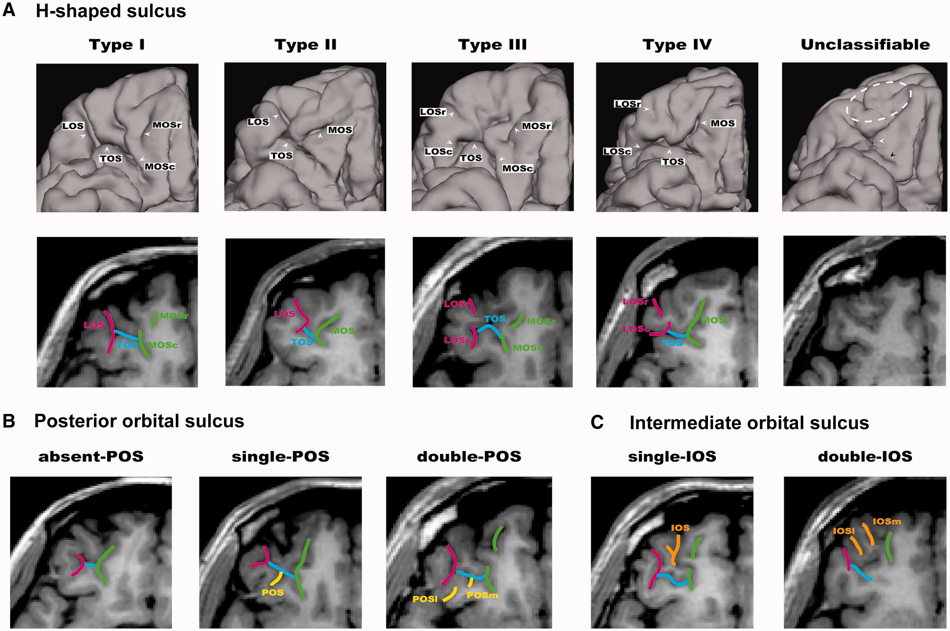
Fig. 1 Examples of the orbitofrontal sulcogyral patterns. (A) Variations of the H-shaped sulcus. Patterns were ...
Notes:
Fig. 1 Examples of the orbitofrontal sulcogyral patterns. (A) Variations of the H-shaped sulcus. Patterns were classified into four subtypes (Type I–IV) according to the continuity of the LOS and MOS in the rostrocaudal direction (r: rostral, c: caudal) (Type I: continuous LOS and discontinuous MOS, Type II: continuous LOS and MOS, Type III: discontinuous LOS and MOS, Type IV: discontinuous LOS and continuous MOS). The rightmost figure represents an ASD case that cannot be classified to either type using the classification systems of Chiavaras and Petrides (2000) and Chakirova et al. (2010). White dotted area shows clearly small and under-developed anterior orbital gyrus without any visible IOS. The TOS is not clearly identified (white arrow), and the caudal MOS and LOS are also unclear (black arrow). (B) Variants of the POS. The patterns were classified into three subtypes depending on the number of identified POS. (C) Variants of the IOS (m: medial, l: lateral). The patterns were classified into two subtypes depending on the number of identified IOS.
Unless provided in the caption above, the following copyright applies to the content of this slide: © The Author(s) (2013). Published by Oxford University Press.This is an Open Access article distributed under the terms of the Creative Commons Attribution Non-Commercial License (http://creativecommons.org/licenses/by-nc/4.0/), which permits non-commercial re-use, distribution, and reproduction in any medium, provided the original work is properly cited. For commercial re-use, please contact journals.permissions@oup.com

Slide 2
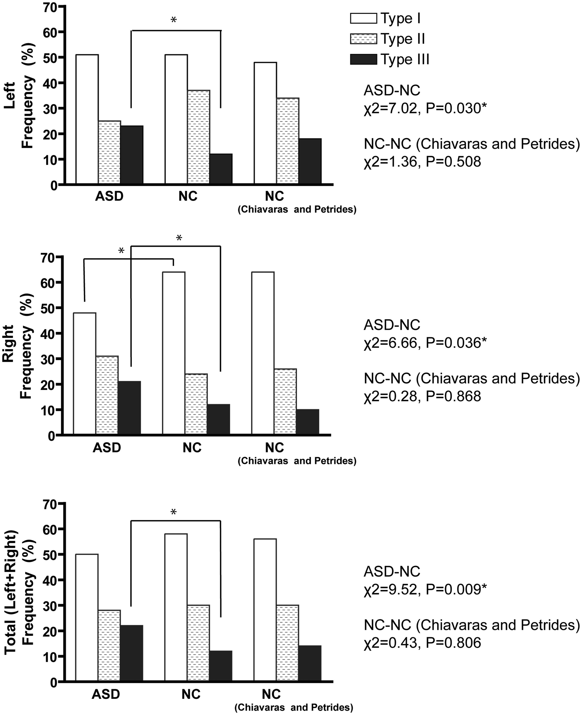
Fig. 2 Sulcal pattern distribution of the ‘H-shaped’ sulcus in the OFC. Right column shows results from the previous ...
Notes:
Fig. 2 Sulcal pattern distribution of the ‘H-shaped’ sulcus in the OFC. Right column shows results from the previous study on neurotypical individuals by Chiavaras and Petrides (2000). According to post hoc test, Type III expression was increased in both hemispheres in the ASD group compared with the NC group (left: χ2 = 5.75, P = 0.016, right: χ2 = 3.80, P = 0.051, bilateral: χ2 = 9.45, P = 0.002), whereas Type I expression was deceased in the right hemisphere (χ2 = 5.93, P = 0.015). *Significant difference thresholded at P = 0.05.
Unless provided in the caption above, the following copyright applies to the content of this slide: © The Author(s) (2013). Published by Oxford University Press.This is an Open Access article distributed under the terms of the Creative Commons Attribution Non-Commercial License (http://creativecommons.org/licenses/by-nc/4.0/), which permits non-commercial re-use, distribution, and reproduction in any medium, provided the original work is properly cited. For commercial re-use, please contact journals.permissions@oup.com

Slide 3
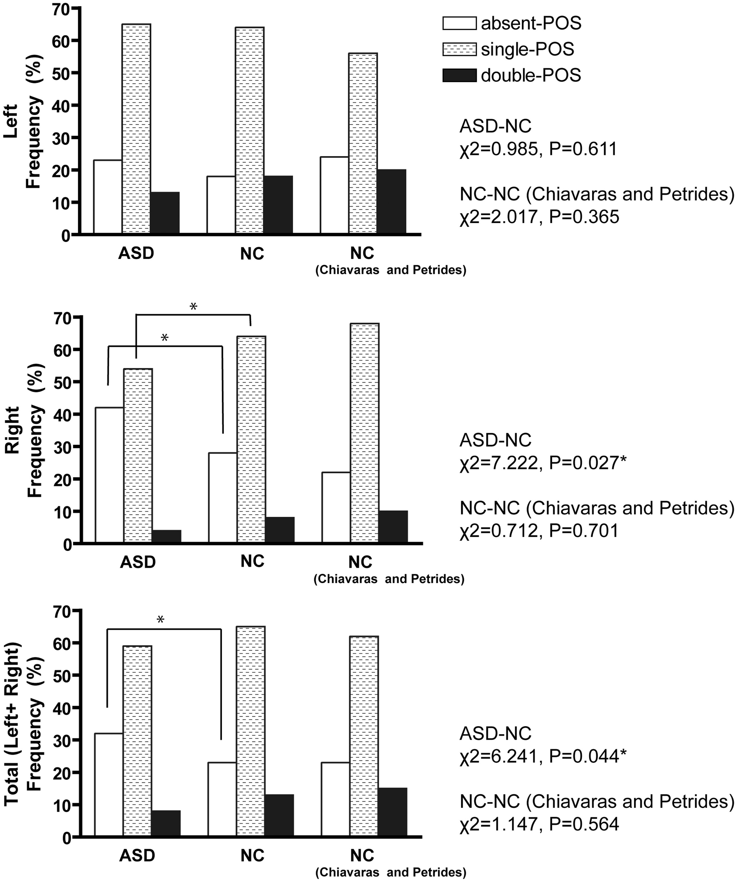
Fig. 3 Sulcal pattern distribution of the POS in the OFC. Right column shows results from Chiavaras and Petrides ...
Notes:
Fig. 3 Sulcal pattern distribution of the POS in the OFC. Right column shows results from Chiavaras and Petrides (2000). Post hoc tests showed significant increase of the absent POS in the right hemisphere (χ2 = 7.213, P = 0.007) and bilateral hemispheres (χ2 = 6.078, P = 0.014), and decrease of the ‘single POS’ in the right hemisphere (χ2 = 5.297, P = 0.021). *Significant difference thresholded at P = 0.05.
Unless provided in the caption above, the following copyright applies to the content of this slide: © The Author(s) (2013). Published by Oxford University Press.This is an Open Access article distributed under the terms of the Creative Commons Attribution Non-Commercial License (http://creativecommons.org/licenses/by-nc/4.0/), which permits non-commercial re-use, distribution, and reproduction in any medium, provided the original work is properly cited. For commercial re-use, please contact journals.permissions@oup.com

Slide 4
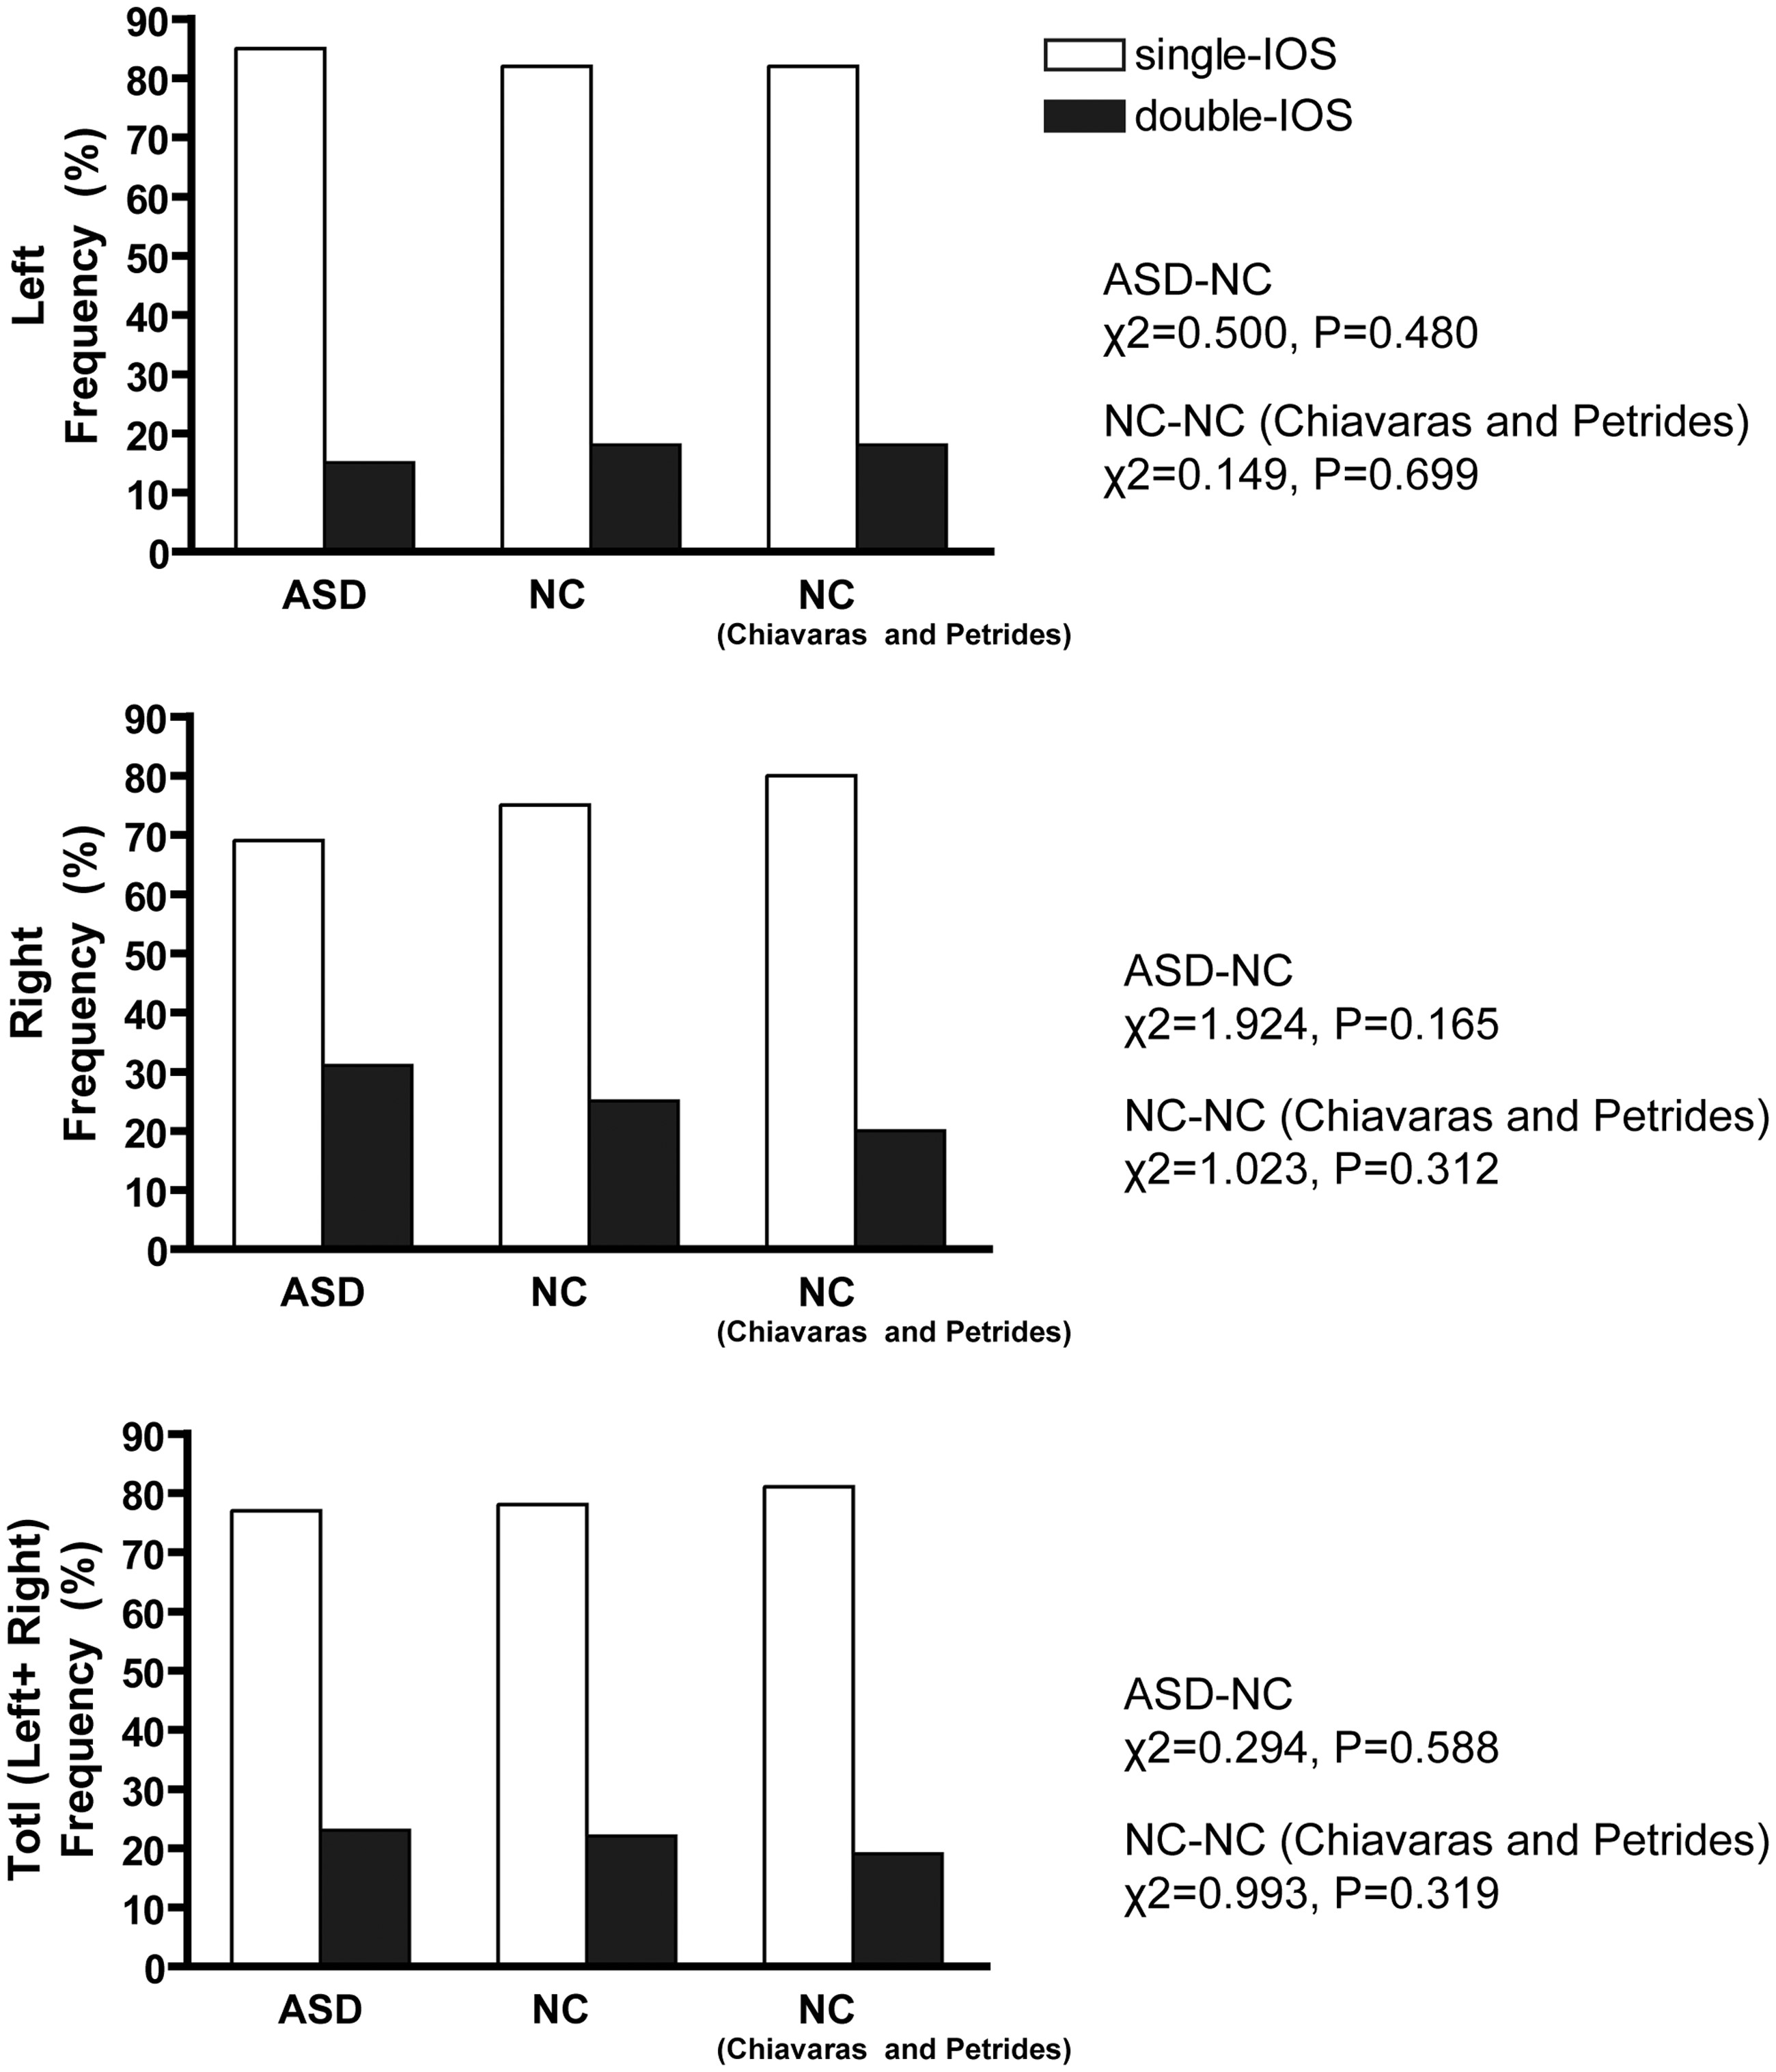
Fig. 4 Sulcal pattern distribution of the IOS in the OFC. Right column shows results from Chiavaras and Petrides ...
Notes:
Fig. 4 Sulcal pattern distribution of the IOS in the OFC. Right column shows results from Chiavaras and Petrides (2000). No significant distribution difference was found between groups.
Unless provided in the caption above, the following copyright applies to the content of this slide: © The Author(s) (2013). Published by Oxford University Press.This is an Open Access article distributed under the terms of the Creative Commons Attribution Non-Commercial License (http://creativecommons.org/licenses/by-nc/4.0/), which permits non-commercial re-use, distribution, and reproduction in any medium, provided the original work is properly cited. For commercial re-use, please contact journals.permissions@oup.com

