Slide 1
Figure 1 Regional distribution of neural response patterns across the olfactory bulb. (A) Dorsal view of the olfactory ...
Notes:
Figure 1 Regional distribution of neural response patterns across the olfactory bulb. (A) Dorsal view of the olfactory bulb showing the position of trajectories. The color of the circles indicates the selectivity of the neurons encountered in a single trajectory: blue, amino acids; red, sex pheromones; and green, bile salts. (B) Cross section of the olfactory bulb along the plane B–B in (A). The numbers 1, 2, and 3 refer to the corresponding trajectories in (A). (C) Examples of the responses from three units (U1, U2, and U3) demonstrating the selectivity of the neurons. ON, olfactory nerve; OT, olfactory tract; L, M, and V, lateral, medial, and ventral parts of the bulb.
Unless provided in the caption above, the following copyright applies to the content of this slide: © The Author 2005. Published by Oxford University Press. All rights reserved. For permissions, please e-mail: journals.permissions@oxfordjournals.org

Slide 2
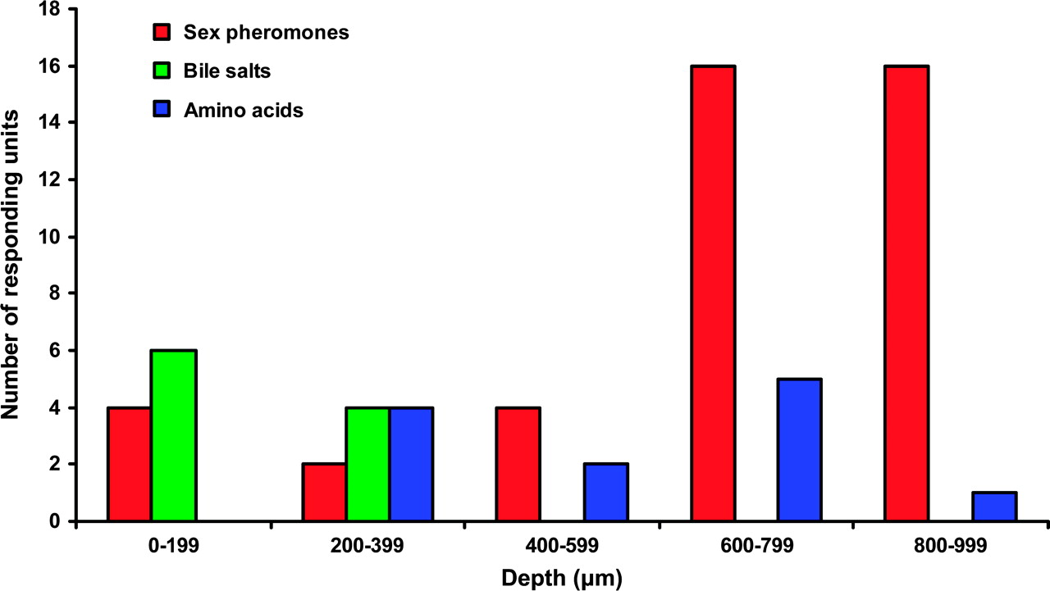
Figure 2 Depth distribution of single units. Histogram showing the number of neurons responding to sex pheromones ...
Notes:
Figure 2 Depth distribution of single units. Histogram showing the number of neurons responding to sex pheromones (red), bile salts (green), or amino acids (blue) with respect to depth, where 0 corresponds to the dorsal surface of the olfactory bulb.
Unless provided in the caption above, the following copyright applies to the content of this slide: © The Author 2005. Published by Oxford University Press. All rights reserved. For permissions, please e-mail: journals.permissions@oxfordjournals.org

Slide 3
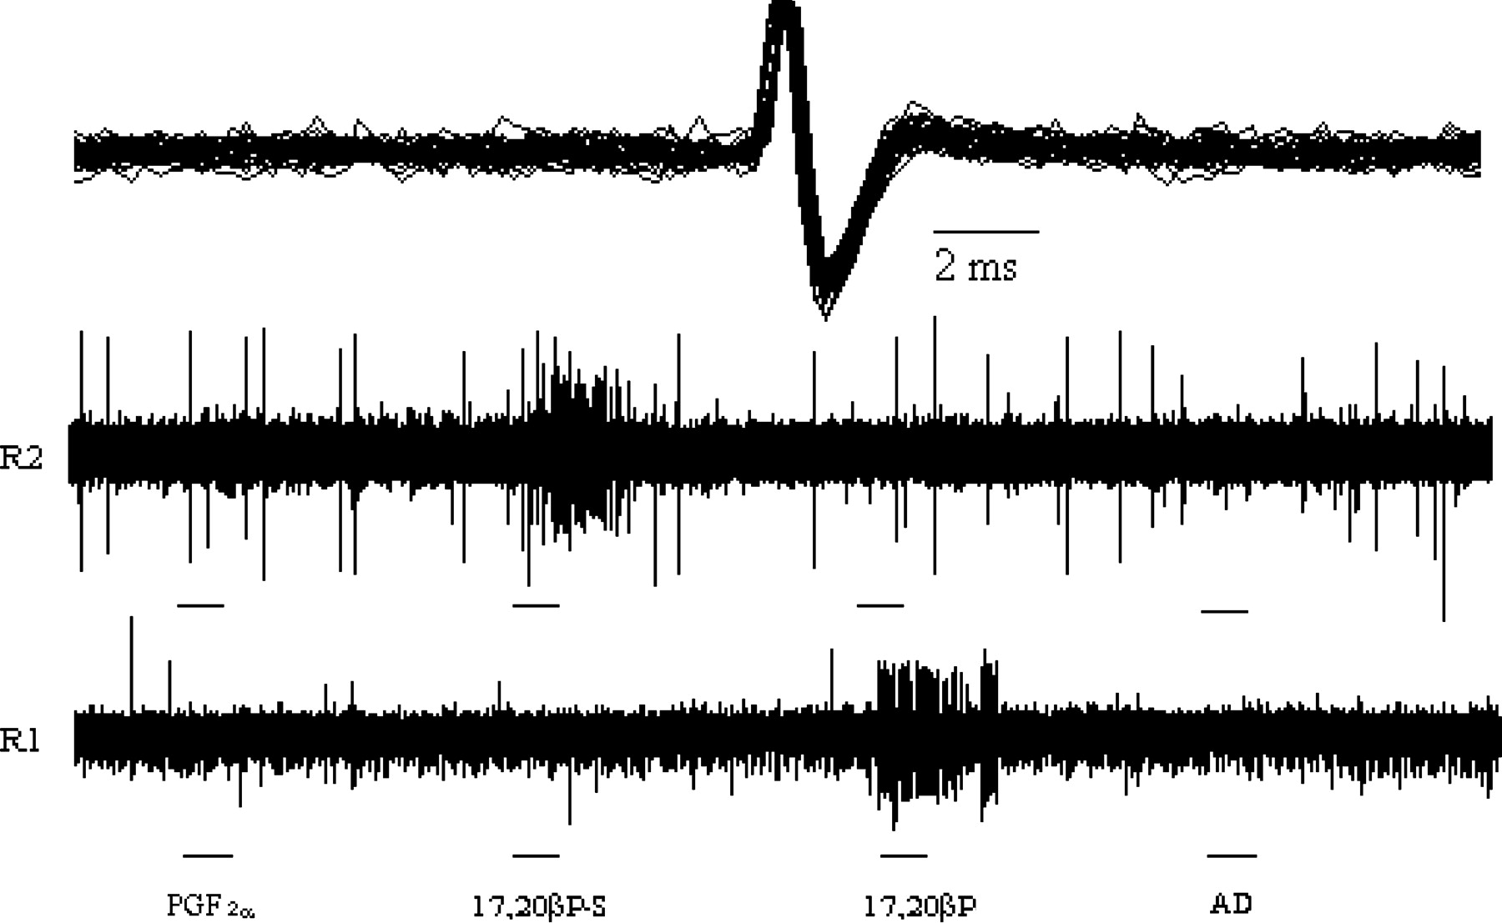
Figure 3 Examples of original extracellular recordings in males. Two examples of extracellular recordings (R1 and R2) ...
Notes:
Figure 3 Examples of original extracellular recordings in males. Two examples of extracellular recordings (R1 and R2) from two different units in the ventral part of the right olfactory bulb upon exposure of the right olfactory organ to sex pheromones in males. The upper trace shows the superimposed spikes from the fired unit in R1. Note the increase of the activity in conjunction with the stimulation. Dashes, stimulation of 10 s. The two lower recording traces are 300 s in duration.
Unless provided in the caption above, the following copyright applies to the content of this slide: © The Author 2005. Published by Oxford University Press. All rights reserved. For permissions, please e-mail: journals.permissions@oxfordjournals.org

Slide 4
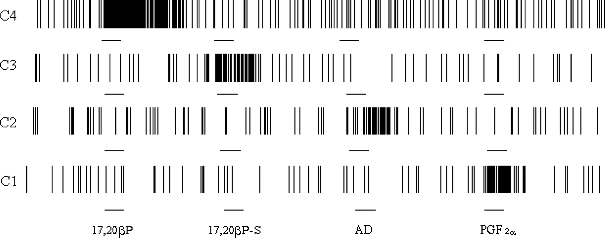
Figure 4 Male bulbar neuron responses to sex pheromones. Activity patterns of four different units (C1–C4) recorded ...
Notes:
Figure 4 Male bulbar neuron responses to sex pheromones. Activity patterns of four different units (C1–C4) recorded extracellularly from the ventral part of the right olfactory bulb in male crucian carp when stimulating the olfactory organ with 17,20βP, 17,20βP-S, AD, and PGF2α. Note 1) the high specificity of the units toward the stimuli and 2) the long-lasting response of the unit C4 when stimulated by 17,20βP. Each recording lasted 300 s during which 10-s stimulations (dashes) were applied.
Unless provided in the caption above, the following copyright applies to the content of this slide: © The Author 2005. Published by Oxford University Press. All rights reserved. For permissions, please e-mail: journals.permissions@oxfordjournals.org

Slide 5
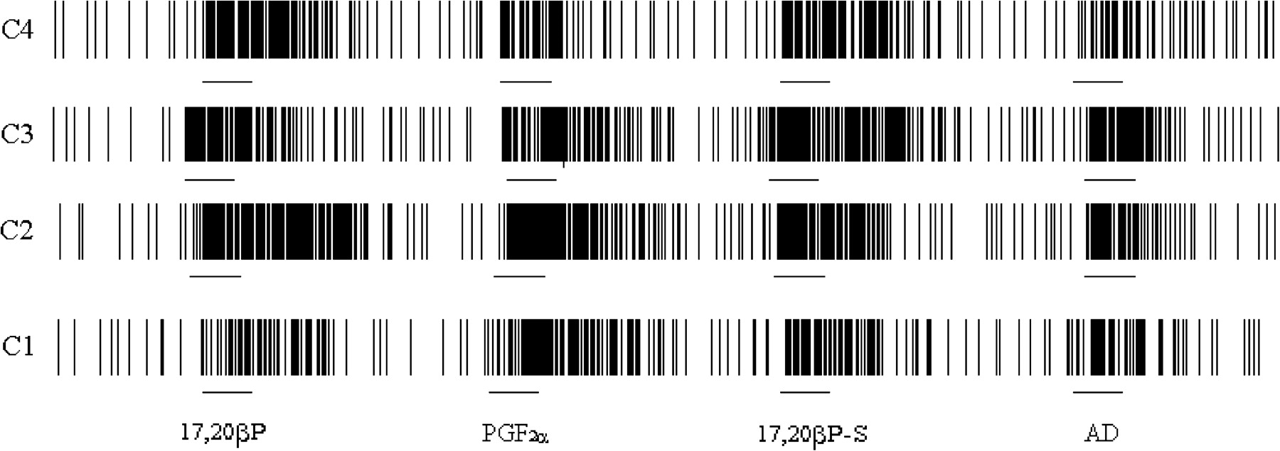
Figure 5 Female bulbar neuron responses to sex pheromones. Activity patterns of four different units (C1–C4) recorded ...
Notes:
Figure 5 Female bulbar neuron responses to sex pheromones. Activity patterns of four different units (C1–C4) recorded extracellularly from the ventral part of the right olfactory bulb in female crucian carp when stimulating the olfactory organ with 17,20βP, 17,20βP-S, AD, and PGF2α. Note the absence of specificity of the units toward the sex pheromones. Each recording lasted 300 s during which 10-s stimulations (dashes) were applied.
Unless provided in the caption above, the following copyright applies to the content of this slide: © The Author 2005. Published by Oxford University Press. All rights reserved. For permissions, please e-mail: journals.permissions@oxfordjournals.org

