Slide 1
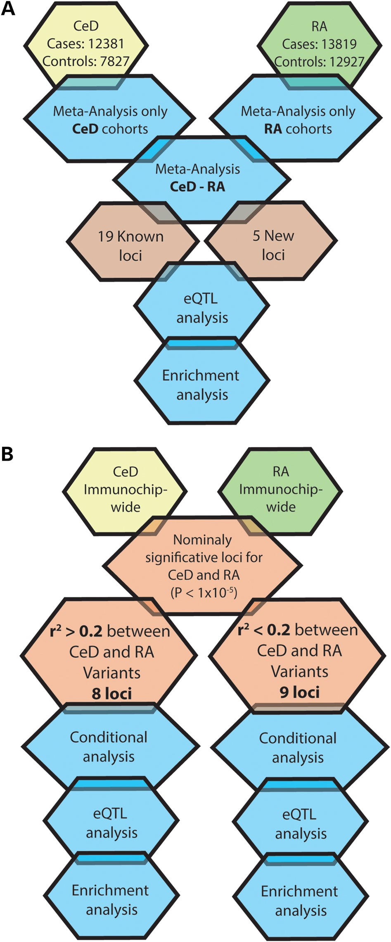
Figure 1. Analysis process. (A) Meta-analysis of CeD and RA datasets and subsequent functional in silico analysis. (B) ...
Notes:
Figure 1. Analysis process. (A) Meta-analysis of CeD and RA datasets and subsequent functional in silico analysis. (B) Based on the results of the meta-analysis, regions with nominal P-values for both CeD and RA were determined. The LD between the CeD and RA SNPs associated in each region was tested with a subsequent functional in silico analysis in each group of SNPs.
Unless provided in the caption above, the following copyright applies to the content of this slide: © The Author 2015. Published by Oxford University Press. All rights reserved. For Permissions, please email: journals.permissions@oup.com

