Slide 1
Figure 1. Gliotoxin biosynthetic gene cluster in Aspergillus fumigatus. The gene cluster is composed of the following: ...
Notes:
Figure 1. Gliotoxin biosynthetic gene cluster in Aspergillus fumigatus. The gene cluster is composed of the following: gliZ encoded a zinc finger–type transcription factor; gliI, a carbon-sulfur lyase; gliJ, a dipeptidase; gliP, a nonribosomal peptide synthase; gliC, a cytochrome P450 monooxygenase; gliM, an O -methyltransferase; gliG, a glutathione- S -transferase; gliK, a hypothetical protein participating in the production and the efflux of gliotoxin; gliA, a major facilitator superfamily transporter; gliN, a methyltransferase; gliF, another cytochrome P450 monooxygenase; gliT, an oxidoreductase; and gliH, a hypothetical protein.
Unless provided in the caption above, the following copyright applies to the content of this slide: © The Author 2014. Published by Oxford University Press on behalf of The International Society for Human and Animal Mycology. All rights reserved. For permissions, please e-mail: journals.permissions@oup.com

Slide 2
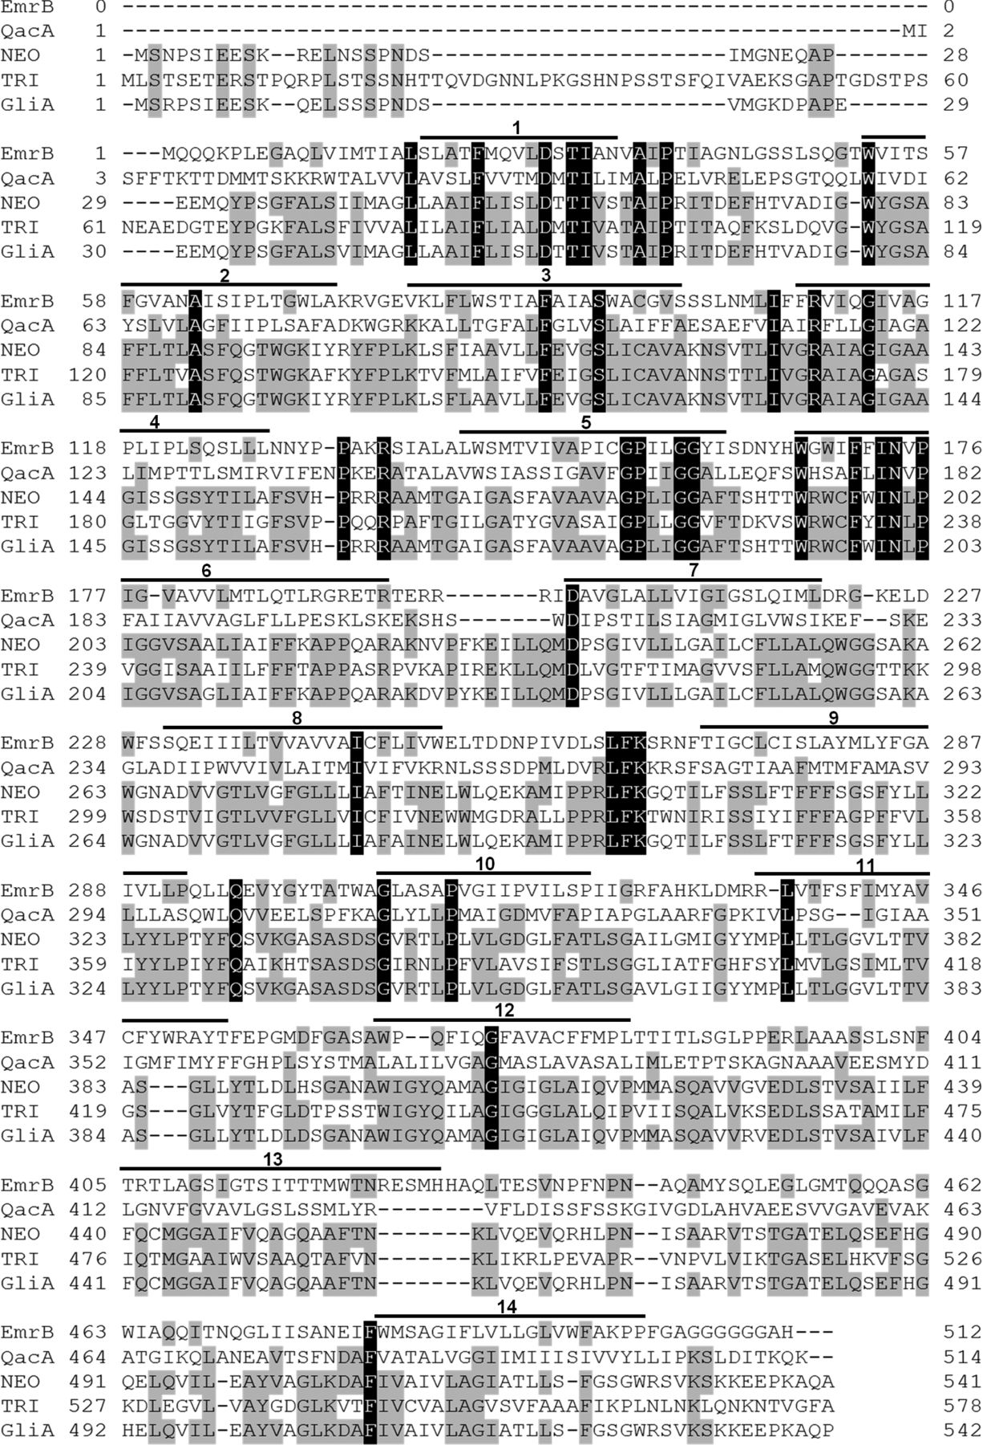
Figure 2. Amino acid sequence of Aspergillus fumigatus GliA (accession no. AAW03302) aligned with other major ...
Notes:
Figure 2. Amino acid sequence of Aspergillus fumigatus GliA (accession no. AAW03302) aligned with other major facilitator superfamily proteins with 14 transmembrane-spanning domains (TMS): Escherichia coli EmrB (accession no. ZP_03032909), Staphylococcus aureus QacA (accession no. YP_003813123), Neosartorya fischeri NEO (accession no. XP_001258088.1), and Trichophyton rubrum TRI (accession no. XP_003234604.1). The lines above the alignment correspond to the predicted positions of TMS [16].
Unless provided in the caption above, the following copyright applies to the content of this slide: © The Author 2014. Published by Oxford University Press on behalf of The International Society for Human and Animal Mycology. All rights reserved. For permissions, please e-mail: journals.permissions@oup.com

Slide 3
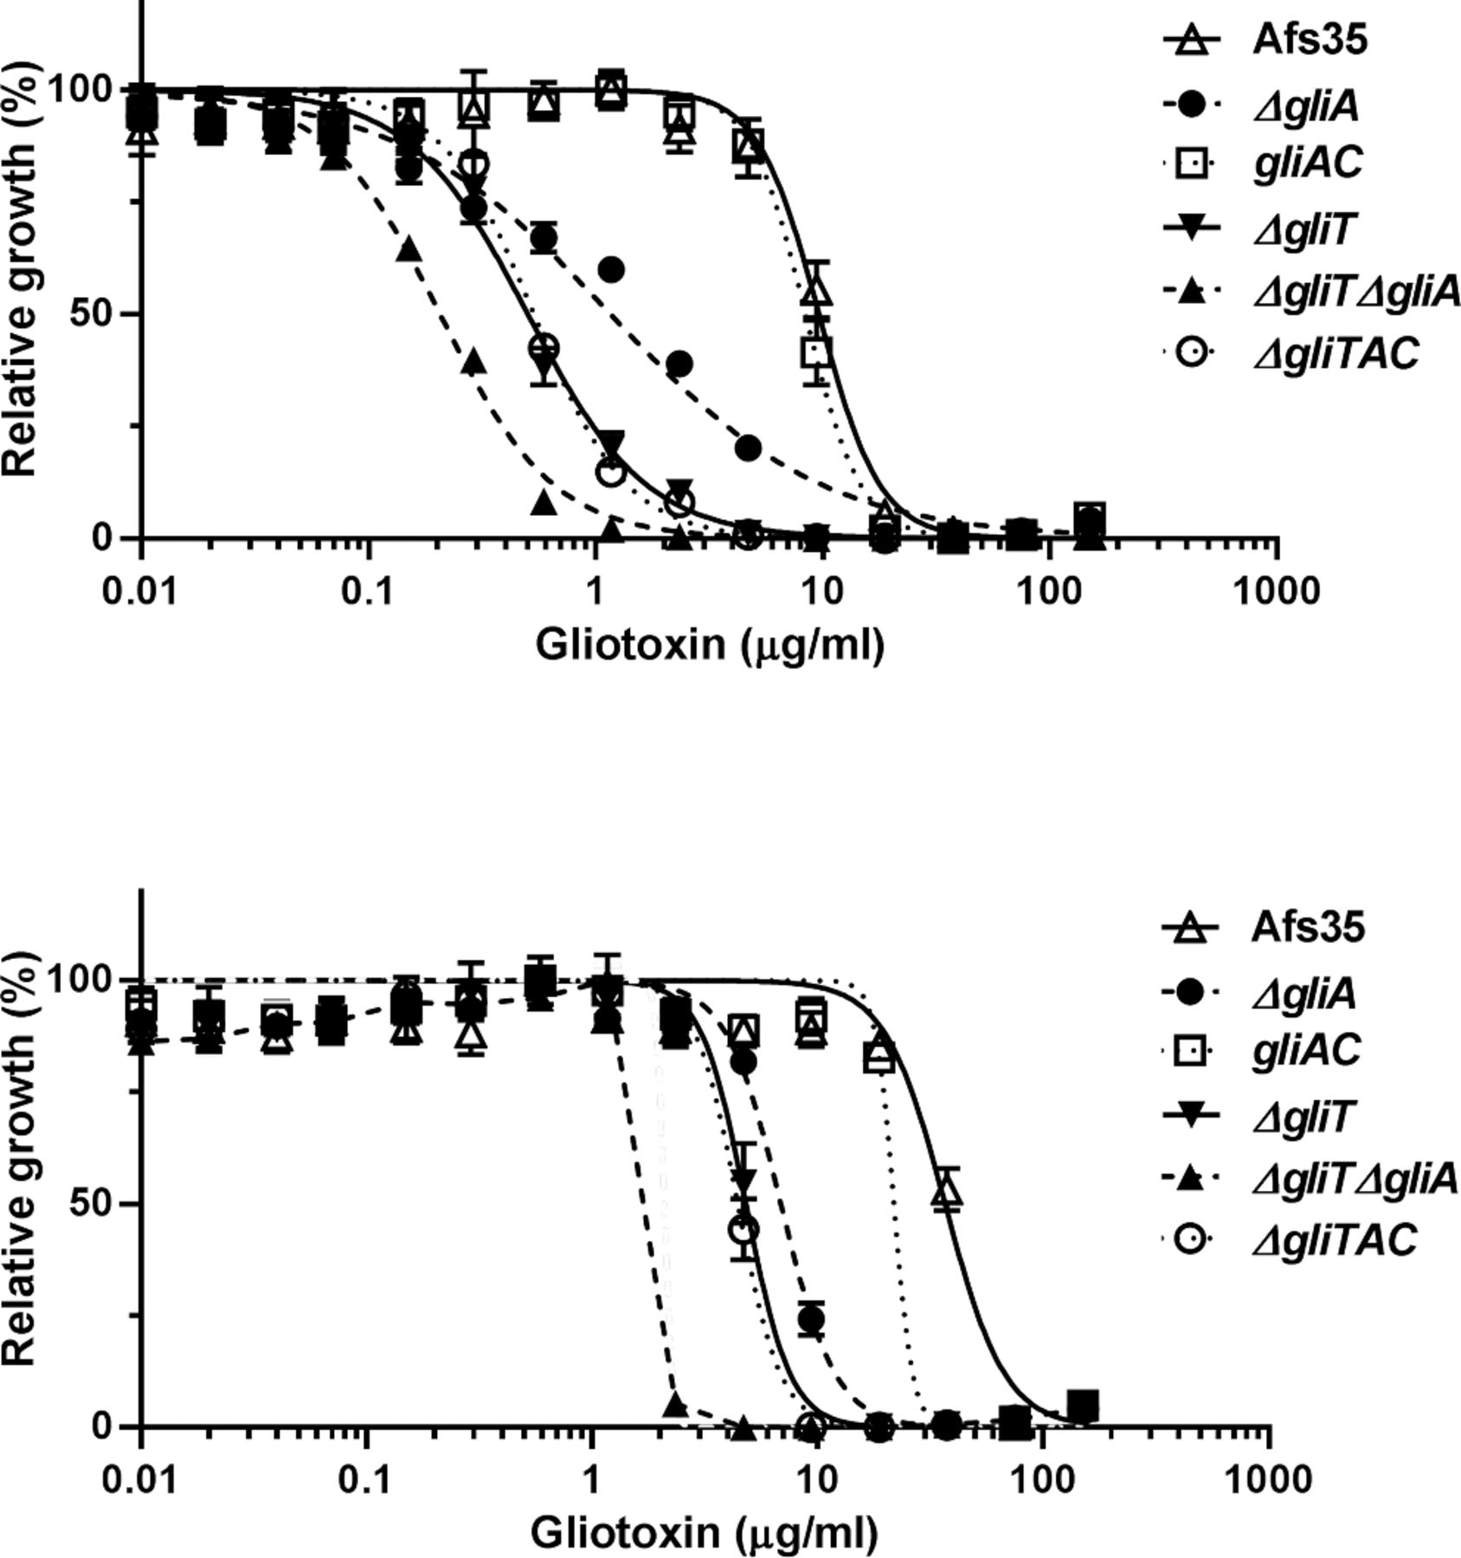
Figure 3. Susceptibility of Aspergillus fumigatus to gliotoxin. The strains indicated in the graph legend were treated ...
Notes:
Figure 3. Susceptibility of Aspergillus fumigatus to gliotoxin. The strains indicated in the graph legend were treated with gliotoxin for 24 h (A) or48 h (B). The number of viable fungal cells is shown relative to the values for each gliotoxin-free well. The curves presented in the graph were estimated using GraphPad Prism 6 software. The results are representative of three independent experiments performed in triplicate and are expressed as the mean ± standard deviationof three replicates.
Unless provided in the caption above, the following copyright applies to the content of this slide: © The Author 2014. Published by Oxford University Press on behalf of The International Society for Human and Animal Mycology. All rights reserved. For permissions, please e-mail: journals.permissions@oup.com

Slide 4
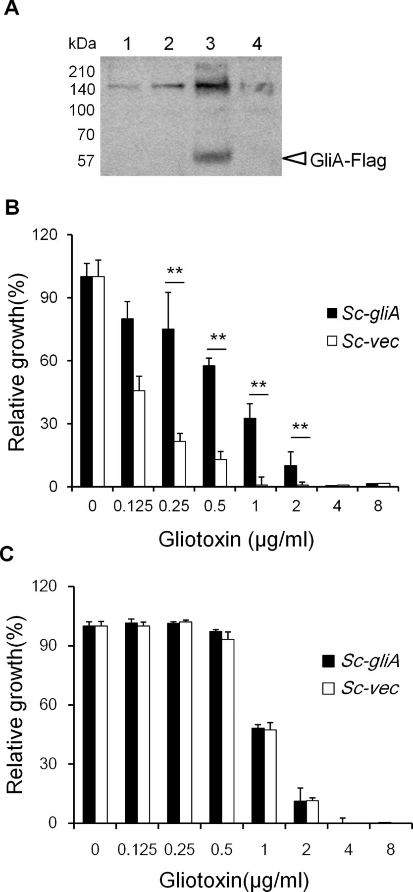
Figure 4. The role of GliA in tolerance to gliotoxin in Saccharomyces cerevisiae. (A) GliA expression was confirmed by ...
Notes:
Figure 4. The role of GliA in tolerance to gliotoxin in Saccharomyces cerevisiae. (A) GliA expression was confirmed by Western blotting. Lane 1, Sc-gliA incubated in yeast nitrogen base (YNB)-glucose (YNB-glu); lane 2, Sc-vec incubated in YNB-glu; lane 3, Sc-gliA incubated in YNB-galactose (YNB-gal); lane 4, Sc-vec incubated in YNB-gal. A 57-kDa product of FLAG-fused GliA protein was detected in lane 3. The susceptibility under conditions ofinduction (B) or suppression (C) of the GAL1 promoter. Each experiment was repeated three times with triplicate samples. **, P < 0.01.
Unless provided in the caption above, the following copyright applies to the content of this slide: © The Author 2014. Published by Oxford University Press on behalf of The International Society for Human and Animal Mycology. All rights reserved. For permissions, please e-mail: journals.permissions@oup.com

Slide 5
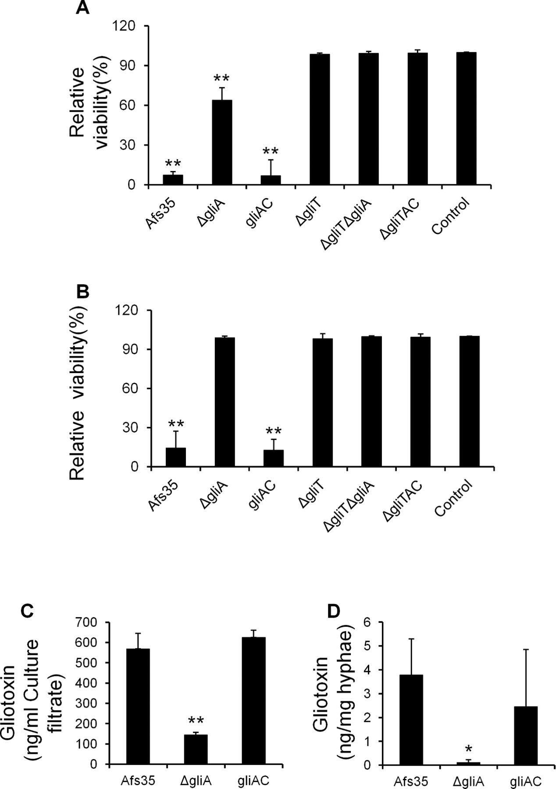
Figure 5. Toxicity of Aspergillus fumigatus culture filtrates (CFs) to A549 cells. The amount of viable cells was ...
Notes:
Figure 5. Toxicity of Aspergillus fumigatus culture filtrates (CFs) to A549 cells. The amount of viable cells was determined 24 h after treatment with (A) 50% (v/v) and (B) 20% (v/v) CFsof A. fumigatus Afs35 strain, ΔgliA strain, gliAC strain, ΔgliT strain, ΔgliTΔgliA strain, and ΔgliTAC strain. Each experiment was repeated three times with triplicate samples. **, P < 0.01, compared with untreated A549 cells (control). (C) The amount of gliotoxin in CFs of A. fumigatus strains was confirmed by reversed-phase high-performance liquid chromatography (RP-HPLC) analysis. Each experiment was repeated three times with triplicate samples. **, P < 0.01, compared with the Afs35 strain. (D) The amount of gliotoxin in A. fumigatus hyphae was confirmed by RP-HPLC analysis. Each experiment was repeated three times with triplicate samples. *, P < 0.05, compared with the Afs35 strain.
Unless provided in the caption above, the following copyright applies to the content of this slide: © The Author 2014. Published by Oxford University Press on behalf of The International Society for Human and Animal Mycology. All rights reserved. For permissions, please e-mail: journals.permissions@oup.com

Slide 6
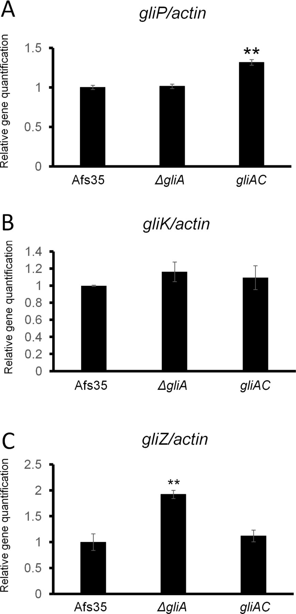
Figure 6. Expression of the gliP (A), gliK (B), and gliZ (C) in Aspergillus fumigatus Afs35, ΔgliA, and gliAC, where ...
Notes:
Figure 6. Expression of the gliP (A), gliK (B), and gliZ (C) in Aspergillus fumigatus Afs35, ΔgliA, and gliAC, where the values were normalized relative to the expression ratios of the Afs35 strain. The relative expression levels of these genes were calculated using the comparative threshold cycle (CT) method, with the A. fumigatus actin gene used as the normalization control [14]. Each experiment was repeated three timeswith triplicate samples. **, P < 0.01, compared with the Afs35 strain.
Unless provided in the caption above, the following copyright applies to the content of this slide: © The Author 2014. Published by Oxford University Press on behalf of The International Society for Human and Animal Mycology. All rights reserved. For permissions, please e-mail: journals.permissions@oup.com

Slide 7
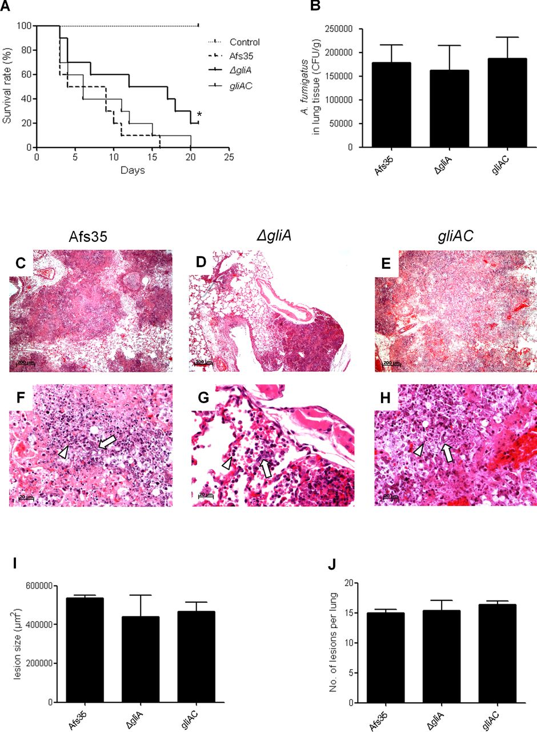
Figure 7. The survival rate, fungal burden, and histopathological analyses of mice infected with the Afs35, ΔgliA, or ...
Notes:
Figure 7. The survival rate, fungal burden, and histopathological analyses of mice infected with the Afs35, ΔgliA, or gliAC strain. (A) The survival rates of mice infected with Afs35, ΔgliA, or gliAC strain. The Kaplan–Meier survival plot and log-rank test were used to compare the survival rates among the groups. *, P < 0.05, compared with Afs35. (B) The fungal burden in lung tissues of mice sacrificed 72 h after infection (10 mice per fungal strain; CFU, colony-forming units). (C–H) Lung tissue sections stained with hematoxylin and eosin from mice (three mice per fungal strain) infected with Afs35 (C and F), ΔgliA (D and G), and gliAC (E and H). Arrowheads indicate neutrophils. White arrows indicate hyphae. (I) Areas containing hyphae and inflammatory cell infiltration. (J) Number of inflammatory lesions per lung.
Unless provided in the caption above, the following copyright applies to the content of this slide: © The Author 2014. Published by Oxford University Press on behalf of The International Society for Human and Animal Mycology. All rights reserved. For permissions, please e-mail: journals.permissions@oup.com

