Slide 1
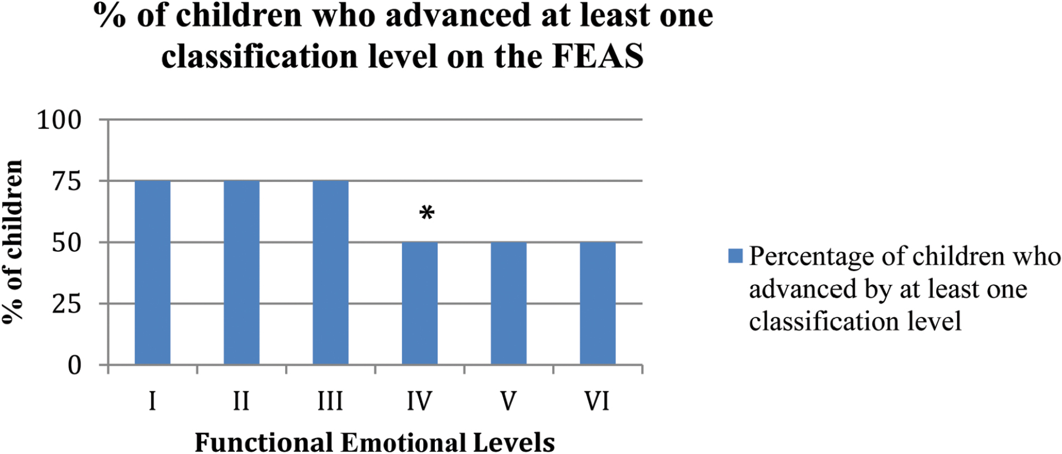
Figure 1. Percentage of children who advanced at least one classification level on the FEAS. * 50% of the children ...
Notes:
Figure 1. Percentage of children who advanced at least one classification level on the FEAS. * 50% of the children scored “normal” at pre-test in area IV and maintained a score of “normal” at pre-test Thus, all of children (100%) scored “normal” at post-test in level IV.
Unless provided in the caption above, the following copyright applies to the content of this slide: © the American Music Therapy Association 2016. All rights reserved. For permissions, please e-mail: journals.permissions@oup.com

Slide 2
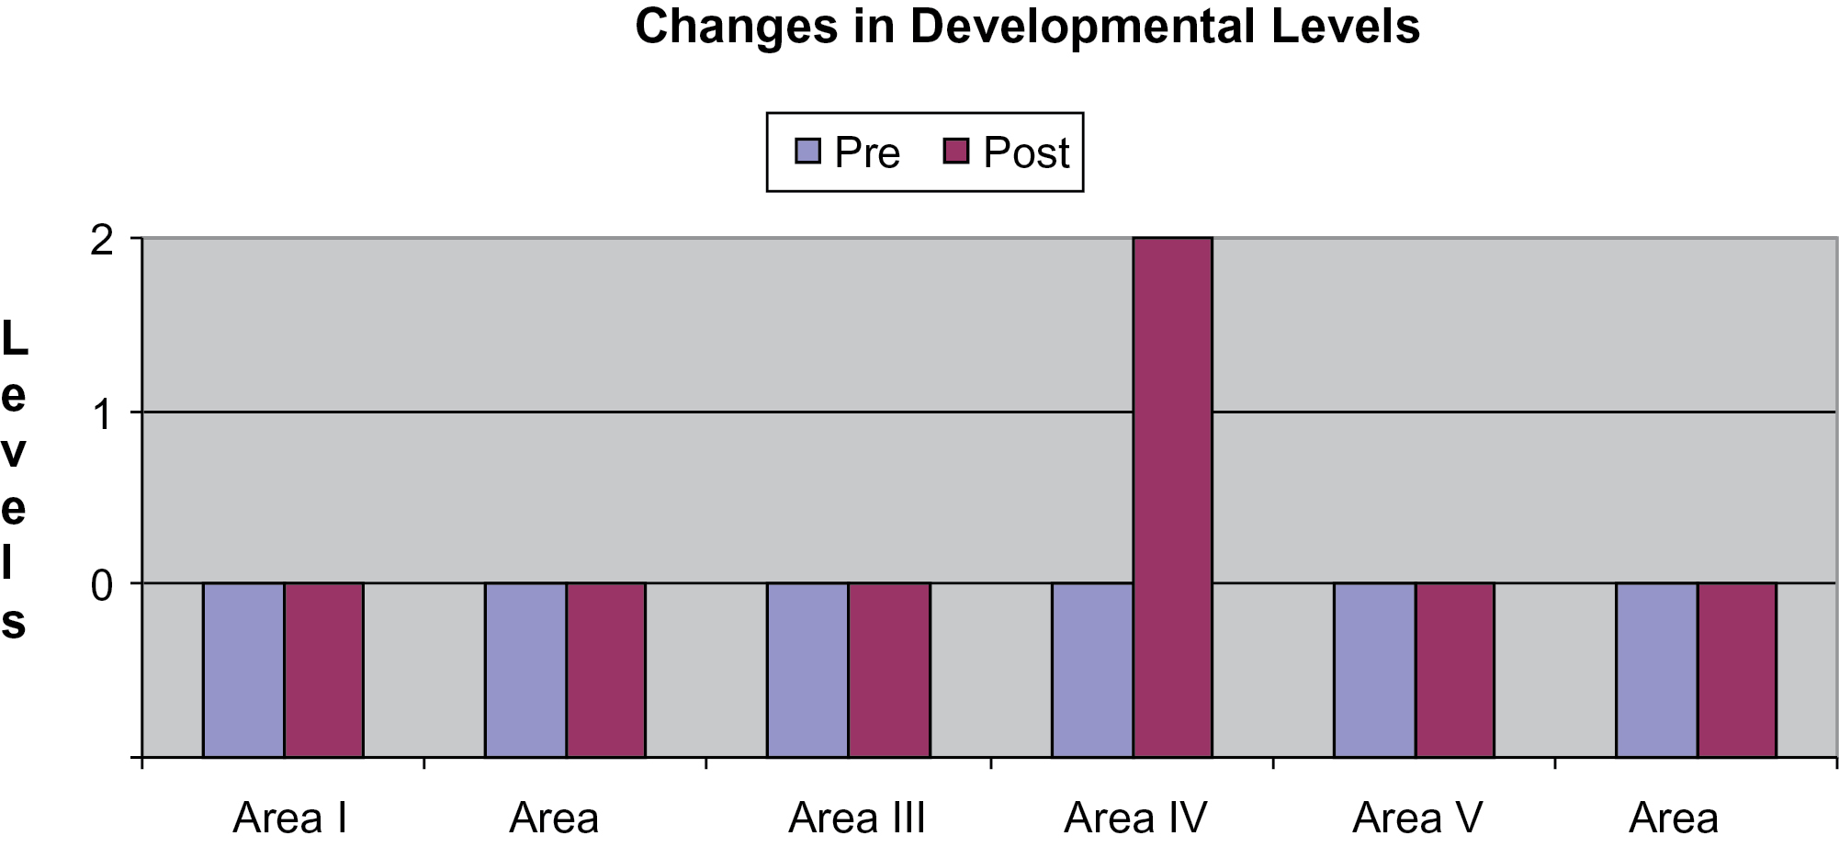
Figure 2. Kyle’s changes in developmental levels.
Notes:
Figure 2. Kyle’s changes in developmental levels.
Unless provided in the caption above, the following copyright applies to the content of this slide: © the American Music Therapy Association 2016. All rights reserved. For permissions, please e-mail: journals.permissions@oup.com

Slide 3
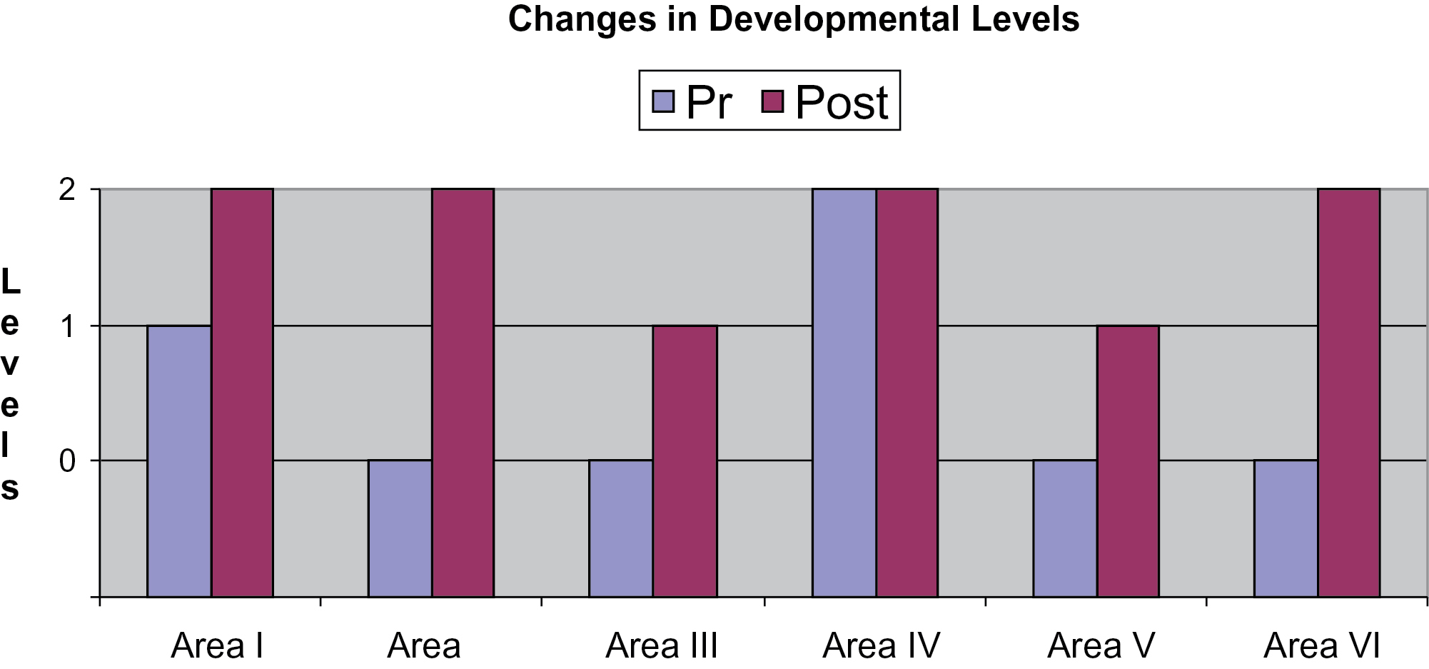
Figure 3. Elaine’s changes in developmental levels.
Notes:
Figure 3. Elaine’s changes in developmental levels.
Unless provided in the caption above, the following copyright applies to the content of this slide: © the American Music Therapy Association 2016. All rights reserved. For permissions, please e-mail: journals.permissions@oup.com

Slide 4
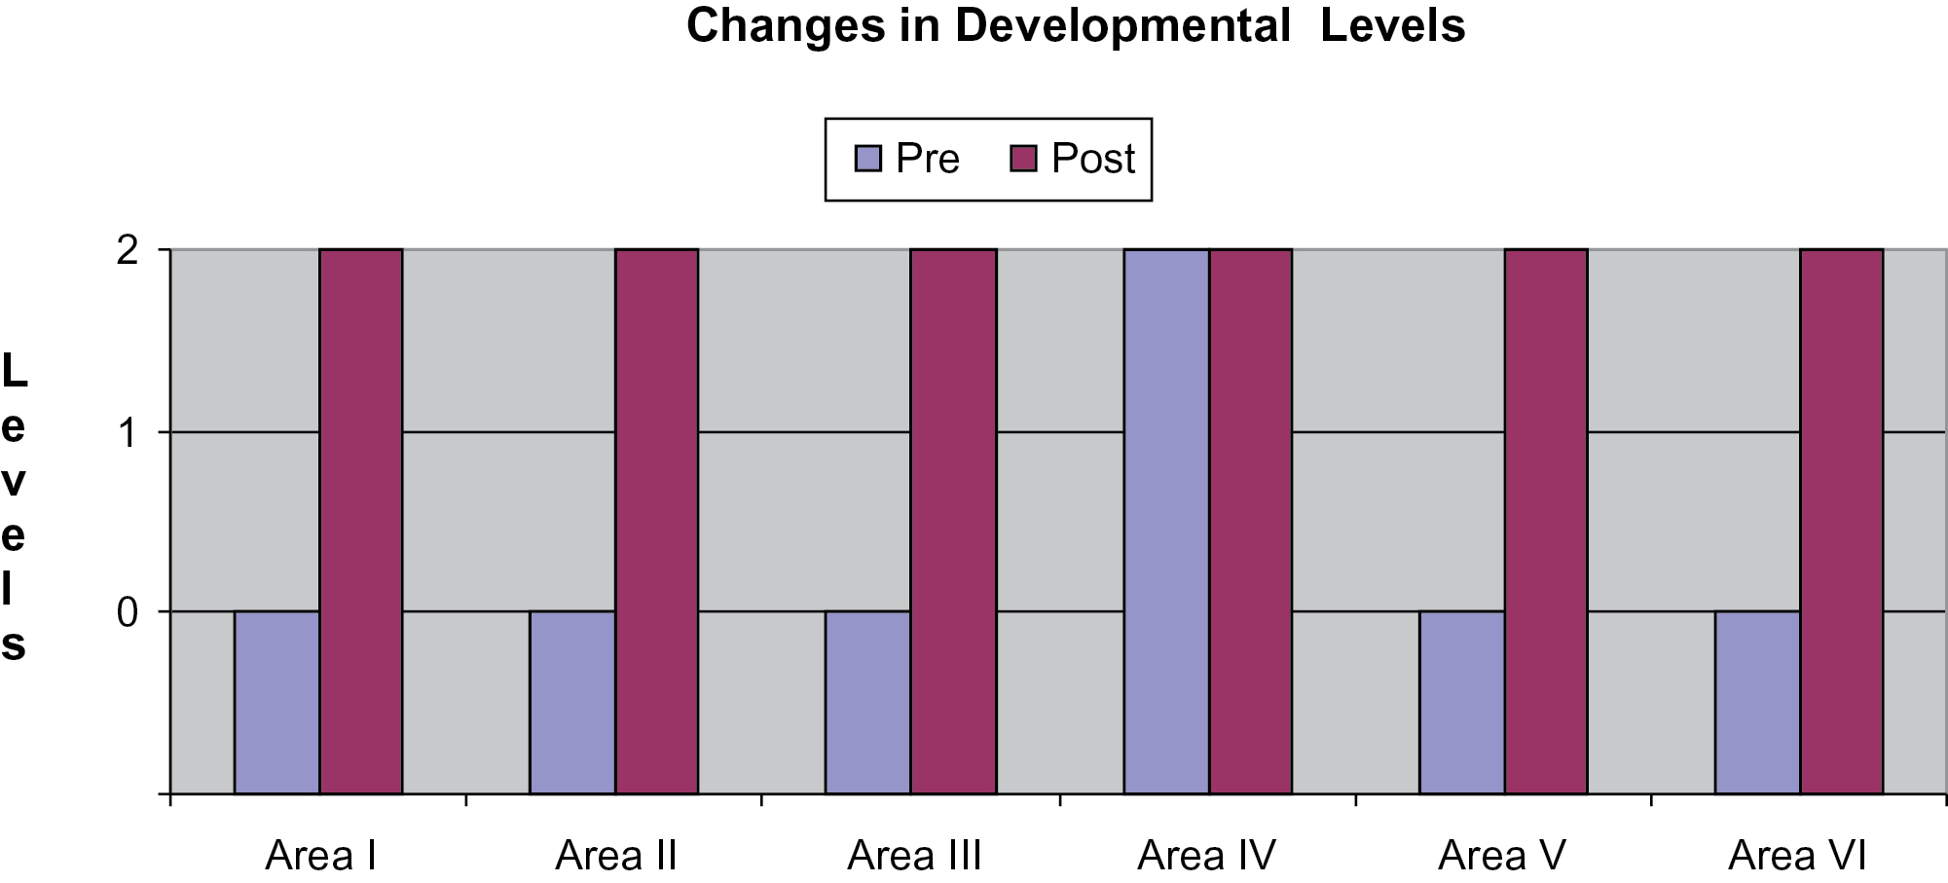
Figure 4. Anthony’s changes in developmental levels.
Notes:
Figure 4. Anthony’s changes in developmental levels.
Unless provided in the caption above, the following copyright applies to the content of this slide: © the American Music Therapy Association 2016. All rights reserved. For permissions, please e-mail: journals.permissions@oup.com

Slide 5
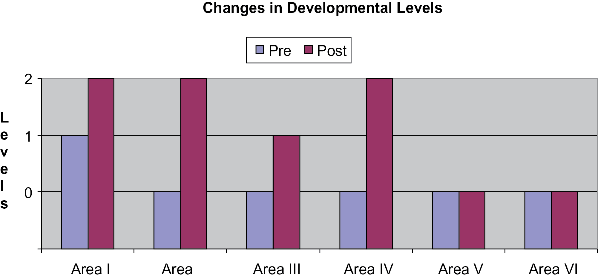
Figure 5. Michele’s changes in developmental levels.
Notes:
Figure 5. Michele’s changes in developmental levels.
Unless provided in the caption above, the following copyright applies to the content of this slide: © the American Music Therapy Association 2016. All rights reserved. For permissions, please e-mail: journals.permissions@oup.com

