Slide 1
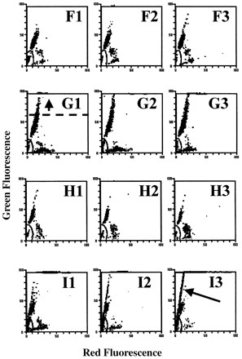
Figure 1. Sperm chromatin structure assay (SCSA)-derived cytograms, showing green (normal double-stranded DNA) versus ...
Notes:
Figure 1. Sperm chromatin structure assay (SCSA)-derived cytograms, showing green (normal double-stranded DNA) versus red (denatured single-stranded DNA) fluorescence of 5000 acridine orange-stained spermatozoa from semen obtained from nine representative couples from Study I. Each couple shows a specific fertility/infertility characteristic or trait as measured by the SCSA. A = pregnancy, excellent quality, highly repeatable; B = pregnancy month 1, uncharacteristically unrepeatable; C = miscarriage, highly repeatable; D = pregnancy month 3, improved quality; E = not pregnant, highly repeatable; F = pregnancy month 5, highly repeatable; G = not pregnant, moderate quality, increased HGRN, highly repeatable; H = occult pregnancy, repeatable; I = not pregnant, repeatable. COMP = cells outside the main population. Arrows: E1, indicates COMP; G1, indicates HGRN threshold; I3, indicates presence of bacteria.
Unless provided in the caption above, the following copyright applies to the content of this slide: © European Society of Human Reproduction and Embryology

Slide 2
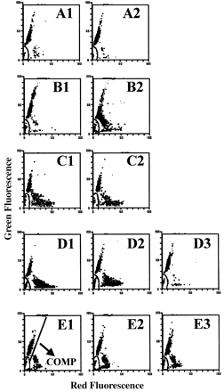
Figure 1. Sperm chromatin structure assay (SCSA)-derived cytograms, showing green (normal double-stranded DNA) versus ...
Notes:
Figure 1. Sperm chromatin structure assay (SCSA)-derived cytograms, showing green (normal double-stranded DNA) versus red (denatured single-stranded DNA) fluorescence of 5000 acridine orange-stained spermatozoa from semen obtained from nine representative couples from Study I. Each couple shows a specific fertility/infertility characteristic or trait as measured by the SCSA. A = pregnancy, excellent quality, highly repeatable; B = pregnancy month 1, uncharacteristically unrepeatable; C = miscarriage, highly repeatable; D = pregnancy month 3, improved quality; E = not pregnant, highly repeatable; F = pregnancy month 5, highly repeatable; G = not pregnant, moderate quality, increased HGRN, highly repeatable; H = occult pregnancy, repeatable; I = not pregnant, repeatable. COMP = cells outside the main population. Arrows: E1, indicates COMP; G1, indicates HGRN threshold; I3, indicates presence of bacteria.
Unless provided in the caption above, the following copyright applies to the content of this slide: © European Society of Human Reproduction and Embryology

