Slide 1
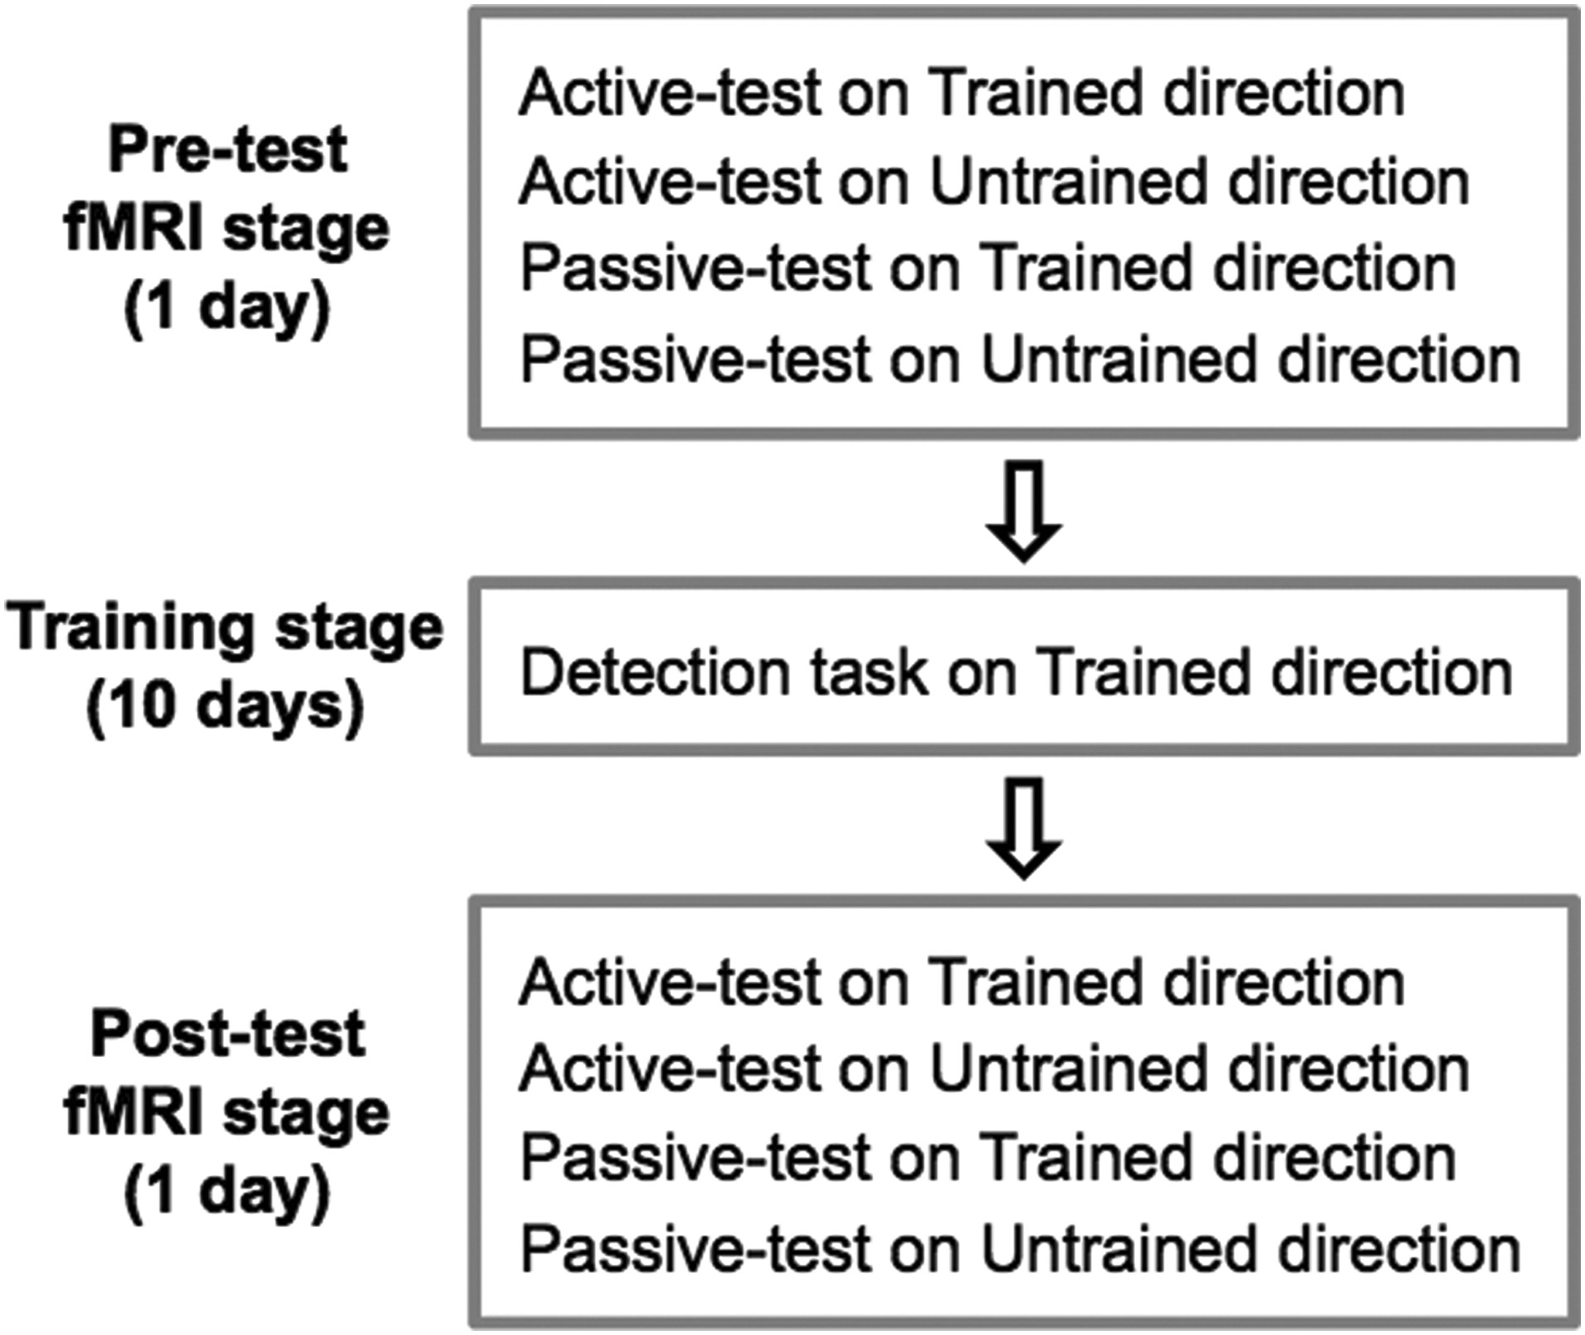
Figure 1. Experimental design. The complete experiment consisted of 3 stages: pre-test fMRI (1 day), training (10 ...
Notes:
Figure 1. Experimental design. The complete experiment consisted of 3 stages: pre-test fMRI (1 day), training (10 days), and post-test fMRI (1 day) stages. In the training stage, subjects were trained on a motion detection task on a particular motion direction (trained direction). In the pre- and post-test fMRI stages, the same group of subjects participated in all 4 different conditions during each of which fMRI responses to the motion stimuli were measured.
Unless provided in the caption above, the following copyright applies to the content of this slide: © The Author 2016. Published by Oxford University Press.This is an Open Access article distributed under the terms of the Creative Commons Attribution Non-Commercial License (http://creativecommons.org/licenses/by-nc/4.0/), which permits non-commercial re-use, distribution, and reproduction in any medium, provided the original work is properly cited. For commercial re-use, please contact journals.permissions@oup.com

Slide 2
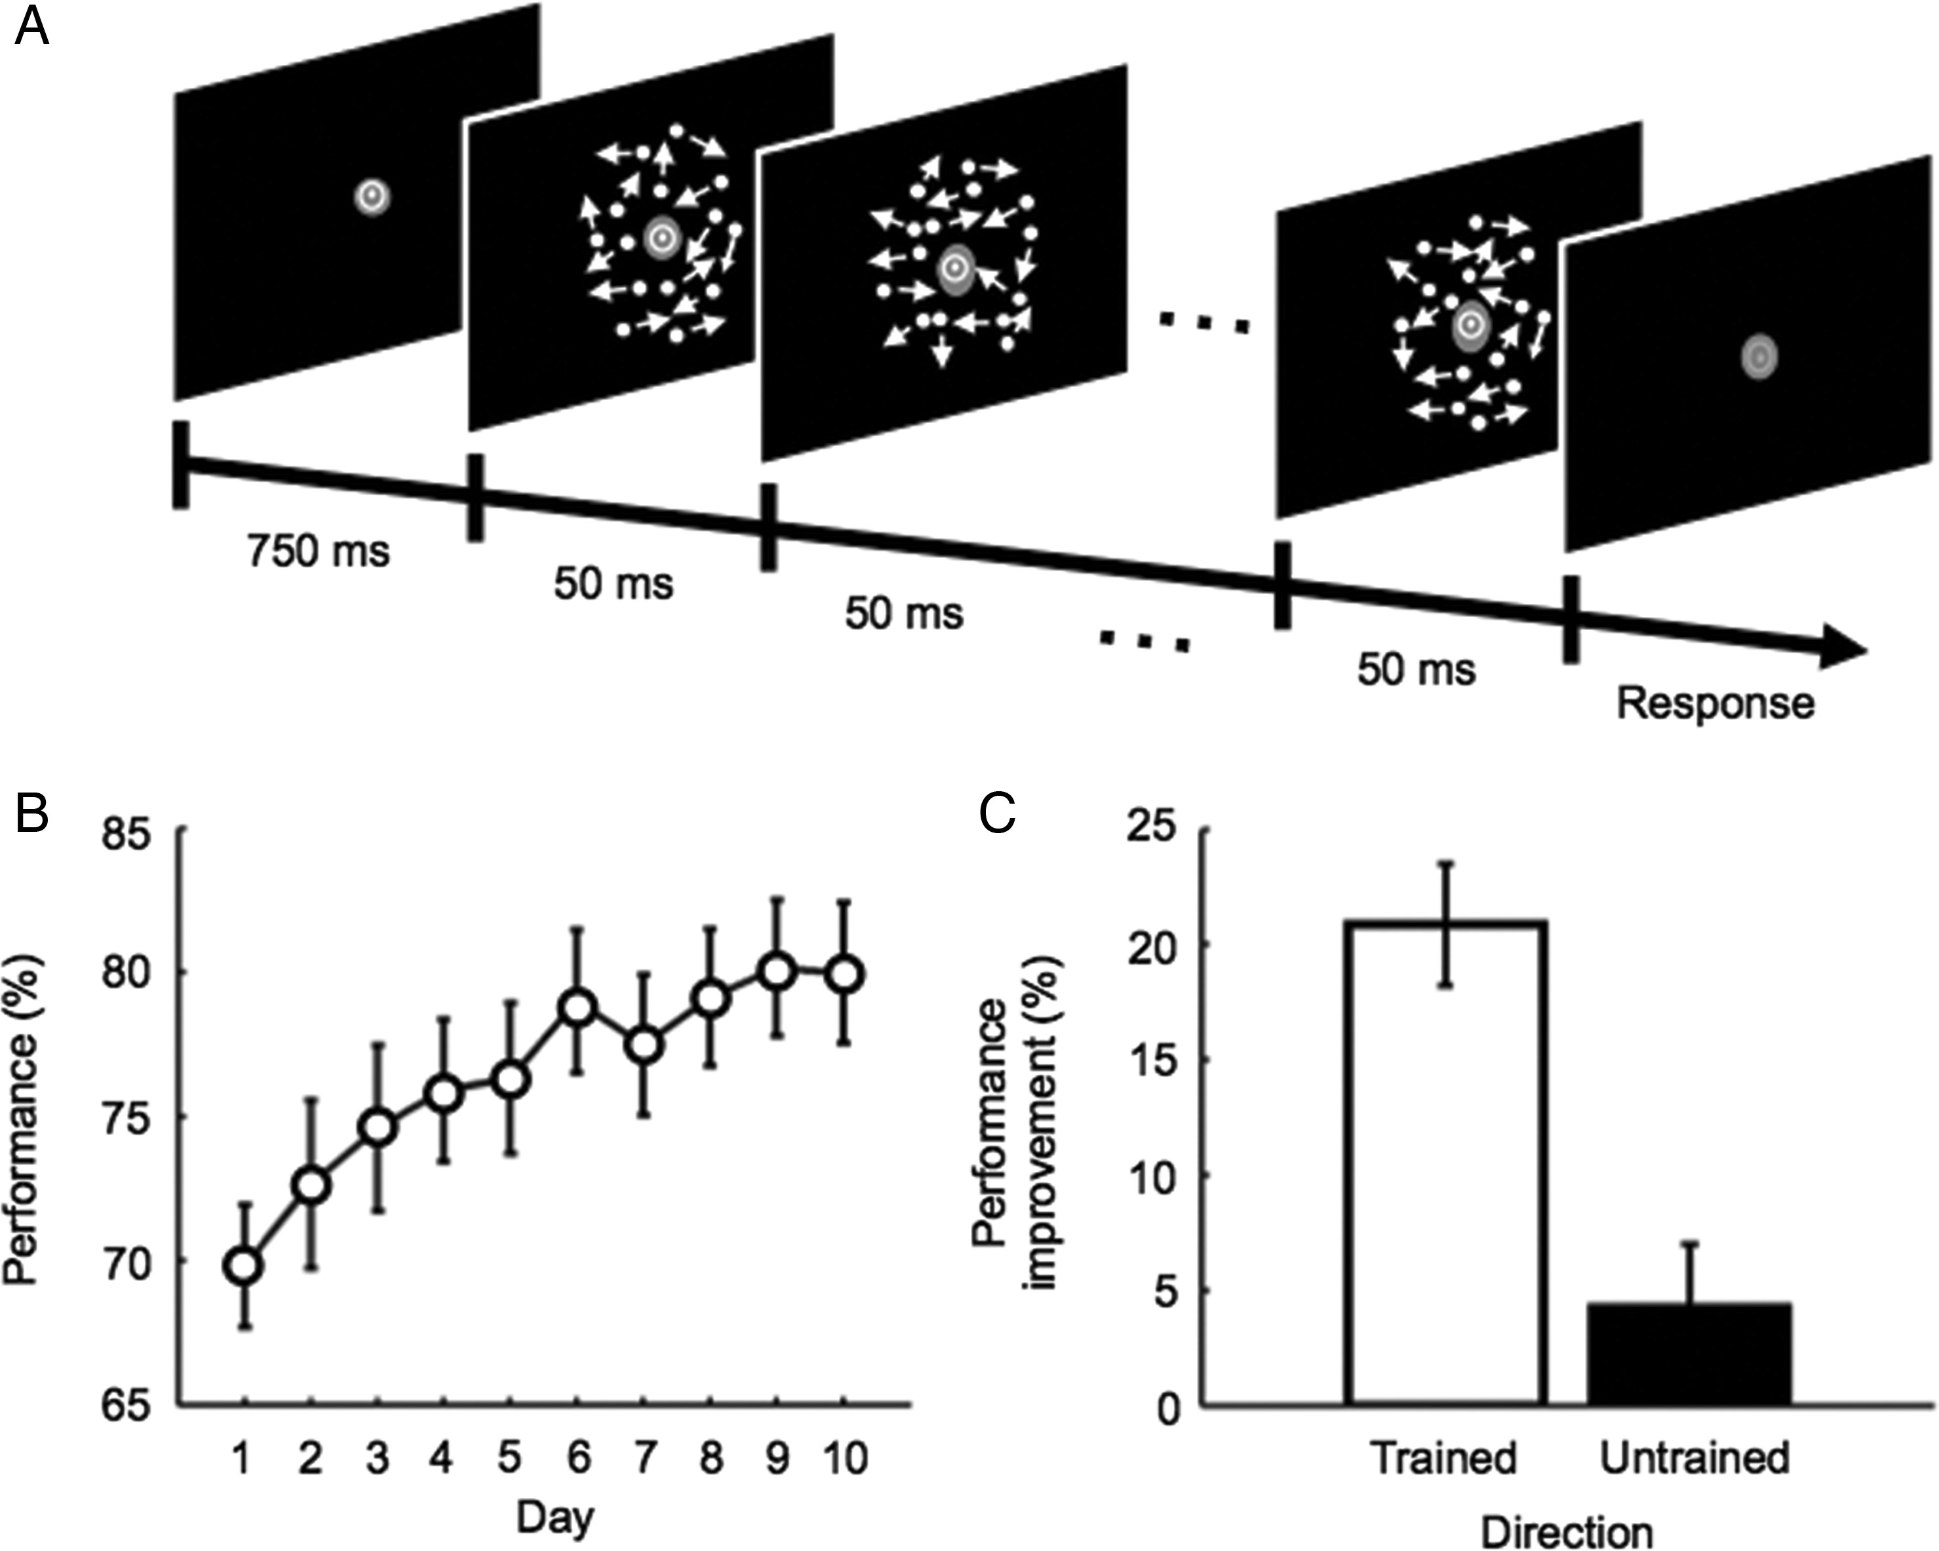
Figure 2. Motion detection task and behavioral results. (A) Example of the time-course of a trial in the training ...
Notes:
Figure 2. Motion detection task and behavioral results. (A) Example of the time-course of a trial in the training stage. Subjects were asked to report whether coherent motion in a particular direction was presented or not. (B) Mean (±SEM) behavioral performance across subjects for the trained direction during the training stage. (C) Mean (±SEM) behavioral performance improvement across subjects in the motion detection task for the trained (white bar) and untrained (black bar) directions from the pre- to post-test fMRI stages.
Unless provided in the caption above, the following copyright applies to the content of this slide: © The Author 2016. Published by Oxford University Press.This is an Open Access article distributed under the terms of the Creative Commons Attribution Non-Commercial License (http://creativecommons.org/licenses/by-nc/4.0/), which permits non-commercial re-use, distribution, and reproduction in any medium, provided the original work is properly cited. For commercial re-use, please contact journals.permissions@oup.com

Slide 3
Figure 3. (A) Mean (±SEM) classification performance improvements across subjects for the trained direction from the ...
Notes:
Figure 3. (A) Mean (±SEM) classification performance improvements across subjects for the trained direction from the pre- to post-test fMRI stages for V1, V3A, MT+, and IPS. Red and blue bars represent the classification performance improvements for the active- and passive-test conditions, respectively. (B) Mean (±SEM) classification performance improvements across subjects for the untrained direction from the pre- to post-test fMRI stages for V1, V3A, MT+, and IPS.
Unless provided in the caption above, the following copyright applies to the content of this slide: © The Author 2016. Published by Oxford University Press.This is an Open Access article distributed under the terms of the Creative Commons Attribution Non-Commercial License (http://creativecommons.org/licenses/by-nc/4.0/), which permits non-commercial re-use, distribution, and reproduction in any medium, provided the original work is properly cited. For commercial re-use, please contact journals.permissions@oup.com

