Slide 1
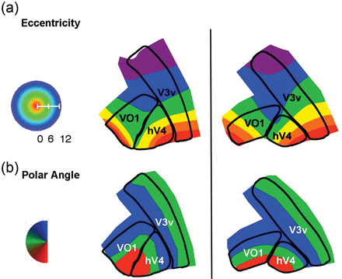
Figure 1. hV4 and VO1 share a polar angle representation but are on different eccentricity representations. Unlike the ...
Notes:
Figure 1. hV4 and VO1 share a polar angle representation but are on different eccentricity representations. Unlike the boundaries between areas V1 and hV4, the boundary between hV4 and VO1 is located at the reversal in eccentricity preference rather than polar angle preference. The shared polar angle representation may be bent such that the eccentricity boundary and the polar angle boundary roughly coincide (left column) or the polar angle representation may be fairly straight (right column). It is worth noting that hV4 does not extend along the entire upper vertical meridian represented in V3v.
Unless provided in the caption above, the following copyright applies to the content of this slide: © The Author 2013. Published by Oxford University Press. All rights reserved. For Permissions, please e-mail: journals.permissions@oup.com

Slide 2
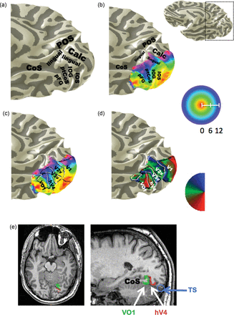
Figure 2. The posterior transverse collateral sulcus divides the confluent and VO eccentricity maps and is the location ...
Notes:
Figure 2. The posterior transverse collateral sulcus divides the confluent and VO eccentricity maps and is the location of the boundary between hV4 and VO1. (a) A ventromedial view of the posterior portion of the right hemisphere with anatomical labels. POS: parietal occipital sulcus; Calc: calcarine sulcus; Ling: lingual sulcus and gyrus; IOS: inferior occipital sulcus; IOG: inferior occipital gyrus; ptCoS: posterior transverse collateral sulcus; pFG: posterior fusiform gyrus; CoS: collateral sulcus. (b) The same hemisphere, but with an unthresholded eccentricity map restricted anatomically to the ventromedial surface of the posterior temporal and occipital lobes. There are 2 clear foveas, the posterior confluent fovea and a more anterior one (VO) located on the fusiform gyrus. Note how the eccentricity bands expanding outward from the 2 foveas “collide” in the ptCoS. (c) Same hemisphere with eccentricity map and boundaries of visual field maps. (d) Polar angle map on same hemisphere with visual field map boundaries. (e) Axial and sagittal views of the brain volume of the same hemisphere. In the axial view, the transverse nature of the sulcus is clearly visible, as is the fact that the visual field maps (hV4: red, VO1: green) lie on opposite sides of the sulcus. The sagittal view shows the collateral sulcus as well as the ptCoS and highlights both the depth of the ptCoS, and the way in which the hV4 and VO1 are wrapped around the neighboring gyri. The blue circle indicates the transverse sinus (TS), showing that it lies fairly distant from the ptCoS.
Unless provided in the caption above, the following copyright applies to the content of this slide: © The Author 2013. Published by Oxford University Press. All rights reserved. For Permissions, please e-mail: journals.permissions@oup.com

Slide 3
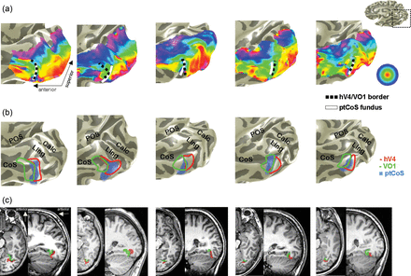
Figure 3. Examples showing boundary of hV4 and VO1 lies within the ptCoS. (a) Five right hemispheres showing the ...
Notes:
Figure 3. Examples showing boundary of hV4 and VO1 lies within the ptCoS. (a) Five right hemispheres showing the unthresholded eccentricity map restricted anatomically to the occipital lobe. In each case, the white line marking the fundus of the ptCoS lies between the confluent and VO foveas. The black dashed line is the boundary of hV4 and VO1. (b) Boundaries of hV4 and VO1 on the labeled anatomies of the same hemispheres with the ptCoS marked in blue gray. (c) Sagittal and axial views of the same hemispheres showing location of hV4 (red) and VO1 (green). In each axial, we illustrate the layout of the ptCoS such that it runs medial to lateral across the ventral surface and that hV4 and VO1 tend to be on opposite sides of the sulcus. The sagittal views show the collateral sulcus and posterior hippocampus for reference and, in some cases, make visible the way in which each of these regions is wrapped around a gyrus.
Unless provided in the caption above, the following copyright applies to the content of this slide: © The Author 2013. Published by Oxford University Press. All rights reserved. For Permissions, please e-mail: journals.permissions@oup.com

Slide 4
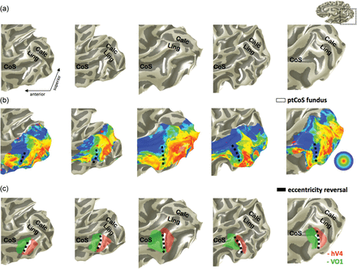
Figure 4. The location of the hV4/VO1 boundary can be reliably predicted from the anatomy alone. (a) Ventromedial views ...
Notes:
Figure 4. The location of the hV4/VO1 boundary can be reliably predicted from the anatomy alone. (a) Ventromedial views of the right hemisphere in 5 subjects from test set 2. The white line represents NW's marking of the location of the fundus of the ptCoS before viewing the retinotopic data. (b) The same subjects as shown in (a). In each case, 2 foveas are visible. The black line is eccentricity reversal as marked by KGS before seeing the ptCoS markings in (a). (c) The same subjects and view as in (a) and (b), with hV4 (red) and VO1 (green) which were defined using the model in Figure 1. NW's marking of the ptCoS and KGS's marking of the eccentricity reversal are shown superimposed on these visual areas.
Unless provided in the caption above, the following copyright applies to the content of this slide: © The Author 2013. Published by Oxford University Press. All rights reserved. For Permissions, please e-mail: journals.permissions@oup.com

