Slide 1
Figure 1. The 3-choice action-selection task. The first and last trial in this example sequence are types of specified ...
Notes:
Figure 1. The 3-choice action-selection task. The first and last trial in this example sequence are types of specified trials, in which the finger to press is indicated by a black opaque circle. The second and third are examples of action-selection trials in which the subject can select any 1 of the 3 options highlighted by the black circles. In the second trial illustrated, there is the option to repeat a response. A repeat action-selection trial would occur if in the second trial the index finger is selected. Conversely, if in the second trial the ring finger was selected, this would be a “repeat-reject” trial, since the repetition was available but not used. A non-repeat action-selection trial would occur in trial 3, if in the second trial the index finger was selected, as this option is not available in trial 3.
Unless provided in the caption above, the following copyright applies to the content of this slide: © The Authors 2012. Published by Oxford University Press.This is an Open Access article distributed under the terms of the Creative Commons Attribution Non-Commercial License (http://creativecommons.org/licenses/by-nc/2.5), which permitsunrestricted non-commercial use, distribution, and reproduction in any medium, provided the original work is properly cited.

Slide 2
Figure 2. (A) Reaction times for repeat, repeat-reject and non-repeat trials in the specified and action-selection ...
Notes:
Figure 2. (A) Reaction times for repeat, repeat-reject and non-repeat trials in the specified and action-selection conditions for patients and controls. Patient reaction times are slower than for controls, and their repeat trials are faster than the trials in which an alternative response was selected. (B) The proportion of repetitive responses (in trials where a repetition was available). At chance, repetitions should be ∼0.33. When “on” dopaminergic medication, patients with less disease severity (lower UPDRS) made more repetitions and this decreased with advancing disease. In contrast, patients “off” medication show a trend of increasing repetitions with increasing disease severity. (C) The difference in patients' repetition rates between sessions (proportion of repetitions when “off” minus proportion when “on”) as a function of disease severity, demonstrating the change in repetition when patients are withdrawn from medication. Patients who have lower UPDRS scores when “on” have a larger reduction in repetition rates when withdrawn from their medication. As UPDRS increases the difference in repetition rates between sessions decreases. At approximately an UPDRS “on” score of 11 points, the change in repetition rates starts to increase, such that those patients who have high UPDRS when “on” have increased repetition rates when withdrawn from medication.
Unless provided in the caption above, the following copyright applies to the content of this slide: © The Authors 2012. Published by Oxford University Press.This is an Open Access article distributed under the terms of the Creative Commons Attribution Non-Commercial License (http://creativecommons.org/licenses/by-nc/2.5), which permitsunrestricted non-commercial use, distribution, and reproduction in any medium, provided the original work is properly cited.

Slide 3
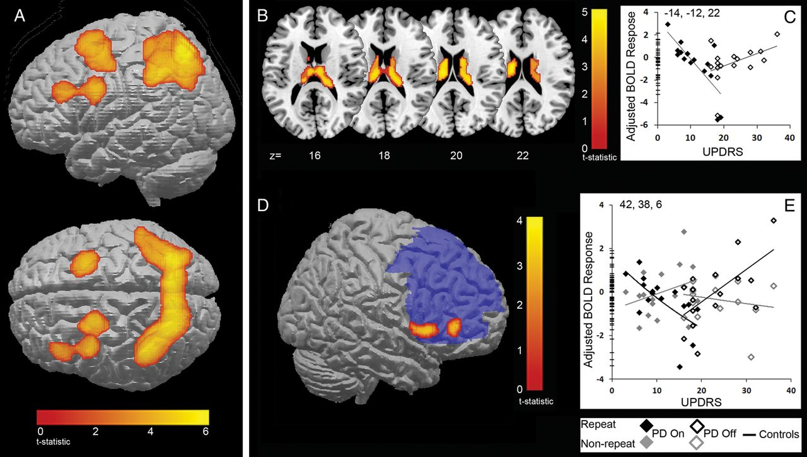
Figure 3. (A) fMRI activity for all action-selection trials compared with all specified trials for all subjects. ...
Notes:
Figure 3. (A) fMRI activity for all action-selection trials compared with all specified trials for all subjects. Activity is within a broad bilateral frontoparietal network. (P < 0.05 FWE cluster correction.) (B to D) Repetition of responses in patients “on” and “off” medication. (B) BOLD activity in the caudate nucleus for repeat action-selection trials versus repeat-specified trials. The activity for patients was linearly related to the UPDRS score (cluster-level FWE P < 0.05). (C) The plot of peak voxels within the caudate (xyz = −14 −12 22) depicts this linear relationship. There is a decrease in BOLD activity with increasing UPDRS in patients “on” medication and an increase in activity with increasing UPDRS in patients “off” medication. (D) BOLD response (red) in ventrolateral PFC for an interaction between repeat action-selection trials versus repeat-specified trials and non-repeat action–selection trials versus non-repeat–specified trials. The activity was significant within a mask of the PFC (blue) (peak voxels FWE P < 0.05). (E) The plot of peak voxels within the ventrolateral PFC (xyz = 42, 38, 6) depicts the interaction of BOLD with UPDRS for both trial types: when repeating actions (black diamonds) patients “on” medication have decreasing activity as UPDRS increases, while patients “off” medication have increasing activity with UPDRS. In non-repeat trials (grey diamonds), the reverse pattern is observed.
Unless provided in the caption above, the following copyright applies to the content of this slide: © The Authors 2012. Published by Oxford University Press.This is an Open Access article distributed under the terms of the Creative Commons Attribution Non-Commercial License (http://creativecommons.org/licenses/by-nc/2.5), which permitsunrestricted non-commercial use, distribution, and reproduction in any medium, provided the original work is properly cited.

