Slide 1
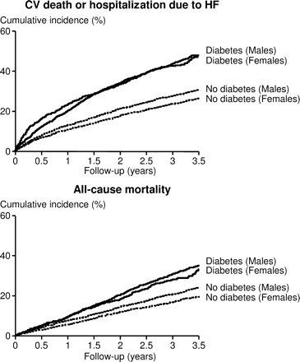
Figure 1 Outcomes in diabetic and non-diabetic patients based on sex. The cumulative incidence of cardiovascular death ...
Notes:
Figure 1 Outcomes in diabetic and non-diabetic patients based on sex. The cumulative incidence of cardiovascular death or heart failure hospitalization and all-cause mortality in diabetic and non-diabetic patient based on sex are shown. CV, cardiovascular; HF, heart failure
Unless provided in the caption above, the following copyright applies to the content of this slide: Published on behalf of the European Society of Cardiology. All rights reserved. © The Author 2008. For permissions please email: journals.permissions@oxfordjournals.org

Slide 2
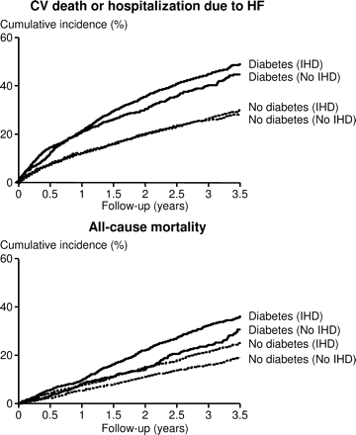
Figure 2 Outcomes in diabetic and non-diabetic patients based on aetiology (ischaemic vs. non-ischaemic). The ...
Notes:
Figure 2 Outcomes in diabetic and non-diabetic patients based on aetiology (ischaemic vs. non-ischaemic). The cumulative incidence of cardiovascular death or heart failure hospitalization and all-cause mortality in diabetic and non-diabetic patients based on aetiology of heart failure are shown. CV, cardiovascular; HF, heart failure; IHD, investigator designated ischaemic heart disease aetiology
Unless provided in the caption above, the following copyright applies to the content of this slide: Published on behalf of the European Society of Cardiology. All rights reserved. © The Author 2008. For permissions please email: journals.permissions@oxfordjournals.org

Slide 3
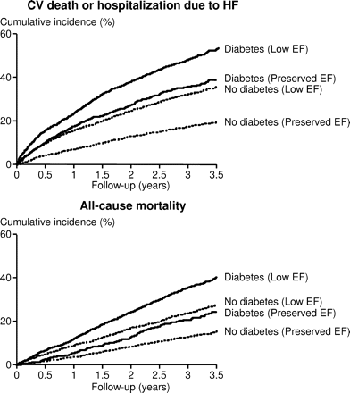
Figure 3 Outcomes in diabetic and non-diabetic patients based on ejection fraction category (low vs. preserved). The ...
Notes:
Figure 3 Outcomes in diabetic and non-diabetic patients based on ejection fraction category (low vs. preserved). The cumulative incidence of cardiovascular death or heart failure hospitalization and all-cause mortality in diabetic and non-diabetic patients based on ejection fraction category. CV, cardiovascular; EF, ejection fraction; HF, heart failure
Unless provided in the caption above, the following copyright applies to the content of this slide: Published on behalf of the European Society of Cardiology. All rights reserved. © The Author 2008. For permissions please email: journals.permissions@oxfordjournals.org

Slide 4
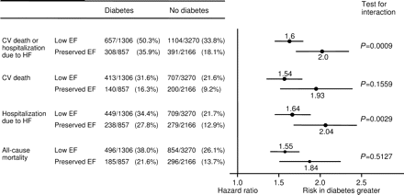
Figure 4 Risk of different outcomes associated with diabetes. Hazard ratios shown are adjusted for 32 baseline ...
Notes:
Figure 4 Risk of different outcomes associated with diabetes. Hazard ratios shown are adjusted for 32 baseline co-variates. Horizontal bars represent the 95% confidence intervals. CV, cardiovascular; EF, ejection fraction; HF, heart failure
Unless provided in the caption above, the following copyright applies to the content of this slide: Published on behalf of the European Society of Cardiology. All rights reserved. © The Author 2008. For permissions please email: journals.permissions@oxfordjournals.org

