Slide 1
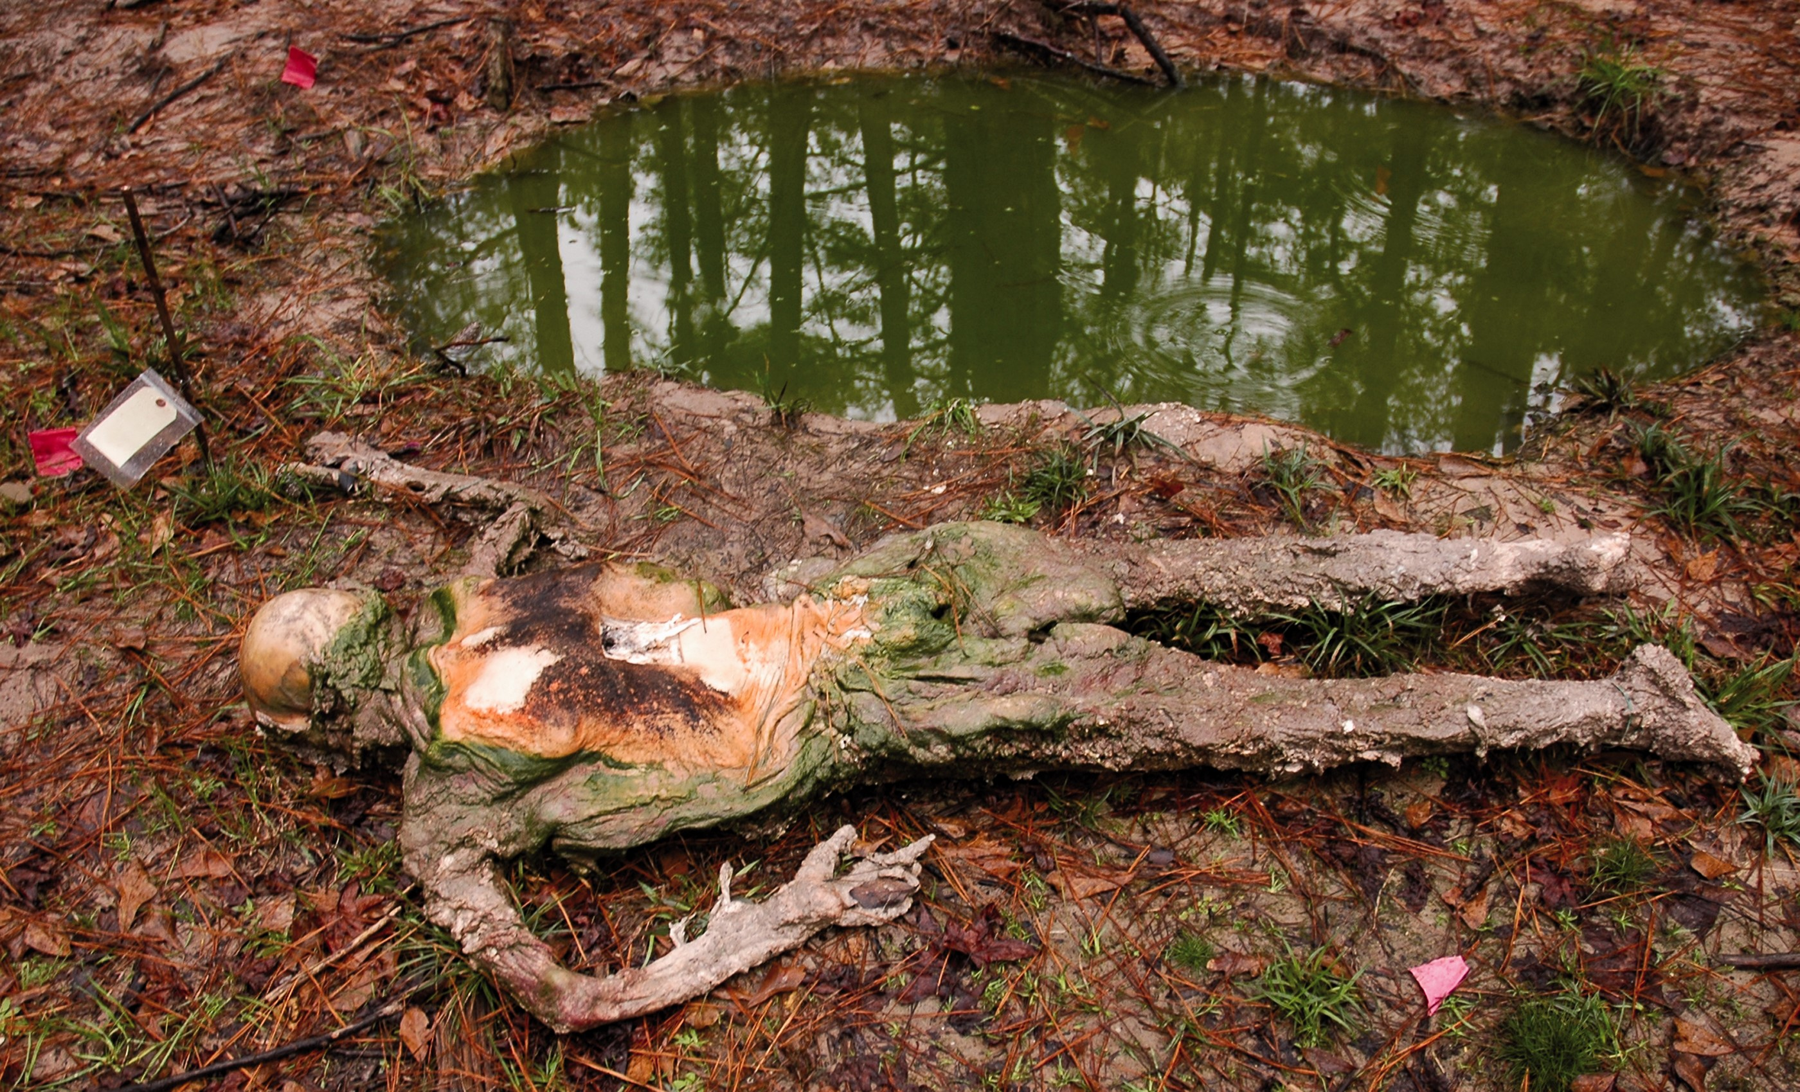
Fig. 1. Cadaver STAFS2009-003 removed from rain-filled grave. Crumbly adipocere present on legs, buttocks, and arms. ...
Notes:
Fig. 1. Cadaver STAFS2009-003 removed from rain-filled grave. Crumbly adipocere present on legs, buttocks, and arms. Green algal ring present around back, buttocks, and shoulders.
Unless provided in the caption above, the following copyright applies to the content of this slide: © The Author 2015. Published by Oxford University Press on behalf of Entomological Society of America. All rights reserved. For Permissions, please e-mail: journals.permissions@oup.com

Slide 2
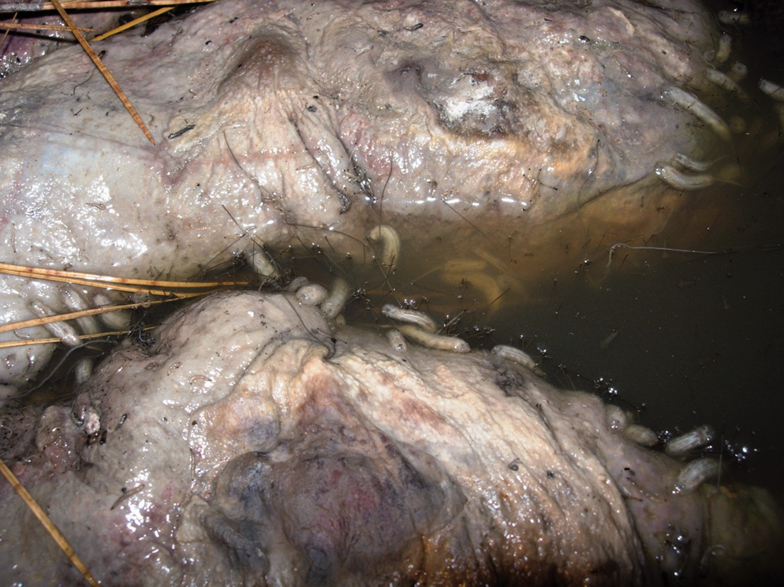
Fig. 2. Eristalis arbustorum maggots feeding in between buttocks, STAFS2009-003.
Notes:
Fig. 2. Eristalis arbustorum maggots feeding in between buttocks, STAFS2009-003.
Unless provided in the caption above, the following copyright applies to the content of this slide: © The Author 2015. Published by Oxford University Press on behalf of Entomological Society of America. All rights reserved. For Permissions, please e-mail: journals.permissions@oup.com

Slide 3
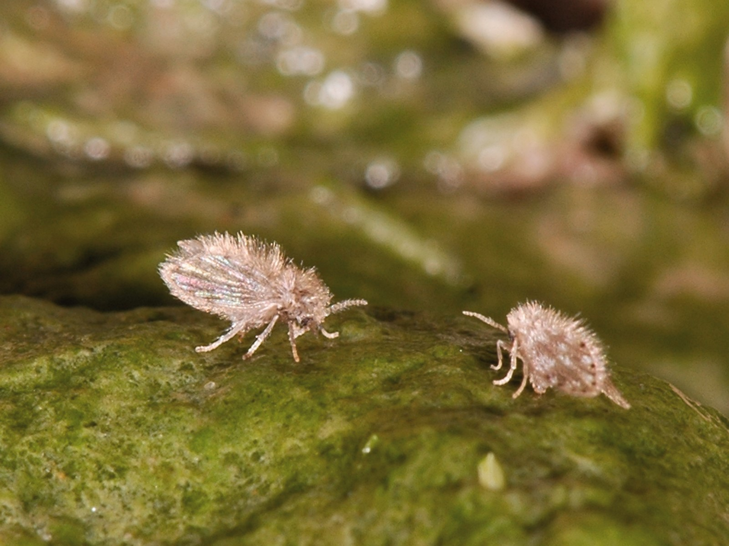
Fig. 3. Psychoda alternata inserting ovipositors into algal film on skin, STAFS2009-003.
Notes:
Fig. 3. Psychoda alternata inserting ovipositors into algal film on skin, STAFS2009-003.
Unless provided in the caption above, the following copyright applies to the content of this slide: © The Author 2015. Published by Oxford University Press on behalf of Entomological Society of America. All rights reserved. For Permissions, please e-mail: journals.permissions@oup.com

Slide 4
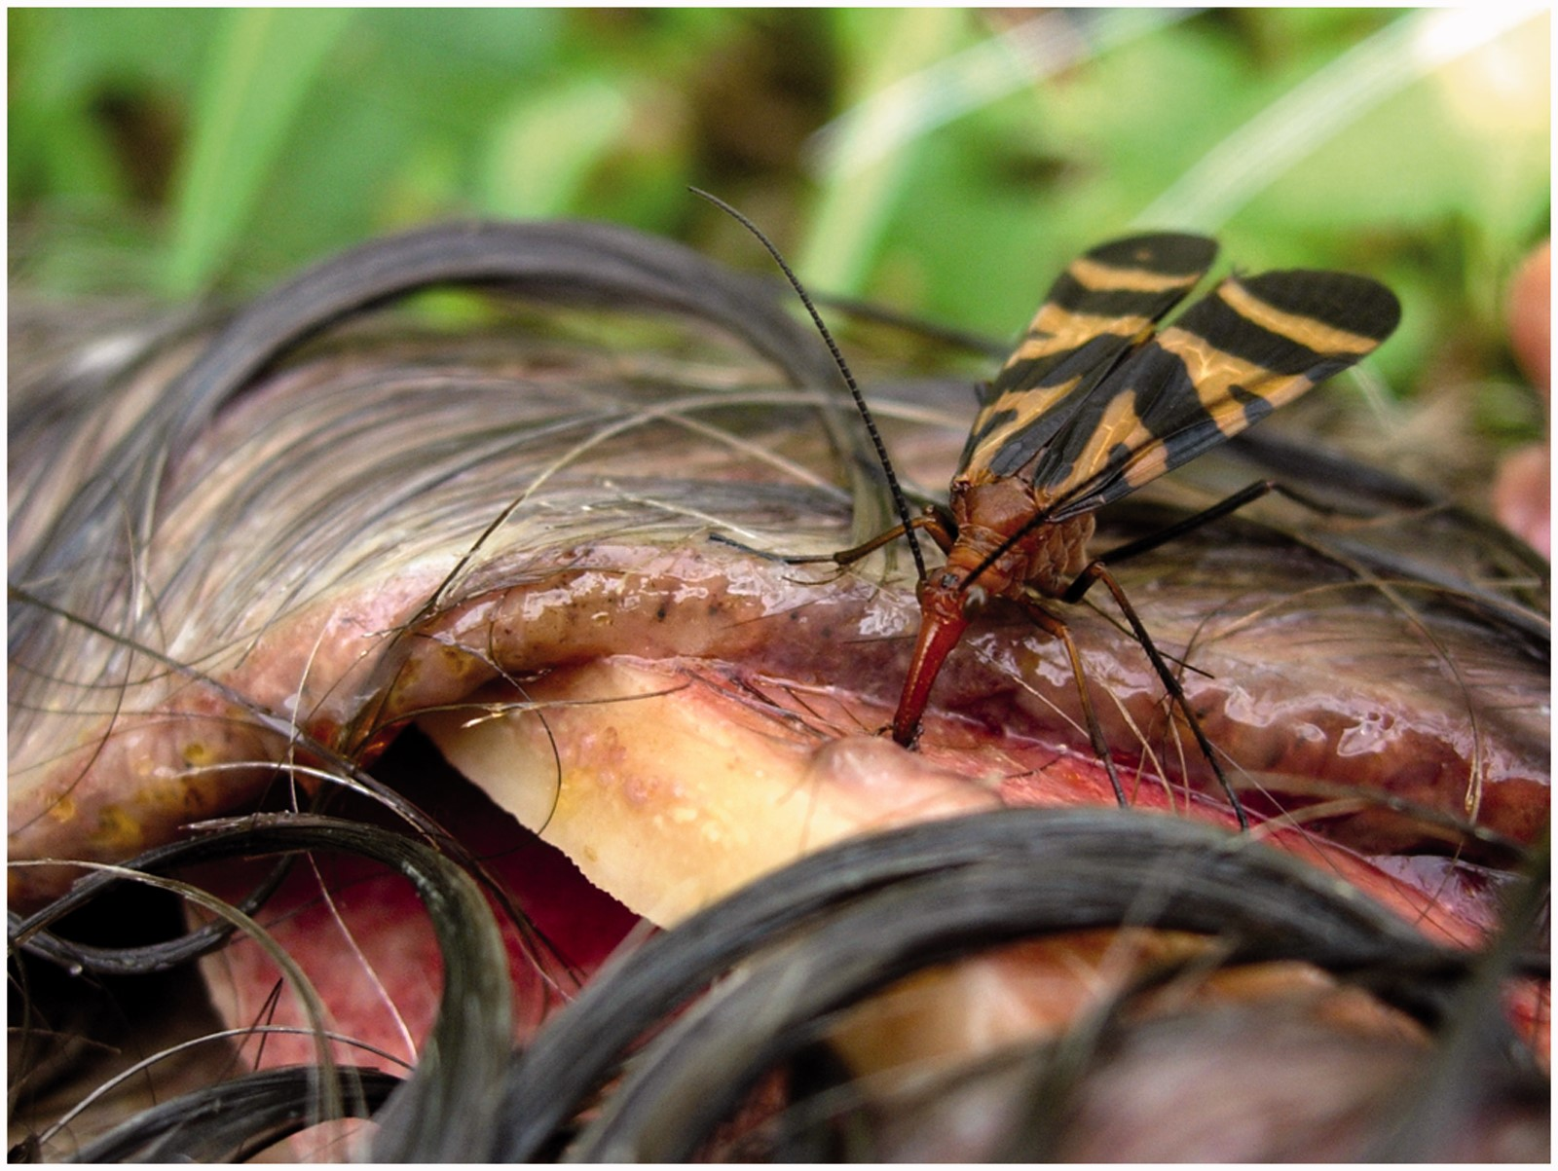
Fig. 4. Panorpa nuptialis feeding on scalp fluids from autopsy incisions, STAFS2009-007.
Notes:
Fig. 4. Panorpa nuptialis feeding on scalp fluids from autopsy incisions, STAFS2009-007.
Unless provided in the caption above, the following copyright applies to the content of this slide: © The Author 2015. Published by Oxford University Press on behalf of Entomological Society of America. All rights reserved. For Permissions, please e-mail: journals.permissions@oup.com

Slide 5
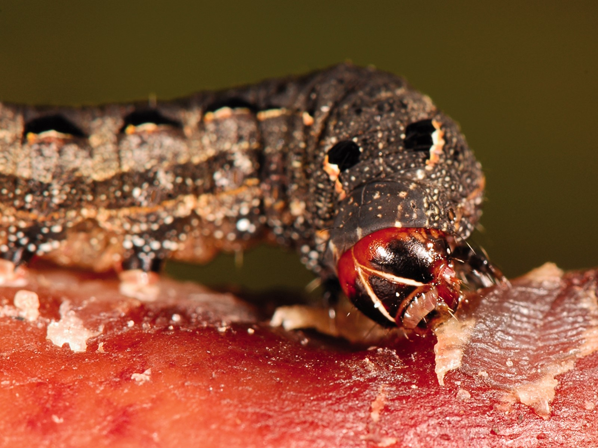
Fig. 5. Spodoptera latifascia ingesting dried skin around where the toe nails were previously located STAFS2009-009.
Notes:
Fig. 5. Spodoptera latifascia ingesting dried skin around where the toe nails were previously located STAFS2009-009.
Unless provided in the caption above, the following copyright applies to the content of this slide: © The Author 2015. Published by Oxford University Press on behalf of Entomological Society of America. All rights reserved. For Permissions, please e-mail: journals.permissions@oup.com

